Slide 1
Diabetes Mellitus
Emad Raddaoui, MD, FCAP, FASC
Associate Professor; Consultant
Histopathology & Cytopathology

Slide 2
Diabetes Mellitus
Sir William Osler defined diabetes mellitus as “a syndrome due to a disturbance in carbohydrate metabolism from various causes, in which sugar appears in the urine, associated with thirst, polyuria, wasting and imperfect oxidation of fats.”

Slide 3
Diabetes Mellitus
Major health problem that affects increasing numbers of persons in the developed world.
Two major forms of diabetes mellitus are recognized, distinguished by their underlying pathophysiology.

Slide 4
Type 1 Diabetes Mellitus Type 2 Diabetes Mellitus
- Diabetes Usually before 20 - Abrupt; symptomatic (polyuria, polydipsia, dehydration); often sever with ketoacidosis Normal weight ; recent weight loss is common -Genetics <20% Monozygotic Twins 50% concordant HLA Association , ABS to islet cell AG + Histopatholog . Early—inflammation . Late—atrophy and fibrosis B-cell mass: Markedly reduced Insulin levels :Markedly reduced | Usually after 30 Gradual; usually subtle Overweight >60% 90% concordant No -Histopathology: Late-Fibrosis, amyloid Normal or slightly reduced Elevated or normal

Slide 5
Management
Type 1 :Insulin absolutely required
Type 2 : lifestyle modification; diet, exercise, oral drugs, often insulin supplement needed

Slide 6
T1DM
Type 1 diabetes mellitus (T1DM), formerly known as insulin-dependent (IDDM)or juvenile-onset diabetes, is caused by autoimmune destruction of the insulin-producing B-cells in the pancreatic islets of Langerhans, and affects less than 10% of all patients with diabetes

Slide 7
Type 2 DM
Type 2 diabetes mellitus, formerly known as non–insulin-dependent(NIDDM)or maturity-onset diabetes, is typically associated with obesity and results from a complex interrelationship between resistance to the metabolic action of insulin in its target tissues and inadequate secretion of insulin from the pancreas

Slide 8
DM, Other Forms
Gestational diabetes develops in a few percent of pregnant women, owing to the insulin resistance of pregnancy combined with a B-cell defect, but almost always abates following parturition.
Diabetes can also occur secondary to other endocrine conditions or drug therapy, especially in patients with Cushing’s syndrome or during treatment with glucocorticoids.

Slide 9
MODY
Maturity-onset diabetes of the young (MODY) :
Rare autosomal dominant form of inherited diabetes.
Associated with a variety of gene defects that affect B-cell function, including glucokinase, an important sensor for glucose metabolism within the B-cell, and several mutations in genes that control the development and function of the B-cells.
Mutations in these genes, however, do not account for the typical prevalent forms ofT2DM.

Slide 10
Criteria for Diagnosis
Fasting plasma glucose level of at least 126 mg/dL or a glucose level above 200 mg/dL taken anytime of day in a patient who typically experienced overt symptoms of polyuria and polydipsia.
A normal fasting plasma glucose level is currently defined as <100 mg/dL
Patients with fasting glucose levels of 100 to 125 mg/dL are considered to have “impaired fasting glucose” and need to be followed closely because they are at high risk of developing diabetes over time.

Slide 11
Type 1 Diabetes Mellitus
Autoimmune destruction of the B cells in the islets of Langerhans.
The disease is characterized by:
few if any functional B cells in the islets of Langerhans and
Extremely limited or nonexistent insulin secretion.
As a result, body fat rather than glucose is preferentially metabolized as a source of energy.
In turn, oxidation of fat overproduces ketone bodies (acetoacetic acid and B-hydroxybutyric acid), which are released into the blood from the liver and lead to metabolic ketoacidosis.

Slide 12
Type 1 Diabetes Mellitus
Hyperglycemia results from unsuppressed hepatic glucose out-put and reduced glucose disposal in skeletal muscle and adipose tissue and leads to glucosuria and dehydration from loss of body water into the urine.
If uncorrected, the progressive acidosis and dehydration ultimately lead to coma and death

Slide 13
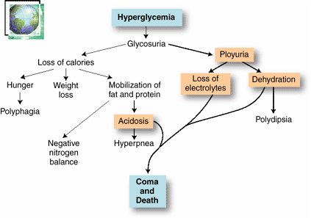

Slide 14
T1DM, EPIDEMIOLOGY
T1DM is most common among northern Europeans and their descendants and is not seen as frequently among Asians, African-Americans, or Native Americans.
Can develop at any age, the peak age of onset coincides with puberty.
Some older patients may present with autoimmune B-cell destruction that has developed slowly over many years.
An increased incidence in late fall and early winter has been documented in many geographical areas.

Slide 15
T1DM ,PATHOGENESIS
1-GENETIC FACTORS:
Fewer than 20% of those with T1DM have a parent or sibling with the disease.
Monozygotic twins : 50% concordant
Environmental factors contribute in a major way to the development of the disease.
Certain genetic factors are important, especially major histocompatibility antigens.
Some 95% of patients with type T1DM have either human leukocyte antigen (HLA)-DR3 or HLA-DR4, or both, compared with 20% of the general population.
Susceptibility to T1DM is associated with the DQ locus.
The children of fathers withT1DM are three times more likely to develop the disease than are children of diabetic mothers

Slide 16
T1DM, PATHOGENESIS
2- AUTOIMMUNITY:
Patients who die shortly after the onset of the disease often exhibit an infiltrate of mononuclear cells in and around the islets of Langerhans, termed insulitis

Slide 17
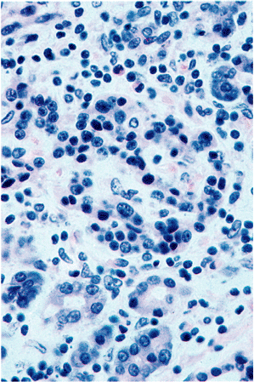
Insulitis

Slide 18
T1DM, Autoimmunity
Cell-mediated immune mechanisms are fundamental to the pathogenesis of T1DM ,CD8 T lymphocytes pre-dominate, although some CD4 cells are also present.
The infiltrating inflammatory cells also elaborate cytokines, for example, IL-1, IL-6, interferon-alpha, and nitric oxide, which may further contribute to B cell injury.
An autoimmune origin for T1DM was initially suggested by the demonstration of circulating antibodies against components of the B cells (including insulin itself) in most newly diagnosed children with diabetes.

Slide 19
T1DM, Autoimmunity
Many patients develop islet cell antibodies months or years before insulin production decreases and clinical symptoms appear.
Detection of serum antibodies to islet cells and certain islet antigens remains a useful clinical tool for differentiating between type 1 and type 2 diabetes
The destruction of B-cells in T1DM generally develops slowly over years .

Slide 20
T1DM , PATHOGENESIS
3- ENVIRONMENTAL FACTORS:
Viruses and chemicals, Mumps and group B Coxsackie, Rubella viruses.
Geographical and seasonal differences in the incidence of T1DM further suggest that environmental factors are important in its pathogenesis.

Slide 21
PATHOLOGY
Lymphocytic infiltrate in the islets (insulitis), sometimes accompanied by a few macrophages and neutrophils
As the disease becomes chronic, the B cells of the islets are progressively depleted of Beta cells
Fibrosis of the islets is uncommon.
In contrast to T2DM, deposition of amyloid in the islets of Langerhans is absent in T1DM.
The exocrine pancreas in chronic T1DM often exhibits diffuse interlobular and interacinar fibrosis, accompanied by atrophy of the acinar cells.

Slide 23
Type 2 DM, Epidemiology
Almost 10%of persons older than 65 years of age are affected, and 80% of patients with T2DM are overweight
Heterogeneous disorder characterized by a combination of reduced tissue sensitivity to insulin and inadequate secretion of insulin from the pancreas.
The disease usually develops in adults, with an increased prevalence in obese persons and in the elderly.

Slide 24
Type 2 DM, Epidemiology
Recently, T2DM has been appearing in increasing numbers in younger adults and adolescents, owing to worsening obesity and lack of exercise in this age group.
Hyperglycemia in T2DM is a failure of the B-cells to meet an increased demand for insulin in the body.

Slide 25
T2 DM, PATHOGENESIS
Complex interplay between underlying resistance to the action of insulin in its metabolic target tissues and reduction in glucose-stimulated insulin secretion.
Progression to overt diabetes in susceptible populations occurs most commonly in patients exhibiting both of these defects

Slide 26
T2 DM, Pathogenesis
1- GENETIC FACTORS:
Multi-factorial
Sixty percent of patients have either a parent or a sibling with the disease.
Among monozygotic twins, both are almost always affected.
No association with genes of the major histocompatibility complex (MHC), as seen in T1DM
The inheritance pattern is complex and thought to be due to multiple interacting susceptibility genes.
Constitutional factors such as obesity (which itself has strong genetic determinants),hypertension, and the amount of exercise influence the phenotypic expression of the disorder

Slide 27
T2 DM, Pathogenesis
2- GLUCOSE METABOLISM:
In a normal person, the extracellular concentration of glucose in fed and fasting states is maintained in a tightly limited range.
This rigid control is mediated by the opposing actions of insulin and glucagon.
Following a carbohydrate-rich meal, absorption of glucose from the gut leads to an increase in blood glucose, which stimulates insulin secretion by the pancreatic B-cells and the consequent insulin-mediated increase in glucose uptake by skeletal muscle and adipose tissue.
At the same time, insulin suppresses hepatic glucose production.

Slide 28
T2 DM, Pathogenesis
3- B-CELL FUNCTION:
Persons with T2DM exhibit impaired B-cell insulin release in response to glucose stimulation
This functional abnormality is specific for glucose, since the B-cells retain the ability to respond to other stimulants, such as amino acids.
B-cell function may also be affected by the chronically elevated plasma levels of free fatty acids that occur in obese persons.

Slide 29
T2 DM , Pathology
No consistent reduction in the number of B-cells
No morphologic lesions of B- cells
In some islets, fibrous tissue accumulates, sometimes to such a degree that they are obliterated.
Islet amyloid is often present particularly in patients over 60 years of age.

Slide 30
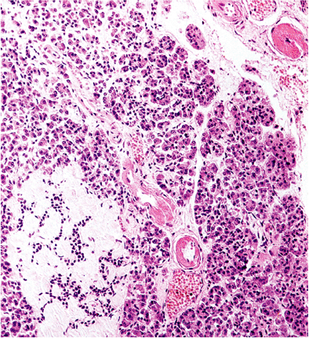

Slide 31
Complications of Diabetes
Diabetic Microvascular Disease:
Responsible for Many of the Complications of Diabetes, Including Renal Failure and Blindness
Arteriolosclerosis and capillary basement membrane thickening are characteristic vascular changes in diabetes.
The frequent occurrence of hypertension contributes to the development of the arteriolar lesions. In addition, deposition of basement membrane proteins, which may also become glycosylated, increases in diabetes.
Aggregation of platelets in smaller blood vessels and impaired fibrinolytic mechanisms have also been suggested as playing a role in the pathogenesis of diabetic microvascular disease.

Slide 32
Complications of Diabetes
Diabetic Microvascular Disease:
The effects of microvascular disease on tissue perfusion and wound healing are profound
Reduce blood flow to the heart, which is already compromised by coronary atherosclerosis.
Healing of chronic ulcers that develop from trauma and infection of the feet in diabetic patients is commonly defective

Slide 33
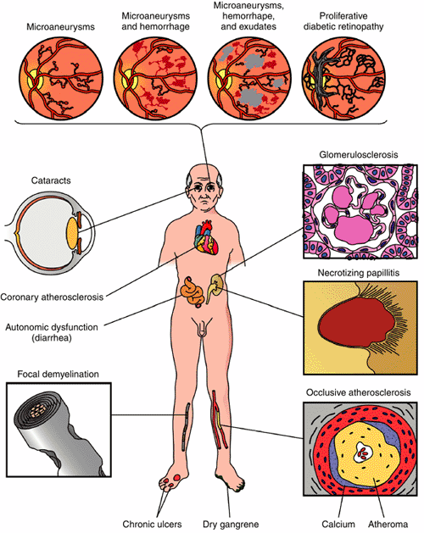

Slide 35
Diabetic Nephropathy
30% to 40% of T1DM ultimately develop renal failure. A somewhat smaller proportion (up to 20%) of patients with T2DM are similarly affected
Diabetic nephropathy accounts for one third of all new cases of renal failure.
The prevalence of diabetic nephropathy increases with the severity and duration of the hyperglycemia.
Kidney disease due to diabetes is the most
common reason for renal transplantation in adults.
The glomeruli in the diabetic kidney exhibit a unique lesion termed Kimmelstiel-Wilson’s disease or nodular glomerulosclerosis

Slide 36
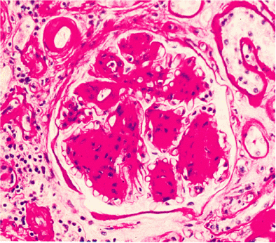

Slide 37
Diabetic Retinopathy
The most devastating ophthalmic complication of diabetes
The most important cause of blindness in the Unites States in persons under the age of 60 years.
The risk is higher in T1DM than in T2DM.
10% of patients with T1DM of 30 years’ duration become legally blind. There are many more patients with T2DM, so these are the most numerous patients with diabetic retinopathy.

Slide 38
Diabetic Neuropathy
Characterized by pain and abnormal sensations in the extremities.
The most common and distressing complications of diabetes.
Microvasculopathy involving the small blood vessels of nerves contributes to the disorder.
Affects Sensory and Autonomic Innervations, Peripheral sensory impairment, and autonomic nerve dysfunction.

Slide 39
Diabetic Neuropathy
Changes in the nerves are complex, and abnormalities in axons, the myelin sheath, and Schwann cells have all been found.
Peripheral neuropathy can leads to foot ulcers.
Plays a role in the painless destructive joint disease that occasionally occur.

Slide 40
Infections
Bacterial and Fungal Infections Occur in Diabetic Hyperglycemia if Poorly Controlled
Renal papillary necrosis may be a devastating complication of bladder infection.
Mucormycosis: A dangerous infectious complication of poorly controlled diabetes is often fatal fungal infection tends to originate in the nasopharynx or paranasal sinuses and spreads rapidly to the orbit and brain.

Slide 41
Gestational diabetes
Diabetes Occurring During Pregnancy
May Put both Mother and Fetus at risk
Develops in only a few percent of seemingly healthy women during pregnancy.
It may continue after parturition in a small proportion of these patients.
Pregnancy is a state of insulin resistance.
These women highly susceptible to overt T2DM later in life.

