Slide 1
Endocrinology (Introduction)
Dr. Hana Alzamil
King Saud University

Slide 2
Introduction
Endocrine vs exocrine gland
Chemical messengers
Hormone
Definition
Chemical structure
Paracrine & autocrine
Transport and clearance
Mechanism of action
Receptors, down-regulation and up-regulation
Intracellular signaling
Second messenger (cAMP, IP3)

Slide 3
introduction
Exocrine gland
Ducts
Lumen and surfaces
Endocrine gland
Chemical messengers
Blood stream

Slide 4
Chemical messengers
The activities of cells, tissues and organs are coordinated by chemical messengers
Neurotransmitters
Endocrine hormones
Neuroendocrine hormones
Paracrines
Autocrines
Cytokines

Slide 7
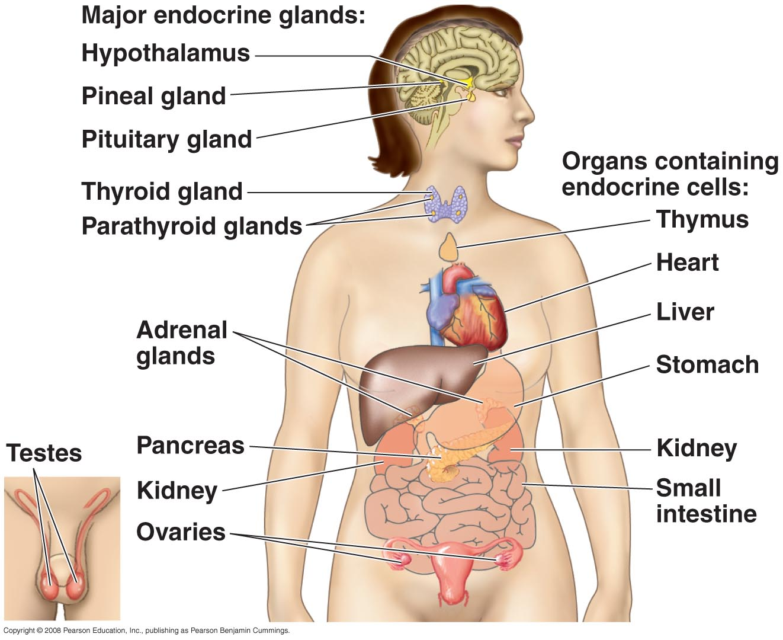
Introduction
Endocrine glands:
Pituitary
Thyroid
Parathyroid
Adrenal
Pancreas
Ovaries
Testes

Slide 8
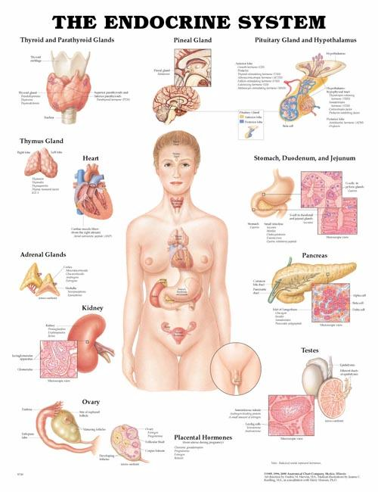

Slide 9
Introduction
The multiple hormone systems play a key role in regulating almost all body functions:
Metabolism
Growth and development
Water and electrolyte balance
Reproduction
Behavior

Slide 10
Introduction
Definition :
Hormone is a chemical substance released by group of cells to control the function of other type of cells.
Types of hormones
Affect many different types of cells (eg. GH and Thyroxin)
Affect only specific target cells (eg. ACTH and estrogen)

Slide 11
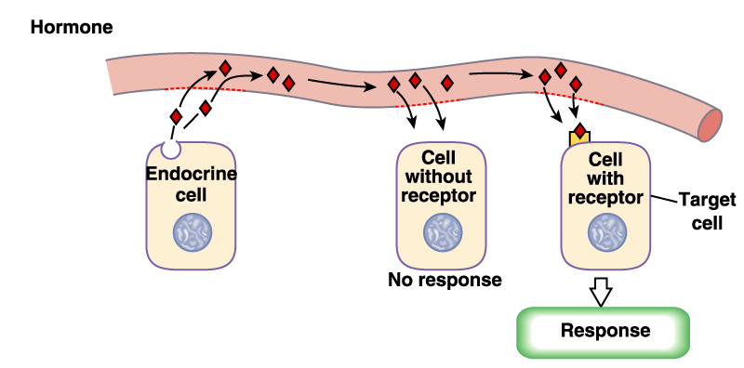
Introduction
What are target cells?
Target cells refer to cells that contain specific receptors (binding sites) for a particular hormone.
Silverthorn, Human Physiology, 3rd edition Figure 6-1&2

Slide 12
Introduction
Chemical structure of hormones
Three general classes of hormones:
Proteins and polypeptides (anterior and posterior pituitary, pancreas and parathyroid hormones) stored in vesicles until needed
Steroids (adrenal cortex, ovarian and testicular hormones) diffuse across the cell membrane
Derivatives of amino acid tyrosine (thyroid hormones and catecholamines)

Slide 13
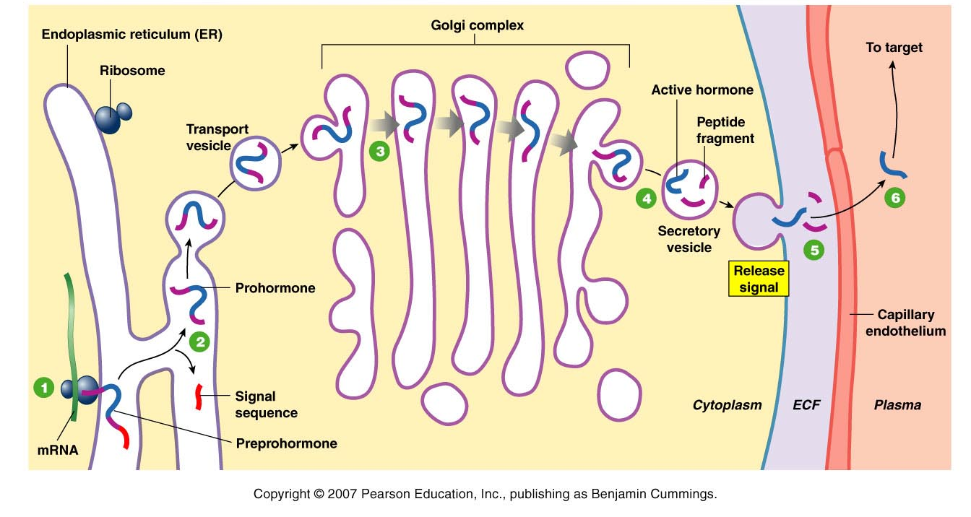
Peptide (Protein) Hormones
Synthesis as preprohormone → post-translational modification to prohormone → then hormone

Slide 14
Peptide (Protein) Hormones
Example of protein hormone
Insulin

Slide 15
Steroid Hormones
Secreted by gonads, adrenals, placenta
Derived from cholesterol (lipophilic)
Cross membranes (no storage)
On-demand synthesis (SER)
Usually Bound to Carrier proteins

Slide 16
Amine Hormones
Derived from tyrosine or tryptophan
3 groups
Tryptophan ⇒ Melatonin
Tyrosine ⇒ Catecholamines behave like peptide hormones
Tyrosine ⇒ Thyroid hormones behave like steroid hormones

Slide 17
Transport of hormones
Water soluble hormones- hydrophilic (peptides & catecholamines) dissolved in plasma
Fat soluble hormones – hydrophobic Steroids and thyroid hormones transported bound to plasma proteins (90%),
binding to proteins helps to
Provide reservoirs
Slow hormones clearance

Slide 18
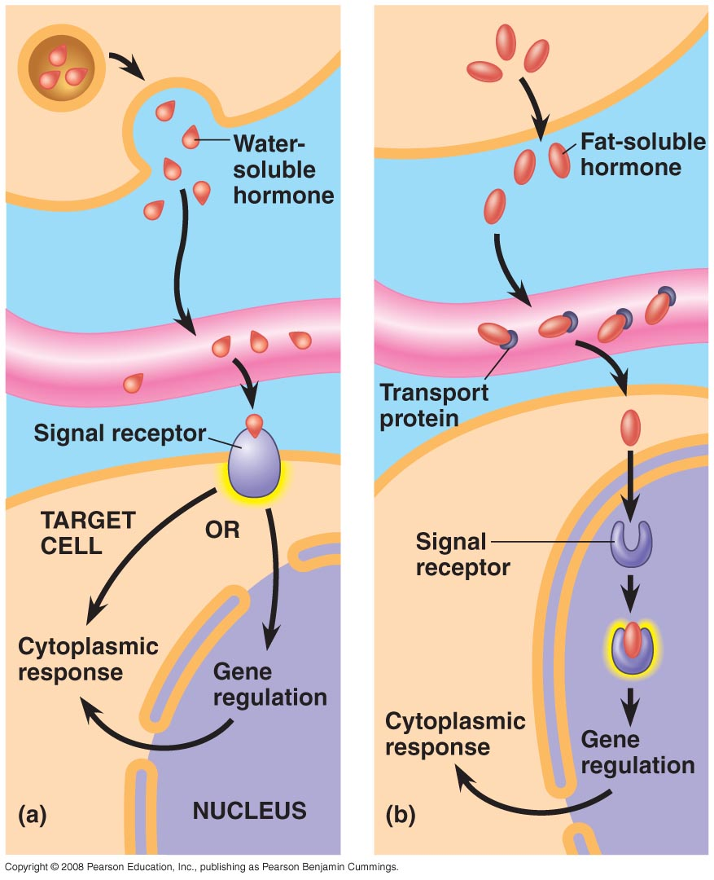
Water and fat soluble hormones

Slide 19
Mechanism of action of hormones
Mechanism of action :
Hormone-receptor interaction (1st messenger)
Enzyme activation
Release of the second messenger
Effects on cellular function

Slide 20
Receptors:
Hormonal receptors are large proteins
2000-100,000 receptors/cell
Receptors are highly specific for a single hormone
Receptor’s Location:
On the surface of cell membrane (proteins, peptides and catecholamines)
In the cell cytoplasm (Steroids)
In the cell nucleus (thyroid hormones)

Slide 21
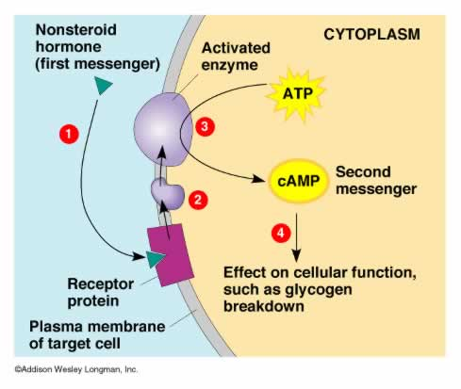
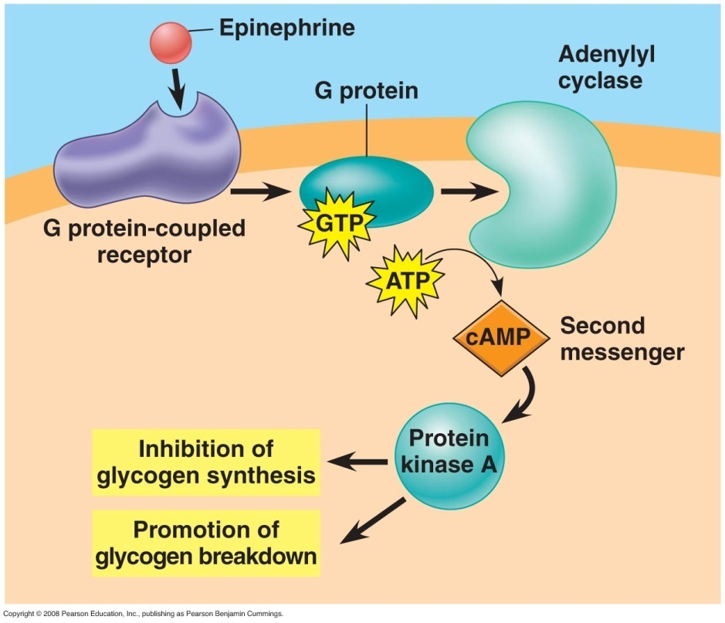
Mechanism of action (peptids and protein hormones)

Slide 22
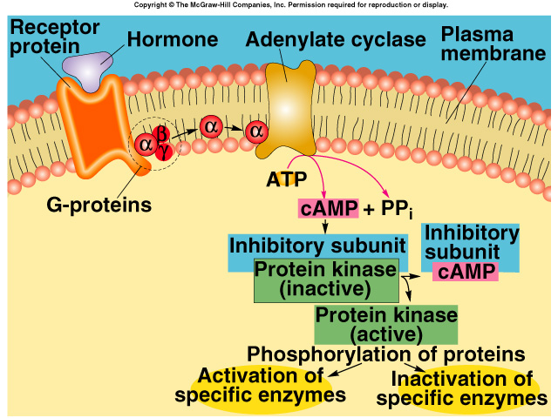
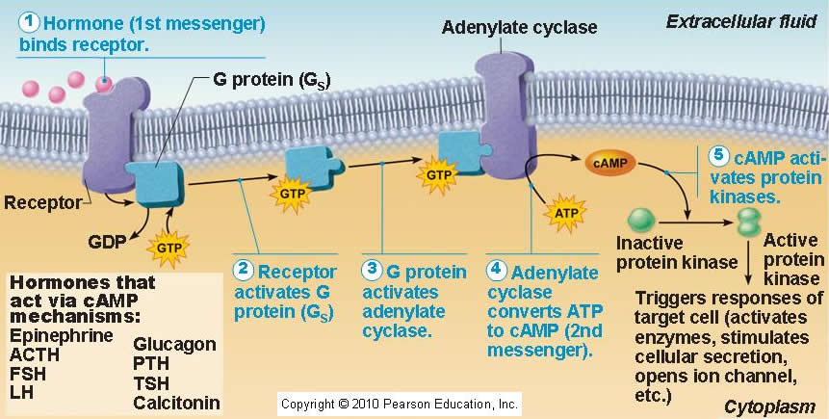
Second messenger (ADYNYLATE CYCLASE-CAMP)

Slide 23
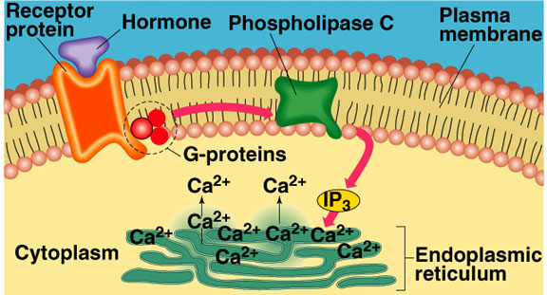
Second messenger (PPOSPHOLIPASE C-ip3)

Slide 24
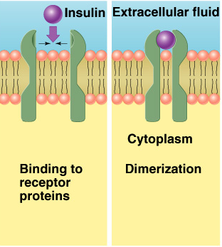
SECOnd Messenger (Tyrosine Kinase System)
Is used by insulin & many growth factors to cause cellular effects
Surface receptor is tyrosine kinase
Consists of 2 units that form active dimer when insulin binds

Slide 25
SECOnd Messenger (Tyrosine Kinase System)
Activated tyrosine kinase phosphorylates signaling molecules
Inducton of hormone/growth factor effects

Slide 26
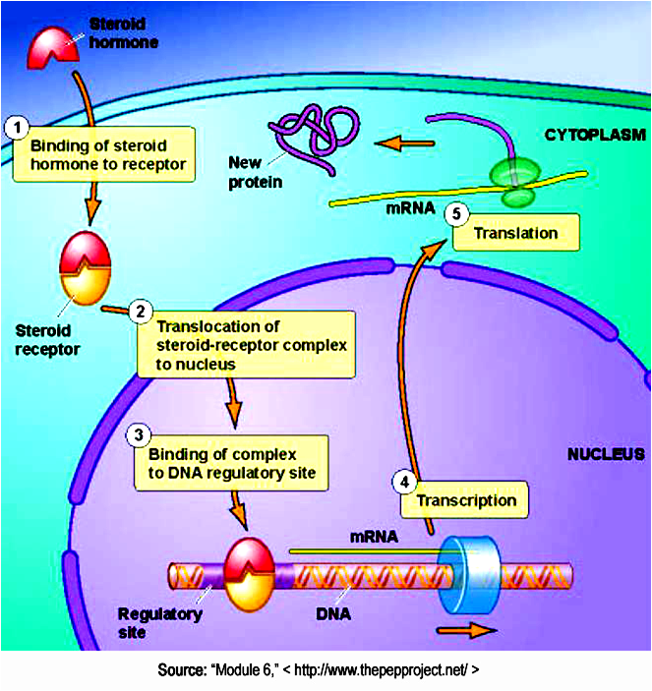
Mechanism of action (steroid hormones)

Slide 27
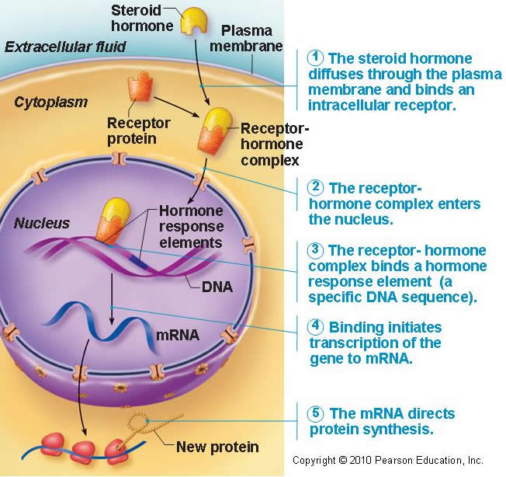
Mechanism of action (steroid hormones)

Slide 28
Regulation of hormonal receptors
Receptors does not remain constant
Inactivated or destroyed
Reactivated or manufactured
Downregulation
Increase hormone concentration leads to decrease in the number of active receptors
Most peptide hormones have pulsatile secretion which prevents downregulation
Upregulation
The hormone induces greater than normal formation of a receptor or intracellular signaling proteins

Slide 29
Clearance of hormones
Two factors control the concentration of a hormone in the blood:
The rate of its secretion
The rate of its removal (metabolic clerance)
Hormones are cleared by:
Metabolic destruction by tissues
Binding with tissues
Excretion by the liver into bile
Excretion by the kidney into urine
Clearance of protein bound hormones is slower than clearance of peptide hormones

Slide 30
Hormone Interactions
Multiple hormones can affect a single target simultaneously
Three types of hormone interactions:
Synergism
Permissiveness
Antagonism

Slide 31
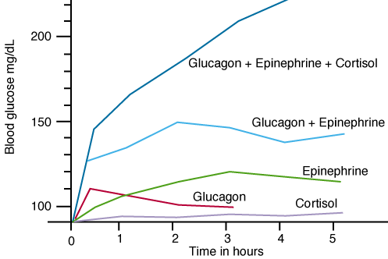
Synergism
Combined action of hormones is more than just additive!
Example: Blood glucose levels & synergistic effects of glucagon, cortisol and epinephrine

Slide 32
Permissiveness
One hormone allows another hormone to have its full effect
Especially during growth
Example
Thyroid hormone have permissive effect on growth hormone action
Deficiency of thyroid hormone in infants leads to dwarfism.

Slide 33
Antagonism
Antagonistic hormones have opposing physiological actions –
Hormone B diminishes the effect of hormone A
Example
Glucagon antagonizes the action of insulin

