Slide 1
Endocrinology
Dr. Hana Alzamil

Slide 2
Pituitary glands
Anterior pituitary hormones
GH
Physiological functions
Regulation of GH secretion
Feedback mechanism
Factors controlling secretion
Prolactin
Physiological functions
Regulation of prolactin secretion

Slide 3
Endocrine gland stimuli may be humoral, neural, or hormonal.

Slide 4
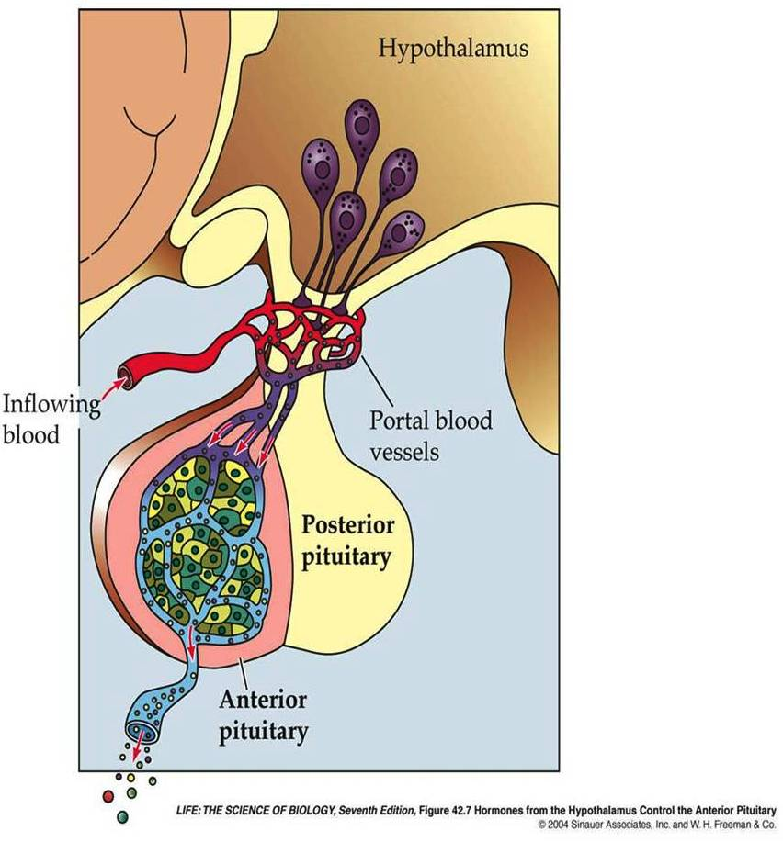
(adenohypophysis)
Anterior pituitary gland (adenohypophysis)
is connected to hypothalamus by portal system: “hypothalamic-hypophysial portal vessels”.

Slide 5
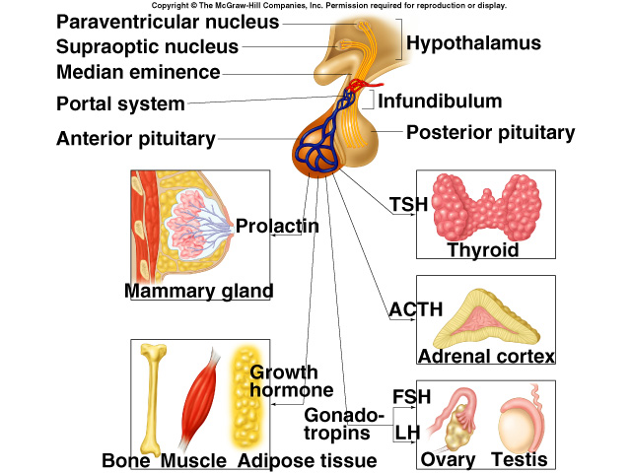
Anterior pituitary hormones

Slide 6
Growth hormone
(Somatotropin)

Slide 7
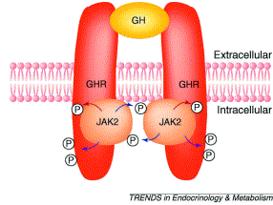
Mechanism of action direct effect

Slide 8
Functions of growth hormone:
Long term effect
Promotion of growth:
↑ cellular sizes & ↑ mitosis
↑ tissue growth & organ size
Indirect effect
Depends on somatomedin C (insulin– like growth factor 1)
IGF-1 is secreted by the liver, which is responsible for effect of GH on bone & cartilage growth and increase the synthesis of protein in skeletal muscles.

Slide 9
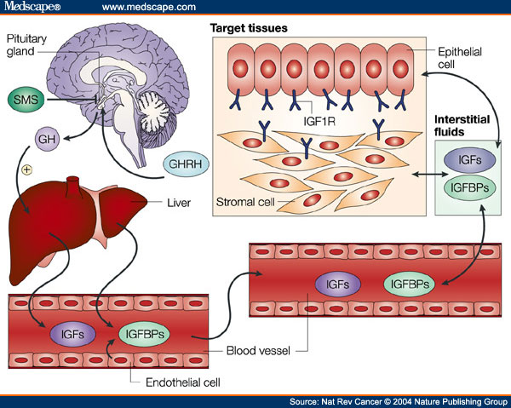
Indirect effect somatomedins

Slide 10
Mechanisms of bone growth
1. Linear growth of long bones:
● Long bones grow in length at epiphyseal cartilages, causing deposition of New Cartilage (↑collagen synthesis) followed by its conversion into bone.
● When bony fusion occurs between shaft & epiphysis at each end, no further lengthening of long bone occur.
2. Deposition of New Bone (↑ cell proliferation) on surfaces of older bone & in some bone cavities, ↑ thickness of bone.
● Occurs in membranous bones, e.g. jaw, & skull bones.

Slide 11
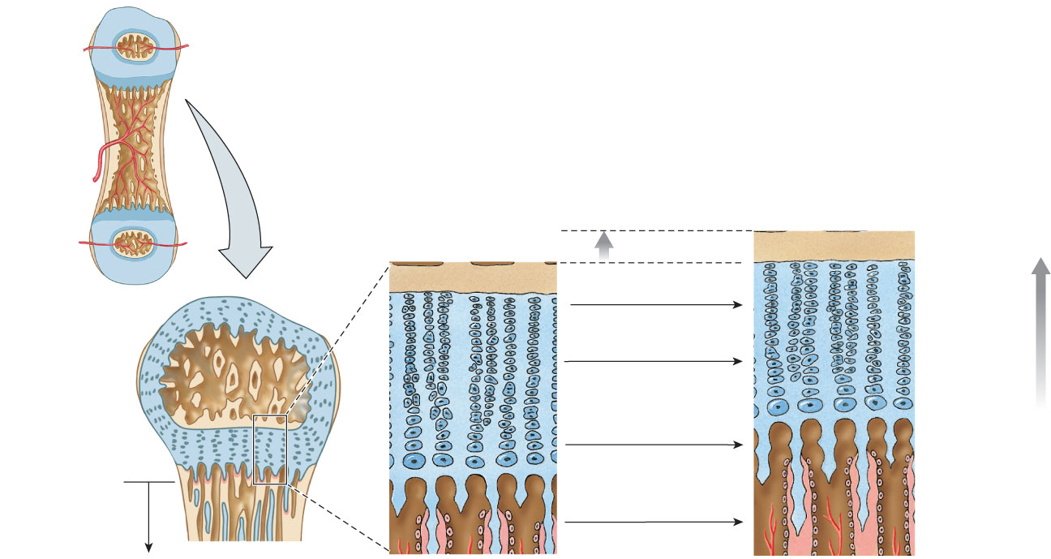
bone growth
Epiphysis
Diaphysis
Bone growth
Compact bone
Dividing chondrocytes
Chondrocytes
Chondrocyte
Old chondrocytes
Cartilage
Epiphyseal plate
Osteoblast
Direction of growth
Diaphysis
Osteoblasts
Newly calcified bone

Slide 12
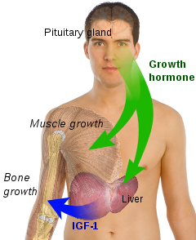
Promotion of growth

Slide 13
Functions of growth hormone:
Short term
Metabolic effects:
Protein metabolism (Anabolic)
↑ rate of protein synthesis in all cells through:
↑ amino acids transport into cells
↑DNA transcription= RNA synthesis
↑RNA translation= protein synthesis
↓protein catabolism “protein sparer”

Slide 14
Functions of growth hormone:
Fat metabolism: Catabolic
↑mobilization of FFAs from adipose tissue stores
Conversion of FFT to acetyl CoA to provide energy

Slide 15
Functions of growth hormone:
CHO metabolism: Hyperglycemic
↓ glucose uptake by tissues (skeletal muscles and fat).
↓ rate of glucose utilization throughout the body
↑glucose production by the liver (↑ gluconeogenesis)
↑ insulin resistance (↑FFA)
(diabetogenic )

Slide 16
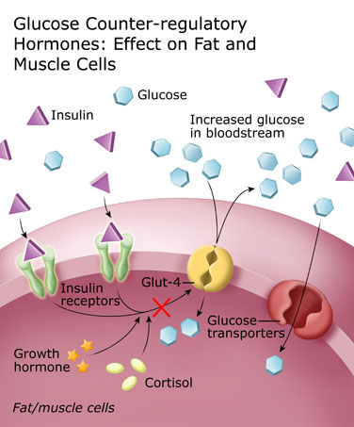

Slide 17
Other effects of growth hormone:
Increases calcium absorption from GIT
Strengthens and increases the mineralization of bone
Retention of Na⁺ and K⁺
Increases muscle mass
Stimulates the growth of all internal organs excluding the brain
Contributes to the maintenance and function of pancreatic islets
Stimulates the immune system

Slide 18
Control of GH secretion:
1. The hypothalamus:
a. GHRH → ↑ GH secretion.
b. GHIH (somatostatin) → ↓ GH secretion
2. Hypoglycemia (fasting)→ ↑ GH secretion.
(N.B. glucose intake → ↓ GH secretion).
3. Muscular exercise → ↑ GH secretion.
4. Intake of protein or amino acids → ↑ GH secretion (after meals).

Slide 19
Control of GH secretion:
5. During sleep → ↑ more in children.
6. Stress conditions, e.g. trauma or emotions → ↑ GH secretion.
7. FFAs → ↓ GH secretion
8. Grelin (stomach)→ ↑ GH secretion.

Slide 20
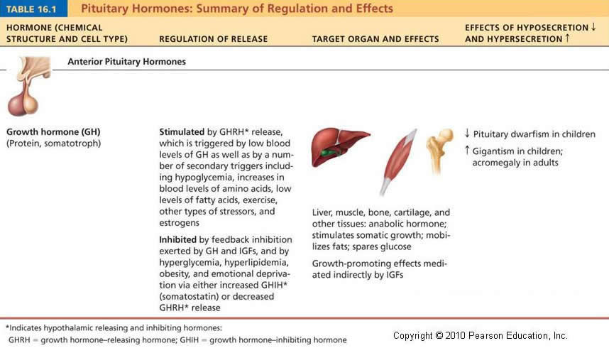

Slide 21
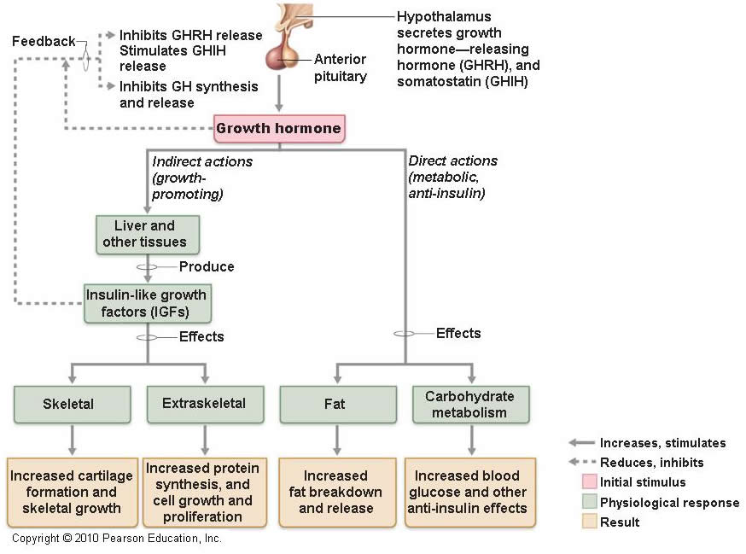

Slide 22
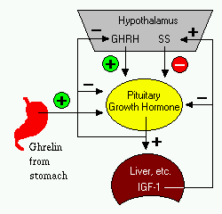

Slide 23
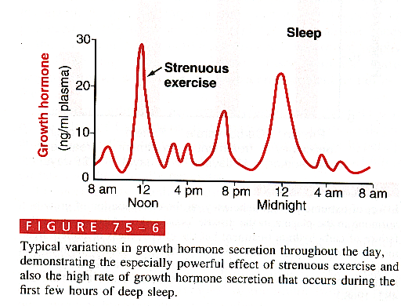

Slide 24
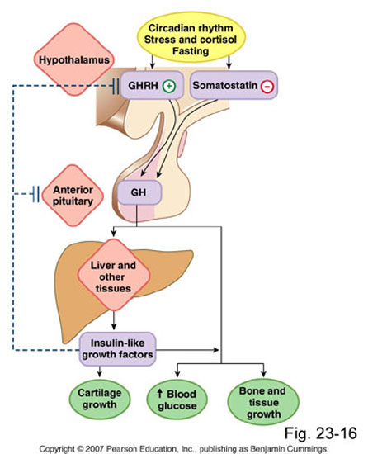

Slide 25
Abnormalities of GH secretion ↑ GH secretion:
Signs & symptoms
‘in childhood’:
Gigantism,
as all body tissues grow rapidly, including bones.
Height ↑ as it occurs before epiphyseal fusion of long bones with their shafts.
Hyperglycemia (diabetes).
Signs & symptoms
‘in adults’:
Acromegally,
person can’t grow taller, BUT soft tissue continue to grow in thickness (skin, tongue, liver, kidney, …)
- Enlargement of bones of hands & feet.
- Enlargement of membranous bones including cranium, nose, forehead bones, supraorbital ridges.
- Protrusion of lower jaw.
- Hunched back (kyphosis) (enlargement of vertebrae).

Slide 26
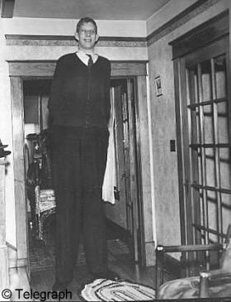
↑GH in children

Slide 27
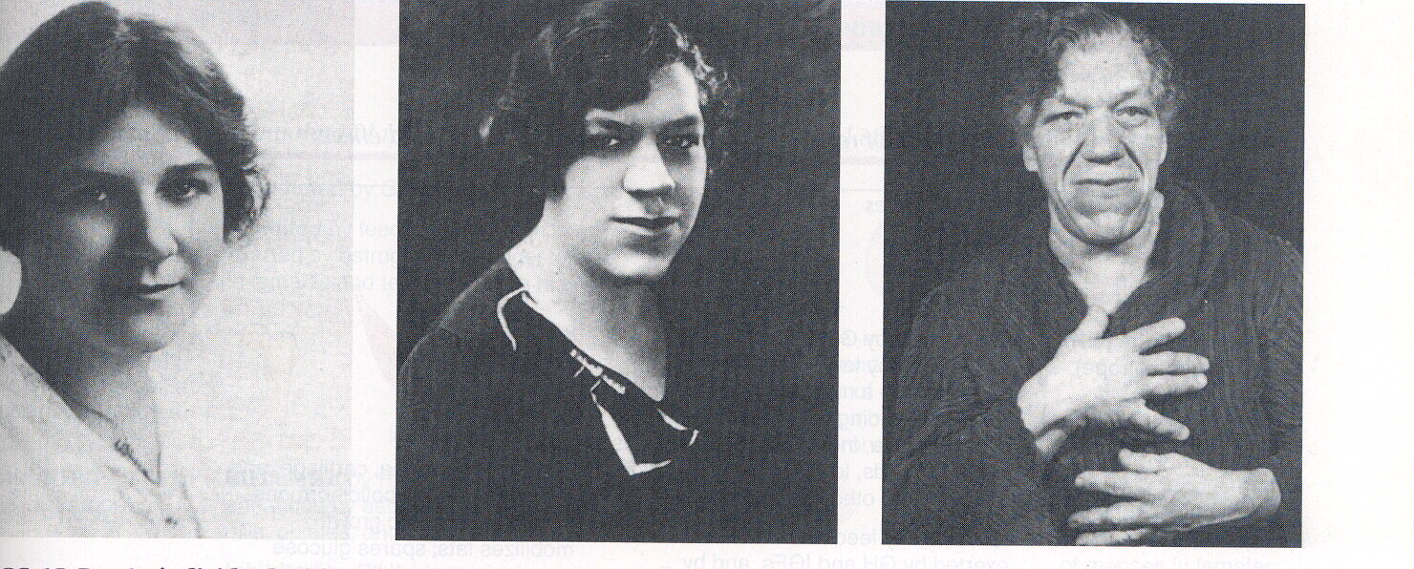
↑GH in an Adult

Slide 28
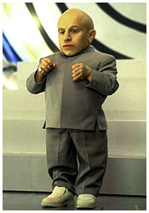
↓GH = pituitary dwarfism

Slide 29
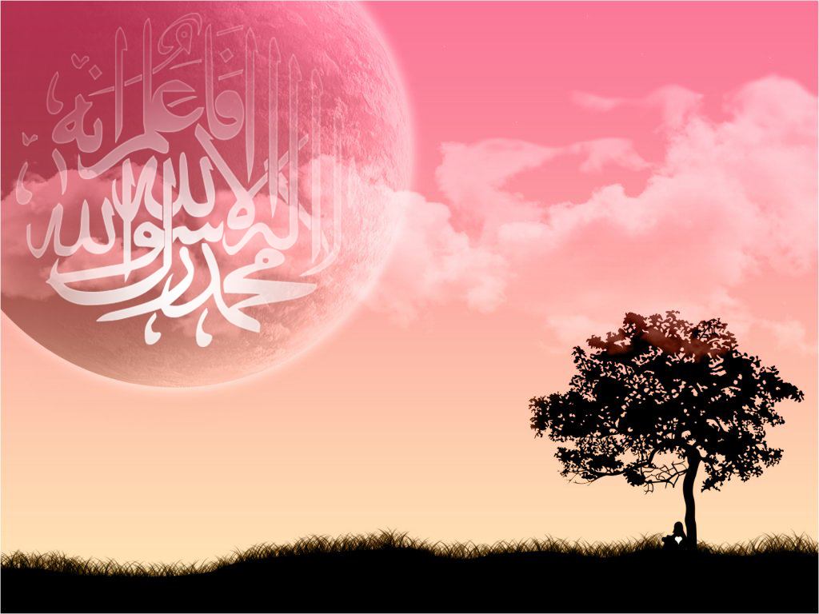

Slide 30
Prolactin

Slide 31
Functions of prolactin
The major function of prolactin is milk production
Release is inhibited by PIH (dopamine)
Suckling response inhibits PIH release

Slide 32
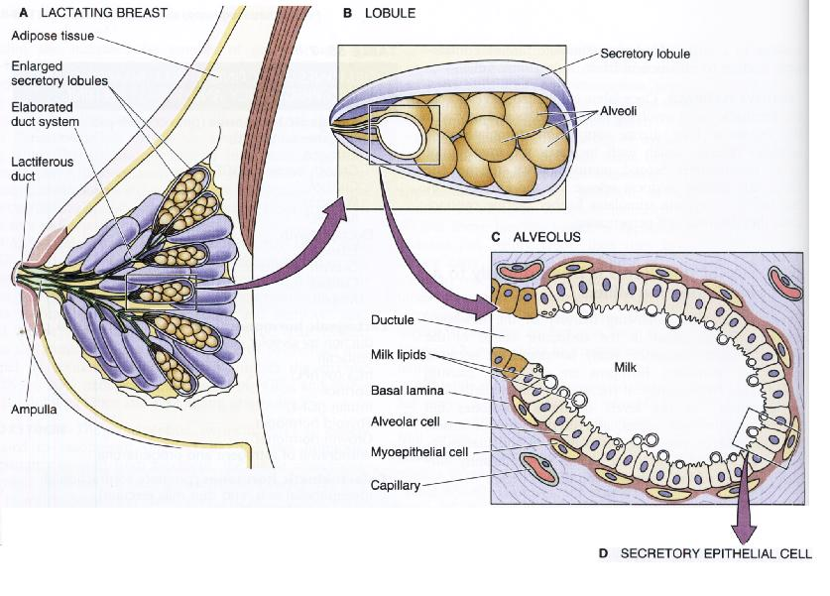
Oxytocin
Prolactin

Slide 33
Functions of prolactin
Effect on the breast
Increases mRNA
Increases production of casein and lactalbumin
Inhibits the effects of gonadotropins
Other effects
Stimulates the secretion of dopamine in median eminence (inhibits its own secretion)

Slide 34
Control of secretion
PIH (Dopamine) inhibit its secretion
Exercise increases PRL secretion
Surgical & psychological stress increases PRL secretion
Stimulation of the nipple increases PRL secretion
Prolctin level rises during sleep
Prolctin level rises during pregnancy
TRH increases PRL secretion

Slide 35
Thank you

