Slide 1
The Posterior Pituitary Gland ( Neurohypophysis ) Hormones Antidiuretic Hormone ( ADH, Vasopressin ) and Oxytocin
Dr Taha Sadig Ahmed

Slide 2
At the end of lectures 1 and 2 the students should be able to :
Identify and describe the hypothalamic control of the posterior pituitary galnd ( Neurohypophysis ) through the direct hypothalamo-neurohyphophyseal tract
Identify and describe the function of ADH.
Identify and describe the regulatory mechanism, influencing factors and control of secretion of ADH.
Appreciate clinical correlates of diabetes Insipidus and syndrome of inappropriate hypersecretion of ADH.
Identify and describe the chemical nature, target effects and function oxytocin.

Slide 3
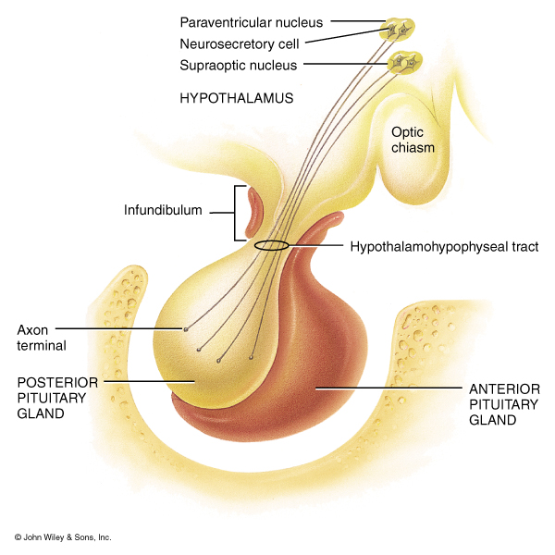
The Posterior Pituitary
consists of axon terminals
of hypothalamic neurons
The Posterior Pituitary does NOT
synthesize the hormones (ADH & Oxytocin)
but only stores them after they are sent
to it from hypothalamus ( where the are
synthesized )
When the need arises , nervous
signals from hypothalamus ( action
potentials travelling down the
hypothalamic neurons to their axon
terminals ) → cause release /secretion
of the Posterior Pituitary hormones
(ADH & Oxytocin ) .
Connects hyothalamus to Postterior Pituitary
ADH and Oxytocin are nonapeptide (nine amino acids) hormones
They are very similar in structure , differing only in amino acids number 3 and 8 .

Slide 4
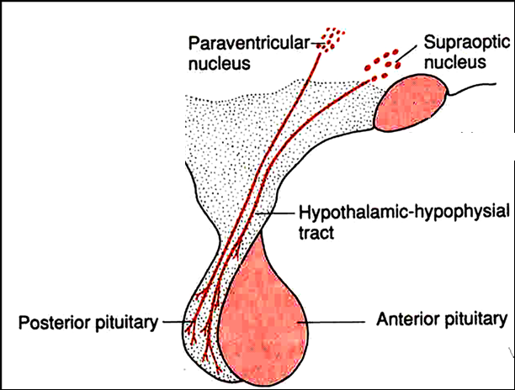
ADH & Oxytocin are synthesized in Supraoptic & Paraventricular nuclei of the hypothalamus .
Thereafter, they are transported through axons of these hypothalamic neurons to be stored in the Posterior Pituitary gland .
Action potentials in these hypothalamic axons result in the release / secretion of ADH & Oxytocin in blood capillaries in the Posterior Pituitary gland.

Slide 5
Actions of ADH
The major action of ADH is on renal cells that are responsible for reabsorbing free (osmotically unencumbered) water from the glomerular filtrate.
ADH responsive cells line the distal convoluted tubules and collecting ducts of the renal medulla.
ADH increases the permeability of these cells to water.
The increase in membrane permeability to water permits back diffusion of water along an osmotic gradient.
ADH action in the kidney is mediated by its binding to V2 receptors, coupled to adenylate cyclase and cAMP production.
cAMP activates protein kinase A which prompts the insertion of water channels into the renal cell membrane → rapid water reabsorption .
When ADH is removed, the water channels withdraw from the membrane and the apical surface of the cell becomes impermeable to water once again. .

Slide 6
Physiological Actions of ADH
The primary action of ADH is antidiuresis , thereby it decreases water loss by the kidney → conserves body water & regulates volume and tonicity of ECF .
ADH secretion is regulated by osmotic and volume/ hemodynamic stimuli
Water deprivation ( or dehydration ) → decreased ECF volume + ECF becomes more concentrated → ECF tonicty increased→ stimualtion of hypothalamic osmoreceptors to secrete more ADH → ADH increases kidney tubular permeabilty to water → increased water reabsorption by the kidney ( thereby decreasing urine volume & decreasing water loss by the kidney ) → bringing ECF volume & tonicity back to normal
On the other hand , water excess ( e,g., by ingestion /drinking too much water → increased ECF volume + ECF becomes more dilute → ECF tonicty decreased → inhibition of hypothalamic osmoreceptors → decreased ADH secretion → increased water loss in urine ( increased urine volume ) → bringing ECF volume & tonicity back to normal .

Slide 7
The major action of ADH is on renal cells that are responsible for reabsorbing free (osmotically unencumbered) water from the glomerular filtrate.
ADH responsive cells line the distal convoluted tubules and collecting ducts of the renal medulla.
ADH increases the permeability of these cells to water.
The increase in membrane permeability to water permits back diffusion of water along an osmotic gradient.
ADH action in the kidney is mediated by its binding to V2 receptors, coupled to adenylate cyclase and cAMP production.
cAMP activates protein kinase A which prompts the insertion of water channels into the renal cell membrane → rapid water reabsorption .
When ADH is removed, the water channels withdraw from the membrane and the apical surface of the cell becomes impermeable to water once again. .

Slide 8
Mechanism of ADH in antidiuresis
ADH binds to V2 receptors on the peritubular(serosal) surface of cells of the distal convoluted tubules and medullary collecting ducts.
Via adenylate cyclase/cAMP it induces production and insertion of Aquaporin 2 into the luminal membrane and enhances permeability of cell to water.
Increased membrane permeability to water permits back diffusion of solute-free water, resulting in increased urine osmolality (concentrates urine).
Thus ADH increases water retention by the kidney → decreased urine output ( volume ) → increasing the ECF volume → body water conservation .

Slide 9
Mechanical disruption or the neurohypohyseal tract by trauma, tumor, or surgery temporarily causes ADH deficiency.
ADH will be restored after regeneration of the axons (about 2 weeks).
But if disruption happens at a high enough level, the cell bodies die in the hypothalamus resulting in permanent ADH deficiency

Slide 10
Secretion of ADH by Osmotic Stimuli
ECF osmolality is detected by osmoreceptors in hypothalamus
Injection ( administration) of solutes that do not freely
or rapidly penetrate cell membranes , such as sodium
( hypertonic saline ) → increase the ECF osmotic pressure
as compared to ICF of osmoreceptors → water diffuses
out of osmoreceptors → ADH secretion is stimualted
On the other hand , injection of substances that enter cells
rapidly, such as urea, do not change osmotic equilibrium and
thus do not stimulate ADH release.
ADH secretion is very sensitive to changes in osmolality.
Changes of 1-2% result in increased ADH secretion.

Slide 11
Secretion of ADH by Non-Osmotic Stimuli ( by decreased BP)
Hypovolemia is perceived by “pressure receptors” → carotid and aortic baroreceptors, and stretch receptors in left atrium and pulmonary veins.
Normally, tonic ( continuos) stimulation of pressure receptors” (→ carotid and aortic baroreceptors, and stretch receptors in left atrium and pulmonary veins) tonically inhibit ADH release
Hypovolemia unstimulates these pressure receptors → disinhibition of ADH relesae → increased ADH release -→ decreased urine output
Sensitivity to baroreceptors is less than osmoreceptors– senses 5 to 10% change in volume

Slide 12
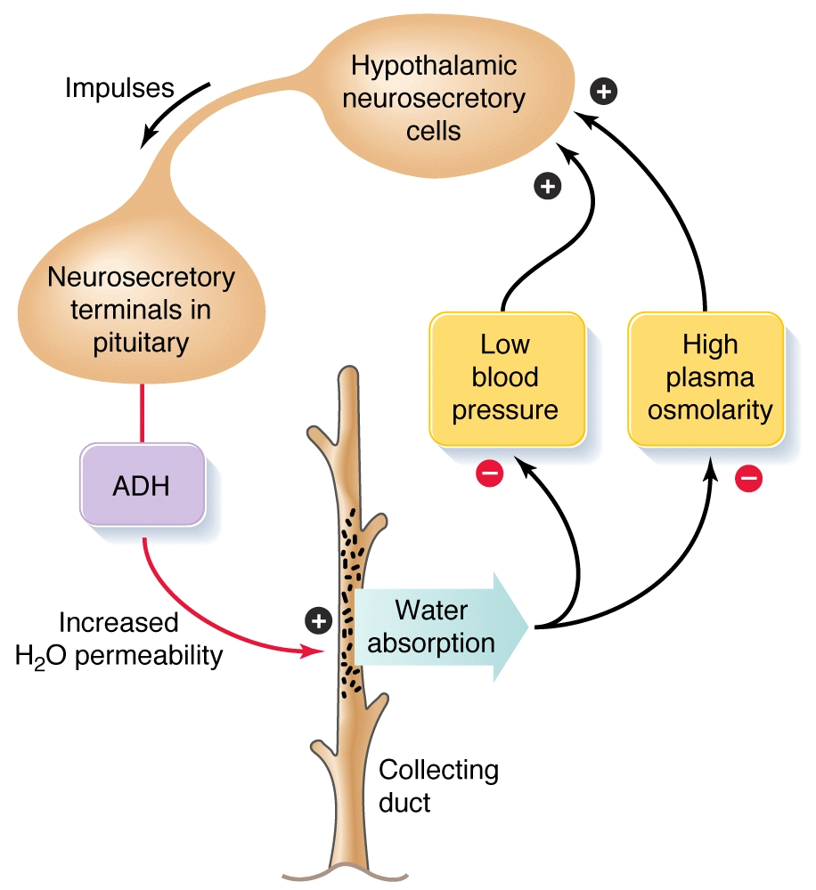
Increased plasma (ECF) osmolality and/or decreased BP → stimulate increased ADH secretion

Slide 13
Other Stimuli that Affect ADH secretion
Stimuli that increase ADH secretion:
Pain
Nausea
Surgical stress
Emotional stress
Stimuli that decrease ADH secretion:
Alcohol intake

Slide 14
Control of ADH Release
Osmotic press
Osmoreceptor mediated
ure:osmolality  ADH secretion
osmolality   ADH secretion
Volume effects
Baroreceptor mediated (vagus nerve)
blood pressure   ADH secretion
blood pressure   ADH secretion

Slide 15
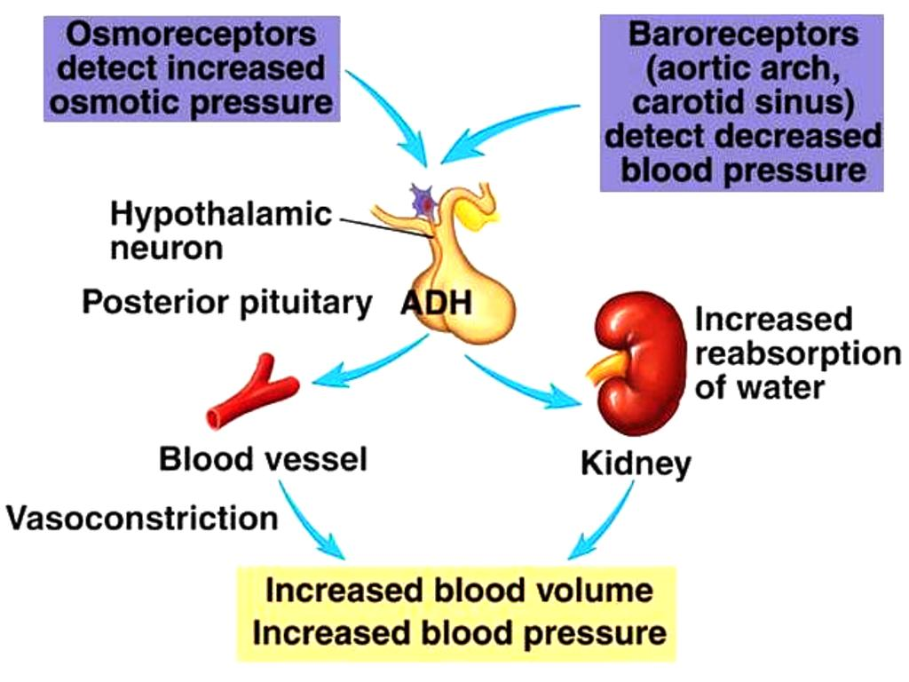
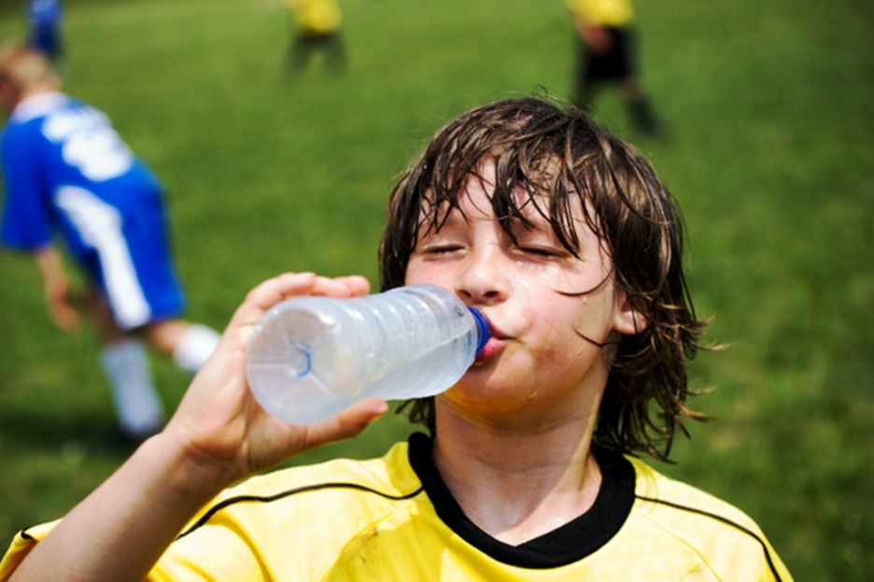
The volume receptors also stimulate the sympathetic nervous system → which stimulates Renin release from Juxtaglomerular Apparatus of the kidney → this leads to activation of Angiotensin II that causes →
(1) vasoconstriction → increase in BP
(2) Thirst → which makes the person drink water → increase blood volume
,

Slide 16
Oxytocin

Slide 17
Actions of Oxytocin
On lactating breast : → to release milk
Note that milk formation is by the hormone Prolactin , but milk release ( when the infant suckles the mother ) is by Oxytocin .
Oxytocin release is stimulated by the infant suckling his mother’s breast .
Then oxytocin acts on myoepthelial cells (specialised contrctile smooth muscle cells thst surround milk storage cavities ) → contraction → expression of milk from its site of synthesis into larger ducts of the breast → milk excretion .
Thus, milk is then made available to a suckling infant
On the uterus :
Stimulation of mechanoreceptors in the uterine cervix and vagina during labor (parturition) cause a rise in oxytocin levels → uterine contraction .
This helps in →
(1) expulsion of the baby during labor
(2) stopping bleeding after delivery
(3) also , after the baby is born & as the mother breast-feeds him → baby suckling produces oxytocin release → milk let-down + uterine contraction ( which prevents further blood-loss from the mother ) .
Oxytocic drugs ( e.g., Syntocinon ) are used by obtetricians ti induce labor in postmature pregnant women

Slide 18
END

