Slide 1
Calcium Homeostasis
Dr Taha Sadig Ahmed

Slide 2
Physiological Importance of Calcium
Calcium salts in bone provide structural integrity of the skeleton
Calcium ions in extracellular and cellular fluids is essential to normal function of a host of biochemical processes
Neuoromuscular excitability
Blood coagulation
Hormonal secretion
Enzymatic regulation
Excessive intake of carbonated beverages is associated with increased loss of calcium from the body
Because normal bone function requires weight-bearing exercise , prolonged immobility & total bed-rest cause bones to lose calcium

Slide 3
Calcium in blood
The total Ca⁺⁺ concentration in blood is around 10 mg / dl (range = 8.5-10 mg / dl )
It exists in ionized , free to react form and in a bound form
The free ionized Ca⁺⁺ is about 50% of the total blood Ca⁺⁺ = 5mg/dl .
It is the only form of Ca⁺⁺ which is biologically active
The remaining 50% is non-free , unionized calcium →
(i) Protein-bound calcium →around 40% of total ECF calcium .
Most of this calcium is bound to albumin , & much smaller fraction is bound to globulin )
(ii) present as complexed salt (mainly bound to serum citrate & phosphate) , around 10% of blood calcium .

Slide 4
Binding of calcium to albumin is pH-dependent
Acute respiraqory alkalosis increases calcium binding to protein → thereby decreases ionized calcium level
When ionized calcium falls below normal, permeability of neuronal cell-membranes to sodium increases → depolarization → hyperexcitability of the nervous system → patients become prone to develop tetanic muscle contractions & seizures .

Slide 5
Consequencies of Abnormal Calcium Levels
Decreased Ca⁺⁺ plasma Ca⁺⁺ [hypocalcaemia]
Increase excitability of nerve and muscle cell membranes → tetany, hyper reflexia, spontaneous twitching, muscle cramps, tingling and numbness.
Increased plasma Ca⁺⁺ conc. [Hypercalcaemia]
Cardiac arrhythmias, decrease neuromuscular excitability, lethargy, constipation, polyuria and polydepsia.

Slide 6
Phosphate
Phosphorous is an essential mineral necessary for ATP, cAMP second messenger systems, and other roles
PO₄ plasma concentration is around 4 mg/dL.
Most of it is ionized (diffusible) → around 50% oftotal
The remainder ( 50%) and much less of it is un-ionized (non-diffusible ) and protein- bound
Calcium is tightly regulated with Phosphorous in the body.

Slide 7
Hormonal Regulation of Calcium
3 principal hormones regulate serum Ca⁺⁺ level .
2 of them increase it :
(1) Vitamin D3 (1,25-dihydroxy ) ( taken in food & synthesized in the skin )
(2) Parathyroid hormone (PTH) : polypeptide hormone secreted by Parathyroid Glands .
And the third one one decreases it :
(3) Calcitonin : polypeptide hormone secreted by Parafollicular (C ) cells of Thyroid Gland
NB : While PTH and vitamin D act to increase plasma Ca⁺⁺ → only calcitonin causes a decrease in plasma Ca⁺⁺.

Slide 8
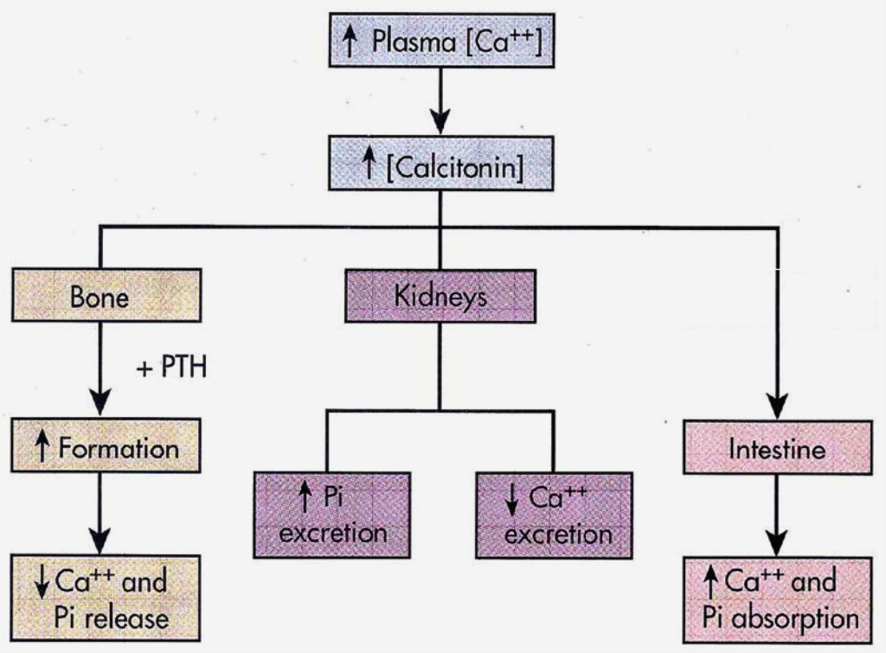
High plasma Ca⁺⁺ leads to → increased Calcitonin secretion
The main action of this calcitonin is to inhibits osteoclasts → inhibition of bone resorption → (1) increases bone formation + (2) decreases blood Ca⁺⁺ level .
Thus calcitonin plays a central role in bone re-modelling .
Calcitonin

Slide 9
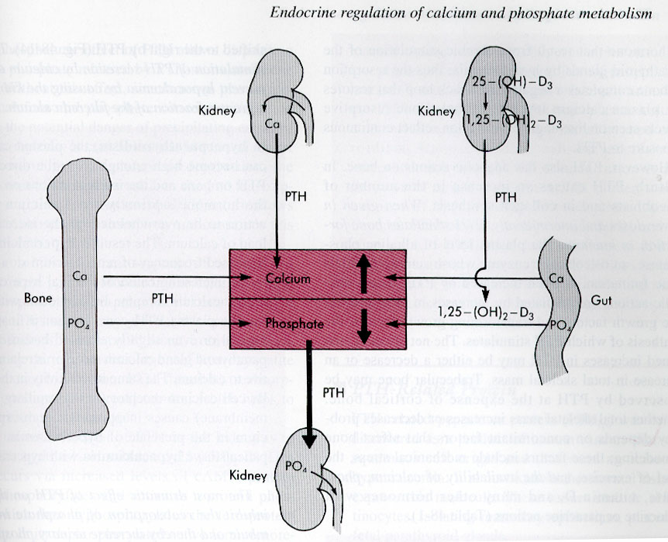
Calcium & Phosphorus

Slide 10
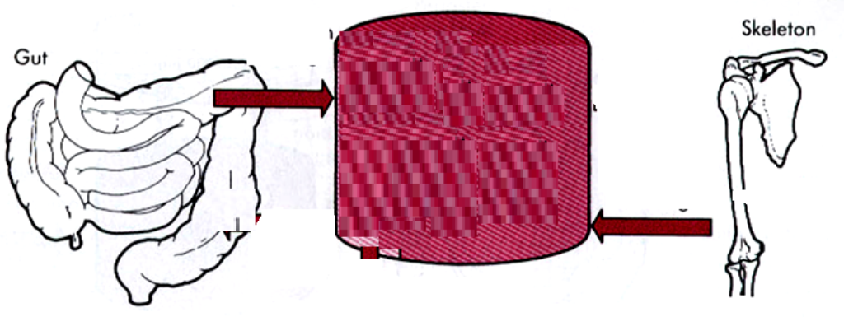
Vitamin D3 increases Ca⁺⁺ level by :
(1) Ca⁺⁺ absorption from the intestine , &
(2) Ca⁺⁺ resorption from the bone ( by increasing
steoclastic number &
activity)
(3) Some believe that it also increases Ca⁺⁺ reabsorption by the kidney
Humans acquire vitamin D from two sources →
(1) Ingestion in diet (food)
(2) Skin : Vitamin D is produced in the skin by ultraviolet light .
Blood

Slide 11
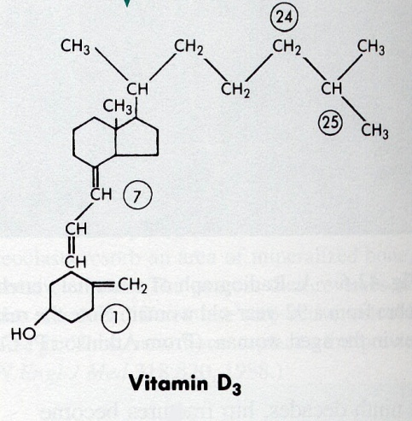
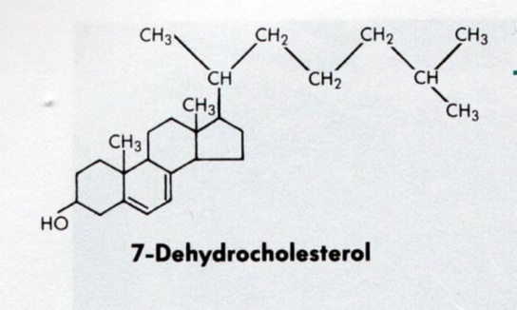
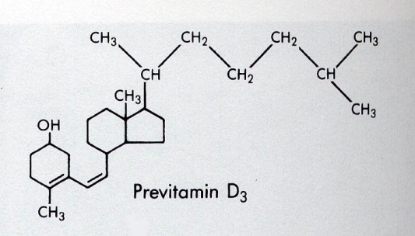
Vitamin D
Keratinocytes in the skin synthesize 7-dehydrocholesterol .
7-dehydrocholesterol is photoconverted ( by UV light in skin) to Cholecalciferol (previtamin D3 ) ,
This form of Vitamin D is inactive, it requires modification to the active metabolite, 1,25-dihydroxy-D → by two hydroxylation reactions → the first one occurs in the liver and the second one in the kidney
When there is limited exposure to the sun , dietary vitamin D is essential . If there is no sufficient exposure to the sun , or if there is ditary deficiency in vitamin D → Rickets ( in children ) or Osteomalacia ( in adults ) occur .
PTH stimulates Vit D synthesis

Slide 12
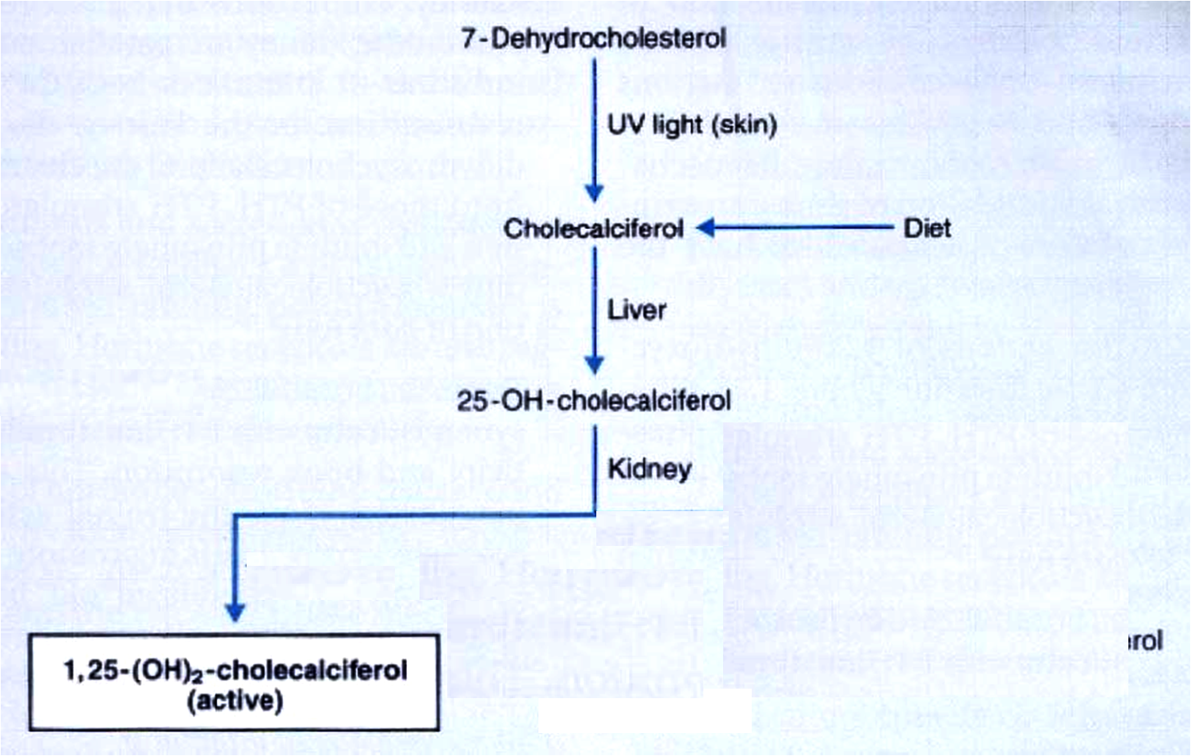

Slide 13
Vitamin D deficiency leads to a disease characterized by softening of bone
If it occurs in choildren → it is called Rickets
If it occurs in adults → it is called Osteomalacia
Most affected areas :
Metaphyses of long bones subjected to stress →
Wrists
Knees
Ankles

Slide 14
Clinical Features
Delayed dentition ( delayed teething )
Bowed legs
(Due to the effect of weight bearing on the legs)
Swelling of wrists and ankles
Short stature

Slide 15
Metaphyseal widening in wrists & knees + signs of bone rarfaction
Bowed legs ( Bowing of legs )
Osteomalacia : an adult disease characterized by a gradual softening and bending of the bones

Slide 16
Thanks

