Slide 1
Adrenal (Suprarenal )Medulla
Dr Taha Sadig Ahmed

Slide 2
The adrenal medulla constitutes the inner part of the suprarenal gland , and comprises 20% of the gland..
It is not essential to life if the animal is kept under sheltered conditions without any external stress ( but is real life devoid of any stress ? )
The adrenal medulla is actually a ganglion of the sympathetic nervous system , since its origin is the embryonic neural crest ( i.e. its cells are actually neurons )
It is made of Chromaffin cells that secrete s catecholamines →
(1) epinephrine (adrenaline) ( around 80% of its secretion ) ,
(2) norepinephrine (noradrenaline) ( around 20% of its secretion ), and
(3) a small amount of dopamine in response to stimulation by preganglionic sympathetic nerves .

Slide 3
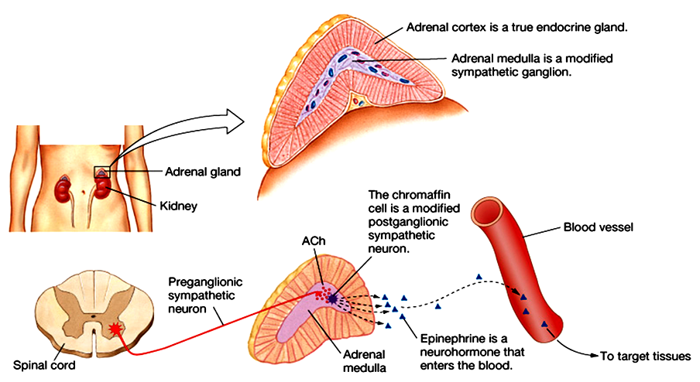
Its secretions are derived from tyrosine :
Tyrosine Dopamine Norepinephrine Epinephrine
Increased glycogenolysis and glucoplasma glucose levels .

Slide 4
Epinephrine is the more potent stimulator of the heart and metabolic activities
Norepinephrine is more influential on peripheral vasoconstriction and blood pressure
Norepinephrine ( Noradrenaline) is metabolised into normetanephrine and Vanillyl mandelic acid (VMA ) .
High urine VMA is one of the diagnostic tests for Pheochromocytoma .

Slide 5
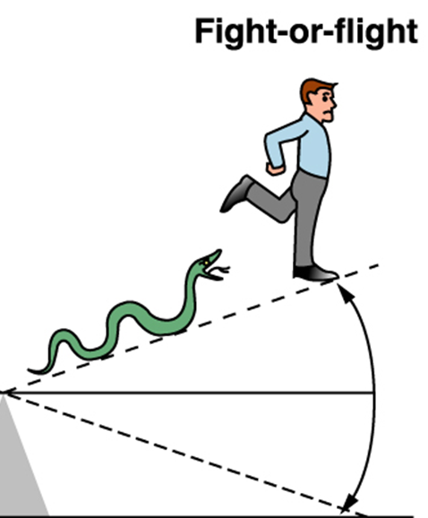
NE & Epinephrine Effects
Stimulates the “fight or fight” reaction
Eye : pupil dilation
Heart : increased heart rate & force of contraction → increased cardiac
output & BP (blood pressure)
TPR ( Total Peripheral Resistance )
Arteriolar constriction (→ raised BP.
norepinephren is causing more effect
Broncioles → Bronchiolar dilation
Liver : glycogenolysis, gluconeogenesis ;
Skeletal muscle → glycogenolysis
Increased blood glucose
Metabolic Rate →Increased.
Epinephrene is causing more effect than NE (5-10 times)

Slide 6
NE & Epinephrine Effects (Contd)
skin:
Increase sweating
GIT and Bladder:
Sphincter contraction
Wall relaxation
GIT :Decreased gastrointestinal secretion and motility
Kidney : Renin secretion
s relaxation

Slide 7
Pheochromocytoma
Pheochromocytoma is a tomor of adrenal medullan .
It can be life threatening if not recognized & not treated.
It can develop at any age, but most often occurs in middle age.
Symptoms & signs →
Sudden bouts of headache ( most common symptom ) ,
pallor ,
Excessive sweating
Palpitations ( the patient is conscious of his heart beats, and feeling that his heart is beating more strongly & rapidly than used to be )
Sense of extreme fear and anxiety
Tachycardia and high blood pressure

Slide 8
Abdominal pains
Weight loss
Orthostatic hypotension (a fall in systolic BP greater than 20 mmHg or a fall in diastolic BP greater than 10 mmHg upon standing)
Elevated blood glucose level (due primarily to catecholamine stimulation of lipolysis (breakdown of stored fat) leading to high levels of free fatty acids and the subsequent inhibition of glucose uptake by muscle cells. Further more , stimulation of beta-adrenergic receptors leads to glycogenolysis and gluconeogenesis and thus elevation of blood glucose levels).

