Slide 1
Revision

Slide 2
Thyroid gland
Fascia
Level
Relation
Identify structures
Blood supply
Clinical

Slide 3
Relation of thyroid gland
Mention 2 nerves related to the thyroid gland medially ?
A.
B.
Key:
Recurrent laryngeal nerve .
External laryngeal nerve.
Mention 2 structures related to both isthmus and lobe of the thyroid gland Anteriorly.
1- -----------------------
2-------------------------
Key:
1- Sternothyroid.
2- Sternohyoid.

Slide 4
With thyrodictomy operation
Mention;
A. Fascia incised.
B. Nerves protected from injury.
Key:
A.
1- Investing layer.
2- Pretracheal layer.
B.
1- The external laryngeal nerve.
2- The recurrent laryngeal nerve

Slide 5
Level of thyroid lobes;
Obliqu line
Level of 4-5 tracheal rings
Level of thyroid Isthmus;
Front of 2- 3- 4- tracheal rings

Slide 6
Relations
Anterolaterally:
1. Sternothyroid.
2. Superior belly of omohyoid
3. Sternohyoid.
4. Sternomastoid.
Posterior:
Carotid sheath & its contents.
Medially:
Above:
Larynx & pharynx .
Below:
Trachea & esophagus.
Recurrent laryngeal nerve in between.
Cricothyroid muscle & external laryngeal nerve.

Slide 7
Relation of the isthmus
Anteriorly:
1- Sternothyroid,
2- Sternohyoid,
3- Anterior jugular vein,
4- Fascia & skin.
Posteriorly:
2nd,3rd, &4th tracheal rings
Terminal branches of the two superior thyroid arteries as they anastomosis along the upper border.

Slide 8
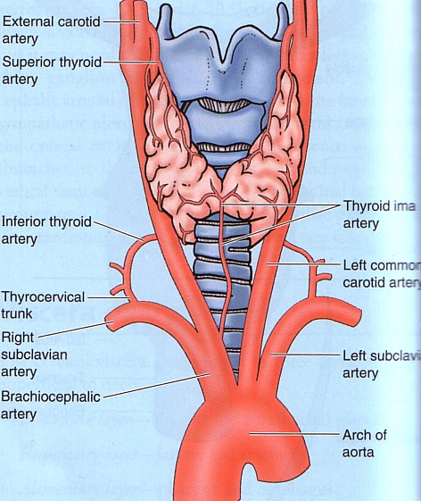
For the thyroid gland Mention;
origin of the arterial supply
end of the venous drainage.
A.-------------------
B. -------------------.
Key:
A. 1- external carotid artery .
2- aortic arch or brachiocephalic artery.
3- thyrocervical trunk of 1st part of subclavian artery.
B. 1- internal jugular.
2- left brachiocephalic

Slide 9
Veins of Thyroid Gland
1-Superior thyroid vein internal jugular
2- Middle thyroid vein internal jugular
3- Inferior thyroid vein left brachiocephalic

Slide 10
Adrenal gland
Level.
Comparison between R. and L. glands
Position
Shape
Relation
Blood supply.

Slide 11
1- Mention the anatomical level of the adrenal glands.
key: just above level of T12

Slide 12
2- Mention the origin of the arterial supply of the adrenal glands ?
a.------------------.
b.-------------------.
c. -------------------.
Key :
a. Superior suprarenal (inferior pherenic).
b. middle suprarenal (abdominal aorta).
c.Inferior suprarenal (renal arteries)
Mention the origin of the venous drainage of the adrenal glands ?
a. the inferior vena cava on the right
b. the left renal vein on the left.

Slide 13
Differences between right and left adrenals
1- position and shape
Pyramid caps the upper pole
crescentic Extends to the hilus
2- Relation
Right
Anterior: right lobe of the liver and inferior vena cava.
Posterior: diaphragm.
Left
Anterior: pancreas, lesser sac, and stomach
Posterior: diaphragm

Slide 14
Pituitary gland
Position
Relation
Blood supply

Slide 15
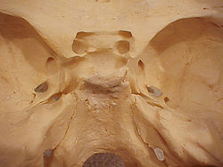
Pituitary gland
Position;
It lies in the hypophyseal fossa of the body of sphenoid bone, between optic chiasma (anteriorly) & mamillary bodies (posteriorly).

Slide 16
Relation
Mention important lateral , superior , posterior and inferior relations of pituitary gland
Superior: Diaphragma sellae
Inferior: Sphenoidal air sinuses
Lateral: Cavernous sinuses
Anteriorly: optic chiasma
Posteriorly: mamillary bodies).

Slide 17
Blood supply
Arterial supply
Arteries:
Superior & inferior hypophyseal arteries
(branches of internal carotid artery)
Venous drainage
Veins:
hypophyseal veins
drain into cavernous sinuses.

