Slide 1
Endocrine practical block

Slide 2
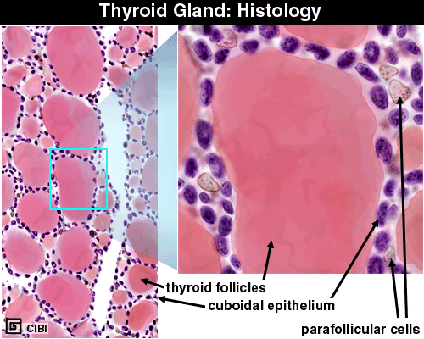
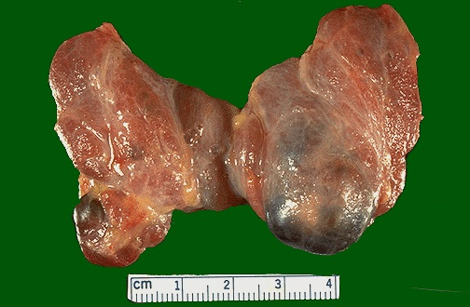
Normal anatomy of thyroid gland
15-25 grams
Notes:
The normal weight of the thyroid, in grams, is also the same as its 24 hour radioactive iodine uptake percentage. Why? Ans: Because it take up 1% per gram.

Slide 3
Gross and histopathology
1- Multinodular goiter

Slide 4
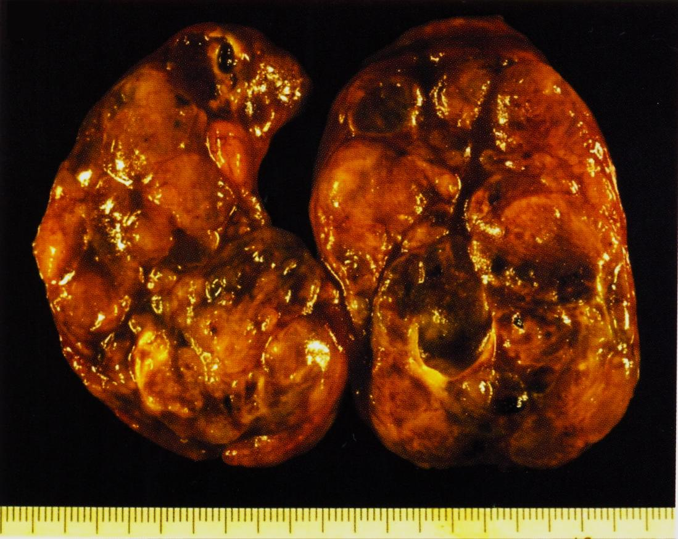
Multinodular Goiter
Asymmetric enlargement
Multinodular
Haemorrhage
Cystic degeneration

Slide 5
Multinodular Goiter
Numerous follicles varying in size filled with colloid.
We can also see
Recent haemorrhage
Haemosiderin
Calcification
Cystic degeneration

Slide 6
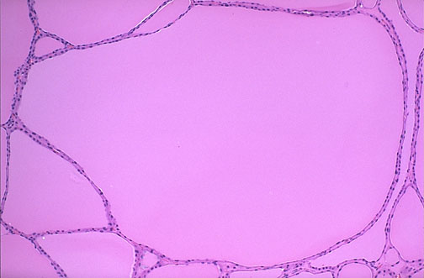
Multinodular Goiter
The follicles are irregularly enlarged, with flattened epithelium, consistent with inactivity, in this microscopic appearance at low power of a multinodular goiter.

Slide 7
2- Thyrotoxicosis

Slide 8
HYPER-THYROIDISM
HYPERMETABOLISM
Tachycardia, palpitations
Increased T3, T4
Goiter
Exophthalmos
Tremor
GI hypermotility
Thyroid “storm”, life threatening

Slide 9
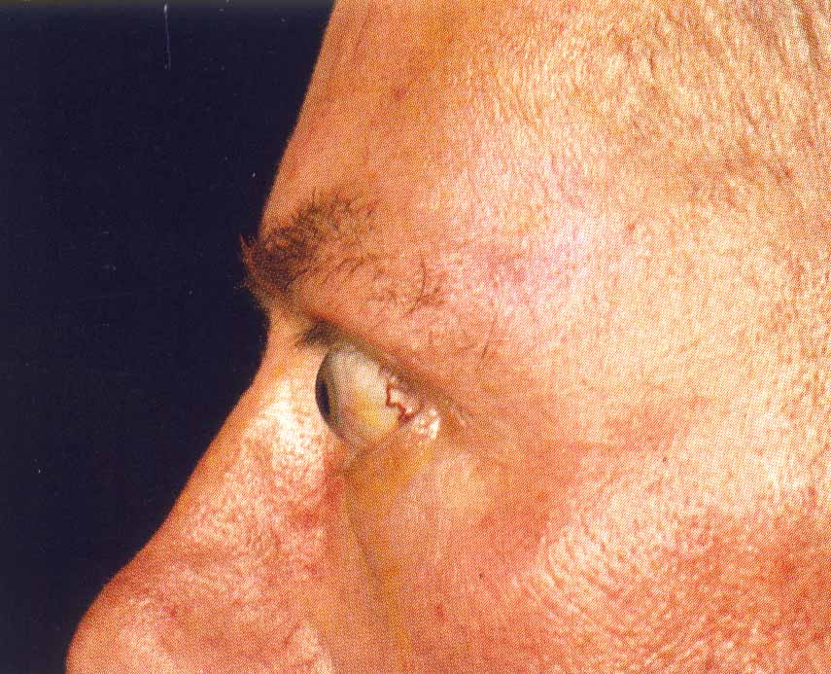
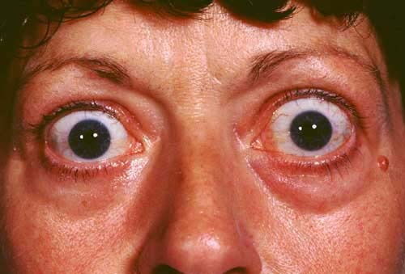
“Exophthalmos”

Slide 10
Graves Disease
Symmetrical enlargement of thyroid gland
Cut-surface is homogenous, soft and appear meaty
Hyperplasia and hypertrophy of follicular cells

Slide 11
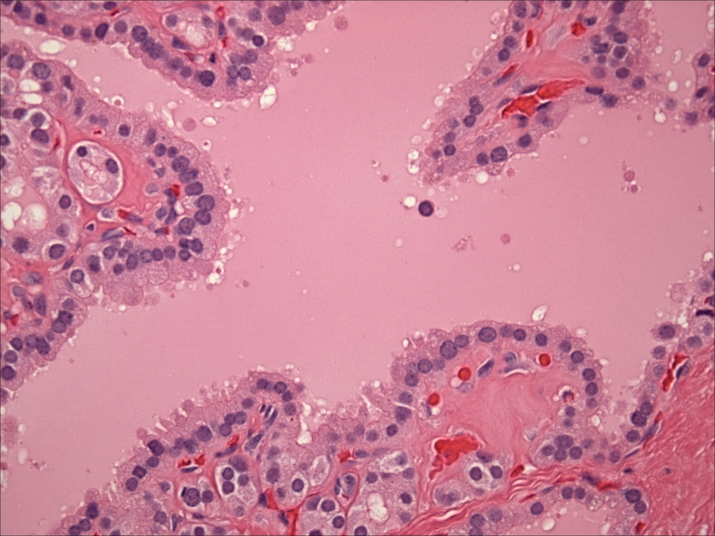
Section shows thyroid follicles lined by columnar and high cuboidal cells with evidence of peripheral vacuoles within the intrafollicular colloid material . Note the presence of peripheral smaller thyroid follicles devoid of colloid but lined by similar cells . Lymphocytic infiltration of the thyroid gland is sometimes seen in thyrotoxicosis . This feature is not , however , seen in the picture above .
Notes:
Section shows thyroid follicles lined by columnar and high cuboidal cells with evidence of peripheral vacuoles within the intrafollicular colloid material . Note the presence of peripheral smaller thyroid follicles devoid of colloid but lined by similar cells . Lymphocytic infiltration of the thyroid gland is sometimes seen in thyrotoxicosis . This feature is not , however , seen in the picture above .

Slide 12
3- Hashimotos thyroiditis

Slide 13
Hashimoto Thyroiditis
Diffuse enlargement.
Firm or rubbery.
Pale, yellow-tan, firm & somewhat nodular cut surface

Slide 14
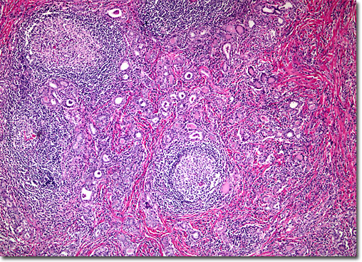
Notes:
The diagnosis of Hashimoto thyroiditis requires not only lymphoid follicles in the thyroid, but SECONDARY (i.e., germinal centers) follicles should be present. If the thyroid gland looks like a lymph node, the diagnosis is Hashimoto thyroiditis, Hashimoto = auto-immune

Slide 15
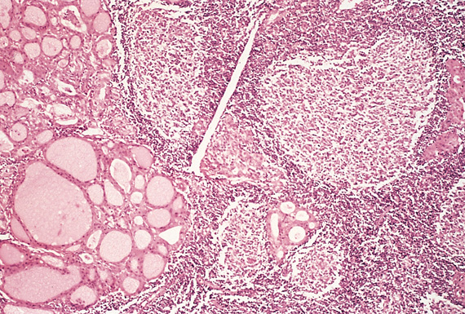
Hashimoto Thyroiditis
Massive lympho-plasmcytic infiltration with lymphoid follicles formation
Destruction of thyroid follicles
Remaining follicles are small and many are lined by Hurthle cells
Increased interstitial connective tissue

Slide 16
4- Follicular adenoma

Slide 17
Follicular Adenoma
Solitary
Variably sized
Encapsulated
Well-circumscribed
With homogenous gray-white to red-brown cut-surface
+/- degenerative changes

Slide 18
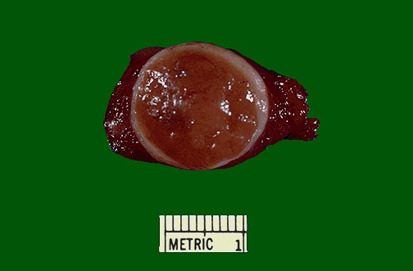
There is a well circumscribed light brown and circular tumor nodule which is surrounded by a thick and whitish capsule . The surrounding thyroid tissue is unremarkable . The features are consistent with a follicular adenoma of thyroid gland .
Notes:
EXTREMELY well encapsulated tumor. Benign. It is sometimes difficult to tell a well-differentiated follicular carcinoma from a follicular adenoma. Thus, patients with follicular neoplasm are treated with subtotal thyroidectomy just to be on the safe side.

Slide 19
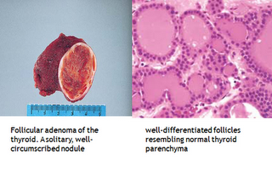

Slide 20
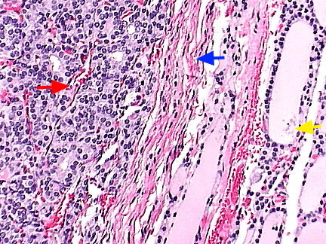
The red arrow is located within the adenoma. € Although composed of follicular cells, little colloid is seen. € The blue arrow points to the capsule of the adenoma, a few strands of connective tissue. € The yellow arrow points to colloid within a large normal follicle.

Slide 21
5- Papillary thyroid carcinoma

Slide 22
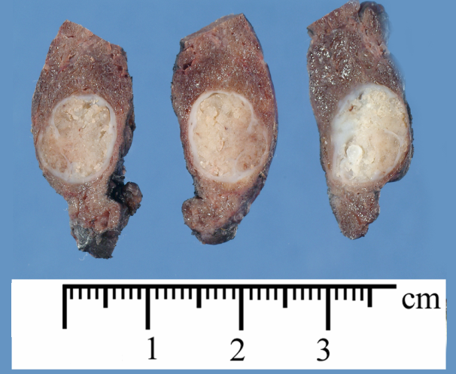
A relatively well circumscribed pale and firm nodule showing a whitish cut surface with vague scattered papillary areas .
Notes:
Papillary neoplasms do NOT usually look uniform on cut surface. This neoplasm can be multifocal, because of the propensity to invade lymphatics within thyroid, and lymph node metastases are common.

Slide 23
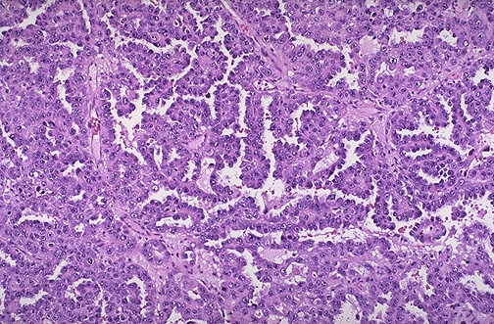
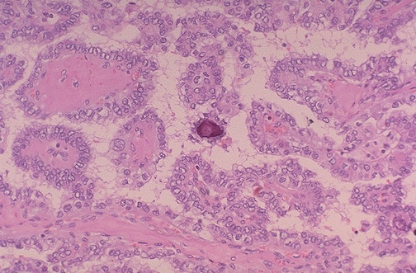
Sections show a papillary neoplasm consisting of papillary fronds lined by overlapping clear nuclei ( Orphan Annie nuclei ). Calcified Psammoma bodies are also seen .
Notes:
Orphan Annie cells are seen in papillary carcinoma in which considerably cytoplasm has invaginated into the nucleus.

Slide 24
6-Pheochromocytoma

Slide 25
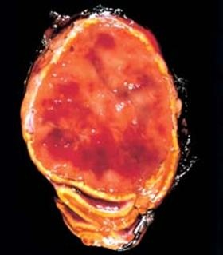
Pheochromocytoma
The figure shows a single partly pale and partly hemorrhagic adrenal medullary mass which appears to be compressing the adrenal cortex ( arrow )
Notes:
The tumor is enclosed within an attenuated cortex and shows areas of haemorrhage. Arrow shows residual adrenal gland

Slide 26
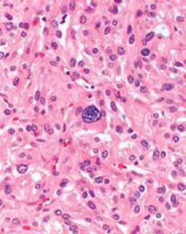
Pheochromocytoma
Characteristic nests of cells “Zellballen” seen.
The cells are polygonal to spindle shaped with abundant finely granular cytoplasm and nuclei with stippled ‘salt and pepper’ chromatin.

