Slide 1
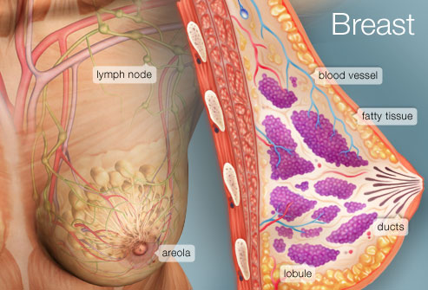
FEMALE BREAST
PROF. Saeed Abuel Makarem & DR.SANAA AL-SHAARAWI

Slide 2
OBJECTIVES
By the end of the lecture, the student should be able to:
Describe the shape and position of the female breast.
Describe the structure of the mammary gland.
List the blood supply of the female breast.
Describe the lymphatic drainage of the female breast.
Describe the applied anatomy in the female breast.

Slide 3
Parts, Shape & position of the Gland
It is conical in shape.
It lies in superficial fascia of the front of chest.
It has a base, apex and tail.
Its base extends from 2nd to 6th ribs.
It extends from the sternum to the midaxillary line laterally.
It has no capsule.

Slide 4
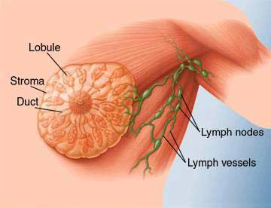
SHAPE AND POSITION OF FEMALE BREAST
2/3 of its base lies on the pectoralis major muscle, while its inferolateral 1/3 lies on:
Serratus anterior &
External oblique muscles.
Its superolateral part sends a process into the axilla called the axillary tail or axillary process.

Slide 5
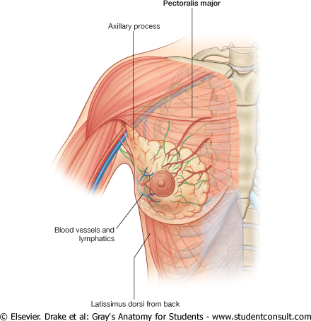
SHAPE AND POSITION OF FEMALE BREAST
Nipple:
It is a conical eminence that projects forwards from the anterior surface of the breast.
The nipple lies opposite 4th intercostal space.
It carries 15-20 narrow pores of the lactiferous ducts.
Areola :
It is a dark pink brownish circular area of skin that surrounds the nipple.
The subcutaneous tissues of nipple & areola are devoid of fat.

Slide 6
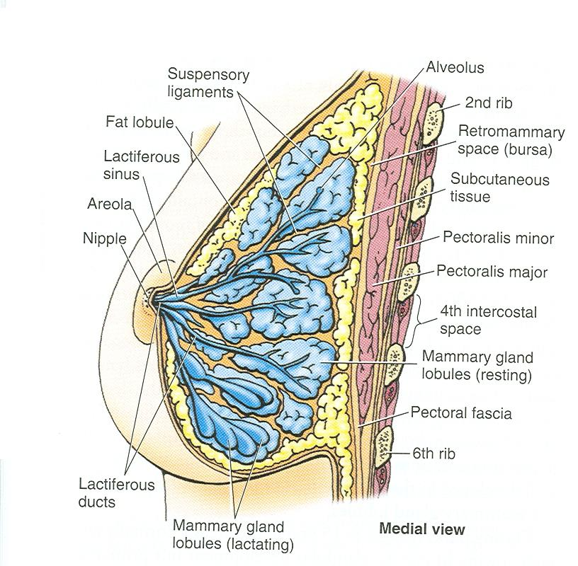
STRUCTURE OF MAMMARY GLAND
It is non capsulated gland.
It consists of lobes and lobules which are embedded in the subcutaneous fatty tissue of superficial fascia.
It has fibrous strands (ligaments of cooper) which connect the skin with deep fascia of pectoralis major.
It is separated from the deep fascia covering the underlying muscles by a layer of loose areolar tissue which forms the retromammary space.? What is its Importance? (allows the breast to move freely).

Slide 7
STRUCTURE OF MAMMARY GLAND
It is formed of 15-20 lobes.
Each lobe is formed of a number of lobules.
The lobes and lobules are separated by interlobar and interlobular fibrous & fatty tissue, called ligaments of Cooper. (Importance?)
It has from 15-20 lactiferous ducts which open by the same number of openings on the summit of the nipple.

Slide 8
ARTERIAL SUPPLY
1. Perforating branches of internal thoracic (internal mammary) artery.
2. Mammary branches of lateral thoracic artery.
3. Mammary branches of Intercostal arteries.

Slide 9
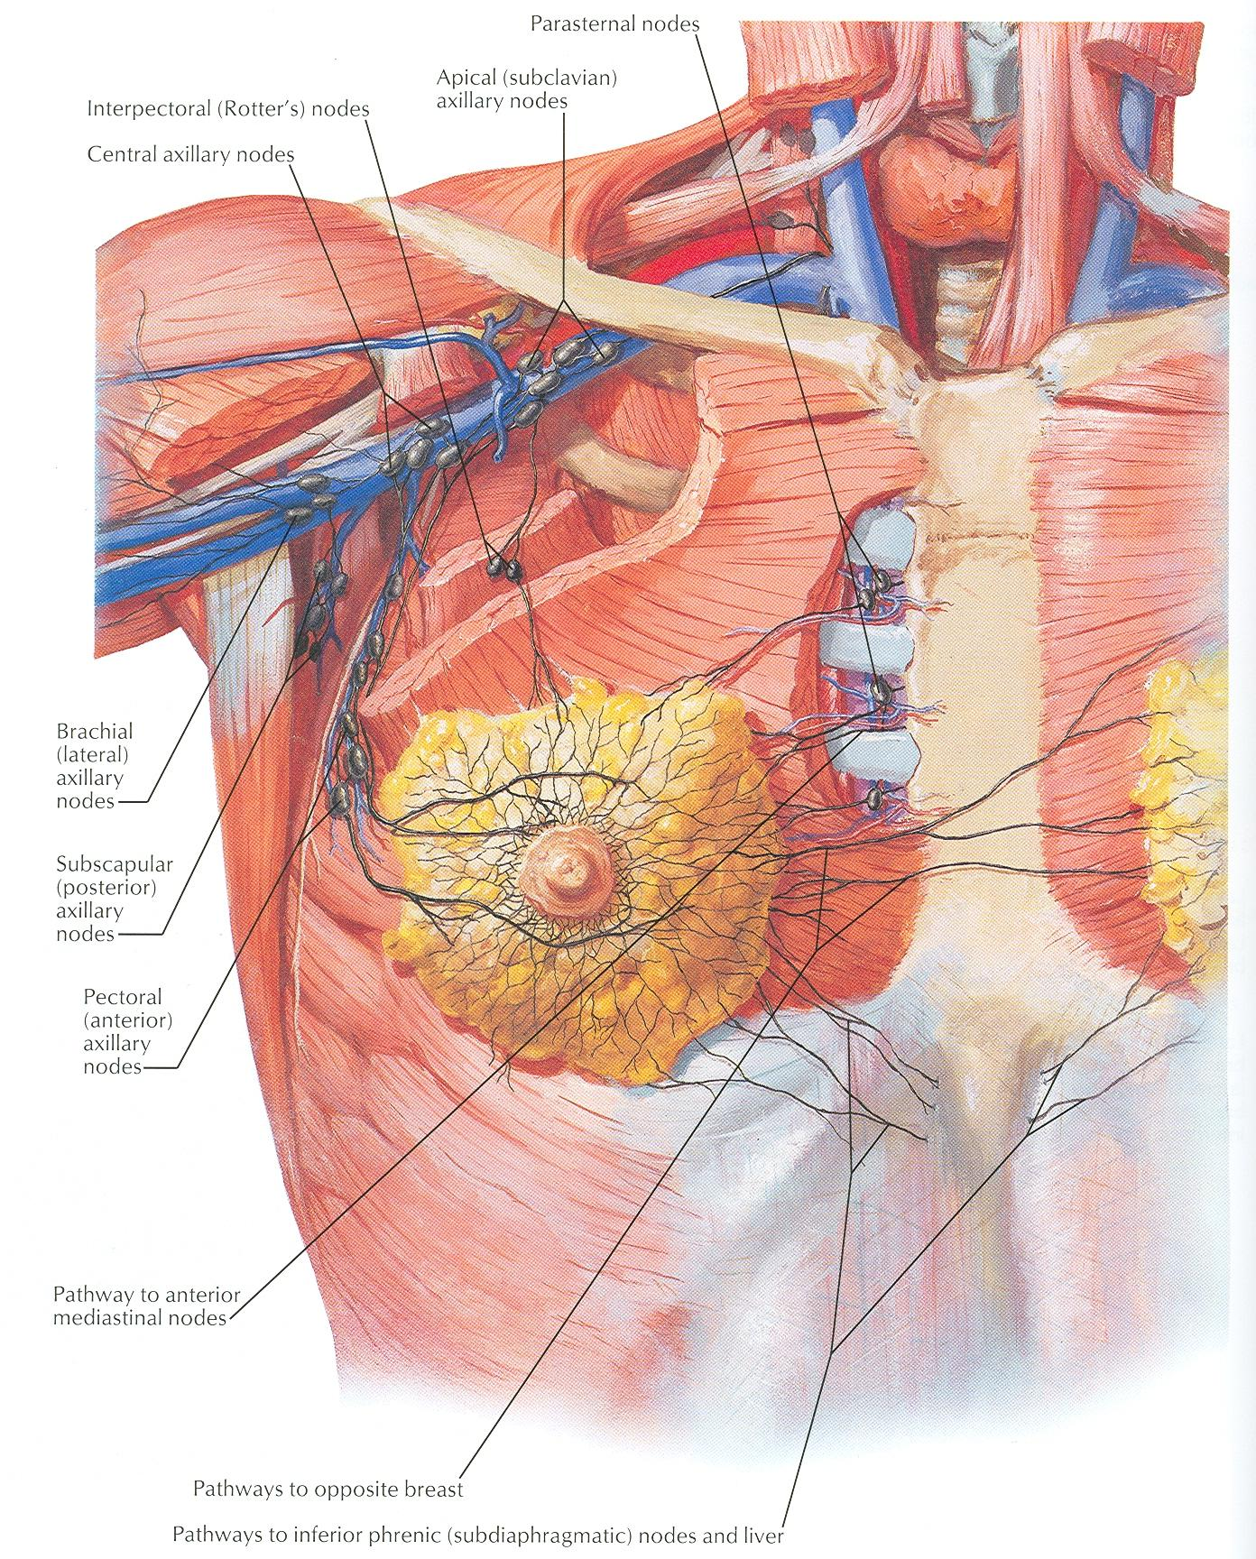
VENOUS SUPPLY
Veins are corresponding to the arteries.
Circular venous plexus are found at the base of nipple.
Finally, veins of this plexus drain into axillary & internal thoracic veins.

Slide 10
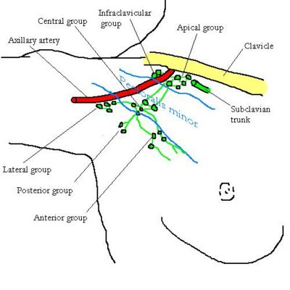
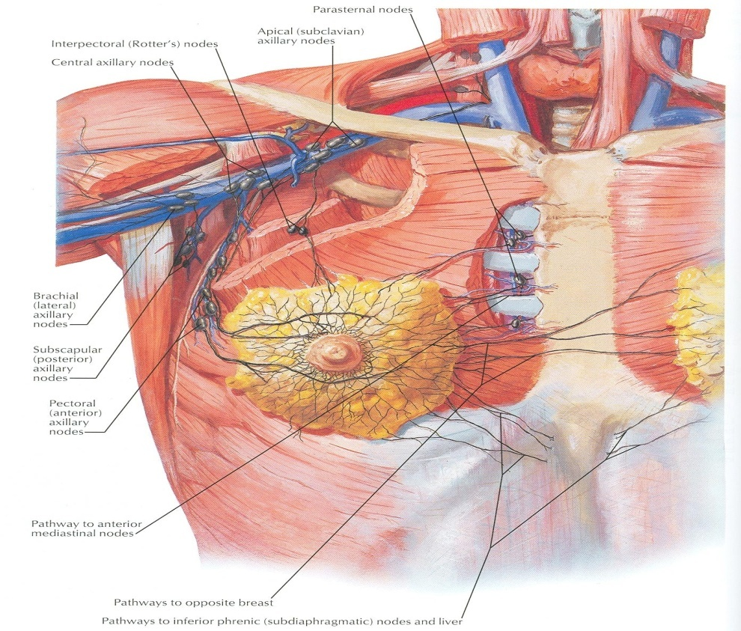
AXILLARY LYMPH NODES
They are arranged into 5 groups which lie in axillary fat :
Pectoral (Anterior) group : which lies on the pectoralis minor along lateral thoracic vessels.
Subscapular (Posterior) group : which lies on posterior wall of axilla on lower border of subscapularis along subscapular vessels.
Brachial (Lateral) group : lies on lateral wall of axilla along 3rd part of axillary vessels.
Central group : lies in axillary fat at the base of axilla.
Apical group : lies at apex of axilla.
Subclavian lymph trunk:
It is formed by union of efferent lymph vessels of apical group. It usually opens in subclavian vein. On the left side it usually opens into thoracic duct.

Slide 11
LYMPHATIC DRAINAGE
Subareolar lymphatic plexus :
Lies beneath the areola.
Deep lymphatic plexus:
Lies on the deep fascia covering pectoralis major.
Both plexuses radiate in many directions and drain into different lymph nodes.

Slide 12
LYMPHATIC DRAINAGE
Central & lateral parts of the gland (75%) drain into pectoral group of axillary lymph nodes.
Upper part of the gland drains into apical group of axillary lymph nodes.
Medial part drains into internal thoracic (parasternal) lymph nodes, forming a chain along the internal thoracic vessels.
Some lymphatics from the medial part of the gland pass across the front of sternum to anastomose with that of opposite side.
Lymphatics from the inferomedial part anastomose with lymphatics of rectus sheath & linea alba, and some vessels pass deeply to anastomose with the sub diaphragmatic lymphatics.

Slide 13
APPLIED ANATOMY- CANCER BREAST
It is a common surgical condition.
60% of carcinomas of breast occur in the upper lateral quadrant.
75% of lymph from the breast drains into the axillary lymph nodes.
In case of carcinoma of one breast, the other breast and the opposite axillary lymph nodes are affected because of the anastomosing lymphatics between both breasts.
In patients with localized cancer breast, a simple mastectomy, followed by radiotherapy to the axillary lymph nodes is the treatment of choice.

Slide 14
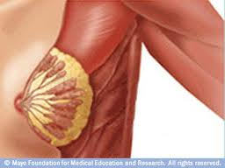
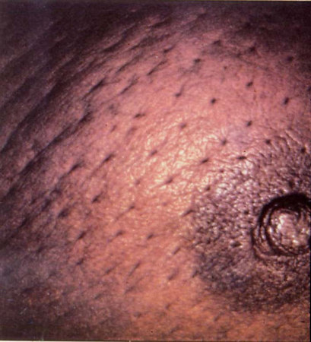
Applied Anatomy
The lactiferous ducts are radially arranged from the nipple, so incision of the gland should be made in a radial direction to avoid cutting through the ducts.
Infiltration of the ligaments of Cooper by breast cancer leads to its shortening giving peau de’orange appearance of the breast.

Slide 15
Mammary ridge
Mammary ridge extends from the axilla to the inguinal region.
In human, the ridge disappears EXCEPT for a small part in the pectoral region.
In animals, several mammary glands are formed along this ridge.

Slide 16
THANK YOU

Slide 17
Which is correct regarding the mammary gland ?
It extends from the 2nd to 8th ribs.
Its base lies on the pectoralis major muscle.
It has 4-8 lactiferous ducts.
Its most lymph drains into the parasternal lymph nodes.
The lymphatics from upper part of mammary gland drain into :
The parasternal lymph nodes.
Subdiaphragmatic lymph nodes.
Apical group of axillary lymph nodes.
Pectoral group of axillary lymph nodes.
The lactiferous ducts of mammary gland are :
Less than 10.
From 10-15.
From 15-20.
More than 20.

