Slide 1
Genetics
In Breast Cancer
Prepared by
Dr. Ammar C. Al-Rikabi
&
Dr. Ghassan Zidan

Slide 2
About 5% to 10% of breast cancers are related to specific inherited mutations

Slide 3
BRC A1 and BRC A2 which are mutated in familial breast cancers are involved in DNA repair.

Slide 4
BRCAI is located on chromosome 17q 21.3
BRCA2 is located on chromosome 13q 12-13.

Slide 5
Most carriers of those mutant genes will develop breast cancer by the age of 70 years, as compared with only 7% of women who do not carry a mutation.

Slide 6
60% to 70% of breast carcinomas express estrogen receptors (ERs) and progesterone receptors (PRS).

Slide 7
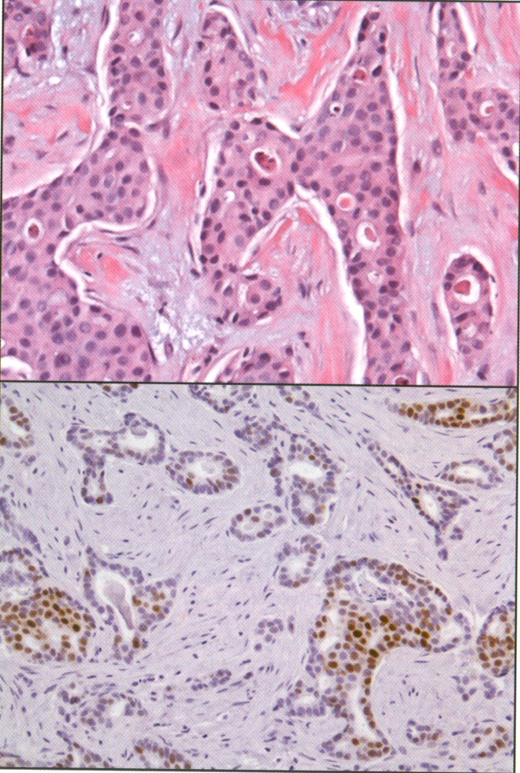
Immunohistochemistry for the evaluation of estrogen receptor (ER)

Slide 8
The presence of ERS in breast cancer is a weak prognostic factor, however, it is optimally useful as a predictive factor for the benefit of adjuvant tamoxifen or aromatase inhibitor therapy.

Slide 9
Normal cells have one copy of the HER 2 gene on each chromosome 17 (CHR17) and when this gene is expressed in normal epithelial cells, it is transmits signals regulating cell growth and survival.

Slide 10
In approximately 15% to 25% of breast cancer, the HER2 gene is found to be amplified 2 fold to greater than 20 folds in each tumour cell nucleus.

Slide 11
As a result, HER2 positive breast cancers tend to be aggressive.

Slide 12
The herceptin molecule (Trastuzumab) has been shown to demonstrate a high specificity and affinity for the HER2 receptor and also acts as a biologic targeted therapeutic agent against HER2 receptors.

Slide 13
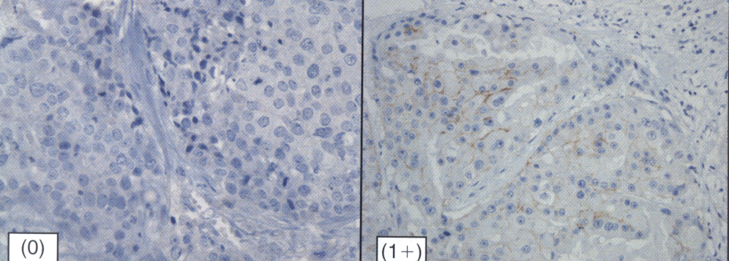
Immunohistochemistry (IHC) for the assessment of the level of HER2 protein expression at the tumor cell membrane.

Slide 14
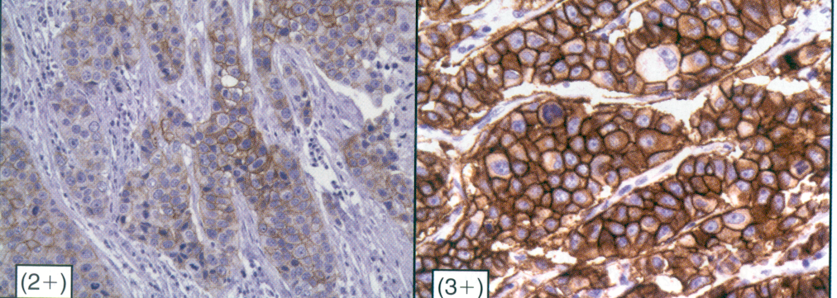
Immunohistochemistry (IHC) for the assessment of the level of HER2 protein expression at the tumor cell membrane.

Slide 15
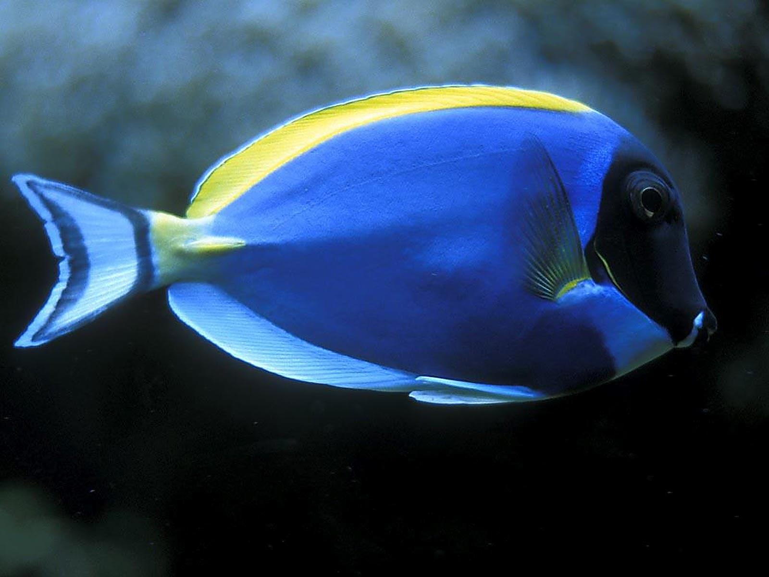

Slide 16
Principles of hybridisation
* DNA is double standed.
* Bonds between complementary bases hold strands together (Cytosine Guanine; Adenine thymine).
* Heat/alkalinise DNA – separation of strands (‘denaturation’) occurs.
* Cool separated strands – complementary double strands re-form.
* Labelled complementary single-strand DNA can identify a DNA sequence (e.g. a gene) in intact cells or disrupted cell preparations.

Slide 17
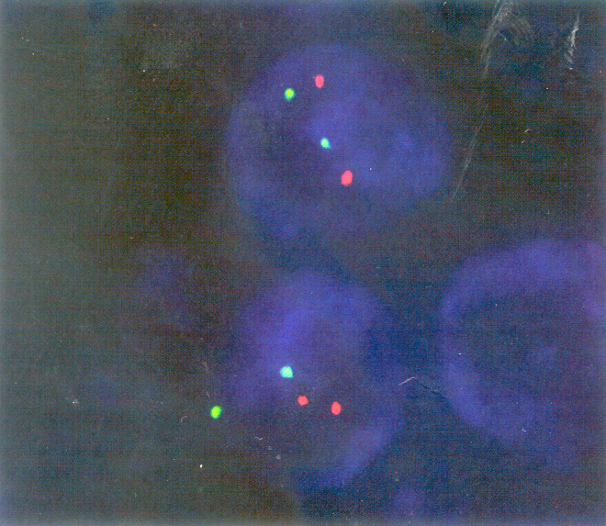
Fluorescence in situ hybridization image.

Slide 18
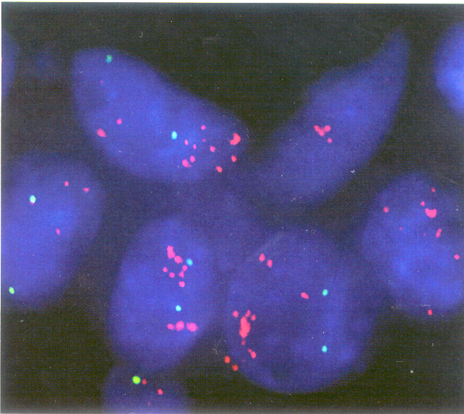
Fluorescence in situ hybridization image.

Slide 19
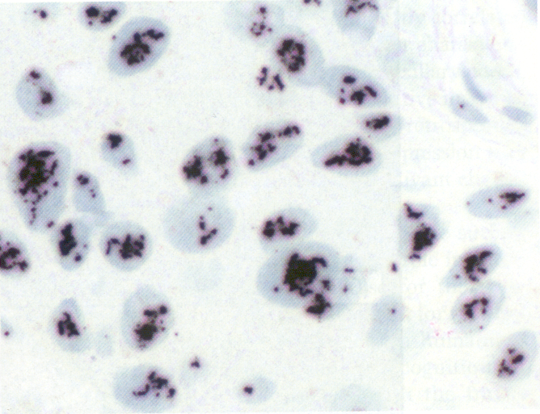
Silver in situ hybridization image.

Slide 20
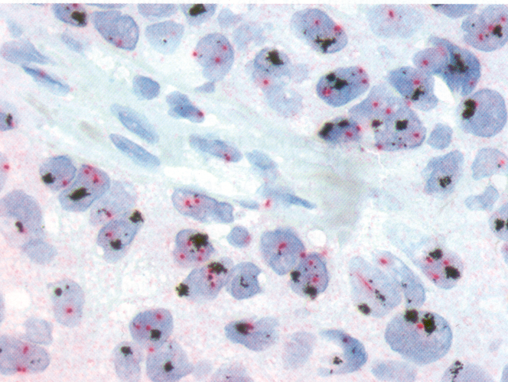
Dual-color silver in situ hybridization (SISH) image.

Slide 21
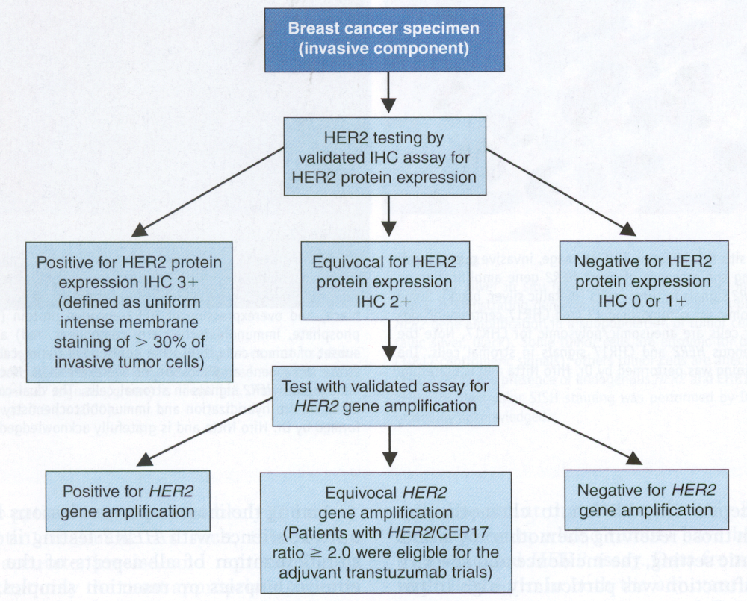
ASCO/CAP guideline recommendations for the optimal algorithm for HER2 testing by IHC

