Slide 1
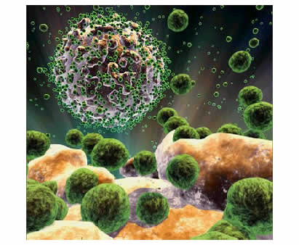
HIV
(Human Immunodeficiency Virus)
&
AIDS
Acquired Immune Deficiency Syndrome
Immunology Unit
Department of Pathology
King Saud University

Slide 2
Objectives
To know the modes of transmission of HIV
To understand HIV interactions with CD4 positive helper lymphocytes
To understand the mechanisms involved in immunodeficiency associated with HIV
To know the course of immunological events from the time of infection with HIV until the development of AIDS

Slide 3
Transmission
Modes of infection
Sexual transmission at genital or colonic mucosa
Blood transfusion
Mother to infant
Accidental occupational exposure
Notes:
Study of HIV ”exposed uninfected” individuals revealed the presence of a mutated CCR5 receptor in some people. Patients homozygous for this mutation are relatively resistant to the virus.

Slide 4
Notes:
The phenotype (or physical appearance/structure) of HIV

Slide 5
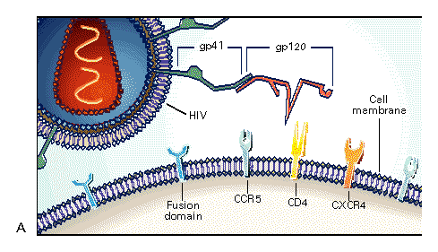
HIV and Cellular Receptors
HIV Receptors
HIV Receptors
Copyright © 1996 Massachusetts Medical Society. All rights reserved.
Notes:
This picture shows HIV’s attachment and entry into a host cell. The gp-120 protein attaches to a CD4 receptor. The gp-41 is exposed for attachment to the host cell, and fusion of the cell membrane with the viral envelope starts.
Source: Levy JA. Infection by human immunodeficiency virus--CD4 is not enough. New Eng J Med, 335(20); 1528-1530

Slide 6
How HIV Enters Cells
gp120 env protein binds to CD4 molecule
CD4 found on T-cells macrophages, and microglial cells
Binding to CD4 is not sufficient for entry
gp120 env protein binds to co-receptor
Chemokine receptors:
CCR5 and CXCR4 receptors
Binding of virus to cell surface results in fusion of viral envelope with cell membrane
Viral core is released into cell cytoplasm
Notes:
Now a review of the lifecycle steps in more detail: For attachment and entry into the human cells, HIV use normal proteins on the surface of human cells.
HIV attaches to the CD4 cell protein. These receptors occur on CD4 cells, monocyte, and macrophages
As second step in entry, HIV binds to co-receptors, which are normally receptors for chemokines. A mutant CCR5 receptor gene that prevents the virus from binding to the cell has been discovered. Homozygosity for this mutant gene is strongly protective against HIV infection. Heterozygous people are not protected from infection but the disease may take longer to develop.

Slide 7
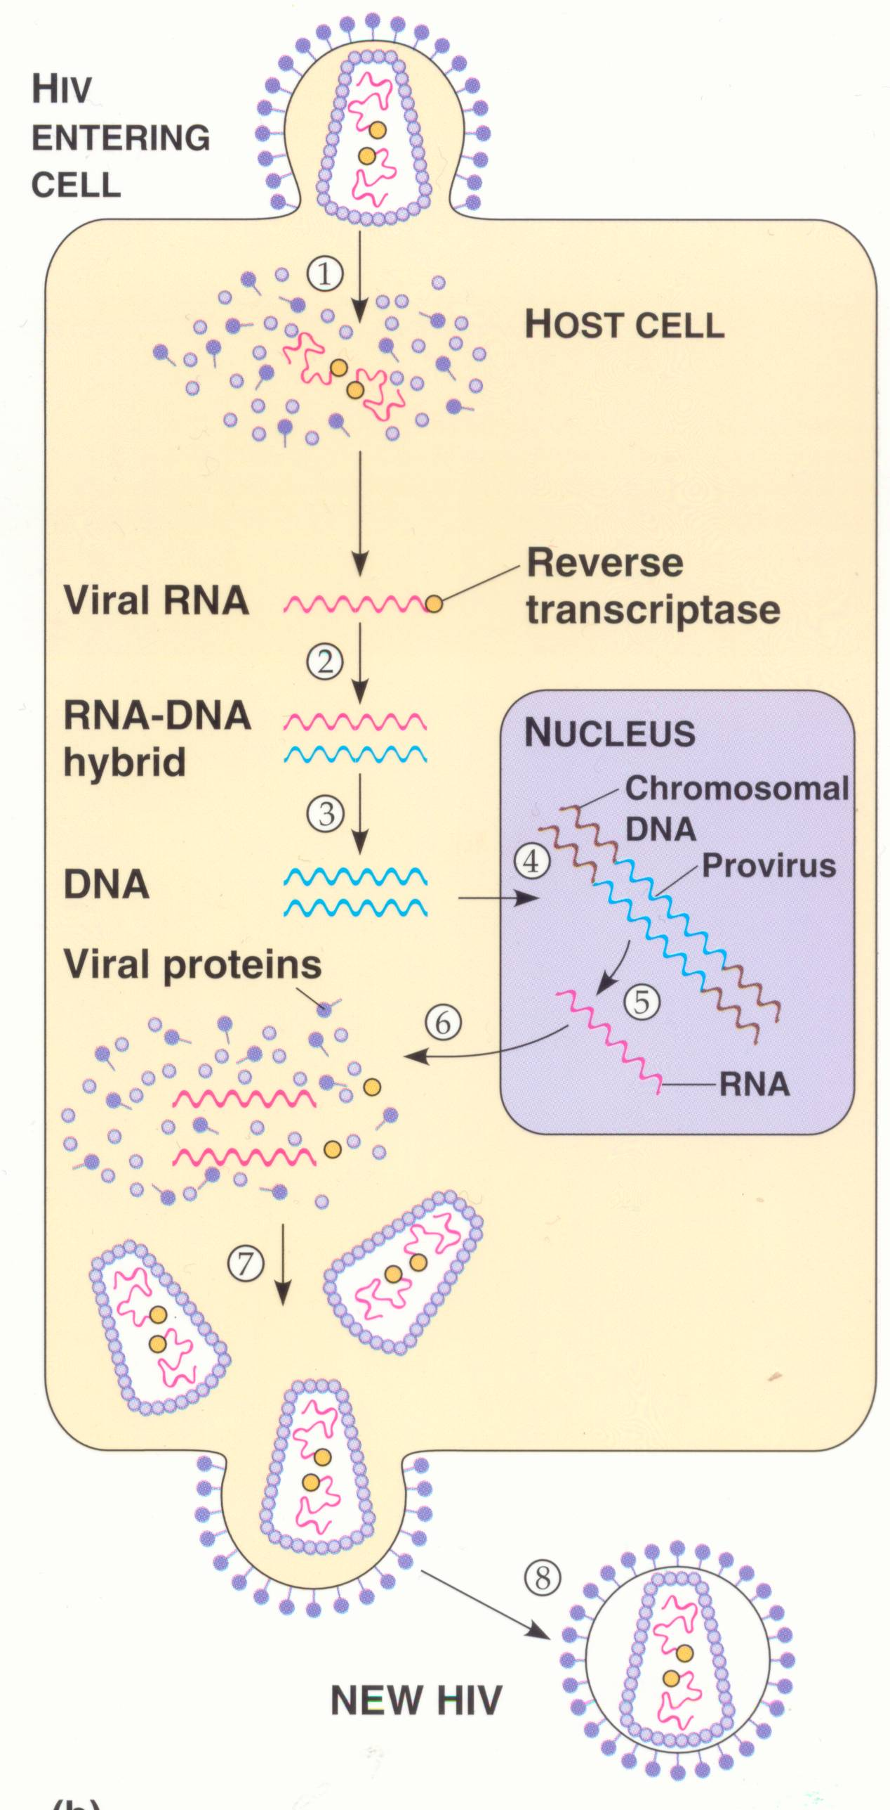
1. HIV (retrovirus) enters cell
Reverse Transcriptase makes DNA copy of RNA
Viral DNA forms provirus with host DNA
Viral DNA makes mRNA
mRNA makes HIV proteins
HIV proteins become HIV capsid
mRNA is collected inside of HIV capsid forming new HIV
New HIV leaves cell and wraps itself in host membrane (envelope)

Slide 8
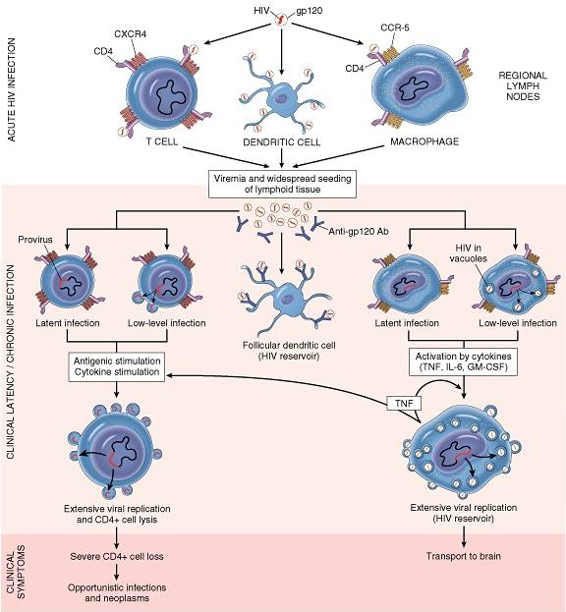

Slide 9
Viral-host Dynamics
About 1010 (10 billion) virions are produced daily
Average life-span of an HIV virion in plasma is ~6 hours
Average life-span of an HIV-infected CD4 lymphocytes is ~1.6 days
HIV can lie dormant within a cell for many years, especially in resting (memory) CD4 cells, unlike other retroviruses
Notes:
The extremely high rates of viral replication results in every possible point mutation in the viral genome arising daily. In any given patient, the virus usually varies by 1-6% in the env gene, for example.

Slide 10
Overview of Adaptive Immune Response
Extracellular infection
APC
Intracellular infection
Free antigen
MHC I presentation of endogenous antigen
MHC II presentation of exogenous antigen
Naïve T8 cell
Naïve B-Cell
Naïve T4 helper cell
Humoral
Antibodies produced by plasma cells neutralize the virus
Antibody directed cell mediated cytotoxicity (ADCC)
Cell-mediated (CTLs directly destroy the infected cells)
Th1
Th2
Notes:
This is an important slide representing the adaptive immune response, which is the main response to HIV (as opposed to the innate immune response).
The adaptive immune response is divided into two types: the cell-mediated (cytotoxic t-cell) type and the humoral (antibody-mediated) type. In general, the location of the infection (intracellular or extracellular) determines the type of adaptive immune response.
Intracellular infections stimulate a cell-mediated response that will ultimately kill the infected cell. This is mediated by T8 cells, and utilizes the MHC I system.
Extracellular infections stimulate a humoral response that will help contain these free antigens. Some extracellular antigens will be picked up by APC and be presented by way of MHCII to the Thc, which will further differentiate into either TH1 or TH2.
TH1 in turn will augment the cell-mediated response and Th2 augments the humoral.
CENTRAL TO THE ADAPTIVE IMMUNE RESPONSE IS THE TH4 CELL. BECAUSE HIV DEPLETES AND DISTRUPTS THE FUNCTION OF THIS CELL, ADAPTIVE IMMUNITY IS IMPAIRED.
APC = antigen presenting cell

Slide 11
General Principles of Viral-host Interactions
Host: mounts HIV-specific immune responses
Cellular (cell-mediated) - most important
Humoral (antibody-mediated)
Virus: subverts the immune system
Infects CD4 cells that control normal immune responses
Integrates into host DNA
High rate of mutation
Hides in tissue not readily accessible to immune system
Notes:
While the host mounts an immune response, the virus employ mechanisms to evade the host’s response.

Slide 12
Cells Infected by HIV
Numerous organ systems are infected by HIV:
Brain: macrophages and glial cells
Lymph nodes and thymus: lymphocytes and dendritic cells
Blood, semen, vaginal fluids: macrophages
Bone marrow: lymphocytes
Skin: langerhans cells
Colon, duodenum, rectum: chromaffin cells
Lung: alveolar macrophages

Slide 13
General Principles of Immune Dysfunction in HIV
All elements of immune system are affected
Advanced stages of HIV are associated with substantial disruption of lymphoid tissue
Impaired ability to mount immune response to new antigen
Impaired ability to maintain memory responses
Susceptibility to opportunistic infections
Notes:
The effects of HIV on the human immune system are extensive and complex, resulting in both depletion and dysfunction of all elements of the immune system.

Slide 14
Mechanisms of CD4 Depletion and Dysfunction
Direct
Elimination of HIV-infected cells by virus-specific immune responses
Loss of plasma membrane integrity because of viral budding
Indirect
Syncytium formation (fusion of cells that are highly unstable and die quickly)
Apoptosis
Autoimmunity

Slide 15
Role of Cellular Activation in Pathogenesis of HIV
HIV induces immune activation
Which may seem paradoxical because HIV ultimately results in severe immunosuppression
Activated T-cells support HIV replication
Intercurrent infections are associated with transient increases in viremia
Accounts for why TB worsens underlying HIV disease
Notes:
Not only does the virus destroy and disrupt the immune system, the virus can manipulate the immune system to its own replicative advantage. This is achieved by immune activation. Clinically, this is demonstrated by the observation that viral load transiently increases in the presence of intercurrent illnesses, such as TB.

Slide 16
Role of Cytokine Dysregulation in Pathogenesis of HIV
HIV is associated with increased expression of pro-inflammatory cytokines
TNF-alpha, IL-1,IL-6, IL-10, IFN-gamma
HIV results in disruption and loss of immunoregulatory cytokines
IL-2, IL-12
Necessary for modulating effective cell-mediated immune responses (CTLs and NK cells)
Notes:
The immune system activation (and disruption) by HIV is mediated by various cytokines

Slide 17
Primary Infection
70-80% symptomatic, 3-12 weeks after exposure
Fever, rash, cervical lymphadenopathy, aseptic meningitis, encephalitis, myelitis, polyneuritis
Surge in viral RNA copies to >1 million
Fall in CD4 count to 300-400 cells/mm³
Recovery in 7-14 days

Slide 18
Seroconversion
Median 8 weeks after infection
Level of viral load post sero-conversion correlates with risk of progression of disease
Asymptomatic Phase
Remain well with no evidence of HIV disease except for generalized lymphadenopathy
Fall of CD4 count by about 50-150 cells per year

Slide 19
CD4 T-cell Count and Progression to AIDS
Gradual reduction in number of circulating CD4 cells is inversely correlated with the viral load
Any depletion in numbers of CD4 cells renders the body susceptible to opportunistic infections

Slide 20
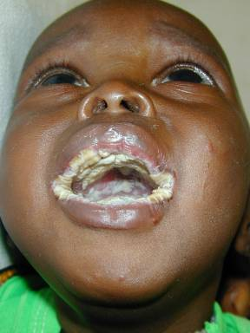
Opportunistic infections
Candidiasis (oesophagus, bronchi, trachea, and lungs)
Coccidioidomycosis
Cryptococcosis, extrapulmonary
Cytomegalovirus disease
Herpes simplex: chronic ulcer(s)
Histoplasmosis, disseminated or extrapulmonary
Mycobacterium tuberculosis, any site (pulmonary or extrapulmonary)
Pneumocystis pneumonia
Salmonella septicaemia,
Toxoplasmosis of brain
An HIV positive infant with severe oral candidiasis

Slide 21
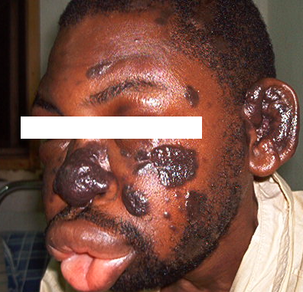
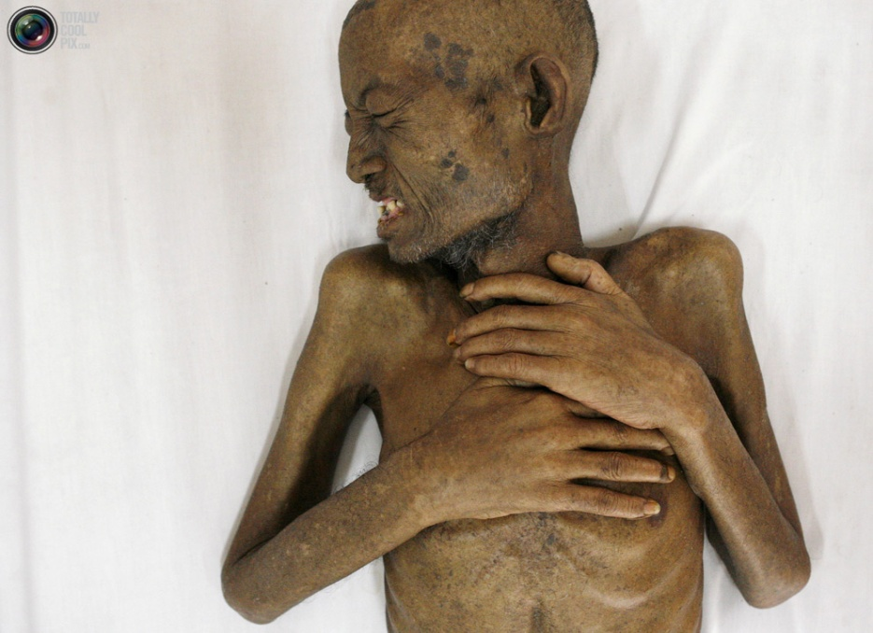
AIDS – Indicator Conditions
Neoplasia
Kaposi’s sarcoma
Lymphoma (Burkitt’s, immunoblastic, primary in brain)
Invasive cervical cancer
Opportunistic infections
General
Wasting syndrome, HIV-related
Encephalopathy, HIV-related
Kaposi’s sarcoma

Slide 22
Window Period: Untreated Clinical Course
Acute HIV syndrome
Primary HIV infection
antibody
Asymptomatic
viremia
--------------------------------------------PCR
P24
ELISA
a
b
Time from a to b is the window period
0
2
3
4
years
Weeks since infection
Source: S Conway and J.G Bartlett, 2003
Notes:
The window period begins at the time of infection and can last 4 to 8 weeks.
During this period, a person is infected, infectious and viremic, with a high viral load and a negative HIV antibody test.
The point when the HIV antibody test becomes positive is called the point of seroconversion.
Source of graph: S Conway and J.G Bartlett, 2003

Slide 23
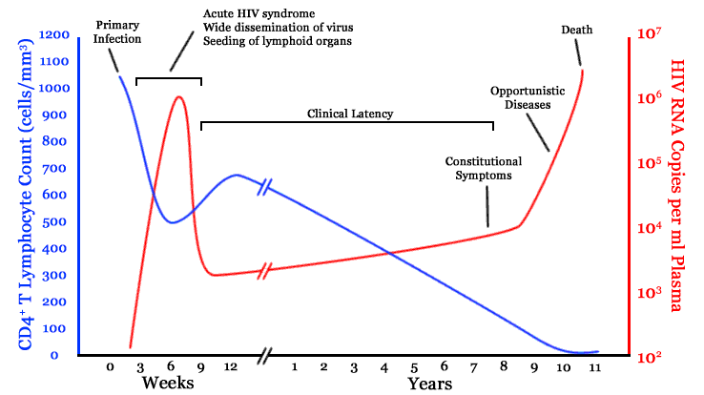
Natural History of HIV
Notes:
Acute (primary) retroviral syndrome is the initial event after infection, which is characterized by a rapid decline in CD4 cell count and high plasma viremia.
Development of cytotoxic T-cell (CTL) response results in clinical recovery of acute infection and a reduction in plasma viremia. The virus reaches “set point” as a result of this immune response. The viral load at this “set point” correlates with the rate of CD4 decline and disease progression. Overtime, HIV RNA levels gradually increase.
In parallel, the CD4 cell count gradually declines over several years, but rapidly drops 1.5 to 2 years before an AIDS-defining diagnosis.
When the CD4 count falls below 200, patients develop opportunistic infections, tumors, and neurological complications. The median survival after the CD4 count has fallen to <200 is 3.7 years, if untreated.
Source: Fauci AS, Pantaleo G, Stanley, Weissman D. Immunopathogenic mechanisms of HIV infection. Ann Intern Med 1996;124:654-63. Galens Curriculum, Module 8, p. 17.

Slide 24
Diagnosis of HIV infection
Tests for HIV detect either antibodies or antigens associated with HIV in whole blood, saliva, or urine
A person whose blood test results show HIV infection is said to be “seropositive” or “HIV-positive”
A person whose blood test results do not show HIV infection is said to be “seronegative” or “HIV-negative”

Slide 25
Laboratory Markers of HIV Infection
Viral load
Viral load is the amount of HIV in the blood
It can be measured by the HIV ribonucleic acid polymerase chain reaction blood test (HIV-RNA PCR)
Marker of HIV replication rate
CD4 count
Marker of immunologic damage
Notes:
The average CD4 T cell count in HIV-1 uninfected Ethiopians reportedly ranged from 591 × 10*6 to 775 × 10*6 cells/L

Slide 26
Laboratory tests for detection of HIV
Antibody test, ELISA
Western blot
HIV RNA viral load

Slide 27
Management
Treatment recommended when symptomatic or CD4 count below 200
Earlier if high viral load, rapidly falling CD4 count, hepatitis C co-infection

Slide 28
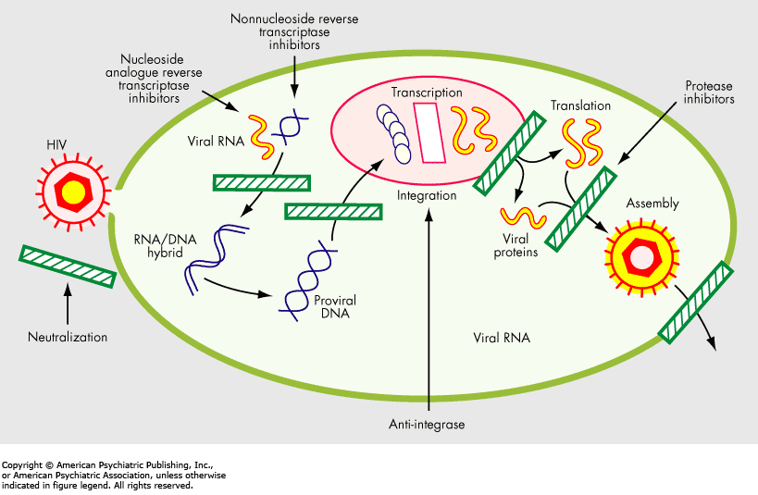
Antiviral therapy

Slide 29
Take Home Message
Infection with HIV usually occurs by sexual transmission, blood transfusion, mother to infant or accidental exposure
HIV targets the immune system and primarily infects CD4 helper lymphocytes
Immunodeficiency associated with HIV infections is mainly due to reduction in CD4 helper lymphocyte counts
Increased viral load, significant reduction in CD4 lymphocytes, opportunistic infections and neoplasia are the hallmarks of progression to AIDS

Slide 30
Thank you

