Slide 1
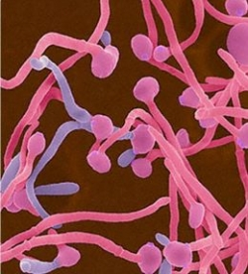
Candida infection
Tricpmonas vaginalis
Bacterial vaginosis

Slide 2
Type of infection
Females
  Cervicitis
  Vulvovaginitis
  Urethritis
  Bacterial vaginosis (BV)
  Salpingitis (pelvic inflammatory disease [PID])
  Endometritis
  Genital ulcers
Pregnant females
  Disease in the neonate.
Children and postmenopausal women
Males
  Urethritis
  Epididymitis
  Prostatitis
  Genital ulcers

Slide 3
Abnormal vaginal secretion
Normal physiological vaginal secretion
Vaginal infection
    Trichimoniasis
    Vulvovaginitis candiasis
    Bacterial vaginnosis
Desquamative inflammatory vaginitis
Cervicitis
    Infectious
    Noninfectious
Esterogen deficiency

Slide 4
History & symptoms of valvovaginitis
General gyneclogical history( age Neonatal ,pregnancy,prepubescent,atrophic post menop)
Onset,,Esterogen depletion)
  Menstrual history
  Pregnancy
  Sexual Hx
  Contraception
  Sexual relationship
  Prior infection
General medical Hx
  Allergies
  DM
  Malignancies
  Immunodeficiecy
Medication OCP<steroids,duches
Symptoms
  Discharge(quality scanty)physiological OCP
  Oder(BV,FB,EV fistula)
  Valvular disconfort(HSV)
  Dyspareunia
  Abdominal pain (tricho) PID

Slide 5
Examination
Breast
Adequate illumination
Magnification if possible
Give a patient mirror
Inspect external genetalia
  Lesions
  Erythema
Vaginal mucosa
  Erythema
  Lesion
  Secretion
Examination of cervix
  Ectropion
  Lesions
  Erythema
  Endocervical secretion
Collect cervical and vaginal specimen
Bimanual examination

Slide 6
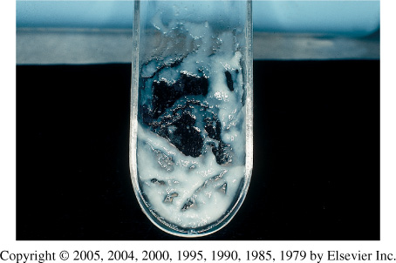
Characteristic of normal vaginal secretion
Desquamated vaginal epithelial cell
Lactobacilli dominate
PH 3.5 to 4.6
Oderless
No itching or irritation
Deonot soil underclothing1

Slide 7
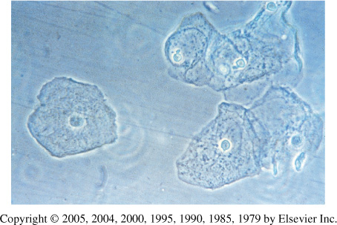
The human vagina
  Lined with 25 layers of epithelium cells.
  Separation of microbial pathogens from the normal genital microbs.
  Lactobacilli
  Corynebacterium spp.
  Gardnerella vaginalis
  coagulase-negative staphylococci, Staphylococcus aureus
  Streptococcus agalactiae
  Enterococcus spp.
  Escherichia coli
  Anaerobes
  Yeasts

Slide 8
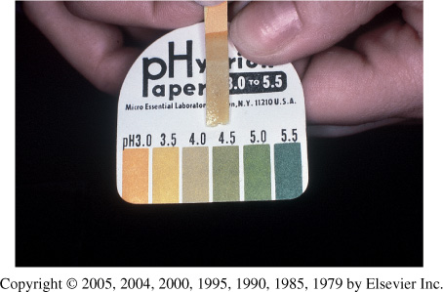
Vaginal PH examination

Slide 9
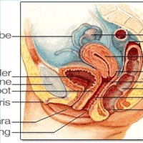

Slide 10
Candida infections yeast infection moniliasis
Candidiasis or thrush is a fungal infection (mycosis) of any of the Candida species (yeasts) of which Candida albicans is the most common.
Common superficial infections of skin and mucosal membranes by Candida causing local inflammation and discomfort.

Slide 11
Cassification of vulvovaginitis
Complicated
  Underlying illness
    HIV
    DM
  Recurrent infection 4 or more per year
  Non albican candida
  Pregnancy
  Sever infection
Culture confirmation mandatory
Antifungal suscep. Testing
Treat for 10-14 days with vaginal or oral agent
Other topical
  Boric acid
  5 fluorocytocine
Consider treatment of the partners
Long term suppressive treatment for frequently recurrent diseases
Uncomplicated
  Sporadic
  No underlying disease
  By Candida albican
  Not pregnanat
  Mild to moderate severity
Any available topical agent
Fluconazole 150mg as a single oral dose

Slide 12
Candidal vulvovaginitis vaginal thrush
Infection of the vagina’s mucous membranes by Candida albicans.
75% of adult women
Found naturally in the vagina
Hormonal changes
Change in vaginal acidity.
Broad-spectrum antibiotics.
Use of corticosteroid medications
Pregnancy.
20-30 years
Poorly controlled diabetes mellitus.

Slide 13
Risk factors
  Antibiotics
  Pregnancy
  Diabetes (poorly controlled)
  Immunodeficiency
  Contraceptives
  Sexual behaviour
  Tight-fitting clothing
  Female hygiene

Slide 14
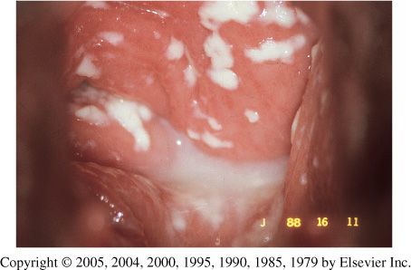
Symptoms
Vulval itching
Vulval soreness and irritation
Superficial dyspareunia.
Dysuria
Odourless vaginal discharge
  thin and watery or thick and white (cheese-like)
Erythema (redness)
Fissuring
satellite lesions.

Slide 15
Types of candidal vulvovaginitis
Uncomplicated thrush
  single episode/less than four episodes in a year.
  mild or moderate symptoms
  caused by the Candida albicans .
Complicated thrush
  four or more episodes in a year.
  severe symptoms.
  Pregnancy
  poorly controlled diabetes/immune deficiency.
  not caused by the Candida albicans

Slide 16
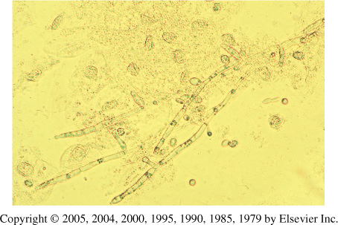
Diagnosis
History & symptoms
physical and pelvic exam
Candidiasis can be similar to other diseases:
  Sexually transmitted diseases
  Chlamydia
  Trichomoniasis
  Bcterial vaginosis
  Gonorrhea

Slide 17
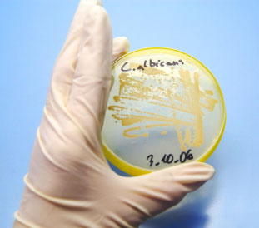
Candida albicans

Slide 18
Treatment
Butoconazole cream
Clotrimazole
  1% cream
  vaginal tablet
Miconazole
  2% cream
  vagina suppository
Nystatin
  vaginal tablet
Oral Agent:
  Fluconazole- oral one tablet in single dose

Slide 19
Treatment
Short-course topical formulations
  single dose and regimens of 1–3 days
  effectively treat uncomplicated candidal vulvovaginitis
  Topical azole drugs are more effective than nystatin
  Azole drugs relief of symptoms in 80%–90% of cases.
Treatment failure
  In up to 20% of cases
  If the symptoms do not clear within 7–14 days

Slide 20
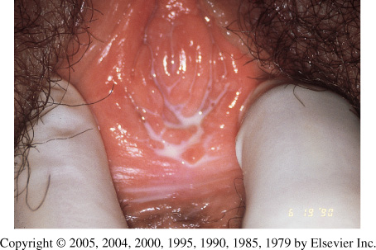
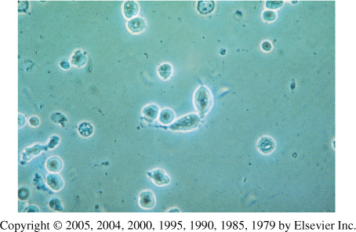
Trichomoniasis
(sexually-transmitted infection)
Symptoms
  Purulent vaginal discharge
  yellow or greenish in color
  Vulvar irritation (strawberry)
  Dysurea
  Dyspareunia
  Abnormal vaginal odor
The wet mount's fast results

Slide 21
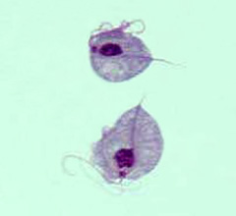
Culture is considered the gold standard for the diagnosis of trichomoniasis. Its disadvantages include cost and prolonged time before diagnosis

Slide 22
Management
Confirm the diagnosis
  Wet preparation (miss 30%)
  Culture
  Gram Stain
Confirm all current sexual partners treated
Oral metronidazole
    500 mg bid for 7 days
    2 g daily for 3-5 days
If Rx failure -Consultation with experts
  Susceptibility testing
  Higher dose of metronidazole
  Alternative Tinidazole

Slide 23


Bacterial Vaginosis
Floral imbalance
Lactobacillus acidophilus
Gardnerella vaginalis
Mycoplasma hominis
Mobiluncus species
Anaerobes
  Bacteroides (Porphyromonas)
  Peptostreptococcus
  Fusobacterium
  Prevotella
Lactobacilli
  Compete with other microorganisms for adherence to epithelial cells
  Produce antimicrobial compounds such as organic acids (which lower the vaginal pH) hydrogen peroxide, and bacteriocin-like substances

Slide 24
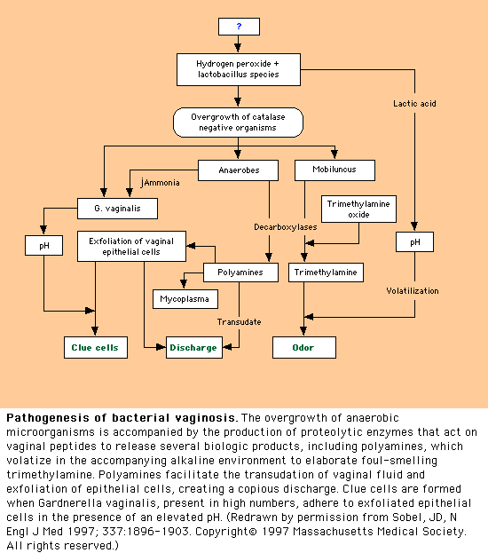

Slide 25
Pathogenesis
Marked reduction in lactobacillus
  Decreased hydrogen peroxide production
Polymicrobial superficial infection: overgrowth of G. vaginalis and anaerobic bacteria
  Lactobacilli predominate after metronidazole treatment

Slide 26
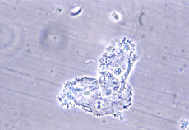
Epidemiology
The most common vaginal infection in women of childbearing age-29%
Risk factors
  Multiple or new sexual partners
  (sexual activity alteration of vaginal pH)
  Early age of first sexual intercourse
  Douching
  Cigarette smoking
  Use of IUD
  *Although sexual activity is a risk factor for the infection, bacterial vaginosis can occur in women who have never had vaginal intercourse

Slide 27
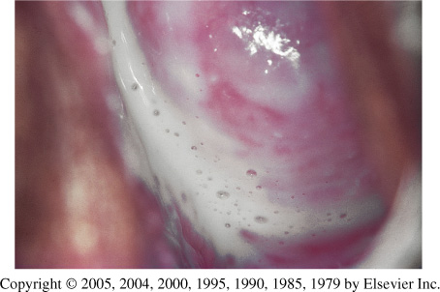

Clinical Features
Most cases (50-75%) Homogenous grey vaginal discharge
Dysuria and dyspareunia rare
Pruritus and inflammation are absent
Fishy vaginal discharge
  During menstruation
  After intercourse
Minimal itching or irritation
Absence of inflammation is the basis of the term "vaginosis" rather than vaginitis

Slide 28
BV complications
OB complication
Preterm delivery
Premature rupture of membranes
Amniotic fluid infection
Chrorioamnionitis
Postpartum endometritis
Premature labor
Low birth weight
GYN Complication
Pelvic inflammatory disease
Postabortal pelvic inflammatory disease
Posthysterectomy infections
Mucopurulent cervicitis
Endometritis
Increased risk of HIV/STD

Slide 29
OFFICE-BASED TESTS FOR
VAGINITIS ARE UNDERUTLIZED
Simple, inexpensive, office-based tests were underutilized.
Microscopy
pH measurement
Whiff amine test

Slide 30
CLINICAL DIAGNOSIS OF
BV
Clinical diagnosis.
3 out of 4 of these criteria.
_____________________________________
PH greater than 4.5
Positive Whiff test
Any clue cells
Homogenous discharge.

Slide 31
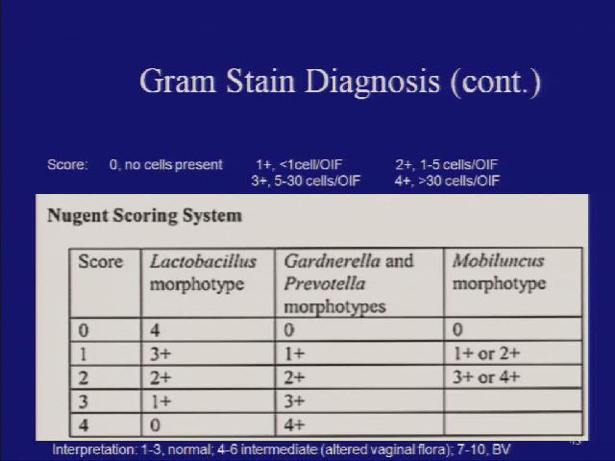
Gram Stain Diagnosis (cont.)

Slide 32
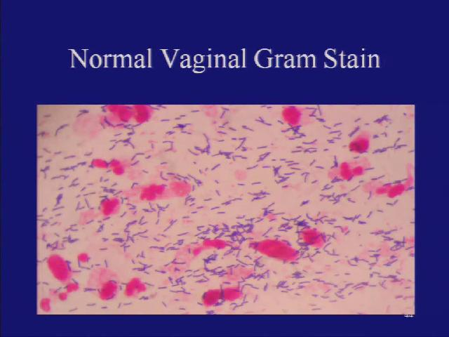
Normal vaginal gram stain

Slide 33
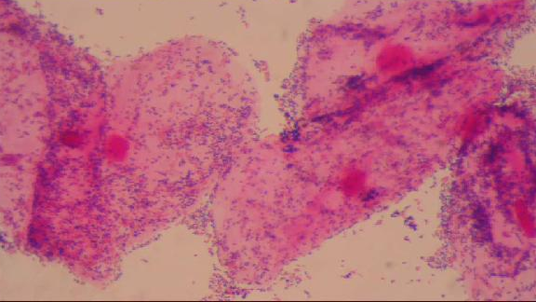
BV

Slide 34
KOH "WHIFF" TEST
Sample of vaginal secretions are placed in a test tube with 10% KOH.
KOH alkalizes amines produced by anaerobic bacteria-results in a sharp "fishy odor"

Slide 35
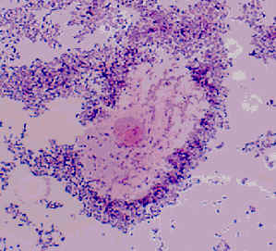
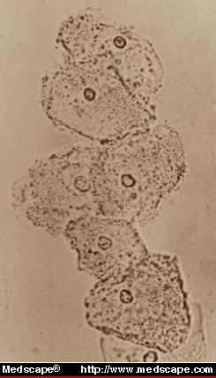
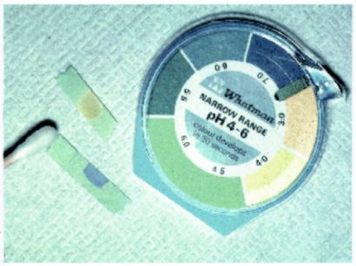
Diagnostic Methods
Clinical/Microscopic Criteria
Gram Stain (“Gold Standard”)
  Clue cells on saline wet mount of vaginal discharge (on >20% cells)
    Bacteria adhered to epithelial cells; most reliable single indicator
  Vaginal pH > 4.5
Elevated pH and increased amine
  Sensitivity 87%; Specificity 92%
*Culture- poor predictive value for G. vaginalis as prevalent in healthy asymptomatic women
*DNA probes- expensive, poor predictive value alone

Slide 36
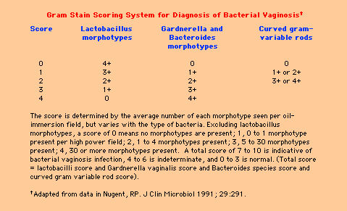
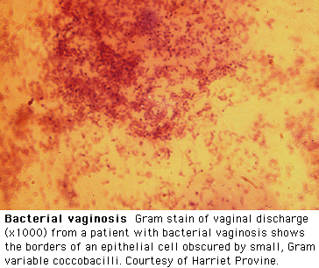
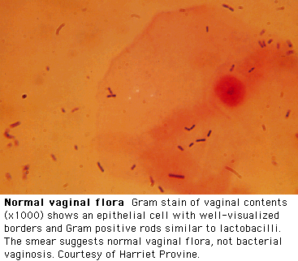
Diagnosis by Gram Stain

Slide 37
Treatment Recommendations
Oral metronidazole 500 mg bid x 7 days ($5)
  84-96% cure rate
  Single dose therapy (2g) may be less effective
Oral Clindamycin 300 mg bid x 7 days ($28)
  Less effective
Topical treatments (higher recurrence rates)
  Metronidazole gel (0.75%) 5 g PV qhs x 5 days ($30)
    70-80% cure rate
  Clindamycin cream (2%) 5 g PV qhs x 7 days ($31)
    Less effective
    May lead to Clindamycin resistant anaerobic bacteria

Slide 38
Specimen Obtained during gynecological examination
Vaginal secretion
  PH
  Saline wet preparation
  KOH wet preparation
Cervical cultural and non cultural
  GC
  C.trachomatis
Vaginal culture
  Candida
  Trichomonas vaginalis
Cervical cytological examination if not documented within previous 12 months

Slide 39
Routine bacterial cultures
not helpful
Routine NOT helpful
Wet mount- 60% sensitive (Trichomoniasis ,BV )
Abnormal or foul odor using a (KOH) "whiff test,"
The Gram stain is useful to diagnose BV
  Using the Nugent scoring system
A wet mount+ a yeast culture and Trichomonas culture
  Recommended tests to diagnose vaginitis.
Performing only a wet mount, without yeast or Trichomonas culture,
  50% of either of these agents of vaginitis will be missed
A sensitive DNA probe assay is available
  Combines the detection of yeasts, Trichomonas, and G. vaginalis as a marker for BV

