Slide 1
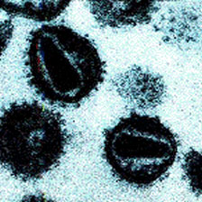
http://www.research.chop.edu/programs/johnsonlab/features/hiv_type_1.php
HIV & AIDS
Dr. Mona Badr
Assistant Professor

Slide 2
Human Immunodeficiency Virus
HIV is known to infect mainly T-helpercells(CD4), .
Destroying T-helper cells(CD4) leads to severe immunologic impairment, leading to multiple opportunistic infections, unusual cancers and death.

Slide 3
Continued..
HIV-1:
Causes HIV infection worldwide.
Highly virulent.
Highly susceptible to mutations.
HIV-2:
Causes the infection in specific regions e.g. West Africa
Relatively less virulent.
Relatively less susceptible to mutations.

Slide 4
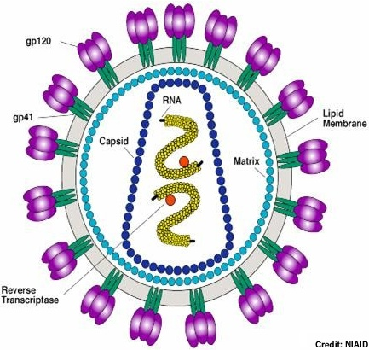
Characteristics of HIV
Family of Retroviridae.
Virion consist of:
Glycoprotein envelope (gp120, gp41).
Matrix layer.
Capsid.
Two copies of ssRNA.
Enzymes (reverse transcriptase, integrase, protease).

Slide 5
Structure of HIV
Family of Retroviridae.
Virion consist of:
Glycoprotein envelope (gp120, gp41).
Matrix layer.
Capsid.
Two copies of ssRNA.
Enzymes (reverse transcriptase, integrase, protease).

Slide 6
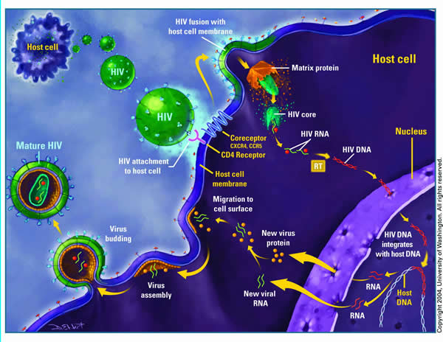
HIV life cycle

Slide 7
Transmission of HIV : Sexually:
The most common mode of HIV infection is sexual transmission at the genital mucosa through direct contact with infected blood, semen and vaginal secretion. Parenterally:
Direct exposure to infected blood and blood products.
Use contaminated needles and syringes as in (drug abuser) and Tattooing.
Through contaminated surgical and dental instruments.
Sharing contaminated razors , tooth brushes, and nail cutters.

Slide 8
Transmission of HIV :
From mother to child
Infected mother transmit HIV to their babies transplacentally (vertical 25%) ,but Treatment of the mother with antiretroviral Anti-reverse transcriptase (Zidovudine) during pregnancy can reduce transmission in most cases.
Virus spread to child perinatally mainly (50%)during delivery given Anti-reverse transcriptase (Nevirapine) as single dose during delivery can reduce the transmission . breast feeding also an important way of perinatal transmission (25%).Antiretroviral treatment of the mother and infant after birth can also significally decrease the risk of HIV infection in the newborn.

Slide 9
The Course of HIV-infection
The course of HIV-infection can be divided into three stages:
The acute phase
The chronic phase 1- (PGL)
2-(ARC)
AIDS

Slide 10
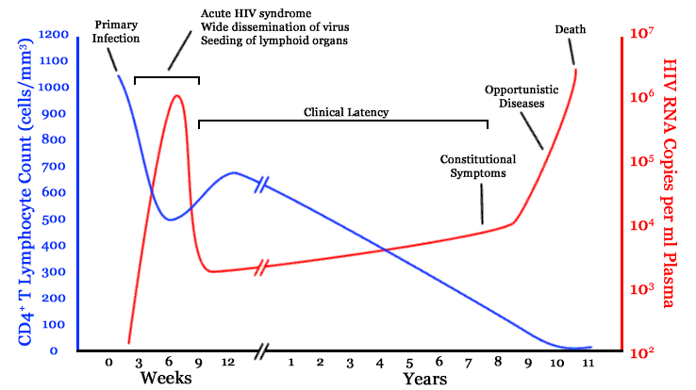
Stages of HIV infection
The course of HIV infection goes through 3 stages: Acute phase, Chronic phase, and AIDS.

Slide 11
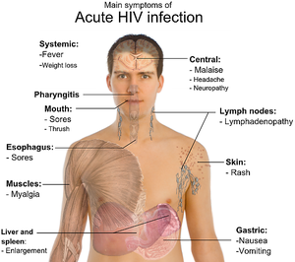
Acute phase:
Incubation period (2-4 weeks) and Lasts for about 12 weeks.
Rapid viral replication (high viral load RNA in the serum).
Gradual decrease in CD4 cell count.
25-65% of patients develop symptoms resemble infectious mononucleosis or Flu like syndrome (fever, headache, anorexia, fatigue, lymphadenopathy, & skin rash).
20% of patients may develop aseptic meningitis.
Notes:
In healthy peoples monocytes exert normal phagocytic activity, antigen presentation and cytokine secretion upon stimulation with cytokine or microbial antigens. However, HIV infected patients the monocytes functions are impaired. So, we hypothesized that ………

Slide 12
Chronic phase:
Lasts for about 10 yrs in adults.
Low viral load.
CD4 count > 500/ml
Totally asymptomatic but the patients still contagious.

Slide 13
Stages of HIV infection
The course of HIV infection goes through 3 stages: Acute phase, Chronic phase, and AIDS.

Slide 14
A-Persistent generalized lymphadenopathy (PGL)
Is defined as enlargement of lymph nodes for at least 1 cm in diameter, and must meet the following conditions:
In two or more extra inguinal area.
Persists for at least 3 months.
In the absence of any illness or medication known to cause PGL.

Slide 15
B-AIDS-related complex (ARC)
Is a group of clinical symptoms that come before AIDS and may include the following:
Fever of unknown origin that persists > 1 month.
Chronic diarrhea, persisting > 1 month.
Weight loss(Slim disease) > 10% of the original weight.
Fatigue. Neuorological disease as myelopathies and peripheral neuropathy.

Slide 16
Slim disease

Slide 17
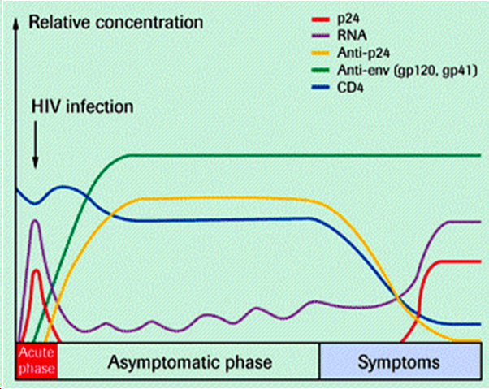
Serological profile of HIV infection

Slide 18
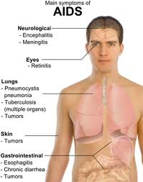
AIDS:
The end stage of the disease.
Continuous viral replication (high viral load viral RNA in the serum).
Marked decrease in CD4 cell count < 200
Persistent or frequent multiple opportunistic infections, unusual cancers (Kaposi sarcoma).

Slide 19
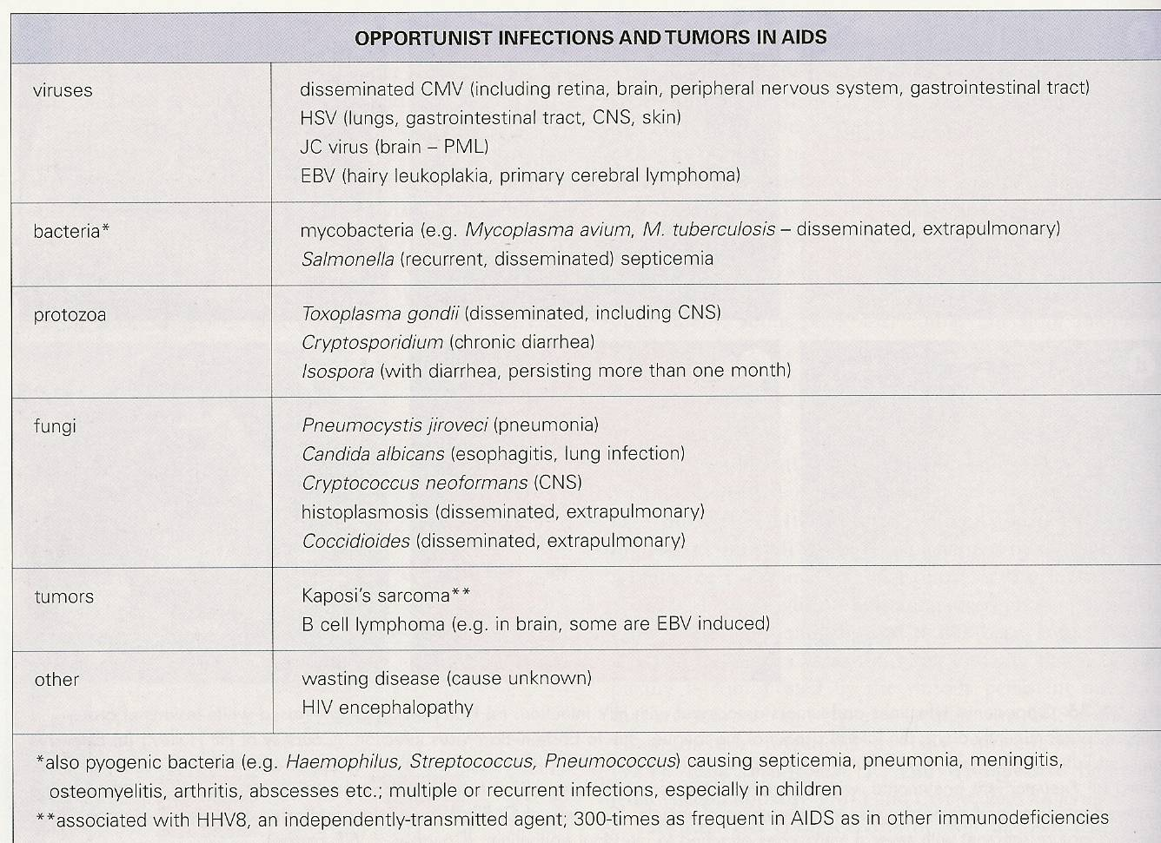

Slide 20
Stages of HIV infection

Slide 21
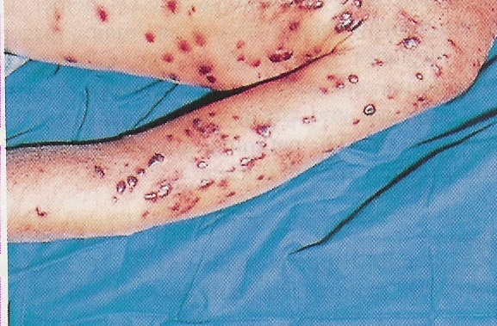
Kaposi’s sarcoma

Slide 22
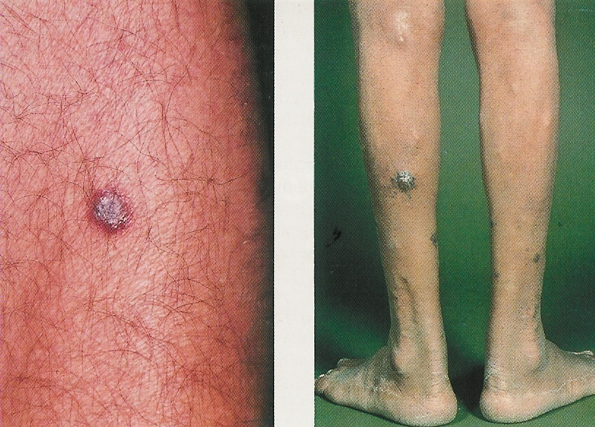
Kaposi’s sarcoma & Slim disease

Slide 23
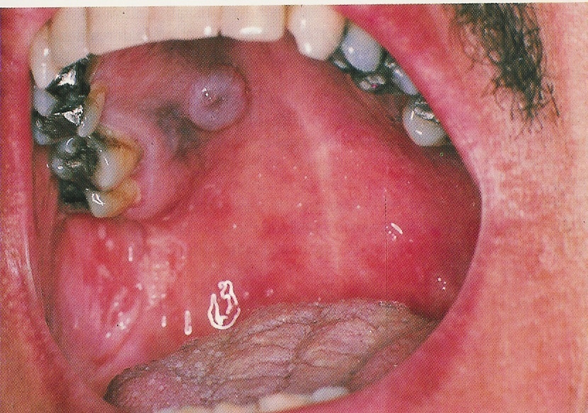
Kaposi’s sarcoma

Slide 24
How to diagnose an HIV patient?
Patient’s history with or without clinical symptoms may give hints for a physician whether the patient has ever exposed to HIV or not.
Screening patient’s serum by ELISA for both (HIV Ag & HIV Ab) if the result is +ve we repeated the specimen twice( in duplicate) if still giving +ve result will do confirmatory tests (Western Blot ,RIBA,PCR).
Blood viral load by PCR is also used to follow up patients response to treatment.

Slide 25
Serological profile of HIV infection

Slide 26
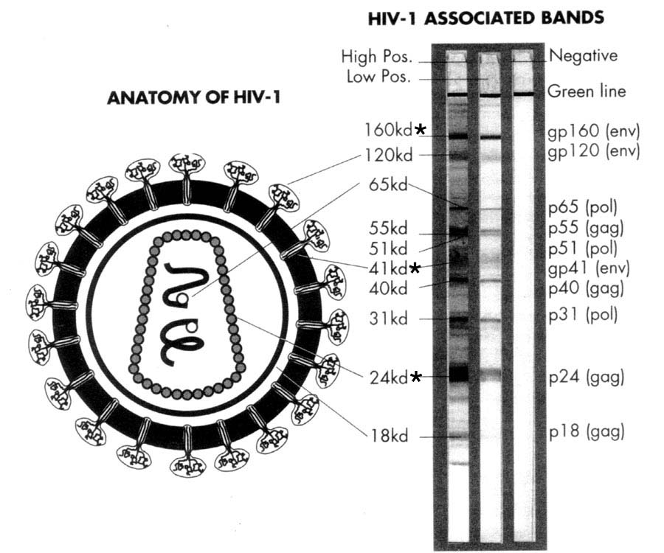
Western Blot To confirm the presence of Anti –HIV to the structural proteins of the virus by ELECTROPHORESIS

Slide 27
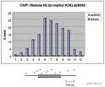
PCR For detection of HIV RNA in the blood (viral load) this test is important for HIV diagnosis in infant of infected mother and also to monitor the antiviral treatment

Slide 28
Treatment
Is a combined therapy known as high active antiretroviral therapy (HAART).
NOTE: HAART does not clear the virus, and should be taken all life.
NOTE: HAART treated patients are still contagious even if their blood viral load below detection (< 50 copies/μL).
HAART is usually composed of two reverse transcriptase inhibitors and one protease inhibitor.

Slide 29
Treatment (Continued)
Reverse Transcriptase Inhibitors:
AZT Zidovudine
ddC Zalcitabine
ddI Didanosine
d4T Stavudine
3TC Lamivudine
Protease inhibitors
Saquinavir
Indiniavir
Ritonavir
Nelfinavir

Slide 30
Goals of HIV treatment
To inhibit viral replication.
To control chronic immune activation and keep the immune system close to the normal state.
To prevent the development of opportunistic infection.
To minimize the chance of viral transmission especially from mother to neonate.
Treatment will never eradicate the HIV virus.

Slide 31
Prevention & Control:
There is no vaccine available yet for HIV
Practice safer sex by having one sexual partner
Do not share razors, tooth brushes, etc
Do not share needles and syringes
Avoid direct exposure to body fluids
Educate the public about HIV-infection.

Slide 32
Thank you for your attention !

