Slide 1
Prostate Pathology
Shaesta Naseem
3-4-2013

Slide 2
Prostate gland
Prostate weighs 20 grams in normal adult
Retroperitoneal organ ,encircling the neck of bladder and urethra
Divided into distinct zones or regions: the peripheral, central, and transitional zones
Histologically the prostate is composed of glands lined by two layers of cells: a basal layer of low cuboidal epithelium covered by a layer of columnar secretory cells

Slide 3
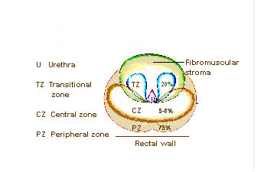
Zones of the Prostate
Peripheral
Central
Transitional
Most hyperplasias arise in the transitional zone,
Most carcinomas originate in the peripheral zone.
Notes:
The prostate includes three zones. The peripheral zone is in the outer most part of the prostate, and the lower peripheral zone is fairly close to the rectal wall. The peripheral zone is the most common site for prostatic adenocarcinoma. The central zone is in the center of the prostate and cancer does not originate there often. The transitional zone is above the central zone and is a common site for benign prostatic hypertrophy, a non-malignant condition of the prostate, but cancer may originate there as well but not as often as in the peripheral zone.

Slide 4
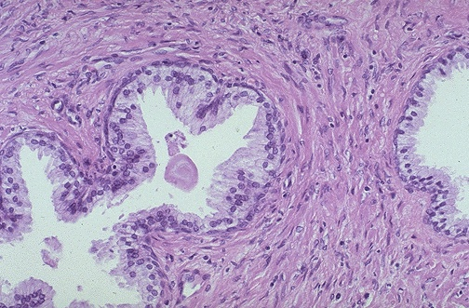
The normal histologic appearance of prostate glands
and surrounding fibromuscular stroma
A small pink concretion (typical of the corpora amylacea seen in benign prostatic glands) appears in the gland just to the left of center. Note the well-differentiated glands with tall columnar epithelial lining cells. These cells do not have prominent nucleoli.

Slide 5
Benign Prostatic Hyperplasia(BPH)
Extremely common lesion in men over age 50
(20% in men over age 40,up to 70% by age 60 ,and 90% by age 70)
Hyperplasia of glands and stroma
Fairly large ,well defined nodules
Related to the action of androgen
DHT , Dihydrotestesterone is the ultimate mediator for prostatic growth
Prepubertal castration prevents BPH

Slide 6
BPH , Morphology
The prostate weighs between 60 and 100 grams( normal 20 gm)
Almost exclusively in the transitional zone of the prostate gland
Nodules ,vary in color and consistency

Slide 7
BPH Clinical features
The increased size of the gland, and the smooth muscle-mediated contraction of the prostate cause uretheral obstruction.
The increased resistance to urinary outflow leads to bladder hypertrophy or diverticulum and distension.
The inability to empty the bladder completely creates a reservoir of residual urine →common source of infection.
Patients experience increased urinary frequency, nocturia, difficulty in starting and stopping the stream of urine, overflow dribbling, dysuria (painful micturition), and have an increased risk of developing bacterial infections of the bladder and kidney.

Slide 8
BPH, Morphology
The hallmark of BPH is nodularity due to glandular proliferation or dilation and to fibrous or muscular proliferation
Aggregation of small to large to cystically dilated glands
Needle biopsy doesn’t sample the transitional zone where BPH occur

Slide 9
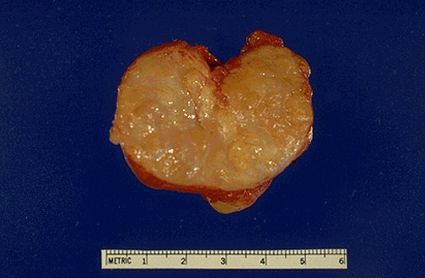
A normal prostate gland is about 3 to 4 cm in diameter. This prostate is enlarged due to prostatic hyperplasia, which appears nodular. Thus, this condition is termed either BPH (benign prostatic hyperplasia) or nodular prostatic hyperplasia

Slide 10
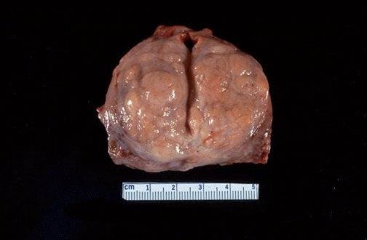
Nodules appear mainly in the lateral lobes. Such an enlarged prostate can obstruct urinary outflow from the bladder causing dysuria and hematuria and lead to an obstructive uropathy or bladder diverticulum

Slide 11
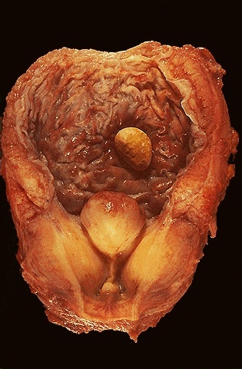
The enlarged prostate gland seen here not only has enlarged lateral lobes, but also a greatly enlarged median lobe that obstructs the prostatic urethra.
This led to obstruction with bladder hypertrophy, as evidenced by the prominent trabeculation of the bladder wall seen here from the mucosal surface.
Obstruction with stasis also led to the formation of the yellow-brown calculus (stone).

Slide 12
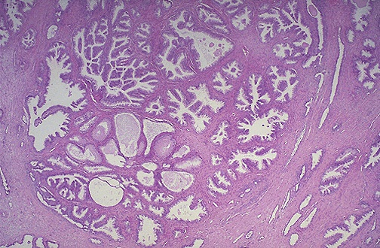
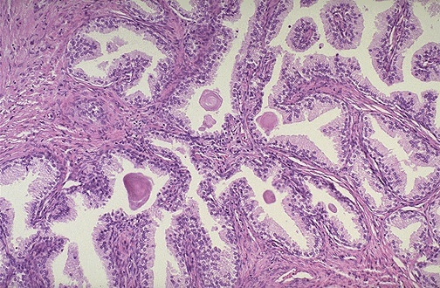
BPH can involve both glands and stroma, though the former is usually more prominent. Here, a large hyperplastic nodule of glands is seen.
The glands are well-differentiated and still have some intervening stroma. The small laminated pink concretions within the glandular lumens are known as corpora amylacea.

Slide 13
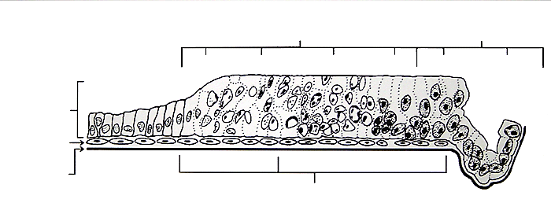
Prostatic Intraepithelial Neoplasia (PIN)
Lumen
Dysplasia
Carcinoma
Mild
Moderate
Severe
In situ
Microinvasive
Secretory
cells
Normal
Basal Cells
Low Grade
High Grade
Basal
Membrane
Prostatic Intra-epithelial Neoplasia
PIN consists of architecturally benign prostatic acini lined by cytologically atypical cells with prominent nucleoli
PIN is an intermediate lesion between normal and invasive cancer and is considered as predisposing factor and precursor of prostatic adenocarcinoma.

Slide 14
Prostatic Adenocarcinoma

Slide 15
Prostatic Adenocarcinoma
Adenocarcinoma of the prostate is the most common form of cancer in men
Second leading cause of cancer death
Disease of men over age 50
More prevalent among blacks in the USA
Etiology
Several risk factors :
Age , race, family history ,hormone level ,and environmental influences .
Androgen are believed to play a role in the pathogenesis

Slide 16
Prostatic Adenocarcinoma , Morphology
70% arises in the peripheral zone of the gland
Palpable in rectal exam
cross-section of the prostate the neoplastic tissue is gritty and firm

Slide 17
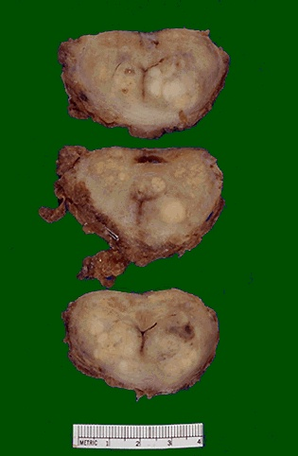
Prostatic adenocarcinoma.
Irregular yellowish nodules.
Prostate glands containing adenocarcinoma are not necessarily enlarged.
Adenocarcinoma may also coexist with hyperplasia.
However, prostatic hyperplasia is not a premalignant lesion

Slide 18
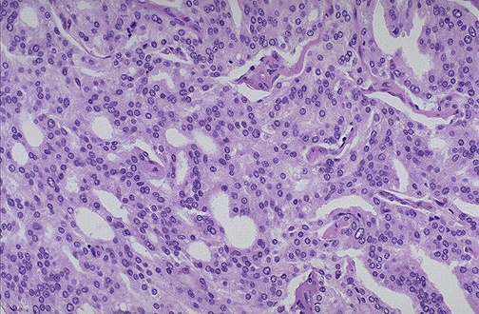
At high magnification, the neoplastic glands of prostatic adenocarcinoma are still recognizable as glands, but there is no intervening stroma and the nuclei are hyperchromatic.

Slide 19
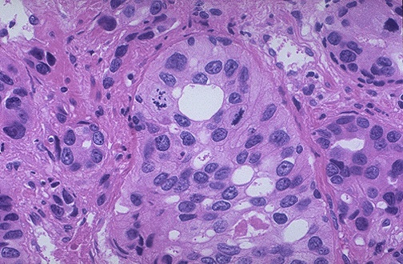
Poorly differentiated prostatic adenocarcinoma demonstrates cells with nucleoli and mitotic figures.

Slide 20
Prostatic Adenocarcinoma,Microscopic
The glands are typically smaller than benign glands and are lined by a single uniform layer of cuboidal or low columnar epithelium.
In contrast to benign glands, prostate cancer glands are more crowded, and characteristically lack branching and papillary infolding.
The outer basal cell layer typical of benign glands is absent.
Nuclei are large and often contain one or more large nucleoli
Peri-neural invasion is common and typical

Slide 21
Spread of prostatic Adenocarcinoma
By direct local invasion and through blood stream and lymph
Local extension most commonly involves the seminal vesicles and the base of the urinary bladder
Hematogenous extension occurs chiefly to the bones.
The bony metastasis are typically osteoblastic

Slide 22
Prostatic Adenocarcinoma Grading and Staging
Gleason grading system is the best known for grading
Five grades on the basis of glandular pattern and degree of differentiation as seen under low magnification
Grading is of particular important in prostate cancer ,because it is the best marker ,along with the stage ,for predicting prognosis
Staging in prostate cancer depends on the TNM system

Slide 23
Prostatic Adenocarcinoma,Clinical Course
Microscopic cancers are asymptomatic, discovered incidentally
Patients with clinically localized disease do not have urinary symptoms
Most arise peripherally ,away from urethra ,therefore ,urinary symptoms occur late

Slide 24
Prostatic Adenocarcinoma ,Clinical Course
Careful digital exam may detect some early cancers
PSA (Prostate Specific Antigen) has been used in the diagnosis and management of prostate cancer
PSA is organ specific but not cancer specific
Could be increased in BPH

Slide 25
Prostatic Adenocarcinoma, Treatment
Surgery ,radiotherapy ,and hormonal therapy
90% of treated patients expected to live for 15 years
Currently the most acceptable treatment for clinically localized cancer is radical surgery
Locally advanced cancers can be treated by radiotherapy
Hormonal therapy (Anti-androgen therapy) could induce remission .

