Slide 1
The Uterine Corpus
Emad Raddaoui
Shaesta Naseem Zaidi

Slide 2
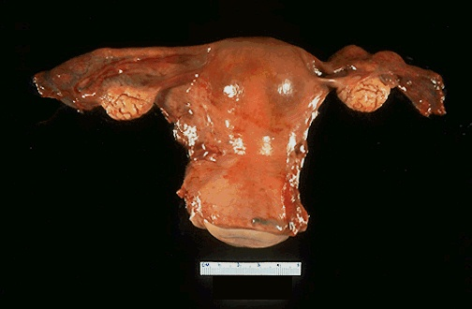

Slide 3
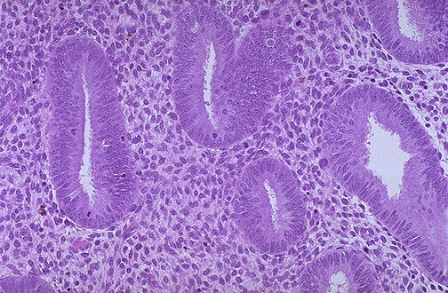
Proliferative Endomertium
Notes:
Proliferative endomertium

Slide 4
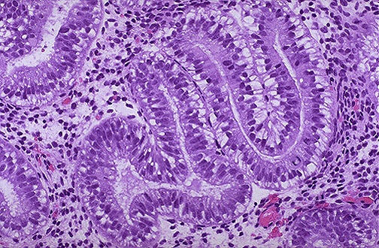
Secretary Endometrium
Notes:
Secretary Endometrium

Slide 5
Acute endometritis
Is most often related to intrautreine trauma e.g. after an abortion either spontaneous or induced, complications of pregnancy, medical instrumentation or intrauterine contraceptive devices.
Is most often caused by Staphylococci, Streptococci.
Others like N. gonorrhoeae, gram-negative bacilli and occasionally fungi and viruses can also cause infection.

Slide 6
Chronic endometritis
Chronic endometritis is associated with
Intrauterine contraceptive device use
pelvic inflammatory disease
retained products of conception following an abortion or delivery.
The etiologic agent is often not apparent and the patient is said to have non-specific chronic endometritis.

Slide 7
Chronic endometritis
Patients present with irregular bleeding.
Histologically, the presence of plasma cells in the endometrium is diagnostic. The stromal cells become spindled and swirl around the glands.
Sometimes granulomatous endometritis is noted in patients with tuberculosis.

Slide 8
Endometrial polyp
Is a localized benign overgrowth of endometrial tissue covered by epithelium.
Endometrial polyps are most common in women between 40 and 50 years.
The polyp may cause irregular bleeding.
It may be broad-based and sessile, pedunculated or attached to the endometrium by a slender stalk.
The size is variable from 1mm to a mass that fills the endometrial cavity.
Occasionally a polyp may protrude through the external os.

Slide 9
Endometrial polyp
Histology
Composed of glands of variable size and shape, fibrotic stroma and thick-walled blood vessels.
Clinical behavior
Endometrial polyps are benign with no malignant potential
but
Sometimes malignant tumors may be found in them.

Slide 10
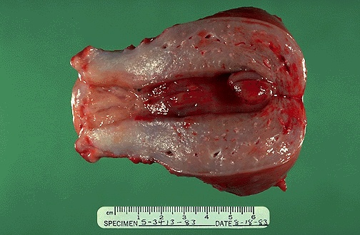

Slide 11
Leiomyoma (Fibroid)
Leiomyoma is a benign tumor of smooth muscle origin.
It is the most common neoplasm of the female genital tract and probably the most common benign neoplasm in women.
Clinical and gross appearances
Patients may present with irregular bleeding, pelvic pain, pelvic mass, infertility.
The tumor is estrogen responsive and often increases in size during pregnancy and decreases in size during menopause.
It can be single or multiple. Mostly it is multiple.

Slide 12
Leiomyoma may be located anywhere in myometrium.
Submucosal tumors are present immediately below the endometrium, may be pedunculated and occasionally protrude though the cervix.
Intramural tumors, the most common, lie within the myometrium.
Subserosal fibroids lie beneath the serosal covering of the uterus or are pedunculated and attached to the serosa.
Pedunculated ones may undergo torsion and infarction or loose their connection to the uterus and become attached to another pelvic organ forming a "parasitic leiomyoma".

Slide 13
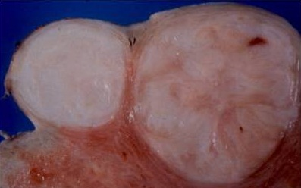
Leiomyoma.
Grossly :
The tumors appear as
well circumscribed
round to spherical
dense and firm-to-hard masses
The cut surface is whorled, tan-white
Areas of hemorrhage can be seen

Slide 14
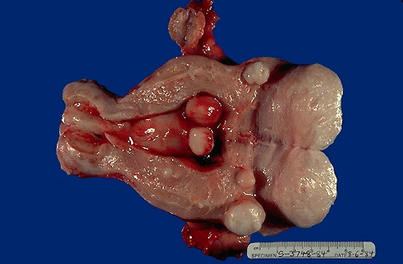

Slide 15
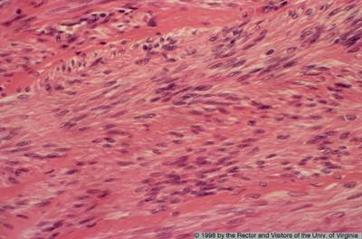
Leiomyoma composed of interlacing fibers of bland smooth muscle with collagenous stroma between bundles

Slide 16
Leiomyoma (Fibroid) Degenerative changes
Atrophy — the tumor reduces in size at menopause or after pregnancy following drop in estrogen level.
Hyaline change (hyalinization) — Usually occurs as the tumor "ages".
Myxoid and cystic change.
Calcification — common in menopausal women.
Necrosis of the center due to circulatory inadequacy.
Red degeneration— venous thrombosis and congestion with interstitial hemorrhage may occur, most commonly in pregnancy. This is usually accompanied by pain, which may produce a clinical picture of acute abdomen.

Slide 17
Leiomyoma (Fibroid) Clinical behavior
This is a benign tumor with no appreciable malignant potential (incidence of malignant transformation is 0.1-0.5%).
It may cause anemia from heavy bleeding, or urinary or bowel obstruction (subserosal or parasitic tumors)
In pregnant women it may cause spontaneous abortion, precipitate labor, obstructed labor ,post partum hemorrhage (due to interference with uterine contraction), and red degeneration.

Slide 18
Endometrial Hyperplasia

Slide 19
Endometrial Hyperplasia
It refers to a process in which there is a proliferation of endometrial glands.
The glands are irregular size and shape with an increase in gland/stroma ratio compared to proliferative endometrium.
It is induced by persistent, prolonged estrogenic stimulation of the endometrium.

Slide 20
Endometrial Hyperplasia
The endometrial hyperplasia may progress to endometrial carcinoma.
The development of cancer is based on the level and duration of the estrogen excess.
The risk depends on the severity of the hyperplastic changes and associated cellular atypia.

Slide 21
Endometrial Hyperplasia, causes
A common cause is a succession of anovulatory cycles (failure of ovulation ).
It may also be caused by excessive endogenously produced estrogen in
-polycystic ovary syndrome including Stein-Leventhal syndrome,
-granulosa cell tumors of the ovary
-excessive ovarian cortical function (cortical stromal hyperplasia)
Prolonged exogenous administration of estrogenic steroids without counter balancing progestins

Slide 22
Endometrial Hyperplasia ,Clinical
Milder forms of hyperplasia tends to occur in younger patients
The great majority of mild hyperplasia regress , either spontaneously or after treatment .
The more severe forms ,occur predominantly in peri- and postmenopausal women .This form has a significant premalignant potential.
Patients usually present with abnormal uterine bleeding .

Slide 23
Endometrial Hyperplasia: microscopy
Characterized by proliferation of both glands and stroma.
In spite of proliferation of both components, glandular overcrowding occurs.
Endometrial hyperplasia is histologically classified according to:
1) Architecture as: simple or complex depending on the degree of glandular complexity and crowding, and
2) Cytologic features as: with or without atypia.

Slide 24
Endometrial Hyperplasia: classification
With atypia
Simple hyperplasia
Without atypia
With atypia
Complex hyperplasia
Without atypia.

Slide 25
Endometrial Hyperplasia: microscopy
Simple hyperplasia (cystic hyperplasia) — glands are cystically dilated and dispersed within abundant cellular stroma and give a "Swiss Cheese" appearance.
Complex hyperplasia —characterized by complex crowded glands with papillary infoldings , budding and irregular shapes.
The crowded glands are back-to-back with very little intervening stroma.
Both simple and complex hyperplasia can be with or without atypia.

Slide 26
Endometrial Hyperplasia: Clinical behavior and premalignant potential
Some endometrial hyperplasia revert to normal spontaneously or with medical treatment, others persist as hyperplasia, and a few progresses to endometrial adenocarcinoma.
Generally, patients who have hyperplasia with atypia are more likely to develop carcinoma than those without atypia.
The risks for developing adenocarcinoma in each are as follows:
Complex atypical — 30%
Simple atypical — 10%
Complex — 3%
Simple — 1%
Atypical hyperplasia in postmenopausal women appears to have a higher rate of progression to adenocarcinoma.

Slide 27
Endometrial Hyperplasia,
Risk Factors
Obesity
Western diet
Nulliparity
Diabetes Mellitus
Hypertension
Hyperestrinism

Slide 28
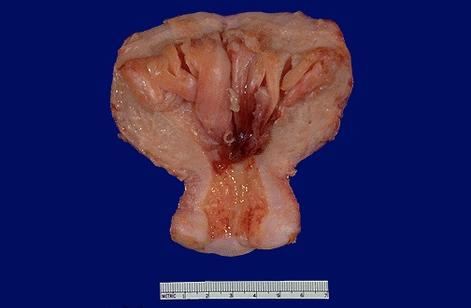

Slide 29
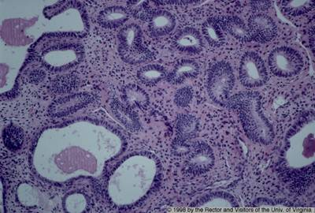
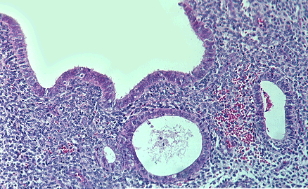
Simple hyperplasia with dilated glands

Slide 30
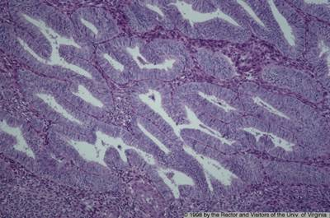
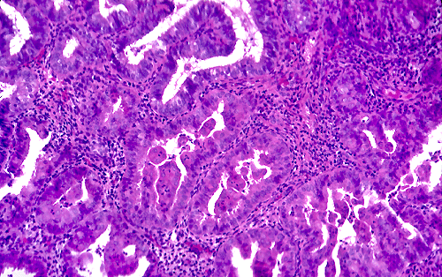
Complex atypical hyperplasia
Back-to-back arrangement (Crowding) of endometrial glands with budding and papillary tufting with epithelial atypia.

Slide 31
Endometrial adenocarcinoma
Epidemiology
It is the most common invasive tumor of the female genital tract in the U.S.
Worldwide, it is the fifth commonest cancer in women.
Notes:
Mutations in the PTEN tumor suppressor gene have been identified in 30% to 80% of endometrioid carcinomas and in approximately 20% of endometrial hyperplasias, both with and without atypia.

Slide 32
Risk Factors, Adenocarcinoma
Obesity
Estrogen therapy
Nulliparity (as a result of infertility due to chronic anovulation),
Chronic anovulation
Late menopause
Diabetes
Hypertension
Tamoxifen therapy
High socioeconomic status.
The disease may follow atypical hyperplasia but may occur independently of it especially in older patients.

Slide 33
Endometrial adenocarcinoma
Clinical presentation
Most patients are between 50 and 59 years.
Endometrial adenocarcinoma manifests as abnormal vaginal bleeding.
The tumor may grow in a diffuse or polypoid pattern usually at the fundus however any site can be involved.
It often involves multiple areas of the endometrium,

Slide 34
Endometrial Adenocarcinoma, morphology:
May closely resemble normal endometrium
May be polypoid
May be exophytic
May be Infiltrative

Slide 35
Endometrial adenocarcinoma, histology:
The commonest type is : Endometrioid adenocarcinoma.
Other types include:
Clear cell
Adeno-squamous
Papillary serous carcinoma.
Endometrioid carcinoma may show areas of benign looking squamous epithelium ( adenoacanthoma).
In adenosquamous carcinoma both glandular and squamous components appear malignant.

Slide 36
Endometrial adenocarcinoma, prognosis:
Clinical behavior depends on the histologic type, the grade (degree of differentiation) and the stage (extent of spread).
Endometrioid carcinoma has a better prognosis than the other histological types
Staging is based on:
degree of myometrial invasion, cervical, adnexal and adjacent pelvic organ invasion,
result of peritoneal fluid cytology and
distant organ metastasis.
Lymph node status is an important prognostic factor.

Slide 37
Endometrial Adenocarcinoma,prognosis:
75% of patients present with stage I disease and these have 95% 5-year survival.
The tumors associated with unopposed estrogen tend to have low histologic grade and clinical stage, hence tend to have better prognosis.
These usually occur in young women.
20% of endometrial carcinoma there is no association with hyperestrinism or preexisting hyperplasia ,these cancers tend to occur late in life and have a poor prognosis.

Slide 38
Endometrial Carcinoma , Grading and staging
Grading is from 1 to 3
Staging is from 1 to 4
Stage 1 : Confined to uterus corpus
Stage 2 : Cervix involvement
Stage 3 : beyond the uterus ,but within the true pelvis
Stage 4 : Distant metastasis/ extrapelvic extension.
Notes:
Grading:
G1. Well-differentiated adenocarcinoma, less than 5% solid growth
G2. Moderately differentiated adenocarcinoma with partly (less than 50%) solid growth
G3. Poorly differentiated adenocarcinoma with predominantly solid growth (greater than 50%)

Slide 39
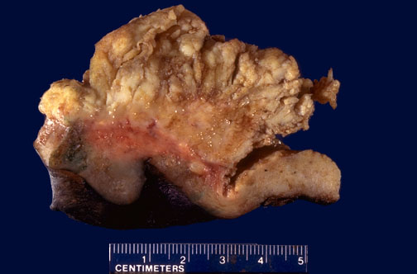
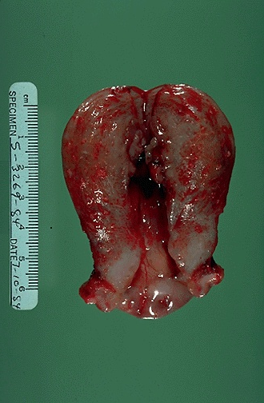

Slide 40
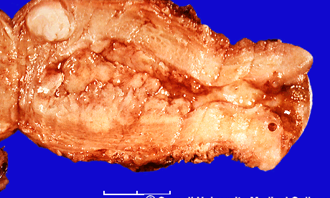

Slide 41
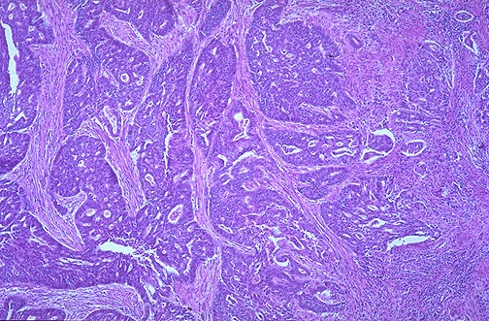

Slide 42
