Slide 1
Uterine Cervix
Emad Raddaoui, MD, FCAP, FASC

Slide 2
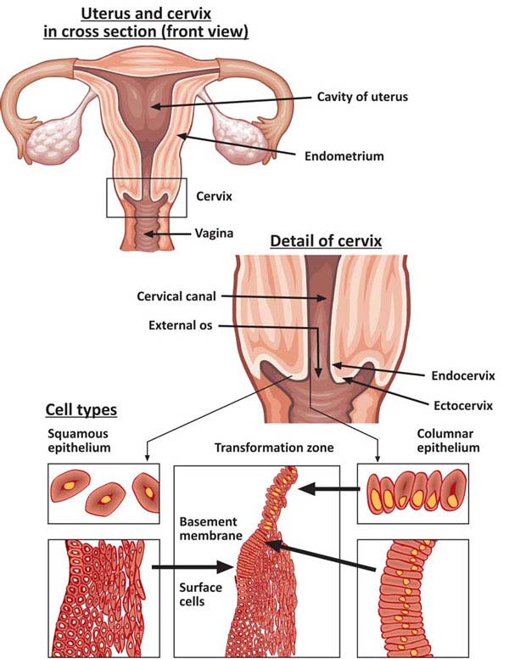

Slide 3
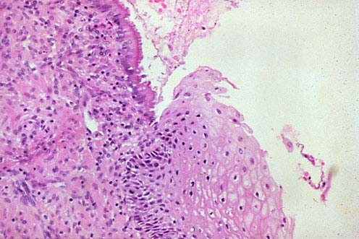
SQUAMO-COLUMNAR JUNCTION

Slide 4
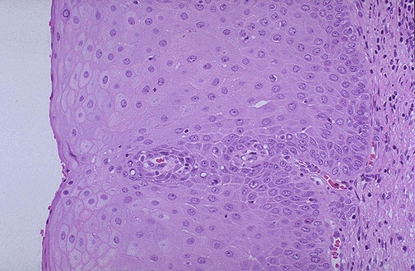

Slide 5
Erosion/Ectropion
Characterized by columnar epithelium replacing squamous epithelium, grossly resulting in an erythematous area.
It is a typical response to a variety of stimuli including hormones, chronic irritation and inflammation (chronic cervicitis).
It is benign and has no malignant potential.

Slide 6
Cervical polyp
This is a small, pedunculated, often sessile mass.
Most originate from the endocervix (endocervical polyps) with a few from the ectocervix (ectocervical polyps).
They are inflammatory proliferations of cervical mucosa and are not true neoplasms.

Slide 7
Cervical polyp
The lesion is characterized by overgrowth of benign stroma covered by epithelium.
Endocervical polyps are covered by endocervical, squamo-columnar or metaplastic squamous epithelium while ectocervical ones are covered by stratified squamous epithelium.
The stroma contains thick-walled blood vessels and fibrous and some inflammatory cells.

Slide 8
CERVICITIS
Inflammation of cervix.
Can be non-infectious or infectious.

Slide 9
Noninfectious (Nonspecific) Cervicitis
This is inflammation of the cervix caused by chemical (e.g. douche, deodorant) or mechanical (e.g. tampon, diaphragm) irritation. It is often acute but may be chronic.
Clinical appearances
Noninfectious cervicitis is often asymptomatic.
The cervix appears red and swollen

Slide 10
Noninfectious (Nonspecific) Cervicitis
Histology
The histologic features are nonspecific. The inflammatory infiltrate may comprise neutrophils or plasma cells and lymphocytes or a combination of these cells.
Squamous metaplasia of the endocervical glandular epithelium is common in chronic cervicitis. Often some of the mucous glands are obstructed and dilate to form mucus-filled cysts called nabothian cysts.

Slide 11
Infectious cervicitis
Can be caused by various organisims e.g.staphylococci, enterococci, Gardnerella vaginalis, Trichomonas vaginalis, Candida albicans and Chlamydia trachomatis.
Most often involves the endocervix.
Is often asymptomatic, may manifest as vaginal discharge

Slide 12
Candidiasis (moniliasis)
Common form of vaginitis /cervicitis.
Caused by Candida albicans, a normal component of the vaginal flora.
Associated with diabetes mellitis, pregnancy, broad spectrum antibiotic therapy, oral contraceptive use and immunosupression.
Characterized by white patchy mucosal lesions with thick white discharge and vulvovaginal pruritis.

Slide 13
Candidiasis (moniliasis)
Histology.
Colonies of the fungus are present on the surface and extend into the epithelium but not into the underlying tissues. Mild edema and chronic inflammatory cells are present. Ulcers may develop. Cytological smears show yeast forms and branching pseudohyphae

Slide 14
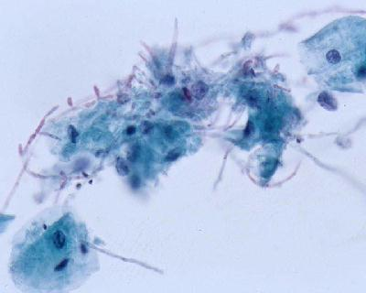

Slide 15
Trichomoniasis
caused by a unicellular flagellated protozoan, Trichomonas vaginalis. It is sexually transmitted disease
Involves the vagina and cervis also.
Clinical presentation
Most infections are asymptomatic and pass unnoticed. Occasionally, a copious, thin, frothy, yellow green to gray offensive discharge is produced. There may be vulvas itching or burning or dyspareunia

Slide 16
Trichomoniasis
Histology
An inflammatory infiltrate of lymphocytes and plasma cells. The organisms are not seen in biopsies because they do not invade the vaginal wall. Diagnosis is made by examination of a saline wet preparation in which the motile trophozoites are seen. The organism can also be found in Pap-stained vaginal smears.

Slide 17
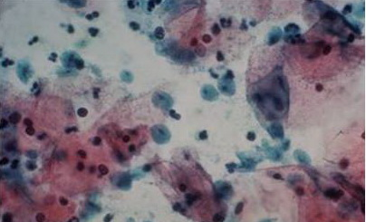

Slide 18
Chlamydia trachomatis Cervicitis
Clamydia trachomatis is an obligate, gram-negative intracellular pathogen.
Clamydial cervicitis is the most common sexually transmitted disease in the developed countries. It may coexist with Neisseria gonorrhoeae infection.
It is a frequent cause of pelvic inflammatory disease.
Is most often asymptomatic.
Chlamdial infection may also cause a condition known as lymphogranuloma venereum

Slide 19
Clamydia trachomatis Cervicitis
Clinical appearances
The disease may be symptomatic or asymptomatic. In symptomatic cases there is a mucopurulent cervical discharge with a reddened, congested and edematous cervix. It may be associated with urethritis.

Slide 20
Herpes simplex virus (HSV) Cervicitis
HSV Type 2 infection accounts for majority of genital herpes cases and is spread by sexual contact.
It produces vesicles and ulcers that can involve the cervix, vagina, vulva, urethra and perianal skin.

Slide 21
Human papilloma virus (HPV) Infection
HPV infection of the cervix is common.
Over 20 serotypes infect the female genital areas. They cause a variety of different lesions with the different serotypes.
Clinical behavior
HPV infection is associated with increased risk of subsequent cervical cancer and so long-term follow-up with attention to the cervix, vagina and vulva is necessary.

Slide 22
Human papilloma virus (HPV) Infection
HPV infection may cause any of the following depending on the serotype
1)Condyloma. This develops in the squamous epithelium of the ectocervix and in foci of squamous metaplasia in the endocervix. The lesions may be flat or exophytic condylomma acuminatum. Can be caused by any HPV serotype but more commonly by types 6 and 11.
2) Mild dysplasia is usually caused by "low risk" HPV serotypes, 6 and 11.
3) High- grade dysplasia is caused by "high risk” HPV (types16 and 18) and moderate risk HPV( types 31,33,35).

Slide 23
Cervix Carcinoma
One of the major causes of cancer-related death in women, specially in developing world.
Most common cervical cancer is squamous cell carcinoma. Other types are adenocarcinoma, neuroendocrine carcinoma etc.
Nowadays there is dramatic improvement because of early diagnosis and treatment.
The wide use of PAP screening lowered the incidence of invasive cancer .

Slide 24
Precancerous lesion
All invasive squamous cell carcinomas arise from pre-cancer epithelial changes referred as Cervical Intraepithelial Neoplasia (CIN ) or Squamous intraepithelial lesions.
Squamous Intraepithelial Lesion (SIL) is the pre-cancerous(non invasive) lesion and detection of these lesions made curative treatment possible.
Not all cases of CIN progress to invasive cancer.

Slide 25
Precancerous lesion
they do not invariably progress to cancer and may spontaneously regress,
the risk of persistence or progression to cancer increases in the high grade precancerous lesions;
they are associated with papillomaviruses, and high-risk HPV types are found in increasing frequency in the higher-grade precursors

Slide 26
CIN
Cytologic examination can detect CIN (SIL) long before any abnormality can be seen grossly .
Pre-cancer changes can precede the development of an overt cancer by many years.
CIN lesions may begin as Low Grade CIN and progress to High Grade CIN, or they might start as HG lesion.

Slide 27
CIN histology.
On the basis of histology ,pre-cancer lesions are graded as follows:
-CIN I : Mild Dysplasia
-CIN II : Moderate Dysplasia
-CIN III : Severe Dysplasia and Carcinoma in situ.

Slide 28
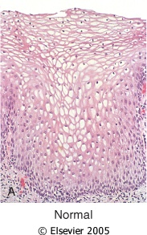
Figure 22-19 Spectrum of cervical intraepithelial neoplasia: normal squamous epithelium for comparison; CIN I with koilocytotic atypia; CIN II with progressive atypia in all layers of the epithelium; CIN III (carcinoma in situ) with diffuse atypia and loss of maturation.
Downloaded from: Robbins & Cotran Pathologic Basis of Disease (on 28 April 2008 12:10 PM)
© 2007 Elsevier

Slide 29
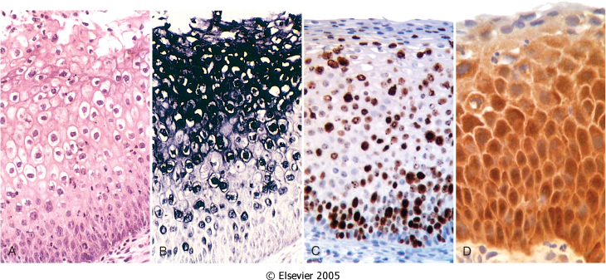
HPV ONLY, no dysplasia
Figure 22-20 A, Histology of CIN I (flat condyloma), illustrating the prominent koilocytotic atypia in the upper epithelial cells, as evidenced by the prominent perinuclear halos. B, Nucleic acid in situ hybridization of the same lesion for HPV nucleic acids. The blue staining denotes HPV DNA, which is typically most abundant in the koilocytes. C, Diffuse immunostaining of CIN II for Ki-67, illustrating widespread deregulation of cell cycle controls. D, Up-regulation of p16ink4 (seen as intense immunostaining) characterizes high-risk HPV infections.
Downloaded from: Robbins & Cotran Pathologic Basis of Disease (on 28 April 2008 12:10 PM)
© 2007 Elsevier

Slide 30
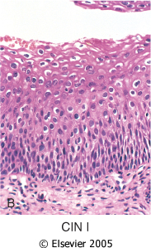
Lower 1/3rd of the epithelium is replaced by pleomorphic cells
Figure 22-19 Spectrum of cervical intraepithelial neoplasia: normal squamous epithelium for comparison; CIN I with koilocytotic atypia; CIN II with progressive atypia in all layers of the epithelium; CIN III (carcinoma in situ) with diffuse atypia and loss of maturation.
Downloaded from: Robbins & Cotran Pathologic Basis of Disease (on 28 April 2008 12:17 PM)
© 2007 Elsevier

Slide 31
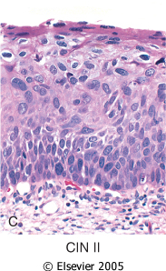
Lower 2/3rd of the epithelium is replaced by pleomorphic cells
Figure 22-19 Spectrum of cervical intraepithelial neoplasia: normal squamous epithelium for comparison; CIN I with koilocytotic atypia; CIN II with progressive atypia in all layers of the epithelium; CIN III (carcinoma in situ) with diffuse atypia and loss of maturation.
© 2007 Elsevier

Slide 32
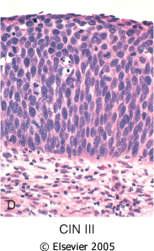
All levels of the epithelium is replaced by pleomorphic cells, (full thickness)
Figure 22-19 Spectrum of cervical intraepithelial neoplasia: normal squamous epithelium for comparison; CIN I with koilocytotic atypia; CIN II with progressive atypia in all layers of the epithelium; CIN III (carcinoma in situ) with diffuse atypia and loss of maturation.
Downloaded from: Robbins & Cotran Pathologic Basis of Disease (on 28 April 2008 12:10 PM)
© 2007 Elsevier

Slide 33
Cytology screening for precancerous lesions
The cervix is examined and the cells lining the cervical wall at the transformation zone are scrapped/ sampled with a spatula and then spread on a slide. They are then fixed, stained (Papanicolaou stain) and examined under a light microscope.

Slide 34
Cytology Pap Screening
In cytology smears we separate pre-cancer lesions into two groups :
Low Grade SIL
High Grade SIL
Of Low Grade SIL 1-5 % become invasive
Of High Grade SIL incidence is 6-74%

Slide 35
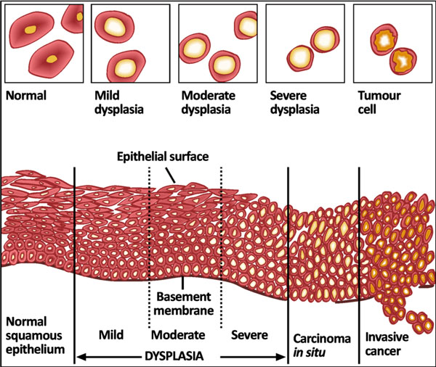

Slide 36
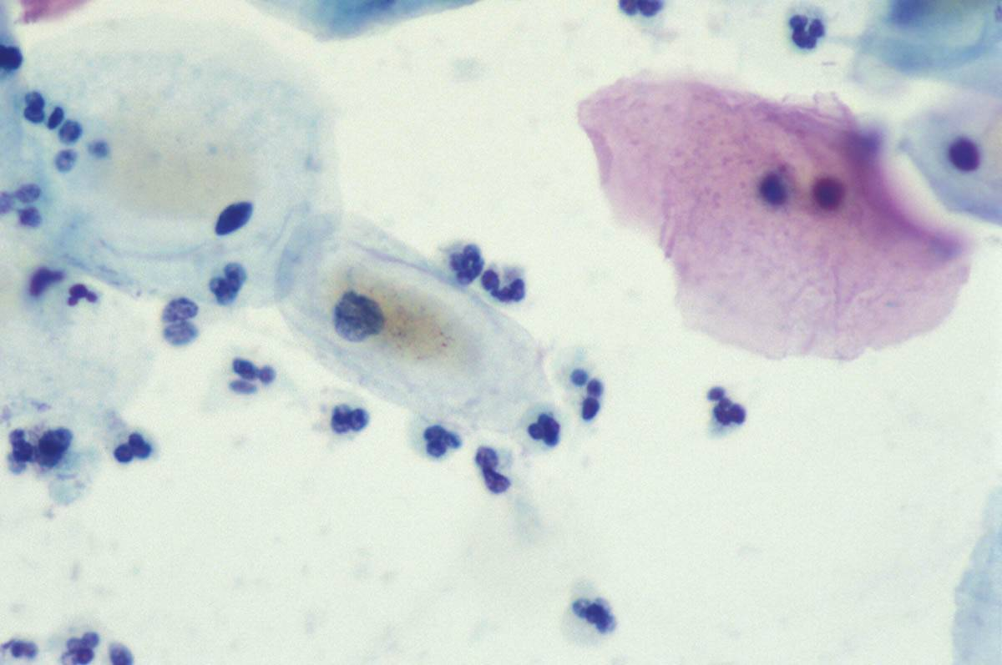

Slide 37
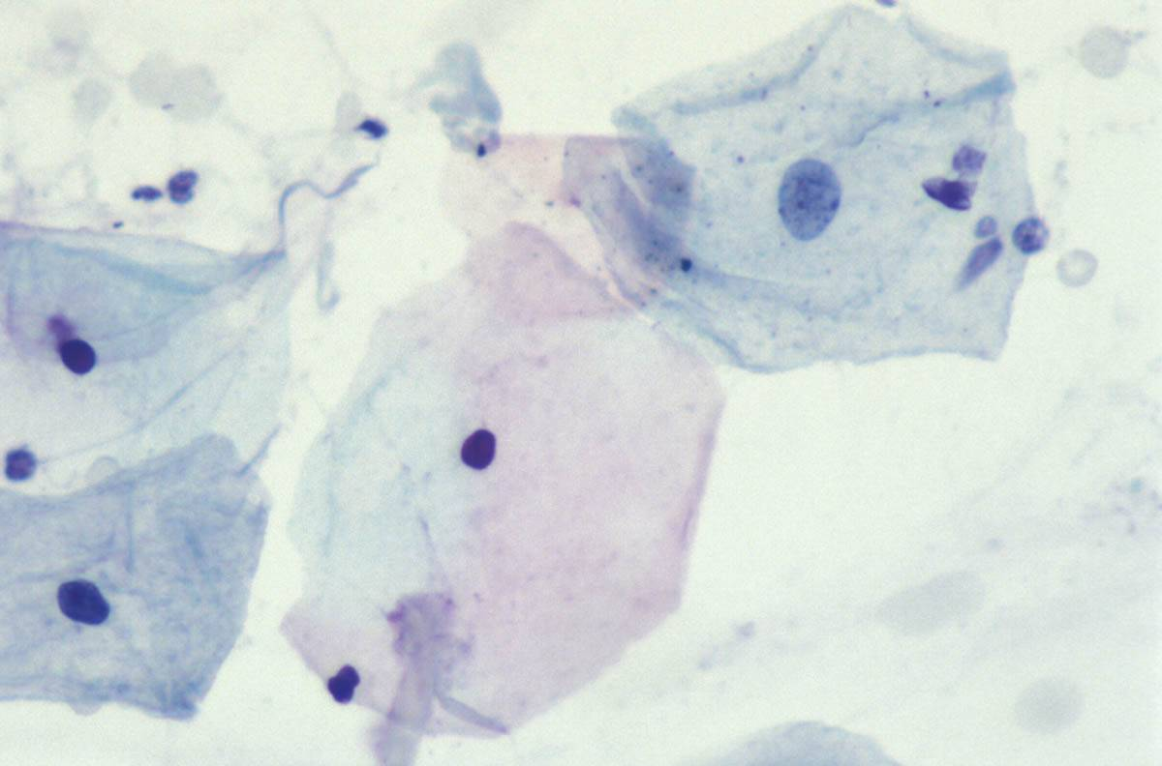

Slide 38
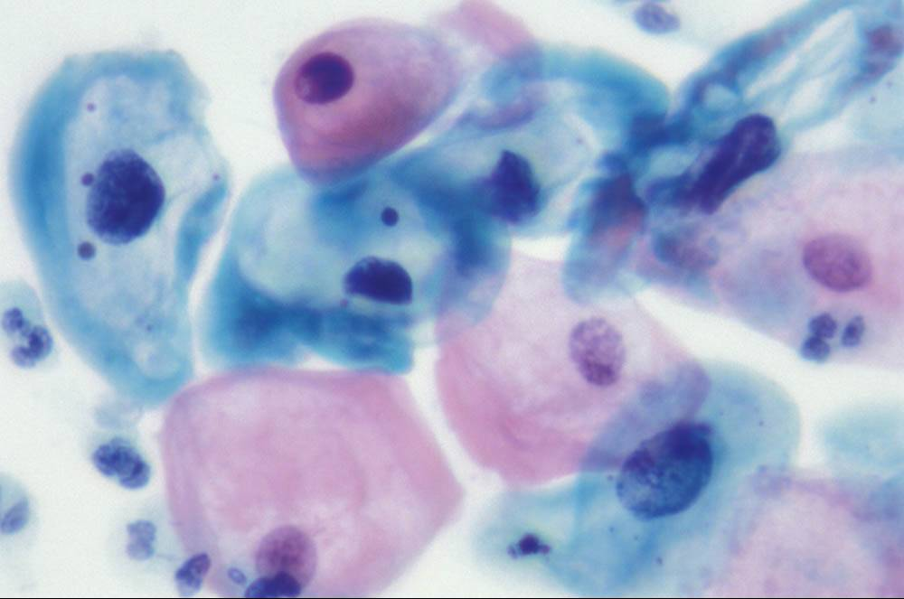

Slide 39
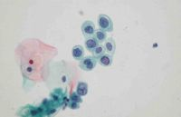

Slide 40
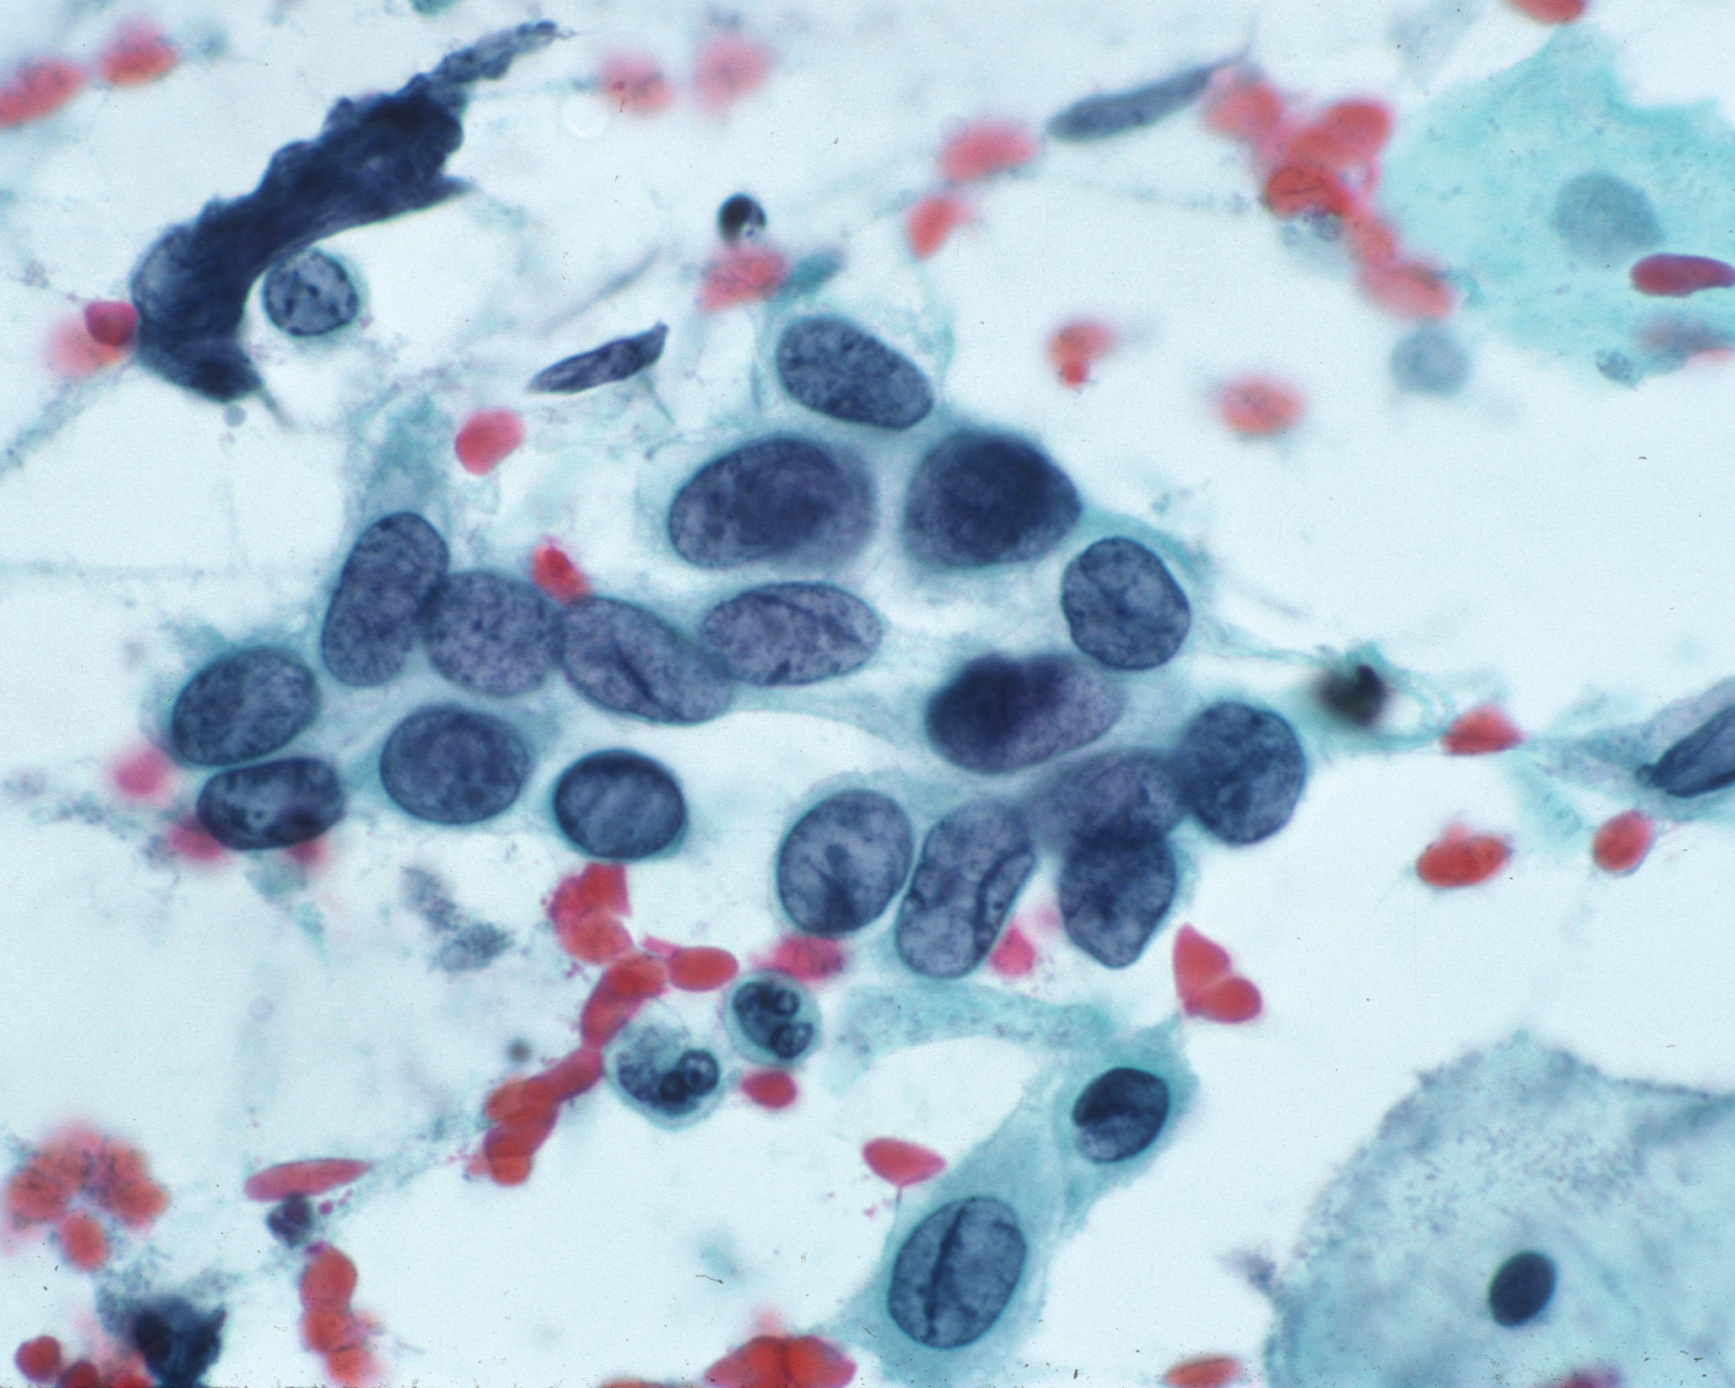

Slide 41
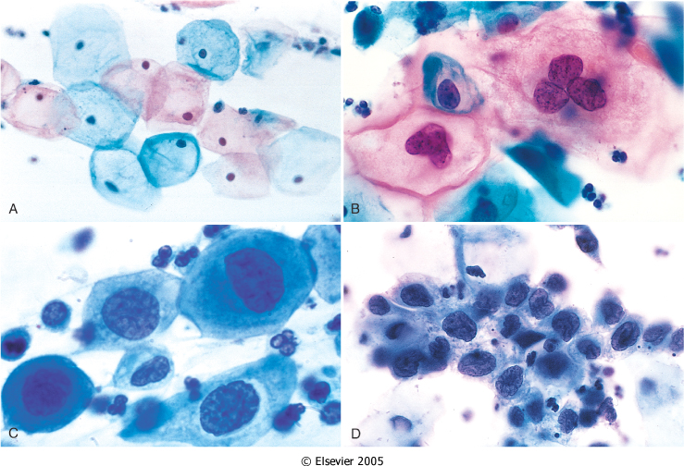
Figure 22-21 The cytology of cervical intraepithelial neoplasia as seen on the Papanicolaou smear. Cytoplasmic staining in superficial cells (A&B) may be either red or blue. A, Normal exfoliated superficial squamous epithelial cells. B, CIN I. C, CIN II. D, CIN III. Note the reduction in cytoplasm and the increase in the nucleus to cytoplasm ratio, which occurs as the grade of the lesion increases. This reflects the progressive loss of cellular differentiation on the surface of the lesions from which these cells are exfoliated (see Figure 22-19). (Courtesy of Dr. Edmund S. Cibas, Brigham and Women's Hospital, Boston, MA.)
Downloaded from: Robbins & Cotran Pathologic Basis of Disease (on 28 April 2008 11:48 AM)
© 2007 Elsevier

Slide 42
CIN , Risk Factors
Early age at first intercourse
Multiple sexual partners
A male partner with multiple previous sexual partners
Persistent infection by high risk papillomaviruses
Some other risk factors; low socioeconomic groups
rare among virgins, multiple pregnancies.

Slide 43
CIN ,causes
HPV can be detected in 85 -90 % of pre-cancer lesions
High risk types HPV : 16, 18, 31, 33, 35, 39, 45, 52, 56, 58, and 59 .
Low risk types HPV :6, 11, 42, 44 . These types result in condylomas.

Slide 44
Cervix Carcinoma ,Cause
The cause is determined to be HPV virus .The HPV is the number one reason for abnormal cells of the cervix.
HPV is a skin virus, which results in warts, common warts ,flat warts, genital warts (condylomas), planter warts, and precancerous lesions.

Slide 45
Cervical carcinoma , Signs
There are no visible symptoms that you have dysplasia of the cervix ,without a Pap smear or Pap exam .
This is why we should have regular pap exams, as to detect any abnormal cells .

Slide 46
Cervical Carcinoma , Screening
The Pap smear detects early HPV infection.
The common testing procedure for HPV infection is an annual pap exam .
There is the HPV DNA ISH test ,the Diegene Hyprid Capture test . This test will determine whether you carry high or low risk strains of the virus.

Slide 47
Cervical Carcinoma ,Invasive
75 -90% of invasive cancers are Squamous cell carcinomas ,which generally evolves from pre-cancer CIN.
The remainder are Adenocarcinoma.
Squamous cell cancers are appearing in increasingly younger women ,now with a peak incidence at about 45 years, about 10-15 years after detection of their precursors.

Slide 48
Cervical Carcinoma ,Morphology
Mainly in the region of the transformation zone ,and range from microscopic foci of early stromal invasion to grossly frank tumors encircling the Os .
The tumors may be invisible or exophytic .
Cervical carcinomas are graded from 1 to 3 based on cellular differentiation and staged from 1 to 4 depending on clinical spread.

Slide 49
Cervical Carcinoma, Staging
0- Carcinoma in Situ
1- Confined to the cervix
2- Extension beyond the cervix without extension to the lower third of Vagina or Pelvic Wall
3- Extension to the pelvic wall and / or lower third of the vagina
4- Extends to adjacent organs

Slide 50
Cervical Carcinoma ,Clinical Course
Many of cervical cancers are diagnosed in early stages , and the vast majority are diagnosed in the pre-invasive phase.
More advanced cases are seen in women who either have never had a Pap smear or have waited many years since the prior smear.

Slide 51
Cervical Carcinoma ,Survival
laser or cone biopsy is the most effective method of managing patients with High grade SIL in cancer prevention .

Slide 52
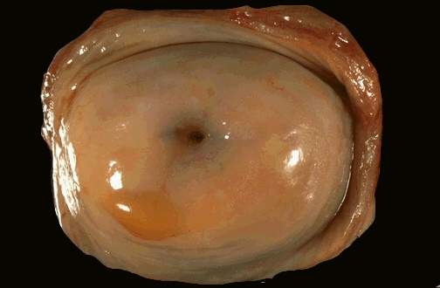

Slide 54
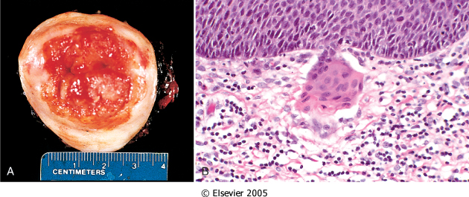
Figure 22-22 The spectrum of invasive cervical cancer. A, Carcinoma of the cervix, well advanced. B, Early stromal invasion occurring in a cervical intraepithelial neoplasm.
Downloaded from: Robbins & Cotran Pathologic Basis of Disease (on 28 April 2008 11:48 AM)
© 2007 Elsevier

Slide 55
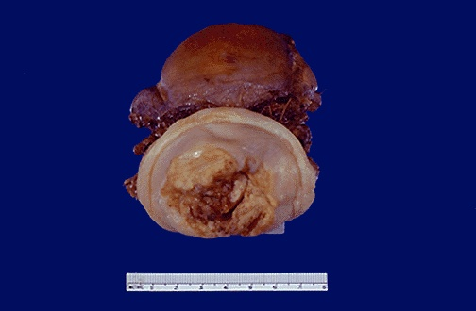

Slide 56
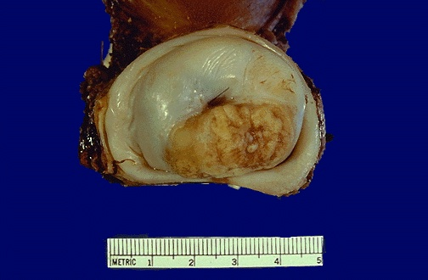

Slide 57
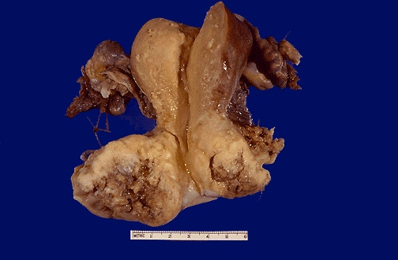

Slide 58
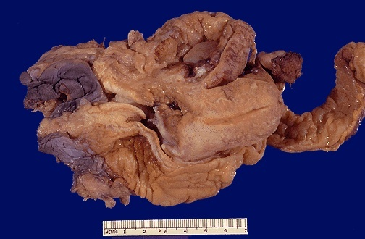

Slide 59
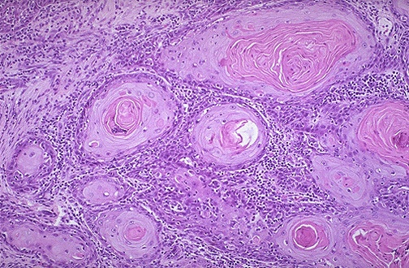

Slide 60
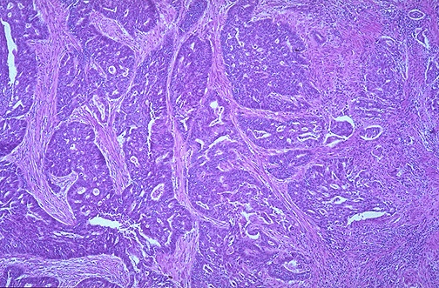

Slide 61
