Slide 1
Breast Pathology
SUFIA HUSAIN, MBBS, MD, FRCPath

Slide 2
Normal Breast
Specialized epithelium and stroma that
gives rise to both benign and malignant lesions
Six to ten major ductal systems originate at the nipple.
Branching of the large ducts leads to the terminal duct lobular units.
The TDU branches into grapelike clusters of small acini to form the lobule.

Slide 3
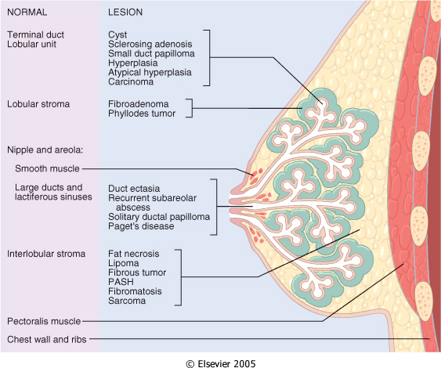
Figure 23-1 Normal breast anatomy and anatomical location of common breast lesions.
Downloaded from: Robbins & Cotran Pathologic Basis of Disease (on 28 April 2008 09:47 AM)
© 2007 Elsevier

Slide 4
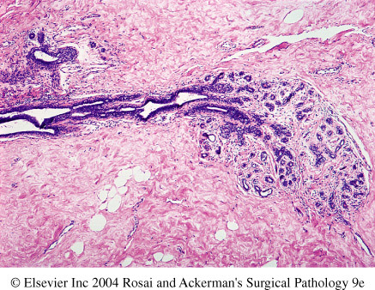

Slide 5
Breast Clinical Presentation
1) Pain (mastalgia): is the most common breast symptom and may be cyclical with menses or noncyclical. Diffuse cyclical pain has no pathologic significance. Noncyclical pain is usually associated with a focal site in the breast. Causes include ruptured cysts or areas of prior injury or infections,or sometime no specific cause.
Although the great majority of painful masses are benign, about 10% of breast cancers present with pain, and all masses need to be investigated.

Slide 6
2)Palpable mass
3)Nipple discharge:
Milky discharge has not been associated with malignancy.
Bloody or serous discharges are most commonly associated with benign lesions but, rarely, can be due to a malignancy.

Slide 7
Characteristics of Breast Carcinomas by Clinical Presentation
Palpable mass
Mammographic density
Mammographic calcifications

Slide 8
Mammographic screening was introduced in the 1980s as a means to detect small, nonpalpable breast carcinomas not associated with breast symptoms. Screening is generally recommended to start at age 40. Younger women usually undergo mammography only if they are at high risk for developing carcinoma. The principal mammographic signs of breast carcinoma are densities and calcifications.

Slide 9
Breast , Benign Epithelial Lesions
1- Non proliferative breast changes
2- Proliferative breast disease without atypia
3- Atypical hyperplasia (Proliferative breast disease with atypia)

Slide 10
Non proliferative Breast Changes (Fibrocystic Changes)
No increased risk for cancer
Could produce palpable breast mass, mammographic densities, calcifications ,or nipple discharge.
Cysts are the most common cause of a palpable mass and they are alarming when they are solitary, firm .

Slide 11
Fibrocystic change
Often produce palpable lumps
characterized by various combinations of cysts, fibrous overgrowth, and epithelial proliferation.
The cause of fibrocystic change is not known.
It is the single most common disorder of the breast.
The condition is diagnosed frequently between the ages of 20 and 55 and decreases progressively after the menopause.
Fibrocystic change presents with asymptomatic masses in the breast, which are discovered by palpation. The masses vary from diffuse small irregularities (lumpy bumpy breast) to a discrete mass or masses.
It may also present with pain, which may be cyclical with midcycle or premenstrual discomfort.
Pain may be focal or diffuse and may or may not be associated with the lumps.

Slide 12
Fibrocystic changes
Three patterns of morphologic changes :
1- Cyst formation
2- Fibrosis
3- Adenosis

Slide 13
Histologically, cysts may be lined by flattened epithelium, columnar epithelium with features of apocrine cells or may completely lack an epithelial lining.

Slide 14
Fibrocystic changes
Cysts :small to big in size ,lined by benign epithelium with apocrine metaplasia
Semi-translucent or turbid fluid
Fibrosis : contribute to the palpable firmness of the breast
Adenosis : Increase in the number of acini per lobule.
Adenosis can be seen in pregnancy.

Slide 15
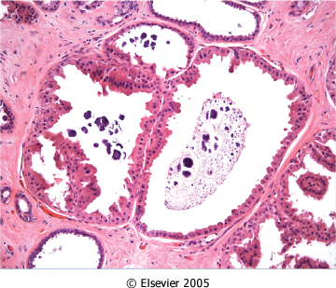
Figure 23-7 Apocrine cysts. Cells with round nuclei and abundant granular eosinophilic cytoplasm, resembling the cells of normal apocrine sweat glands, line the walls of a cluster of small cysts. Secretory debris, frequently with calcifications, is often present. Groups of cysts are common findings associated with clustered mammographic calcifications.
Downloaded from: Robbins & Cotran Pathologic Basis of Disease (on 11 November 2007 08:05 PM)
© 2007 Elsevier

Slide 16
Benign Epithelial Lesions proliferative Disease without Atypia
Rarely form palpable masses
Detected as mammographic densities.
Incidental finding
e.g. Large duct papilloma present in 80% as nipple discharge.
Risk for cancer is 1.5 – 2 times normal

Slide 17
Benign Epithelial Lesions proliferative Disease without Atypia
Many entities included here :
1- Epithelial hyperplasia
2- Sclerosing adenosis
3- complex sclerosing lesions/radial scar
3- Papillomas

Slide 18
Benign Epithelial Lesions proliferative Disease without Atypia
Epithelial Hyperplasia.
In the normal breast, only myoepithelial cells and a single layer of luminal cells. Epithelial or ductal hyperplasia is a proliferative condition in which there is an increase in the cellularity of the epithelium of the TDLU.
Epithelial hyperplasia is defined by the presence of more than two cell layers. Hyperplasia ranges from mild, moderate to florid and from typical (i.e. without atypia) to atypical short of malignancy.

Slide 19
The proliferating epithelium distends the ducts and ductules. It shows two distinct cell populations, epithelial and myoepithelial cells.
It is a microscopic finding, which cannot be predicted clinically or by mammographic examination.
The lesion may coexist with other features of fibrocystic change, but in some cases may form the predominant pattern.

Slide 20
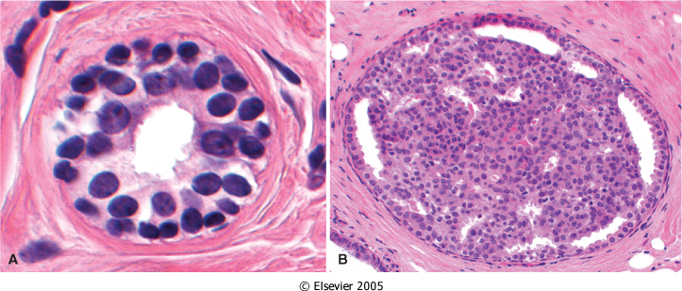
Figure 23-8 A, Normal. A normal duct or acinus has a single basally located myoepithelial cell layer (cells with dark, compact nuclei and scant cytoplasm) and a single luminal cell layer (cells with larger open nuclei, small nucleoli, and more abundant cytoplasm). B, Epithelial hyperplasia. The lumen is filled with a heterogeneous population of cells of different morphologies, often including both luminal and myoepithelial cell types. Irregular slitlike fenestrations are prominent at the periphary.
Downloaded from: Robbins & Cotran Pathologic Basis of Disease (on 11 November 2007 08:05 PM)
© 2007 Elsevier

Slide 21
Benign Epithelial Lesions proliferative Disease without Atypia
Sclerosing Adenosis.
This condition most often occurs as an incidental microscopic finding but may manifest as a palpable mass that may be mistaken clinically for cancer.
It is almost always associated with other forms of fibrocystic change.
Diffuse microcalcifications are commonly seen in the lesion, which may mimic carcinoma on mammography.

Slide 22
Sclerosing Adenosis
Microscopically, sclerosing adenosis consists of proliferation of ductular structures and stroma with distortion of the TDLU.

Slide 23
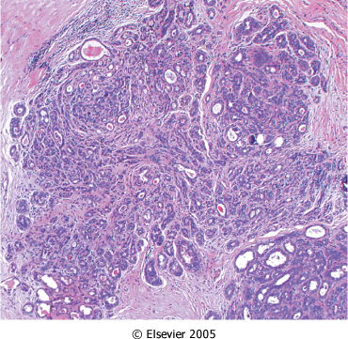
Figure 23-9 Sclerosing adenosis. The involved terminal duct lobular unit is enlarged, and the acini are compressed and distorted by the surrounding dense stroma. Calcifications are often present within the lumens. Although this lesion is frequently mistaken for an invasive carcinoma, unlike carcinomas, the acini are arranged in a swirling pattern, and the outer border is usually well circumscribed.
Downloaded from: Robbins & Cotran Pathologic Basis of Disease (on 11 November 2007 08:05 PM)
© 2007 Elsevier

Slide 24
Benign Epithelial Lesions proliferative Disease without Atypia
Complex Sclerosing Lesion (Radial Scar).
Radial scars are stellate lesions characterized by a central nidus of entrapped glands in a hyalinized stroma
can resemble irregular invasive carcinomas mammographically or on gross examination..

Slide 25
Benign Epithelial Lesions proliferative Disease without Atypia
Complex Sclerosing Lesion (Radial Scar).
"scar" refers to the morphologic appearance, as these lesions are not associated with prior trauma or surgery.

Slide 26
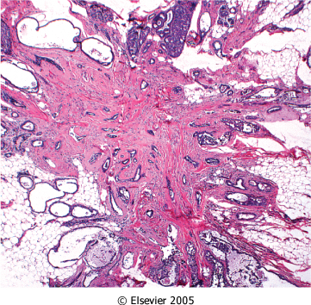
Figure 23-10 Complex sclerosing lesion (radial scar). There is a central nidus consisting of small tubules entrapped in a densely fibrotic stroma surrounded by radiating arms of epithelium with varying degrees of cyst formation and hyperplasia. These lesions typically present as an irregular mammographic density and closely mimic an invasive carcinoma.
Downloaded from: Robbins & Cotran Pathologic Basis of Disease (on 11 November 2007 08:05 PM)
© 2007 Elsevier

Slide 27
Benign Epithelial Lesions proliferative Disease without Atypia
Papillomas
This is a papillary tumor that arises from the duct epithelium including large ducts.
It arises more often in the central part of the breast from the lactiferous ducts (75%) but can occur in any quadrant.
It is more commonly solitary, consisting of a single tumor in one duct, but multiple discrete tumors, usually in contiguous branches of the ductal system may occur.

Slide 28
Benign Epithelial Lesions proliferative Disease without Atypia
Large duct papillomas are usually solitary and situated in the lactiferous sinuses of the nipple.
Small duct papillomas are commonly multiple and located deeper within the ductal system.
Small duct papillomas have been shown to increase the risk of subsequent carcinoma.

Slide 29
Nipple discharge, which may be bloody, is the most common presentation for central papillomas and less commonly of peripheral tumors.
A subareolar mass may be palpable.
Age range is from 30 to 50 years.

Slide 30
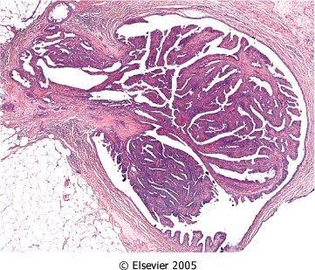
Figure 23-11 Intraductal papilloma. A central fibrovascular core extends from the wall of a duct. The papillae arborize within the lumen and are lined by myoepithelial and luminal cells.
Downloaded from: Robbins & Cotran Pathologic Basis of Disease (on 11 November 2007 08:05 PM)
© 2007 Elsevier

Slide 31
Proliferative Breast Disease with Atpyia/ atypical hyperplasia
Risk for cancer is 4-5 times normal
Atypical hyperplasia is a cellular proliferation resembling ductal carcinoma in situ (DCIS) or lobular carcinoma in situ (LCIS) but lacking sufficient qualitative or quantitative features for a diagnosis of carcinoma in situ.

Slide 32
Proliferative Breast Disease with Atpyia
Include two entities
1 –Atypical ductal hyperplasia
2 –Atypical lobular hyperplasia

Slide 33
Atypical hyperplasia has some of the architectural and cytologic features of carcinoma in situ but lack the complete criteria for that diagnosis and is categorized as ductal or lobular in type

Slide 34
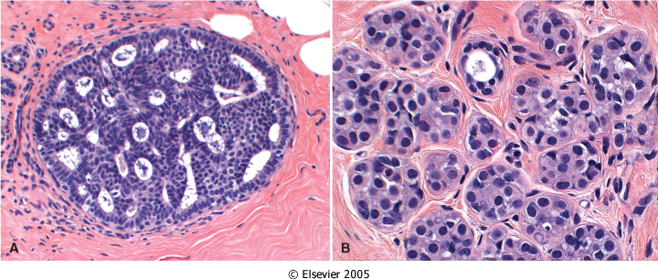
Figure 23-12 A, Atypical ductal hyperplasia. A duct is filled with a mixed population of cells consisting of oriented columnar cells at the periphery and more rounded cells within the central portion. Although some of the spaces are round and regular, the peripheral spaces are irregular and slitlike. These features are highly atypical but fall short of a diagnosis of DCIS. B, Atypical lobular hyperplasia. A population of monomorphic small, rounded, loosely cohesive cells partially fill a lobule. Some intracellular lumina can be seen. Although the cells are morphologically identical to the cells of LCIS, the extent of involvement is not sufficient for this diagnosis.
Downloaded from: Robbins & Cotran Pathologic Basis of Disease (on 11 November 2007 08:05 PM)
© 2007 Elsevier

Slide 35
Breast cancer

Slide 36
Breast Carcinoma
The most common malignancy of breast is carcinoma
Carcinoma of the breast is the most common cancer in women
Women who lives to age 90 has a one in eight chance to have breast cancer

Slide 37
Breast Cancer
Mammographic screening increased dramatically the detection of small invasive cancers
DCIS by itself is almost exclusively detected by mammography ,so the incidence of DCIS is increased with the use of mammography.
The number of women with an advanced cancer is markedly decreased

Slide 38
Breast Cancer
In 1994,the mortality rate started to decline
Currently only 20% of the women with breast cancer are expected to die of the disease

Slide 39
Breast Cancer Risk Factors
Age : There is a steady increase in the incidence of breast cancer, as women grow older. The age-specific incidence rate is highest in postmenopausal women. Breast cancer is rare before 25 yrs, except familial forms ,77% of cases occur in women >50 yrs of age. The average age at diagnosis is 64 years.
Age at Menarche: The younger a woman’s age at menarche, the higher her risk of breast cancer. For each 2 years delay in onset of menstrual activity, the risk is reduced by about 10%. Menarche younger than age 11 have a 20% increased risk to that who have their menarch at 14yrs.

Slide 40
Breast Cancer Risk Factors
First Live birth: The earlier a woman has her first birth, the lower her lifetime risk for breast cancer. This is independent of parity. A woman who has her first birth after 30 years has an increased risk. A nulliparous woman has increased risk. Full term pregnancy before age 20 years has half the risk of nulliparous ,or women who have first birth after age 35.
First Degree relative with Breast Cancer . The relative risk of breast cancer in a woman with breast cancer in first-degree relative (mother, sister, or daughter) ranges from 1.5 to 2.5.The risk increases with the number of affected first degree relatives. The majority of cancers occur in women without such history

Slide 41
Breast Biopsy :Atypical hyperplasia increases the risk for breast cancer
Race :Overall incidence of breast cancer is lower in African American women
Estrogen Exposure: The later a woman’s age at menopause, the higher her risk of breast cancer. Women who had their menopause after 55 years have 2 times the risk of those who had their menopause before 45 years postmenopausal hormone replacement slightly increase the risk

Slide 42
Breast Cancer Risk Factors
Radiation exposure: Higher rate of breast cancer
Women who have had a breast cancer have a 10-fold increased risk of developing a second primary breast cancer.
Geographic influence : Breast cancer is more common in Western industrialized countries than in developing countries. Four to seven times in USA and Europe higher than those in other countries.
Diet: Fat might increase the risk
Obesity : may play a role

Slide 43
Breast Cancer Risk Factors
Exercise :some studies showed degreased risk
Breast–Feeding :The longer the women breast –feed ,the lower the risk
Environmental toxins: pesticides .
Tobacco :Not associated with breast cancer,but associated with the development of peri-ductal mastitis,or sub-areolar abscess .

Slide 44
The major risk factors for the development of breast cancer are hormonal and genetic (family history). Breast carcinomas can, therefore, be divided into sporadic cases, possibly related to hormonal exposure, and hereditary cases, associated with family history or germ-line mutations

Slide 45
Hereditary Breast Cancer
A family history of breast cancer in a first-degree relative is reported in 13% of women with the disease
About 25% of familial cancers (or around 3% of all breast cancers) can be attributed to two highly penetrant autosomal-dominant genes: BRCA1 and BRCA2

Slide 46
Sporadic Breast Cancer
The major risk factors for sporadic breast cancer are related to hormone exposure: gender, age at menarche and menopause, reproductive history, breast-feeding, and exogenous estrogens. The majority of these cancers occur in postmenopausal women and overexpress estrogen

Slide 47
Breast Carcinoma Classification
Almost all are Adenocarcinoma
Divided into In situ Carcinoma( non-invasive) and Invasive carcinoma
Noninvasive carcinoma (Carcinoma in situ): This is epithelial proliferation that is still confined to the TDLU, has not invaded beyond the basement membrane and is therefore incapable of metastasis.

Slide 48
Breast Carcinoma Classification ,Carcinoma in situ
There are two subtypes:
Ductal carcinoma in situ (DCIS) or intraductal carcinoma 80%
2) Lobular carcinoma in situ. The incidence in autopsy studies is about 20%.

Slide 49
DCIS
DCIS comprises a heterogeneous group of noninvasive neoplastic proliferation with risk of development of subsequent invasive carcinoma.
The tumor distends and distorts the ducts in the TDLU so that the terminal ducts enlarge and resemble large ducts.

Slide 50
DCIS
DCIS occurs throughout the age range of breast carcinoma with mean age at diagnosis between 50 and 59 years, similar to the mean age of women with invasive ductal carcinoma.
Mammography is a very sensitive diagnostic procedure for detecting DCIS, as a substantial proportion is not palpable. Mammographically detected microcalcifications are found in 72 to 98% of DCIS.

Slide 51
DCIS( Ductal Carcinoma In Situ)
Rapidly increased in the past two decades
Half of mammographically detected cancers
Most frequently as a calcifications
Less frequently as a density or a vaquely palpable mass or nipple discharge

Slide 52
DCIS( Ductal Carcinoma In Situ)
Many subtypes
-Comedocarcinoma,
-solid ,
-Papillary,
-and micropapillary.
Clinical behavior
Comedocarcinoma has essentially a 100% chance of becoming invasive if left untreated.
Pure cribriform/micropapillary carries only a 30% chance of invasive carcinoma.

Slide 53
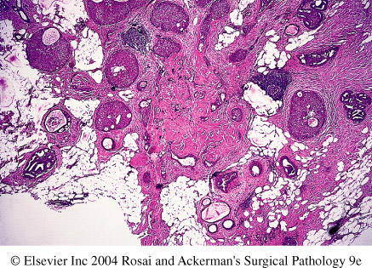
Ductal carcinoma insitu

Slide 54
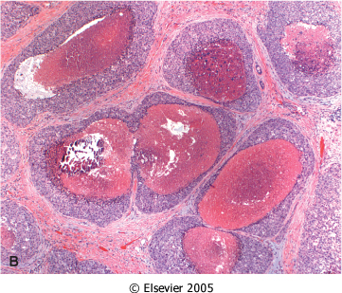
Figure 23-16 A, This mammogram reveals multiple clusters of small, irregular calcifications in a segmental distribution. Suspicious calcifications must be biopsied, as 20% to 30% will prove to be due to DCIS. B, Comedo DCIS fills several adjacent ducts (or completely replaced lobules) and is characterized by large central zones of necrosis with calcified debris. This type of DCIS is most frequently detected as radiologic calcifications. Less commonly, the surrounding desmoplastic response results in an ill-defined palpable mass or a mammographic density.
Downloaded from: Robbins & Cotran Pathologic Basis of Disease (on 28 April 2008 09:47 AM)
© 2007 Elsevier

Slide 55
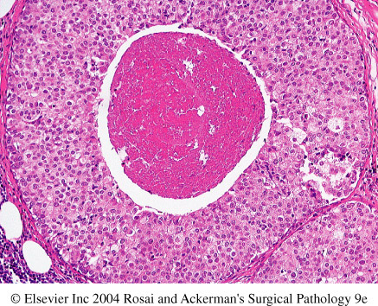

Slide 56
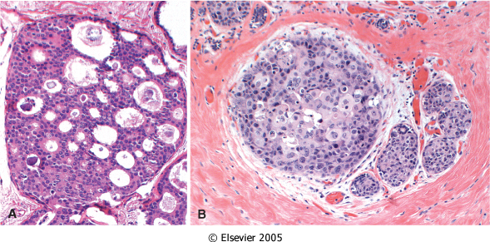
Figure 23-17 Noncomedo DCIS. A, Cribriform DCIS comprises cells forming round, regular ("cookie cutter") spaces. The lumens are often filled with calcifying secretory material. B, This solid DCIS has almost completely filled and distorted this lobule with only a few remaining luminal cells visible. This type of DCIS is not usually associated with calcifications and may be clinically occult.
Downloaded from: Robbins & Cotran Pathologic Basis of Disease (on 28 April 2008 09:47 AM)
© 2007 Elsevier

Slide 57
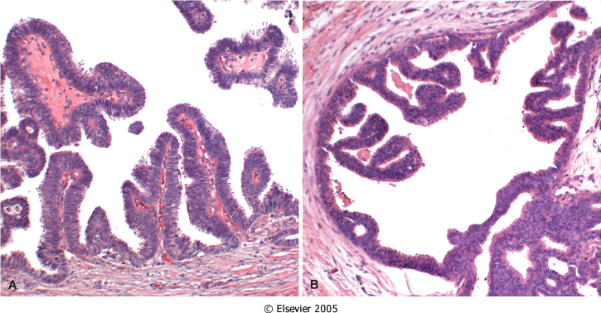
Figure 23-18 Noncomedo DCIS. A, Papillary DCIS. Delicate fibrovascular cores extend into a duct and are lined by a monomorphic population of tall columnar cells. Myoepithelial cells are absent. B, Micropapillary DCIS. The papillae are connected to the duct wall by a narrow base and often have bulbous or complex outgrowths. The papillae are solid and do not have fibrovascular cores.
Downloaded from: Robbins & Cotran Pathologic Basis of Disease (on 28 April 2008 09:47 AM)
© 2007 Elsevier

Slide 58
Paget’s Disease
Rare skin manifestation of breast cancer(1 to 2 %)
Paget’s disease of the nipple presents with an eczematous area of the nipple, which may be subtle or form an obviously eroded, weeping lesion.
Pruritus is common ,might be mistaken for Eczema, presents as a unilateral erythematous eruption with a scale crust.
Malignant cells, referred to as Paget cells and are found scattered in the epidermis.

Slide 59
Paget’s Disease
The histologic hallmark of Paget’s disease of the nipple is the infiltration of the epidermis by large ductal neoplastic cells with abundant clear or pale cytoplasm and nuclei with prominent nucleoli. The cells usually stain positively for mucin.
Paget cells extend from DCIS within the ductal system into nipple skin without crossing the basement membrane
Palpable mass is present in 50 to 60% of women with Paget disease indicating an underlying invasive carcinoma.

Slide 60
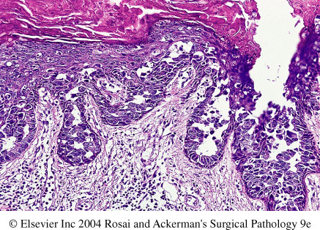
Pagets disease

Slide 61
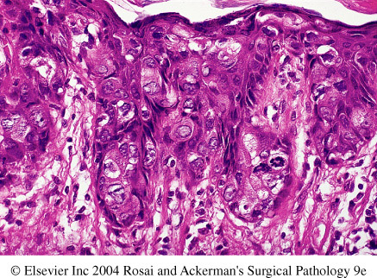
Pagets disease

Slide 62
LCIS -Lobular Carcinoma in Situ
Always an incidental finding in a biopsy performed for another reason
Infrequent (1% to 6% )of all carcinomas
Bilateral in 20% to 40% of women when both breasts are biopsied
LCIS is frequently multicentric and bilateral and subsequent carcinomas occur at equal frequency in both breasts

Slide 63
LCIS -Lobular Carcinoma in Situ
Lobular carcinoma in situ (LCIS) does not form a palpable mass and cannot be detected clinically, felt at operation or seen grossly on pathological examination.
Although LCIS may have microcalcifications, these are infrequent and so mammography has not been useful for detecting it.
The tumor presents as a coincidental finding in breast tissue removed for other reasons. The disease tends to be bilateral and multicentric.
LCIS shows a proliferation of cells that fill and distend the TDLU.

Slide 64
LCIS -Lobular Carcinoma in Situ
Clinical behavior
If LCIS is left untreated, about 30% of women develop an invasive cancer within 20 years of diagnosis. The invasive cancer may be ductal or lobular. LCIS is therefore a marker of increased cancer in both breasts.

Slide 65
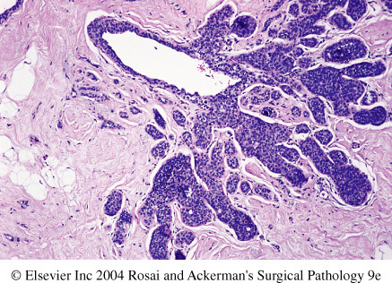
Lobular carcinoma insitu

Slide 66
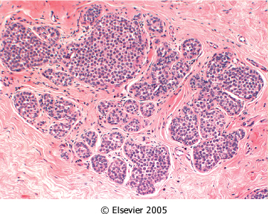
Figure 23-20 Lobular carcinoma in situ. A monomorphic population of small, rounded, loosely cohesive cells fills and expands the acini of a lobule. The underlying lobular architecture can still be recognized.
Downloaded from: Robbins & Cotran Pathologic Basis of Disease (on 28 April 2008 09:47 AM)
© 2007 Elsevier

Slide 67
Invasive Breast Carcinoma Classification
Invasive breast carcinoma is tumor that has extended across the basement membrane. This permits access to lymphatics and vessels and the potential distant metastases and thereby a lethal outcome. There are several different types of invasive carcinoma. Invasive breast carcinoma is subdivided into
1- NOS Ductal 80%
2- Lobular 10%
3- tubular 6%
4-Mucinous(Colloid) 2%
5- Medullary 2%
6- Papillary 1%
7- Metaplastic Carcinoma 1%

Slide 68
CLINICAL FEATURES OF BREAST CANCER
Palpable mass.
By the time a cancer becomes palpable, over half the patients will have axillary lymph node metastases .
Larger carcinomas may be fixed to the chest wall or cause dimpling of the skin.
Lymphatics may become so involved as to block the local area of skin drainage and cause lymphedema and thickening of the skin, a change referred to as peau d'orange.
When the tumor involves the central portion of the breast, retraction of the nipple may develop.

Slide 69
CLINICAL FEATURES OF BREAST CANCER
In older women undergoing mammography, invasive carcinomas most commonly present as a density.
Invasive carcinomas presenting as mammographic calcifications without an associated density are usually very small in size.

Slide 70
CLINICAL FEATURES OF BREAST CANCER
The term "inflammatory carcinoma" refers to the clinical presentation of a carcinoma extensively involving dermal lymphatics, resulting in an enlarged erythematous breast. The diagnosis is made on clinical grounds and does not correlate with a specific histologic type of carcinoma

Slide 71
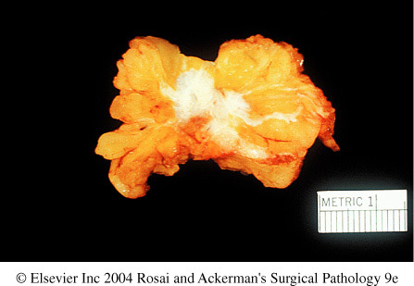
Invasive carcinoma

Slide 72
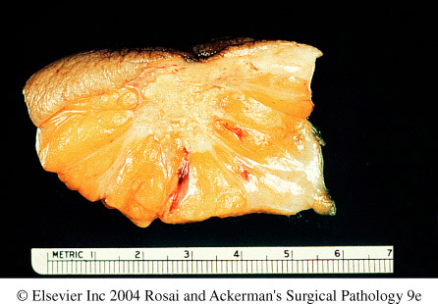
Invasive carcinoma

Slide 73
Invasive Ductal Carcinoma ,NOS
It is the commonest type of breast cancer, forming up to 80% of these cancers.
Most of these tumors excite a pronounced fibroblastic stromal reaction to the invading tumor cells producing a palpable mass with hard consistency (hence scirrhous carcinoma), which is the most common presentation.
The tumor shows an infiltrative attachment to the surrounding structures and may cause dimpling of the skin (due to traction on suspensory ligaments) or nipple retraction.

Slide 74
Invasive Ductal Carcinoma ,NOS
Grossly ,firm ,hard, and have an irregular border
Cut surface is gritty and shows irregular margins with stellate infiltration and in the center there are small foci of chalky white stroma and occasionally calcifications
Characteristic grating sound when cut or scraped
Could be soft and well demarcated
Accompanied by varying amounts of DCIS

Slide 75
Invasive Ductal Carcinoma,NOS
Histologically, the tumor cells are larger than normal epithelium, and can assume a variety of patterns such as glandular formation, cords of cells, broad sheets of cells or a mixture of all these, usually within a dense stroma.
The tumors range from well differentiated, in which there is glandular formation, to poorly differentiated, containing solid sheets of pleomorphic neoplastic cells.
Carcinomas associated with a large amount of DCIS require large excisions with wide margins to reduce local recurrences

Slide 76
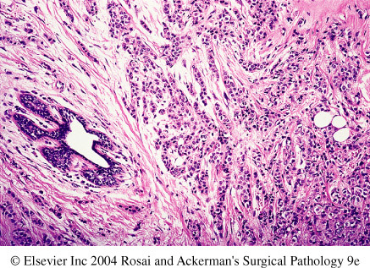
Invasive carcinoma, ductal

Slide 77
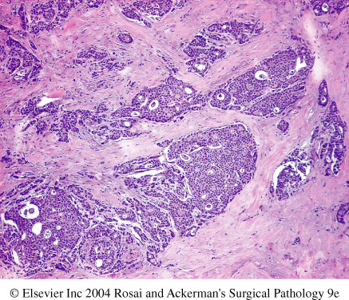
Invasive ductal carcinoma

Slide 78
Invasive Lobular Carcinoma
It is the second most common type of invasive breast cancer forming up to 10% of breast cancers.
The tumor may occur alone or in combination with ductal carcinoma.
It tends to be bilateral more often than ductal carcinoma and multicentric.
The amount of stromal reaction to the tumor varies from dense desmoplasia to little reaction and therefore the presentation varies from a discrete mass to a subtle, diffuse indurated area.

Slide 79
Invasive Lobular Carcinoma
Most are firm to hard with irregular margins
Single infiltrating cells ,often one cell width
No tubules or papillary formation
In about 10% of cases, tumors have mixed features of invasive ductal and lobular carcinomas.

Slide 80
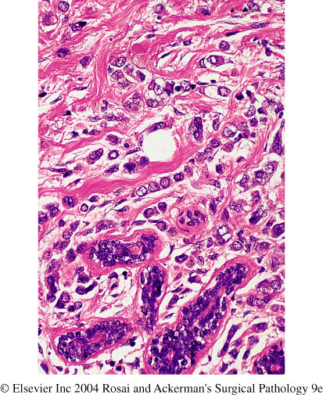

Slide 81
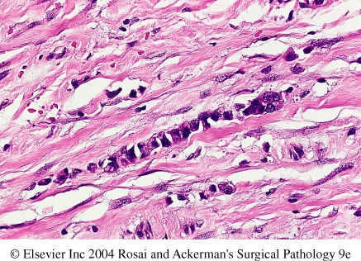

Slide 82
Medullary Carcinoma
This subtype of breast cancer presents as a well circumscribed mass.
May mistaken clinically and radiologically for fibroadenoma
It does not produce any fibroblastic (desmoplastic) reaction and therefore is soft and fleshy (encephaloid). On section foci of necrosis and hemorrhage are evident.
Microscopically, the tumor is composed of solid sheets of malignant cells and frequent mitoses. There is scant fibrous stroma. Lymphocytes and plasma cells surround the tumor cells.

Slide 83
Colloid Carcinoma/ Mucinous carcinoma
tends to occur in older women.
It is sharply circumscribed, lacks fibrous stroma and is slow growing.
Is soft and gelatinous and has a glistening cut surface.
It may be in pure mucinous or mixed in which it is associated with other types of invasive breast carcinoma.
The mucinous tumor is composed of small islands, occasionally forming glands, and isolated tumor cells floating in pools of extracellular mucin

Slide 84
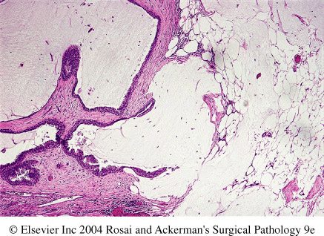
Invasive colloid carcinoma

Slide 85
Breast Carcinoma , Major Prognostic Factors
1- Invasive or In situ disease: By definition, in situ carcinoma is confined to the ductal system and cannot metastasize. Breast cancer deaths associated with DCIS are due to the subsequent development of invasive carcinoma or areas of invasion undetected at the time of diagnosis. The great majority of women with adequately treated DCIS will be cured. In contrast, at least half of invasive carcinomas will have metastasized locally or distantly at the time of diagnosis.

Slide 86
Breast Carcinoma , Major Prognostic Factors
2- Distant metastasis: Once distant metastases are present, cure is unlikely, although long-term remissions and palliation can be achieved. Favored sites for dissemination are the lungs, bones, liver, adrenals, brain, and meninges.

Slide 87
Breast Carcinoma , Major Prognostic Factors
3- Lymph node metastasis: Axillary lymph node status is the most important prognostic factor for invasive carcinoma in the absence of distant metastases. The clinical assessment of nodal involvement is very inaccurate, therefore, biopsy is necessary for accurate assessment. With no involvement, the 10-year disease-free survival rate is close to 70% to 80%; the rate falls to 35% to 40% with one to three positive nodes and 10% to 15% in the presence of more than 10 positive nodes.

Slide 88
Breast Carcinoma , Major Prognostic Factors
4- Tumor Size: The size of the carcinoma is the second most important prognostic factor. The risk of axillary lymph node metastases does increase with the size of the carcinoma.
Note : all the above parameters are used to stage the tumor.Stage is a combination of size and lymph node status. Tumor size less than 2 cm is associated with a favorable prognosis. The single most important prognostic indicator is the lymph node status. Negative lymph nodes have the best prognosis. Involvement of 1 to 3 lymph nodes has an intermediate prognosis and 4 or more positive nodes have the worse prognosis.

Slide 89
Breast Carcinoma , Major Prognostic Factors
5- Locally advanced disease:Tumors invading into skin or skeletal muscle are frequently associated with concurrent or subsequent distant disease. With increased awareness of breast cancer detection, such cases have fortunately decreased in frequency and are now rare at initial presentation.

Slide 90
Breast Carcinoma , Major Prognostic Factors
6- Inflammatory Carcinoma: Women presenting with the clinical appearance of breast swelling and skin thickening have a particularly poor prognosis with a 3-year survival rate of only 3% to 10%.

Slide 91
Breast Carcinoma , Minor Prognostic Factors
1- Histologic Subtype: Infiltrating ductal and lobular carcinomas have the worse prognosis, medullary and mucinous have intermediate and tubular and cribriform have the most favorable prognoses
2- Tumor Grade: This is calculated by the pathologist. Grading separates tumors into three categories according to the amount of well formed tubules, the degree of nuclear pleomorphism, and the mitotic rate. The most commonly used grading system to assess the degree of tumor differentiation (Bloom Richardson). There are three grades with grade 1 having better prognosis and grade3 having poorer prognosis.

Slide 92
Breast Carcinoma , Minor Prognostic Factors
3- Estrogen and progesteron receptors:50% to 85% of carcinomas express estrogen receptors, such tumors are more common in postmenopausal women, hormone positive cancers have better prognosis. They respond well to specific chemotherapuetic drugs eg. Tamoxifen. Therefore reporting of ER/PR positivity is important when reporting breast cancer.

Slide 93
Breast Carcinoma , Minor Prognostic Factors
4- HER2/neu. (human epidermal growth factor receptor 2 or c-erb B2 or neu) is a glycoprotein overexpressed in 20% to 30% of breast carcinomas.
Many studies have shown that overexpression of HER2/neu is associated with a poor prognosis.
In addition, ongoing studies have shown that HER2/neu-overexpressing tumors respond very well to hormonal or anthracycline chemotherapy regimens
eg. Trastuzumab (Herceptin). Therfore evaluation of HER2/neu is most important when reporting breast cancer.

Slide 94
Breast Carcinoma , Minor Prognostic Factors
5- Lymphovascular invasion: Tumor cells may be seen within vascular spaces (either lymphatics or small capillaries) surrounding tumors. This finding is strongly associated with the presence of lymph node metastases and is a poor prognostic factor in women without lymph node metastases.
6- Proliferative rates

Slide 95
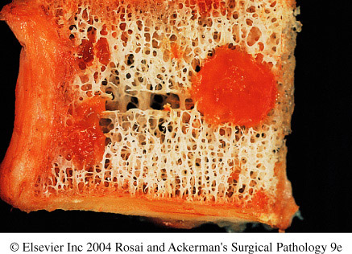
Metastasis to vertebra

Slide 96
STROMAL TUMORS

Slide 97
2 basic stromal tumors are
- fibroadenoma
- Phylloids tumor

Slide 98
Fibroadenoma
The most common benign tumor of the female breast and is composed of both epithelial and stromal tissue derived from the TDLU.
Any age ,most common before age 30
Usually present with a palpable mass
Regression usually occurs after menopause

Slide 99
The tumor presents as a spherical, rubbery nodule, which is sharply circumscribed from the surrounding breast tissue and so is freely movable and can be shelled out.
It may increase in size during pregnancy and cease to grow after menopause. The tumor is usually solitary but may be multiple and involve both breasts. The cut surface is pearl-white

Slide 100
Fibroadenoma
Spherical nodules
Sharply demarcated
Freely movable (breast mouse)
Size vary
Proliferation in both glands and stroma
Treatment: lumpectomy (only the lump is removed)

Slide 101
Histologically, the tumor is composed of a mixture of ducts and fibrous connective tissue
The tumor is completely benign.
Rarely, carcinoma may arise within a fibroadenoma. The predominant type has been lobular carcinoma

Slide 102
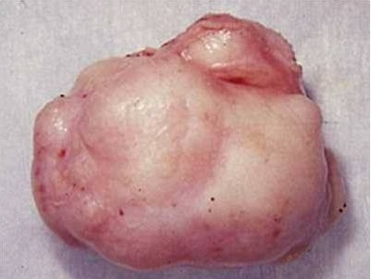

Slide 103
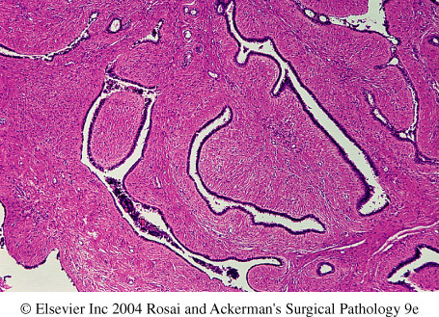
fibroadenoma

Slide 104
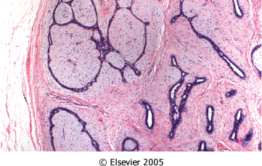
Figure 23-29 Fibroadenoma. The lesion consists of a proliferation of intralobular stroma surrounding and often pushing and distorting the associated epithelium. The border is sharply delimited from the surrounding tissue.
Downloaded from: Robbins & Cotran Pathologic Basis of Disease (on 28 April 2008 09:47 AM)
© 2007 Elsevier

Slide 105
Phylloides tumor
Phyllodes tumors, like fibroadenomas, arise from intralobular stroma. Although they can occur at any age, most present in the sixth decade, 10 to 20 years later than the average presentation of a fibroadenoma
Most present as palpable masses

Slide 106
Phyllodes tumors must be excised with wide margins to avoid the high risk of local recurrences.
The majority are low-grade tumors that may recur locally but only rarely metastasize. Rare high-grade lesions behave aggressively, with frequent local recurrences and distant hematogenous metastases in about one third of cases.

