Slide 1
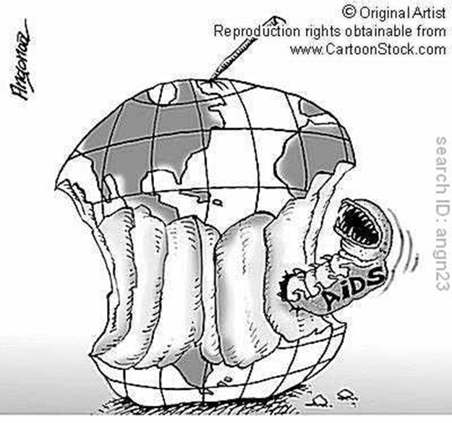
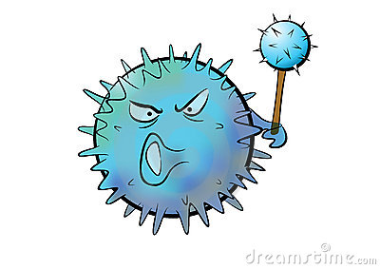
Dr. Sufia husain
HIV pathology

Slide 2
Introduction
Human immunodeficiency virus (HIV) is the causative agent for AIDS.
HIV is caused by a retrovirus of the lentivirus family that contains only RNA .
It was unknown until the early 1980's, but since then has been spread around the world to infect millions of persons.
The most common type of HIV infections is known as HIV-1 and is the type that has led to the worldwide AIDS epidemic.
There is also an HIV-2 that is much less common.

Slide 3
The result of HIV infection is the destruction of the immune system.
All HIV infected persons are at risk for illness and death from development of opportunistic infections and tumors and the inevitable manifestations of AIDS.

Slide 4
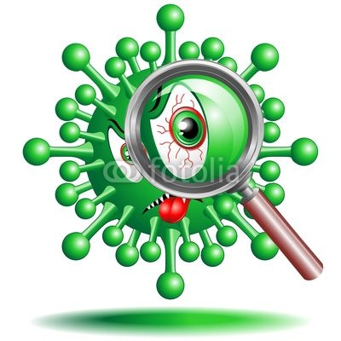
HIV Structure
The mature virus consists of an electron dense core containing the viral genome consisting of the 2 short strands of RNA (ribonucleic acid). In addition the enzymes reverse transcriptase, protease, ribonuclease, and integrase are present. All are encased by an outer lipid envelope.

Slide 5
Pathogenesis of hiv infection
The HIV virion expresses a cell surface protein/antigen called gp120, that aids in the binding of the virus to the target cells. Once the virus enters the human body it attaches itself to the target cell attaching to the CD4 receptors on the surface of the target cell and therefore gains entry into the target cell. Gp120 is responsible for tropism/attraction to CD4+ receptors. This function helps in entry of HIV into the host cell.
In addition gp120 also binds to two co-receptors CXCR4 and CCR5 on the host cell surface. They too assist in the entry of HIV into the host cell.

Slide 6
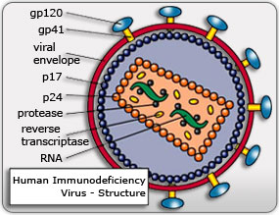
The structural components of human immunodeficiency virus are diagrammed

Slide 7
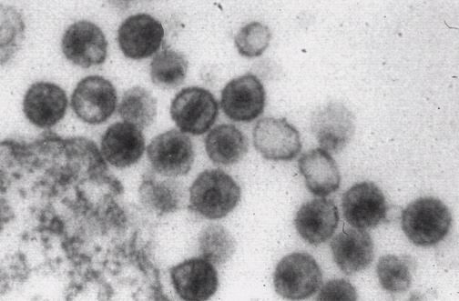
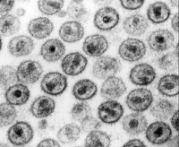
Human immunodeficiency viral particles are seen at medium magnification in this electron micrograph. Note the central core and the outer envelope

Slide 8
Pathogenesis of hiv infection
The T-lymphocytes have surface CD4 receptors (CD4+ T lymphocytes) to which HIV can attach to promote entry into the cell.
NOTE: The probability of infection depends on both the number of infective HIV virions in the body fluid which contacts the host as well as the number of cells with CD4 receptors available at the site of contact.

Slide 9
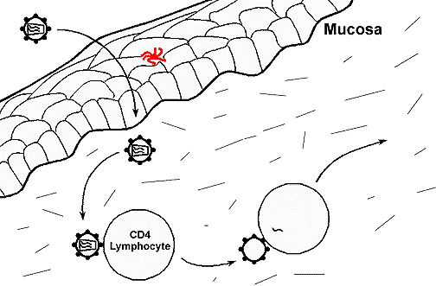
Human immunodeficiency virus is shown crossing the mucosa of the genital tract to infect CD4+ T-lymphocytes. A Langerhans cell in the epithelium is shown in red in this diagram

Slide 10
Pathogenesis of hiv infection
Retroviruses are unable to replicate outside of living host cells because they contain only RNA and do not contain DNA. Therefore once HIV infects a cell, it must use its reverse transcriptase enzyme to transcribe its RNA to host cell proviral DNA for replication.

Slide 11
Pathogenesis of hiv infection
The enzyme, reverse transcriptase which is bound to the HIV RNA helps in the reverse transcription (i.e. conversion) of RNA to proviral DNA. It is this HIV proviral DNA which is then inserted into host cell genomic DNA by the integrase enzyme.
Once the HIV proviral DNA is within the infected cell's genome the HIV provirus is replicated by the host cell to produce additional HIV virions which are released by surface budding. Alternatively the infected cells can undergo lysis with release of new HIV virions which can then infect additional cells.

Slide 12
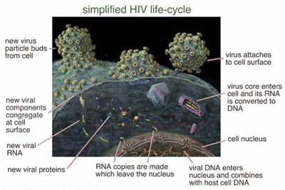
HIV life cycle (start from right side)

Slide 13
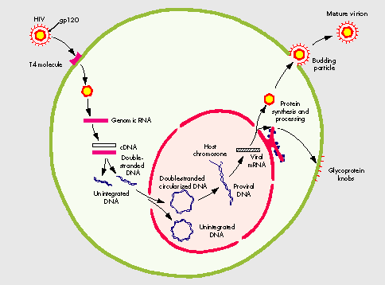

Slide 14
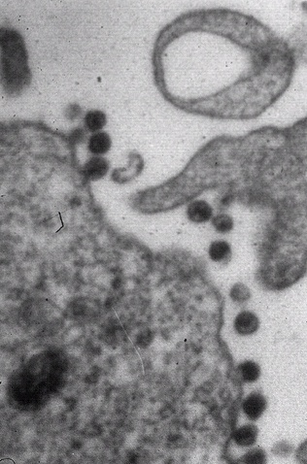
Human immunodeficiency virus, viral particles are seen at low magnification adjacent to the cell surface in this electron micrograph

Slide 15
Pathogenesis of hiv infection
The primary target cells are: cells of the mononuclear phagocyte system e.g. blood monocytes and tissue macrophages, T lymphocytes, B lymphocytes, natural killer (NK) lymphocytes, dendritic cells (i.e. the Langerhans cells of epithelia and follicular dendritic cells in lymph nodes), hematopoietic stem cells, endothelial cells, microglial cells in brain, and gastrointestinal epithelial cells.

Slide 16
Establishment of HIV Infection
Macrophages and Langerhans cells are important both as reservoirs and vectors for the spread of HIV in the body including the CNS. Both macrophages and Langerhans cells can be HIV-infected but are not destroyed themselves. HIV can then be carried elsewhere in the body.
Once the infection extends to the lymph nodes, the HIV virions are trapped in the processes of follicular dendritic cells (FDC's), where they provide a reservoir and infect CD4+ T lymphocytes that are passing through the lymph node. The FDC's themselves become infected, but are not destroyed.
NOTE: HIV may infect neural cells directly by way of CD4 receptors or may compete (through the gl120 protein) for neural receptor sites for neuroleukin, a neural tissue growth factor.

Slide 17
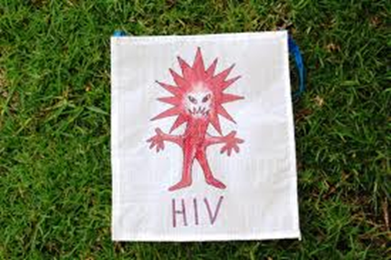
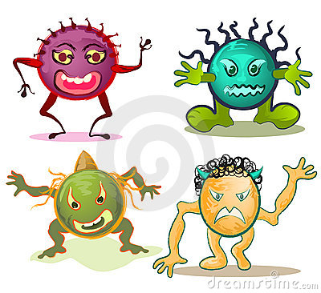
Establishment of HIV Infection
In addition HIV has the ability to mutate easily. This high mutation rate leads to the emergence of HIV variants within the infected person's cells that are more toxic and can resist drug therapy. Over time, different tissues of the body may harbor differing HIV variants

Slide 18
The major modes of transmission of HIV (the high risk population)
HIV can be present in a variety of body fluids and secretions. They include genital secretions, blood, and breast milk. Genital secretions, blood, saliva, urine, tears, and sweat
NOTE: saliva, urine, tears, and sweat is of no major clinical importance, as transmission of HIV through these fluids does not routinely occur because of the low concentration of HIV in these fluids.

Slide 19
The major modes of transmission of HIV (the high risk population)
1. HIV is primarily spread as a sexually transmissible disease. Transmission of HIV can occur from male to male, male to female, and female to male. Female to female transmission remains extremely rare.

Slide 20
The major modes of transmission of HIV (the high risk population)
2. HIV can be transmitted through parenteral route, e.g.
- Intravenous drug users sharing infected needles. Less common practices like use of instruments such as tattoo needles not properly disinfected also carries a potential risk.
- Health care workers with percutaneous exposures (needle puncture) to HIV-containing blood.
- Persons receiving multiple blood transfusions e.g hemophiliacs. Screening of blood products for HIV has significantly reduced HIV transmission by this means.

Slide 21
The major modes of transmission of HIV (the high risk population)
3. HIV infection can also be acquired as a congenital infection either perinatally or in infancy. Mothers with HIV infection can pass the virus
– transplacentally i.e. in utero
- at the time of delivery through the birth canal
- through breast milk.
NOTE: HIV infection is not spread by casual contact in public places, households, or in the workplace. HIV is not spread by insect vectors. There is no vaccine to prevent HIV infection

Slide 22
Diagnosis OF hiv
Test for HIV antibodies is done with a rapid test using an enzyme-linked immunosorbent assay (ELISA) technique.
If rapid test is positive, then the next step is to:
Confirm HIV infection with Western blot or immunofluorescence assay (IFA)
NOTE: The average HIV-infected person may take up to several weeks to become seropositive, and then may live up to 8 or 10 years, on average, before development of the clinical signs and symptoms of AIDS.

Slide 23
Primary HIV Infection
Primary HIV infection may go unnoticed in at least half of cases or produce a mild disease which quickly subsides,or produce acute HIV infection, followed by a long clinical "latent" period lasting years.
Primary acute HIV infections may include fever, generalized lymphadenopathy, pharyngitis, rash, arthralgia and diarrhea. These symptoms diminish over 1 to 2 months.

Slide 24
Pathogenesis of aids/clinical aids
The primary target of HIV is the immune system, which is gradually destroyed.
Clinically, HIV infection may appear "latent" for years. During this period there is ongoing immune system destruction but still enough of the immune system remains intact to provide immunity and prevent most infections.
Eventually, when a significant number of CD4+ T lymphocytes have been destroyed and when production of new CD4 cells cannot match destruction, then failure of the immune system leads to the appearance of clinical AIDS
The CD4+T cells to CD8+T cells ratio is also greatly reduced, often to less than 1.0.

Slide 25
Pathogenesis of aids/clinical aids
The progression to clinical AIDS (acquired immune deficiency syndrome) is also marked by the appearance of syncytia-forming (SI) variants of HIV in about half of HIV infected patients. These SI viral variants have greater attraction to CD4 cells and are associated with more rapid CD4+ cell decline.
The development of signs and symptoms of AIDS typically parallels laboratory testing for CD4 lymphocytes. When the CD4 lymphocyte count drops below 200/microliter, then the stage of clinical AIDS has been reached. This is the point at which the characteristic opportunistic infections and neoplasms of AIDS appear.

Slide 26
Acquired Immunodeficiency Syndrome (AIDS)
The stage of clinical AIDS is reached years after initial infection and is marked by the development of one or more of the typical opportunistic infections or neoplasms common to AIDS.
Following are some of the more common complications seen with AIDS:

Slide 27
Pneumocystis jiroveci
Pneumocystis jiroveci (formerly carinii) is the most frequent opportunistic infection seen with AIDS. It commonly produces a pulmonary infection.
Diagnosis is made histologically by finding the organisms in cytologic (bronchoalveolar lavage) or biopsy (transbronchial biopsy) material from lung.

Slide 28
Cytomegalovirus
Cytomegalovirus (CMV) infection is seen with AIDS. It causes pneumonia and it can also cause serious disease in the brain and gastrointestinal tract. It is also a common cause for retinitis and blindness in persons with AIDS.

Slide 29
Mycobacterial infections
Mycobacterial infections are frequently seen with AIDS.
Mycobacterium tuberculosis.
Mycobacterium avium complex (MAC) infection.
Definitive diagnosis of mycobacterial disease is made by culture and PCR.

Slide 30
Fungal Infections
Candidiasis of the esophagus, trachea, bronchi, or lungs.
Cryptococcus neoformans (produces pneumonia and meningitis), Histoplasma capsulatum, and Coccidioides immitis.

Slide 31
Others
Toxoplasmosis caused by Toxoplasma gondii is a protozoan parasite that most often leads to infection of the brain with AIDS.
Herpes simplex infection in the mucosa
Aspergillosis especially in the lung
Cryptosporidium and Microsporidium produce voluminous watery diarrhea in patients with AIDS.
Viral HIV encephalitis
Syphilis (primary, secondary and tertiary)

Slide 32
Malignant Neoplasms
Kaposi's sarcoma (KS) produces reddish purple patches or nodules over the skin and can be diagnosed with skin biopsy. Visceral organ can also be involved with KS.It is a sarcoma of the blood vessels.
Malignant lymphomas are seen with AIDS. Commonly it is B-cell Non Hodgkins Lymphoma. They are typically of a high grade and often in the brain. They are very aggressive and respond poorly to therapy.

Slide 33
Miscellaneous
Lymphoid interstitial pneumonitis (LIP) is a condition involving the lung that can be seen in AIDS in children.

