Slide 1
Testicular Pathology
Emad Raddaoui, MD, FCAP, FASC
Associate Professor & Consultant

Slide 2
Normal Anatomy

Slide 3
Testicular diseases
Epididymitis And ORCHITIS:
Inflammatory conditions are generally more common in the
epididymis than in the testis
However, some infections, notably syphilis, may begin in the testis with secondary involvement of the epididymis
Epididymitis and possible subsequent orchitis are commonly related to infections in the urinary tract (cystitis, urethritis, genitoprostatitis)
These infections reach the epididymis/testis through either the vas deference or the lymphatics of the spermatic cord

Slide 4
Epididymitis And Orchitis
Epididymitis
CAUSES: Varies with age
Children: uncommon, usually associated with a congenital genitourinary abnormality and infection with Gram –ve rods.
In sexually active men < 35 years →Chlamydia trachomatis
and Neisseria
Older than 35 Years → E.Coli and Pseudomonas.

Slide 5
Epididymitis And Orchitis
Microscopic findings:
Non specific acute inflammation characterized by congestion, edema and infiltration by lymphocytes, neutrophils and macrophages.
Initially involves the interstitial connective tissue→
later involves tubules → may progress to frank abscess.
Often followed by fibrous scarring.
Leydig cells are not usually destroyed

Slide 6
Granulomatous (Autoimmune) Orchitis
Usually middle –aged men, unilateral testicular mass.
Moderately tender but sometimes may present as painless testicular mass; mimicking a testicular tumor.
Although an autoimmune basis is suspected, the cause of these lesions remain unknown.
May be a response to acid-fast products of disintegrated sperm, post-infectious, or due to trauma or sarcoidosis
Microscopically: granulomas, restricted within the spermatic tubules.

Slide 7
Specific Inflammations:
Gonorrhea:
Extension of infection from the posterior urethra →prostate →seminal vesicles →epididymis is the usual course of a neglected gonococcal infection.
Can lead to frank abscess may spread to testis and can produce a supurative orchitis.
Tuberculosis:
Almost invariably begins in the epididymis and may spread to the testis.
In many of these cases ,there is associated tuberculous prostatitis and seminal vesiculitis
Microscopy: Caseating Granulomatous inflammation.

Slide 8
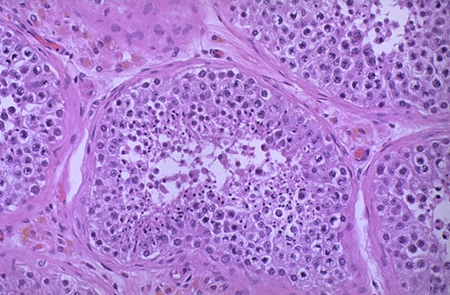
*
Pink Leyding cells are seen here in the interstitium( arrow). Note the pale golden brown pigment as well( bold arrow). There is active spermatogenesis (*)
Notes:
Normal testis shows tubules with active spermatogenesis

Slide 9
Testicular Tumors

Slide 10
Testicular Tumors
Complex mixture of anatomic types
95% of them originate from germ cells,
Age group→15-30 years, whites> blacks
Most of gem cell tumors are highly aggressive cancers
Capable of wide ,extensive dissemination
Current therapy ,most of them can be cured
Non germinal tumors are generally benign

Slide 11
Testicular Tumors Classification
Germ cell tumors :
Seminomatous:
Seminoma
Spermatocytic seminoma
Non Seminomatous
Embryonal carcinoma
Yolk sac (endodermal Sinus) tumor
Choriocarcinoma
Teratoma
Sex Cord Tumors
Leydig cell tumor
Sertoli cell tumor

Slide 12
Testicular Tumors Pathogenesis
Predisposing factors:
-Cryptorchidism :10% of testicular tumors
-Testicular dysgenesis
-Genetic factors

Slide 13
Seminoma
The most common type of germ cell tumors (50%)
Peak incidence in thirties (Almost never occur in infants)
Identical one occurs in the ovary(Dysgerminoma)

Slide 14
Bulky masses
Homogenous
Gray-white
Lobulated cut surface
Usually no necrosis or hemorrhage
In 50% ,the entire testis is involved
Occasionally extends to the epididymis, spermatic cord, or scrotal sac
Seminoma

Slide 15
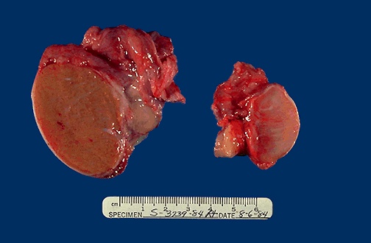
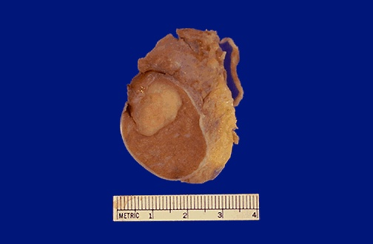
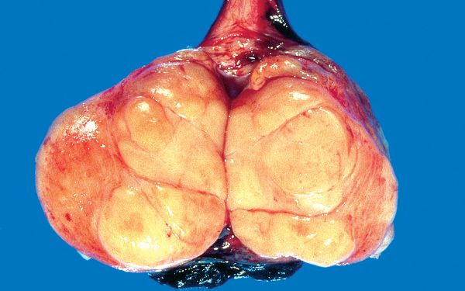
Seminoma of the testis appears as a fairly well-circumscribed, pale, fleshy, homogeneous mass

Slide 16
Seminoma , Morphology
Microscopically ,sheets of uniform cells
Lobules separated by delicate fibrous septa with many lymphocytes
Cells are large ,round ,has distinct cell membrane
Large nucleus with prominent nucleolei
Positive for PLAP

Slide 17
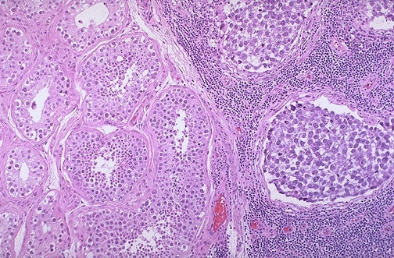
Sheets of uniform cells
Lobules separated by delicate fibrous septa with many lymphocytes
Cells are large ,round ,has distinct cell membrane
Large nucleus with prominent nucleolei
Positive for PLAP
Notes:
Normal spermatogenesis on left, seminoma on right

Slide 18
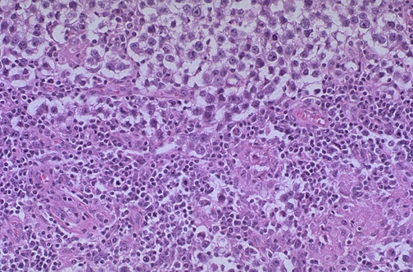
Large cells with distinct cell borders, pale nuclei, prominent nucleoli, and a sparse lymphocytic infiltrate

Slide 19
Spermatocytic Seminoma
Distinctive tumor ,clinically and histologically
1-2 % of testicular tumors
Over age 65
Slow growing tumor ,rarely metastasise
Prognosis is excellent

Slide 20
Embryonal Carcinoma
20 to 30 year age group
More aggressive than seminomas
Smaller than seminoma
Grossly, shows foci of necrosis and hemorrhage
Microscopically,shows sheets of undifferentiated cells as well as primitive glandular differentiation. Cells grow in alveolar or tubular pattern ,sometimes with papillary convolutions.
Could be present with other neoplasm in 45%

Slide 21
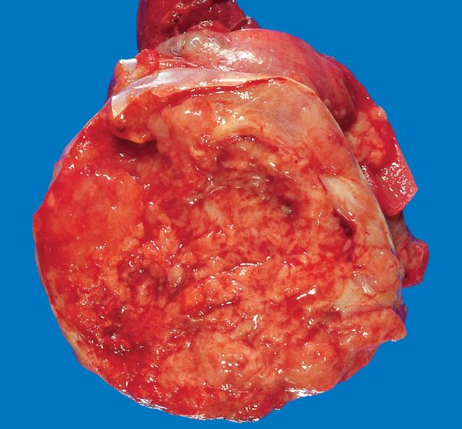
Embryonal carcinoma
hemorrhagic mass.

Slide 22
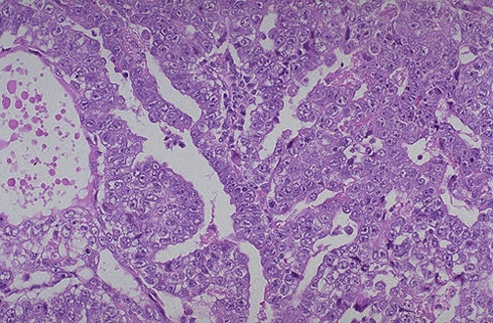
Embryonal carcinoma shows sheets of undifferentiated cells as well as primitive glandular differentiation.
The nuclei are large and hyperchromatic

Slide 23
Yolk Sac Tumor
Also known as Endodermal sinus tumor
The most common tumor in infant and children up to 3 years of age
Has a very good prognosis
Non encapsulated ,homogenous ,mucinous appearance

Slide 24
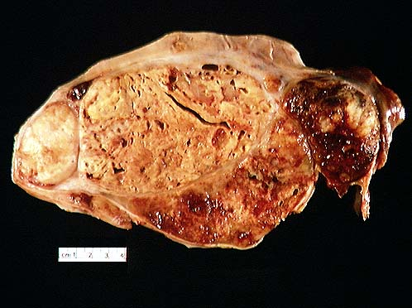
Mixed germ cell tumor of testes, with embryonal carcinoma, yolk sac tumor

Slide 25
Yolk Sac Tumor
Microscopically ,structures resemble endodermal sinuses
Schiller-Duval bodies
Hyaline –pink globules
AFP positive

Slide 26
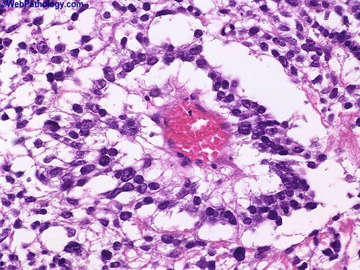
Schiller-Duval body is a structure seen in yolk sac tumor.
It consists of a central vessel surrounded by tumor cells – the whole structure being contained in a cystic space often lined by flattened tumor cells

Slide 27
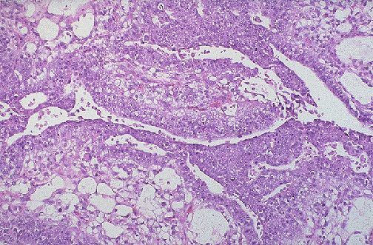
An endodermal sinus tumor (yolk sac tumor) of the testis is shown composed of primitive germ cells that form glomeruloid or embryonal-like structures. These tumors are most frequent in children, but overall they are rare.

Slide 28
Choriocarcinoma
Highly malignant tumor
Cytotrophoblastic and syncytiotroblastic cells
Small lesions
HCG positive

Slide 29
Teratoma
Various cellular or organoid components
Any age ,infancy to adult life
Mature forms are common in infants and children
Adult forms are rare
As a component with other type in 45%

Slide 30
Teratoma
Usually large 5 -10 cm
Heterogenous appearance
Hemorrhage and necrosis indicate embryonal component
Composed of heterogenous collection of cells or organoid structures
Neural tissue ,cartilage ,squamous epithelium ,glandular components….

Slide 31
Teratoma
Germ cell tumors could arise from teratoma
In children ,mature teratomas behave benign
In post pubertal male ,all teratomas regarded malignant ,and capable of metastasis ,regardless of whether the elements are mature or not.

Slide 32
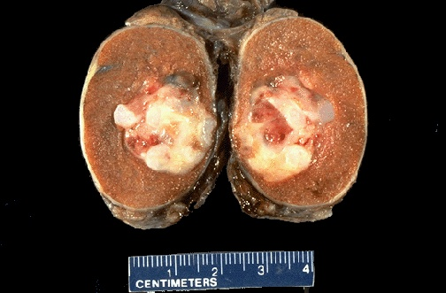
A small testicular carcinoma is shown here. There is a mixture of bluish cartilage with red and white tumor tissue. This neoplasm microscopically contained mainly teratoma, but areas of embryonal carcinoma were also present

Slide 33
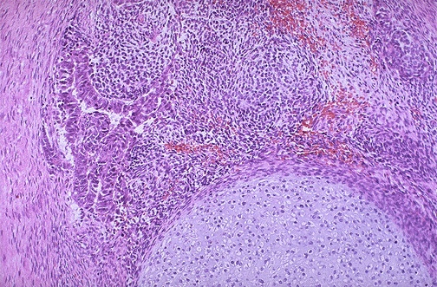
At the bottom is a focus of cartilage. Above this is a primitive mesenchymal stroma and to the left a focus of primitive cells most characteristic for embryonal carcinoma. This is embryonal carcinoma mixed with teratoma.

Slide 34
Testicular tumors Clinical Features
Biopsy of a testicular tumor is associated with a risk of tumor spillage
The standard management of solid tumors is radical orchiectomy
Lymphatic spread is common
Retroperitoneal and para-aortic nodes are first to be involved
Hematogenous spread to Lung, liver, Brain, and bones.

