Slide 1
Ectopic pregnancy, spontaneous abortion and gestational trophoblastic disease.
Emad Raddaoui, MD, FCAP, FASC

Slide 2
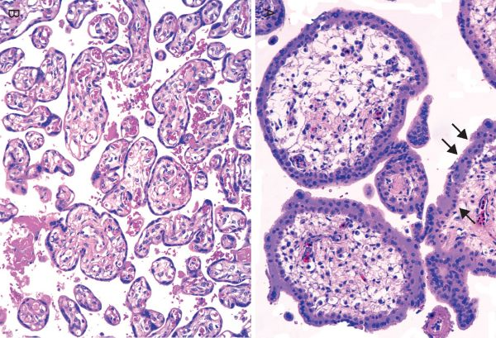
Normal placenta
The placenta is composed of chorionic villi that sprout from the chorion to provide a large contact area between the fetal and maternal circulations
Chorionic villi composed of delicate mesh of central stroma surrounded by two discrete layers of epithelium—the outer layer consisting of syncytiotrophoblast (two arrows) and the inner layer consisting of cytotrophoblast (arrow).

Slide 3
Ectopic Pregnancy
Definition: Ectopic pregnancy refers to the implantation of the developing blastocyst at any other site other than the endometrium.
Sites
Fallopian tubes: (Over 95% of ectopic pregnancies).
Within the tube, up to 80% occur in the ampulla, 25% in the isthmus, 5% in the infundibulum and up to 2% in the interstitial portion.
Right-sided ectopics are commoner than left-sided.
Other sites include the ovary, peritoneal cavity and uterine cervix.

Slide 4
Ectopic Pregnancy, Etiology & C/F
Pelvic inflammatory disease is the most common antecedent factor.
Other etiologic factors:
Abnormal tubal motility or mucosal adhesions (that impede passage of the conceptus along the tube)
Endometriosis
Previous pelvic surgery.
Clinical Features:
Pelvic pain or abnormal bleeding following a period of amenorrhoea.
The majority will present as an emergency with tubal rupture and hemorrhagic shock.

Slide 5
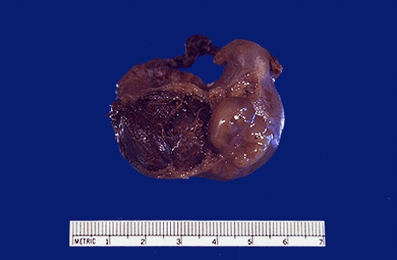
This is a ruptured tubal ectopic pregnancy. Note the twin fetuses at the lower right adjacent to the blood clot at the left. About half of ectopic pregnancies occur because of an identifiable lesion such as chronic salpingitis from pelvic inflammatory disease or adhesions from appendicitis, endometriosis, or previous laparotomy. However, in half of cases no cause can be found.

Slide 6
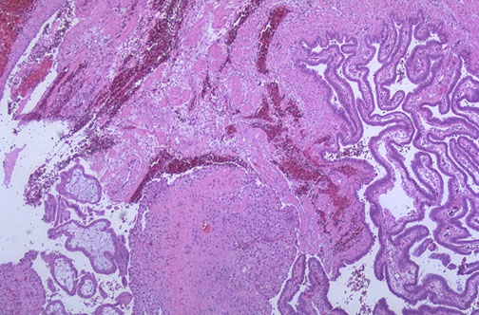
A positive pregnancy test (presence of human chorionic gonadotropin), ultrasound, and culdocentesis with presence of blood are helpful in making the diagnosis of ectopic pregnancy. Seen here is tubal epithelium at the right, with rupture site and chorionic villi at the lower left.

Slide 7
Spontaneous abortion / Miscarriage
Spontaneous end of a pregnancy at a stage where the fetus is incapable of surviving
Generally defined in humans before 20 weeks of gestation.
It is the most common complication of early pregnancy and most common type of pregnancy loss.
10-25% of all clinically recognized pregnancies will end in miscarriage.

Slide 8
Very early miscarriages—those that occur before the sixth week LMP (since the woman's Last Menstrual Period)—are medically termed early pregnancy loss or chemical pregnancy.
Miscarriages that occur after the sixth week LMP are medically termed clinical spontaneous abortion

Slide 9
Causes of Spontaneous abortion/miscarriage:
The cause of a miscarriage cannot always be determined.
Genetic, Uterine or Hormonal abnormalities like diabetes, collagen vascular disease (such as lupus)
Reproductive tract infections
Congenital (present at birth) abnormalities of the uterus
Most clinically apparent miscarriages occur during the first trimester.
Chromosomal abnormalities of the fetus are the most common cause of early miscarriages.

Slide 10
1.Chromosomal abnormalities:
Half (50%) of the fetal tissue from 1st trimester miscarriages contain abnormal chromosomes. This number drops to 20% with 2nd trimester miscarriages.
Chromosomal abnormalities also become more common with aging, and women over age 35 have a higher rate of miscarriage than younger women
Advancing maternal age is the most significant risk factor for early miscarriage in otherwise healthy women.
A pregnancy with a genetic problem has a 95% probability of ending in miscarriage.

Slide 11
2. Hormonal problems :
A. Cushing's Syndrome, thyroid disease, polycystic ovary syndrome
B. Diabetes generally can be well managed during pregnancy.
If the diabetes is insufficiently controlled, risk of
miscarriages
baby can have major birth defects.
Good control of blood sugars during pregnancy is very important.
C. Inadequate function of the corpus luteum in the ovary (which produced progesterone necessary for maintenance of the very early stages of pregnancy) leads to progesterone deficiency which may lead to miscarriage.
It is termed as "luteal phase defect’’

Slide 12
3. Infections:
Listeria monocytogenes,
Toxoplasma gondii,
Parvovirus B19,
Rubella,
Cytomegalovirus,
Herpes simplex
4. Maternal health problems
Collagen vascular diseases:
Examples of collagen vascular diseases associated with an increased risk of miscarriage are systemic lupus erythematosus, and antiphospholipid antibody syndrome.
Notes:
Collagen vascular diseases are illnesses in which a person's own immune system attacks their own organs.

Slide 13
5. Lifestyle (i.e. smoking, drug use, malnutrition, excessive caffeine and exposure to radiation or toxic substances)
6. Abnormal structural anatomy of the uterus :
In some women there can be a tissue bridge (uterine septum), that acts like a partial wall dividing the uterine cavity into sections. The septum is not well suited for placental attachment and growth. Therefore, an embryo implanting on the septum would be at increased risk of miscarriage.
Fibroids can uncommonly interfere with the embryo implantation and the embryo's blood supply, thereby causing miscarriage
7.Maternal age: SABs increase after age 35 due to ovum abnormalities
8. Maternal trauma
9. Invasive surgical procedures in the uterus, such as amniocentesis and chorionic villus sampling, also slightly increase the risk of miscarriage

Slide 14
Spontaneous abortion / Miscarriage: Diagnosis
A miscarriage can be confirmed by
Ultrasound and
Examination of the passed tissue.
Microscopic examination of the products of conception: Villi, trophoblast, fetal parts, and background gestational changes in the endometrium.
Genetic tests may also be performed to look for abnormal chromosome arrangements

Slide 15
Gestational Trophoblastic Disease
Gestational trophoblastic disease constitutes a spectrum of tumors and tumor-like conditions characterized by proliferation of placental tissue, either villous or trophoblastic.
Gestational trophoblastic disease (GTD) can be benign or malignant.
Majority of GTD cases are benign.
Most forms of gestational trophoblastic disease can be cured with prompt management.
Surgery and chemotherapy are the most common forms of treatment.
Most women who have had gestational trophoblastic disease can have normal pregnancies later

Slide 16
Gestational Trophoblastic Disease:Diagnosis
A blood test for the human chorionic gonadotropin (HCG) hormone is most commonly used to diagnose GTD.
Serum HCG is markedly increased is GTD.
Serum HCG is also elevated in normal and ectopic pregnancy, choricarcinoma and germ cell tumor.
Serum HCG levels continue to rise after 14th week as opposed to drop in normal gestation

Slide 17
Gestational Trophoblastic Disease : Histologically
Histologically, it is classified into
Hydatidiform mole (complete and incomplete)
Invasive mole (chorioadenoma destruens)
Choriocarcinoma
Placental site trophoblastic tumor (PSTT).

Slide 18
Hydatidiform Mole
Hydatidiform mole is characterized histologically by cystic swelling of the chorionic villi, accompanied by variable trophoblastic proliferation
Grossly it looks like a bunch of grapes
Symptoms:
Patients present with increased abdominal swelling (rapid increase in uterine size) mistaken for normal pregnancy but the uterus is disproportionately large for stage of pregnancy.
In addition patient has some vaginal bleeding, severe nausea and vomiting.

Slide 19
Complete HM
Defintion: Genetically abnormal placenta with hyperplastic trophoblast, without fetus or embryo.
Uterus is distended and filled with swollen/large villi. No embryo, or fetal tissue is present.
There is elevated HCG levels.
On chromosomal analysis there are 46 chromosome (2 haploid sets), 46XX karyotype and all the chromosomes come from the male/paternal side.

Slide 20
Complete HM
Treatment : Evacuation of uterus by curettage, chemotherapy.
With appropriate therapy cure rate is very high
spontaneous regression in 81%
17% developed an invasive mole
2% developed choriocarcinoma

Slide 21
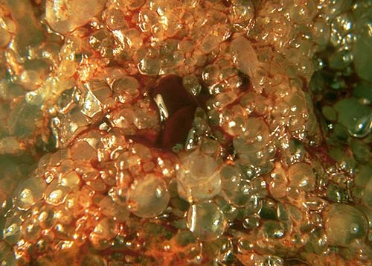
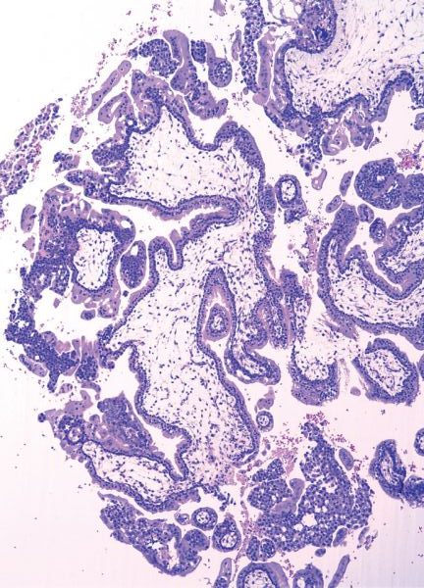

Slide 22
Partial Mole (PM)
Definition: genetically abnormal placenta with a mixture of large and small villi with slight hyperplasia of the trophoblast, filling the uterus. Embryonal/fetal tissue is present.
Grossly large vesicular chorionic villi mixed with normal-appearing villi.

Slide 23
Partial Mole (PM)
It makes up 15–35% of all moles
Uterine size usually small or appropriate for gestational age
Serum hCG levels elevated but not as high as complete mole.
Chromosomal analysis of partial moles shows 69 chromosomes (i.e. 3 haploid sets also called as triploidy), XXY in which 2 haploids are paternal (from the male) and one is maternal
Prognosis
Risk for development of choriocarcinoma very low. Only 2-3% become malignant. Follow-up is mandatory.

Slide 24
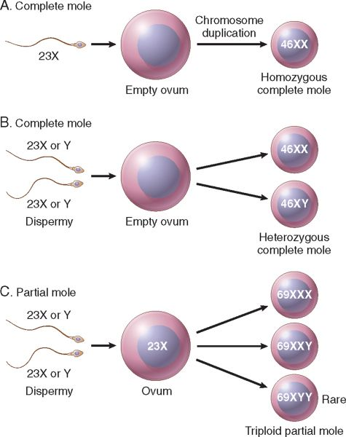

Slide 25
Invasive Mole
Definition: Hydatidiform mole, generally of the complete type, in which villi penetrate deeply in the myometrium and/or its blood vessels.
It occurs in about 15% of complete moles and rarely in partial mole.
Can cause hemorrahge and uterine perforation.

Slide 26
Choriocarcinoma
Definition: Malignant tumor derived from normal or abnormal placental tissue, composed of a proliferation of malignant cytotrophoblast and syncytiotrophoblast, without villi formation.
It is an aggressive malignant neoplasm.
It is characterized by highly increased serum concentration of HCG.
Choriocarcinomas are aneuploid.

Slide 27
Choriocarcinoma
It spreads early via blood to the lungs and other organs.
Responds well to chemotherapy
About half the choriocarcinoma are preceded by complete hydatidiform mole .
Others are preceded by partial mole (very unusual), abortion, ectopic pregnancy and occasionally normal term pregnancy.

Slide 28
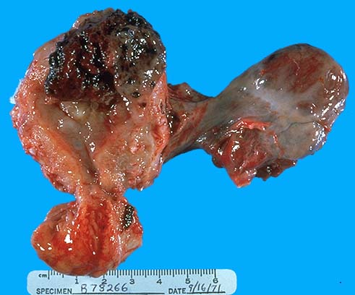
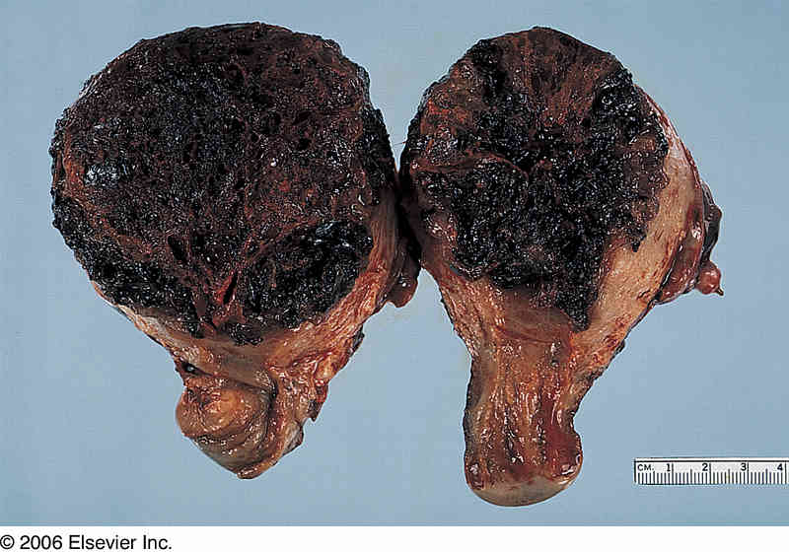
Choriocarcinoma

Slide 29
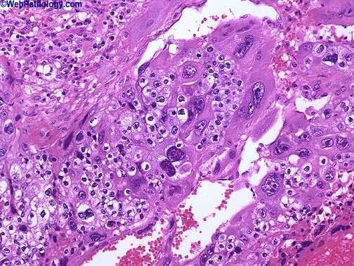
This image shows admixture of polygonal cells with clear cytoplasm (cytotrophoblast) large multinucleated cells with smudged nuclear chromatin (syncytiotrophoblast).

