Slide 1
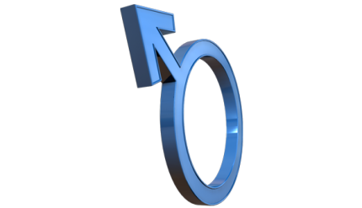
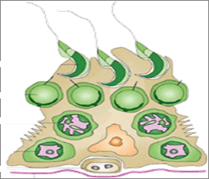
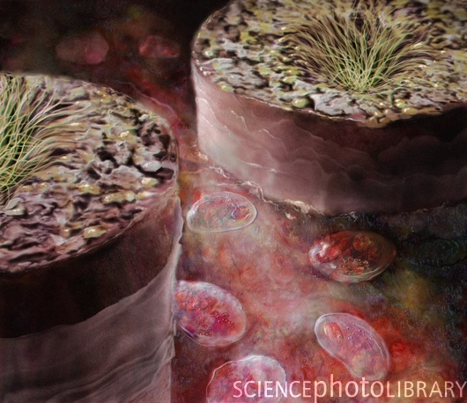
DRUGS USED IN
MALE INFERTILITY

Slide 2
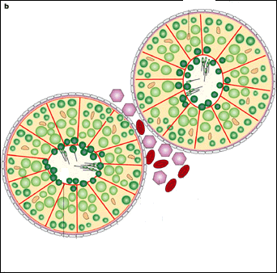
DRUGS USED IN
MALE INFERTILITY
ILOs
By the end of this lecture you will be able to:
Define male infertility
Recognize regulations contributing to male fertility & dysregulations leading to infertility
Classify hormonal & non-hormonal therapies used in male infertility whether being empirical or specific.
Expand on the mechanism of action, indications, preparations, side effects, contraindications & interactions of most hormonal therapies
Highlight some potentialities of emperical non-hormonal therapies

Slide 3
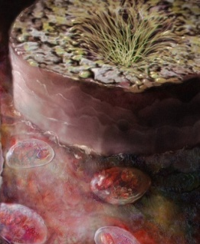
MALE INFERTILITY
Definition
Inability of a male to achieve conception in a fertile woman after one year of unprotected intercourse.
Prevalence
Approximately 15-20% of all cohabiting couples are infertile
In up to + 50% of such cases, males are responsible

Slide 4
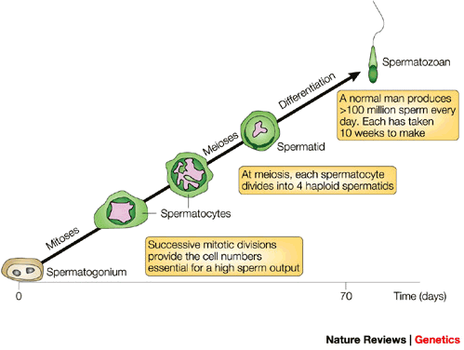
Mature Sperm / No motility / Sterile
TESTIS
A Seminiferous Tubule
Spermiation
Site of SPERMATOGENESIS
LEYDIG C.
 TESTOSTERONE
Spermiogenesis
Spermatidogenesis
Spermato
cytogenesis
Meioses
SERTOLI C.
~74 dys/ 15 dys in epididymis
SPERMATOGONIUM
Testosterone Secretion & Spermatogenesis
Are Coupled
Nests  the GERM CELLS
Communicate in a paracrine fashion
Separate them from rest of body by the blood-testicular barrier
Converts Testosterone to Dihydrotestosterone [DHT] & Estradiol to direct spermatogenesis
Secret androgen-binding-proteins [ABP]  concentrate &  testosterone in seminiferous tubules to stimulate spermiogenesis
LEYDIG C.
TESTOSTERONE
SERTOLI C.
LH
FSH
PITUITARY
GnRH
HYPOTHALAMUS

Slide 5
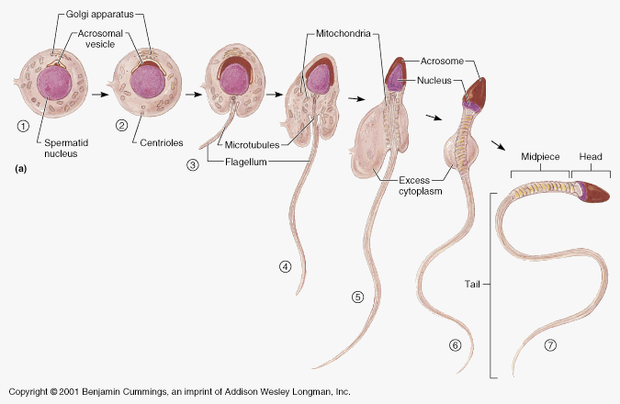
Steps from Spermatid to Spermatozoan
Proceed Seminiferous ductsRete testis
○ Efferent ductulesEpididymis
DHT > Testosterone + Estradiol + other paracrine/autocrine
[ Develop Motility & Fertilizing ability
Protection+Storage ] Till Ejaculation
IN SEMINAL ANALYSIS
Alteration in sperm quantity
Low ( oligospermia) or non (azoospermia)
Alteration in sperm quality
Low motility (asthenospermia) or dead (necrospermia)
Alteration in both
Prostatic & seminal secretions add to sperm functions
If something went WRONG INFERTILITY

Slide 6
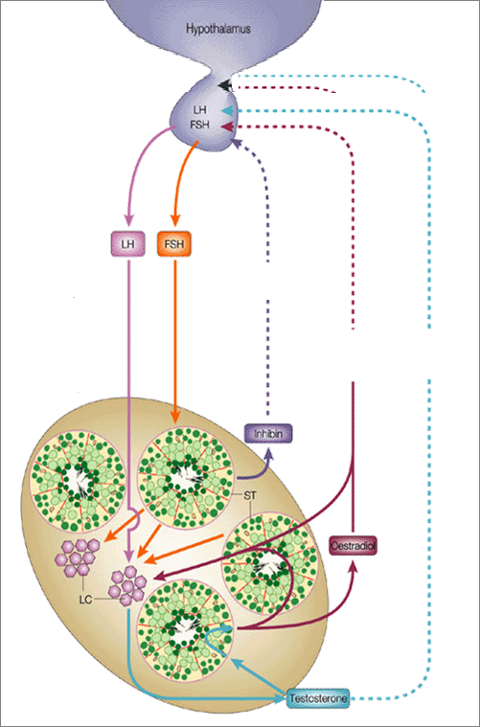
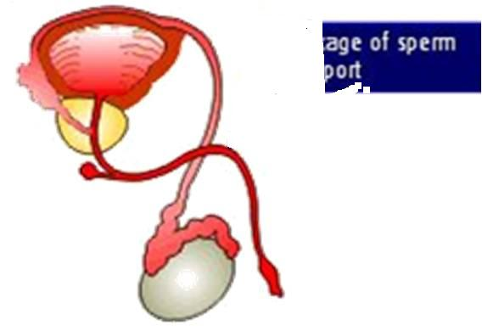
If WRONG INFERTILITY
HYPOTHALAMUS
Pulsatile Secretion
GnRH
3. Problems of Sperm Transport
GnHs
E facilitate –ve of T on GnRH & GnHs
POST-TESTICULAR
LH
FSH
-ve
-ve
Initiation & Maintenance of spermatogenesis
-ve
+ve
PRE-TESTICULAR
Inhibin
4. Problem in Erection & Ejaculation
Estradiol
+ve
1. Problems related to Hormone Production
2. Problems related to Sperm Production
5DHT
TESTOSTERONE
TESTICULAR
LHTestosterone Pulsatile
(chronic LH  makes testis refractory)
MALE INFERTILITY

Slide 7
Needs 3 ms. before semen quality changes
DRUG TREATMENT OF MALE INFERTILITY
HORMONAL THERAPY
NON-HORMONAL THERAPY
SPECIFIC
IMPERICAL
IMPERICAL
SPECIFIC
Hyperprolactinaemia DA₂₋ Agonists
Hypothyroidism Thyroxine
Congenital Adrenal Hyperplasia  Glucocorticoids
Erectile Dysfunction PDE 5 Is, Alprostadil, Apomorphine…
Premature Ejaculation SSRIs
Retrograde Ejaculation  αAD agonists
Leukocytospermia Antibiotics
Euogonadotrophic Hypogonadism  (T only) Antiestrogens; SERMs & Aromatase Is
Idiopathic  Androgens, Antiestrogens,GnH(FSH)
Hypogonadotrophic hypogonadism  2^{ndry} Hypogonadism ( Hypothalamo-Pituitary )
(T &  FSH / LH )
Pulsatile GnRH, hCG, hMG, Androgens, Clomiphene
Pentoxiphylline
Kallikrins
Antioxidants; Vit E, C/ N-A Cystiene
Zinc Supplements
Folic a.
L-Carnitine
Hypergonadotrophic Hypogonadism 
P^{ry} Hypogonadism (T &LH ) Assisted Reproduction

Slide 8
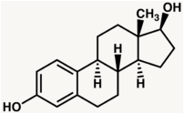
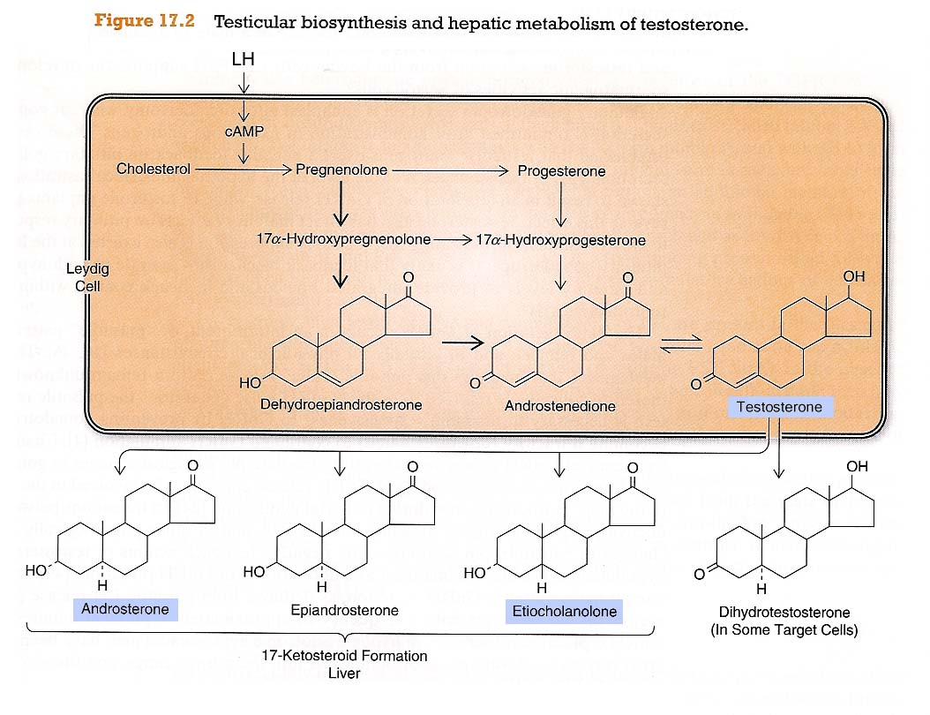
HORMONAL THERAPY
> in brain, bone, liver, adipose t.
1. ANDROGENS
AROMATASE
Estradiol
In NATURE
> in accessory sex organs
5-α-REDUCTASE
Leydig C
DHT
TESTOSTERONE
Principle male sex hormone produced in testis, small amount in adrenals. It follows a circadian patternin early morning & in evening
As Therapy
1. Testosterone
2. Synthetic Androgens;
Derived from Testosterone
Esters; proprionate, enanthate, cypionate
Or derivatives as Fluoxymesterone, Methyltestosterone, Danazol
Derived from DHT; Mesterolone

Slide 9
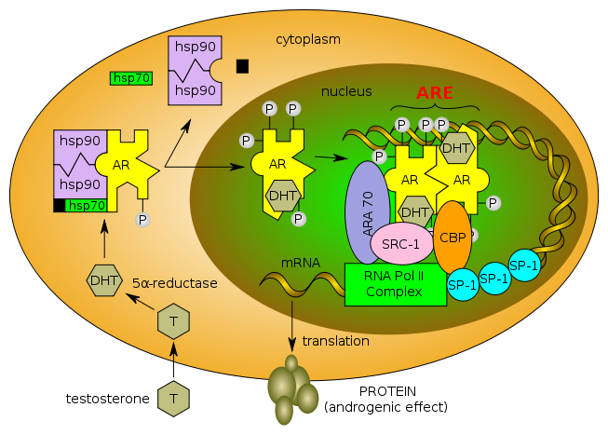
1. ANDROGENS
What does testosterone do ?
A. It or its DHT metabolite bind to Androgen Receptors [AR]
Like all other steroid hormones they act on;
1. Cytosolic GENOMIC Action mediates cell growth & differentation in AR responsive tissues; reproductive, those of 2^{ndry} male sex characters, muscles …
Binding & Activation
Nuclear translocation
Dimerization on SRE
Gene Transcription
mRNA Translation
New Protein Formation
PROTEIN
TESTOSTERONE

Slide 10
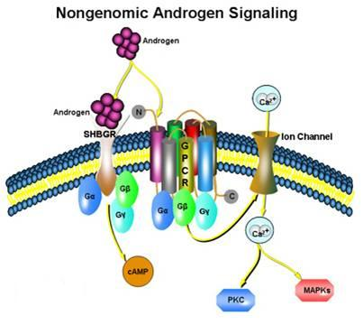
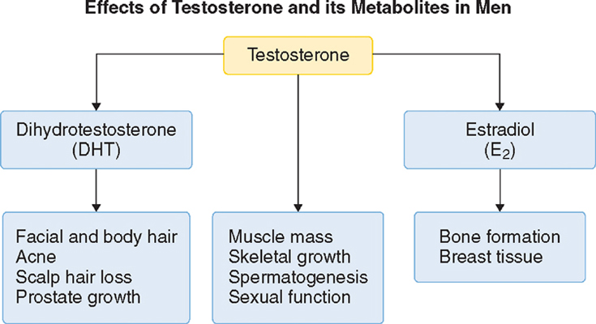
1. ANDROGENS
2. Membranous 
NON-GENOMIC Action  mediates rapid responses  on some brain, CVS, T cells functions
Like all other steroid receptors
B. It aromatize to estradiol and binds to Estrogen Receptors [ER]
Estradiol rather than testosterone; 1.Responsible for feedback inhibition on hypothalamus (specially –ve LH secretion)
2. Induce maturation of cartilage
 leading to closure of
epiphyses & conclusion
of growth.
3. Some CVS protective actions
AR
ER
AR
CNS; -ve loop
CVS; protection
CNS; libido

Slide 11
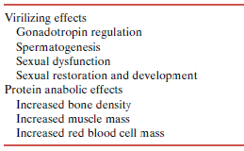
1. ANDROGENS
ACTIONS
ACTIONS DIVIDED INTO
○ Testosterone & Synthetic Androgens
Anabolic Steroids
Not used in infertility

Slide 12
1. ANDROGENS
Kinetics
Binds to SHBG
t1/2 = 10 –20 min
Inactivated in the liver.; 90% of metabolites excreted in urine.
Synthetic androgens  less rapidly metabolized & some are excreted unchanged in urine
Administration
Testosterone ineffective orally(inactivated by 1st pass met.) I.M or S.C.
Skin patch (genital & no genital) & gels…. are also available
Synthetic Androgens
Derived from Testosterone
Esters; proprionate, enanthate, cypionate in oil for IM; every 2-3 weeks
Other derivatives as Fluoxymesterone, Methyltestosterone, Danazol  given Orally; daily
Derived from DHT; Mesterolone  given Orally; daily

Slide 13
1. ANDROGENS
INDICATIONS
In adult Male Infertility
1. Low dose oral (methyltestosterone 10-50 mg/day)or(fluoxymesterone 5-20 mg/day) may improve epididymal function &  sperm motility
2. High dose exogenous testosterone given then abruptly stopped will 1st  systemic T levels  -ve feedback   LH &  endogenous testosterone production   spermatogenesis.
2nd TESTOSTERONE REBOUND  spermatogenesis after stoppage .
The success rate is very low . Hazards are high  many men become azoospermic for prolonged periods after. Now this is best avoided
As Androgen Replacement Therapy
In delayed puberty with hypogonadism
 give androgen slow & spaced for fear of
premature fusion of epiphyses  short stature

Slide 14
1. ANDROGENS
ADRs
Specific In Males
1. Prostatic hyperplasia  carcinoma specially in elder (give low dose)
2. 2^{ndry} Gn H suppression ; azoospermia, impotence, gynecomastia (if taken > 6 wks).
3. Short stature due to premature closure of epiphysis (before 18 years)
General
1. Behavioral changes; physiologic dependence,↑ aggressiveness, psychotic symptoms
2. Alteration in serum lipid profile: HDL & LDL; risk of ACS
3. Salt & water retention
4. Hepatic dysfunction; AST levels,alkaline phosphatase,  bilirubin & cholestatic jaundice.
Most oral preparations are hepatotoxic  adenomas & carcinomas
5. Polycythemia

Slide 15
Contraindications
1. ANDROGENS
Male patients with cancer breast or prostate
Severe renal & cardiac disease → predispose to edema
Psychiatric disorders
Hypercoagulable states
Polycythemia
Interactions
All forms + corticosteroids  oedema
All forms + warfarin  metabolism   bleeding
Synthetic Androgens + insulin or oral hypoglycemics  hypoglycemia
Testosterone + propranolol   propranolol clearance  efficacy
Mesterolone
 oral synthetic androgen derived from DHT is more safely given if  testosterone or in 2ndry hypogonadism. Why???
1. Not aromatised into estrogens/ no binding to estrogen receptorsno –ve of GnHs  encourages natural testosterone production+ SHBG from attaching to it  spermatogenesis is enhanced
2. Unlike almost all other orals synthetic androgens it is not hepatotoxic; not -alkylated but methylated  less hepatic complications

Slide 16
2. GnRH
LEUPROLIN
GOSERELIN
Used in hypothalamic dysfunctionandrogenization & spermatogenesis
Given as Pulsatile GnRH therapy (4-8 ug subcut every 2 hours) using a portable pump. Less use by intranasal or intravenous routes
Exogenous excess of GnRH  down-regulation of pituitary GnRH receptors &  LH responsiveness.
ADRs; Headache, depression, generalized weakness, pain & gynecomastia osteoporosis, neurological symptoms.
Prostate cancer (on long term), yet can be prevented with the simultaneous use of antiandrogens for 2-4 weeks
3. GnHs
PREGNYL
hCG
MENOTROPIN
hMG
Used in 2ndry hypogonadism (FSH or both FSH or LH absent)  spermatogenesis
GnHs replacement must be combined; hCG (3 x 2000 U/w. IM.2 ms.) followed by hCG + hMG (3x 75 to 3 x 150 U /w. IM. 6 -12 ms). rhFSH alone  little efficacy
ADRs; Headache, local swelling (injection site), nausea, flushing, depression, gynecomastia, precocious puberty, anaphylactic shock.

Slide 17
4. Antiestrogens
Because estrogens  –ve feedback on hypothalamus  GnRH pulse frequency & pituitary responsiveness to GnRH , so antiestrogens  used, with the rationale that absence of such feedback inhibition Gn RH & improve its pituitary response…..
4.a. SERMs
Tamoxifen, Clomiphene
Tamoxifen Gn RH, but has its own estrogen agonistic property  feminizing side effects.
Clomiphene has less estrogenic agonistic property. Yet both drugs can induce libido & bad temper in men
4.b. Aromatase Inhibitors
Anastrozole
Blocks conversion of testosterone to estrogen within the hypothalamus
All are used for inducing spermatogenesis in oligozoospermia
Given as daily dose over a period of 1–6 months.
Best to improve sperm count & motility with good pregnancy rates

Slide 18
Non-HORMONAL THERAPY
Sometimes it is very promising, to improve sperm quality > quantity.
ANTIOXIDANTS
Protect sperm from oxidative damage
KALLIKREIN
Has proteolytic activity, cleaving kininogen to kinins important for sperm motility.
FOLIC ACID
Plays a role in RNA and DNA synthesis during spermatogenesis & has antioxidant properties.
ZINC
Plays an important role in testicular development, spermatogenesis & sperm motility.
L-CARNITINE
Is highly concentrated in the epididymis & is important for sperm metabolism & maturation

Slide 19
DRUGS USED IN
MALE INFERTILITY
GOOD LUCK

Slide 20
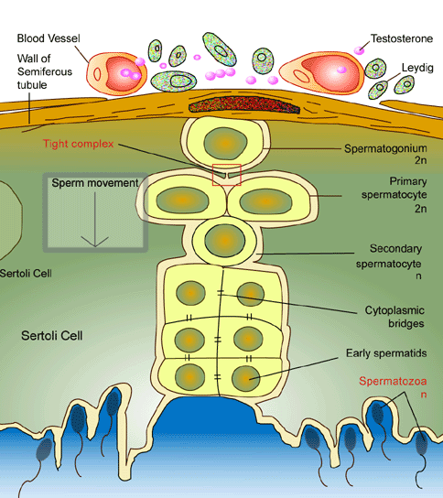
Cell type | Chromosome | Chromatide | Process
Spermatogonium | diploid/46 | 2N | SPERMATOCYTOGENESIS (mitosis)
P^{ry} Spermatocyte | diploid/46 | 4N | SPERMATOCYTOGENESIS (miosis1)
2^{ndry} Spermatocyte | haploid/23 | 2N | SPERMATIDOGENESIS (miosis2); Till formation of spermatid
Spermatid | haploid/23 | 1N | SPERMIOGENESIS; Till formation of mature spermatozoan
Spermatozoan | haploid/23 | 1N | SPERMIATION; deliveryr free in seminiferous tubules
Spermiation

