Slide 1
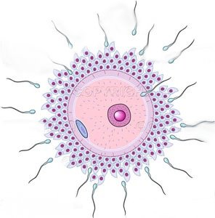
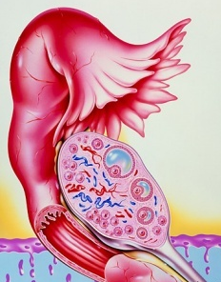
Drugs In
OVULATION INDUCTION

Slide 2
Drugs In
OVULATION INDUCTION
ILOs
By the end of this lecture you will be able to:
Recall how ovulation occurs and specify its hormonal regulation
Recognize causes and types of female infertility
Classify ovulation inducing drugs in relevance to the existing deficits
Expand on the pharmacology of each group with respect to mechanism of action, protocol of administration, indication, efficacy rate and adverse effects.

Slide 3
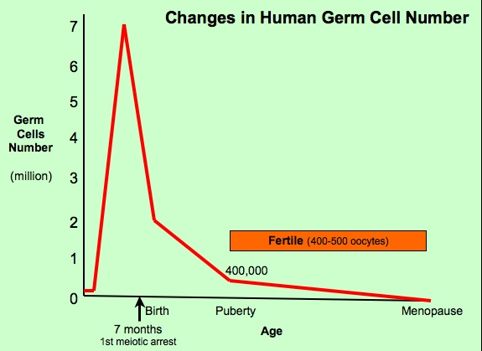
Follicular Phase
Primordial
Recruitment
Gn-independent
Pry
2/3-7 d
Sec
13 cycles / year
between puberty & menopause
Selection
Gn-responsive
Preantral
Little estrogen
A Fertile; ovulates 400 in life
Antral
7/8-12 d
Dominance=Maturation
Hormone-dependent
Graffian Follicle
High estrogen
Follicular Phase
LH > FSH SURGE
12-14 d
X
OVULATION
INFERTILITY

Slide 4
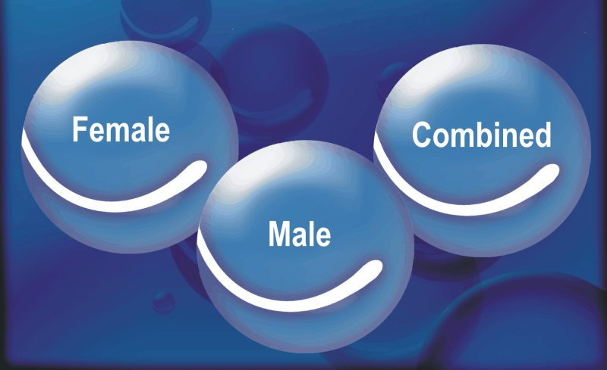
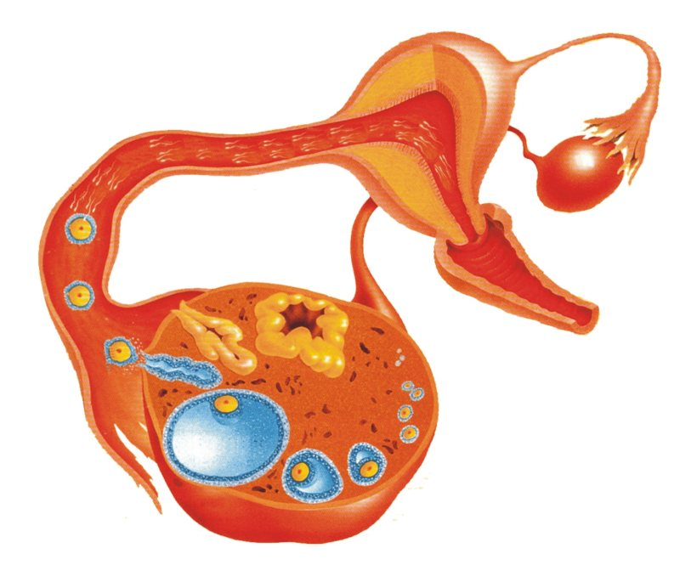
INFERTILITY
A condition characterized by a reduction in ability to reproduce or to achieve conception
Endometriosis
1/3 attributed to women.
1/3 attributed to male factors
1/3 both or unexplained
Tubal causes, blockage or damage
Fibroids
Polycystic Ovarian Syndrome
Miscarriage
Most common cause of female infertility
Common cause of female infertility
Failure of Ovulation

Slide 5
Ovulation Induction
Hyperprolactinaemia
Hypogonadotropic

ANTIESTROGENS
D₂ R Agonists
Hypothalamus 
GnRH
◉
Anterior Pituitary 
FSH / LH 
Ovary
◉
Estrogen
Progestins
Hypothalamo-pituitary
SERMs;
Clomiphene
Tamoxifen
Bromocreptine
GONADOTROPHINS
HMGs; Menotropin
HCGs; Pregnyl
GnRH
GnRH-agonists
Leuprolin
Goserelin
(-)
(-)
METFORMIN; IN POLYCYSTIC OVARIAN SYNDROME
to  body weight &
 response to ovulation induction drugs
Ovarian
Normogonadotrophic

Conception remote, no place for therapy
Hypergonadotrophic
☒

Slide 6
ANTIESTROGENS
SERMs
Selective Estrogen Receptor Modulators [SERMs]  compete with estrogen on estrogen receptors in the nucleus
Doing so they act as antagonists or partial agonists depending on how they bind & the different target tissue of action.
In the hypothalamus & pituitary they have ANTAGONISTIC ACTION

Slide 7
ANTIESTROGENS
SERMs
1. CLOMIPHENE
Hypothalamus 
GnRH
◉
Anterior Pituitary 
FSH / LH 
Ovary
◉
Estrogen
Progestins
Pharmacological effects
On hypothalamus; negative feed back of endogenous estrogen on hypothalamus pulse GnRH   gonadotrophin production [FSH & LH]  cause growth maturation & rupture of follicles OVULATION
☒
Clomiphene
(-)
On pituitary; response of gonadotrophins to GnRH
Indication
Female infertility;
not due to ovarian or pituitary failure  Normogonadotrophic
The success rate for ovulation 80% & pregnancy 40% .
The discrepancy between 2 rates is due to the antiestrogenic effects of clomiphene on uterus, cervix & vagina

Slide 8
Method of administration
CLOMIPHENE cont.
ANTIESTROGENS
Coitus every other day
SERMs
Clomiphene given  50 mg/d for 5 days from 5th day of the cycle to the 10th day.
If no response give 100 mg for 5 days again from 5th to10th day
The drug can be repeated not more than 6 cycles .
5 days
7 days
Clomiphene
50-100 mg/d
5 days
Progesterone
LH
FSH
ADRs
2
4
6
8
10
12
14
16
18
20
22
24
26
28
30
Menses
1.Hot Flushes & breast tenderness
2. Gastric upset (nausea and vomiting)
3. Visual disturbances (reversible)
4.  nervous tension & depression
5. Skin rashes
6. Fatigue
7. Weight gain
8. Hair loss (reversible)
N.B.  incidence of multiple ovulation  twins in 10% birth

Slide 9
ANTIESTROGENS
2. TAMOXIFEN
SERMs
Is similar & alternative to clomiphene
But differ in being Non Steroidal
Used in palliative treatment of hormone-dependent / estrogen receptor- positive advanced breast cancer
But why clomiphene not used in such cases of cancer breast?

Slide 10
GONADOTROPHINS
[FSH & LH]
Are naturally produced by the pituitary gland
For therapeutic use, extracted forms are available as;
1. Human Menopausal Gonadotrophins (hMG ) extracted from postmenopausal urine  contains LH & FSH MENOTROPIN
2. Human Chorionic Gonadotrophins (hCG) extracted from urine of pregnant women contains mainly LH) PREGNYL
N.B. Now new available preparations by recombinant technology
Mechanism
Preparations of FSH  act on ovary directly, stimulating growth & maturation of Graafian Follicle(s)
Preparations of LH  act just to induce ovulation
Given sequentially
Indication
Stimulation & induction of ovulation in infertility 2^{ndry} to gonadotropin deficiency (pituitary insufficiency)

Slide 11
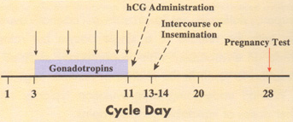
Success rate for inducing ovulation is usually >75 %
GONADOTROPHINS
Method of administration
[FSH & LH]
hMG is given i.m or subcut. every day starting at day 2-3 of cycle for 10 days followed by
hCG on (10th - 12th day) for OVUM RETRIEVAL within 36 hrs.
When we indicate:
intrauterine insemination
or intercourse
ADRs
FSH containing preparations; Fever Ovarian enlargement (hyper stimulation) Multiple Pregnancy (approx. 20%)
LH containing preparations; Headache & edema

Slide 12
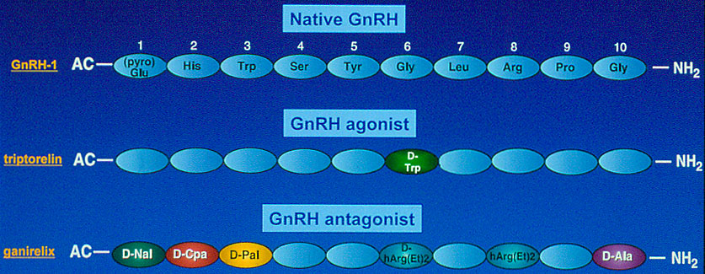
GnRH
native-Gh RH
GnRH-Agonist
LEUPROLIN GOSERELIN
Mechanism
Native GnRH is naturally produced by hypothalamus in a pulsatile manner. It is triggered when the negative feedback inhibition of ovarian hormones is lost by the end of the cycle. This activates FSH release from pituitary that stimulate growth and maturation of ova early during the follicular phase of the cycle. It also mediates estrogen induced LH surge that triggers ovulation.
GnRH-Agonists  bind to the receptors & mimic the native hormones provided it is given PULSATILE

Slide 13
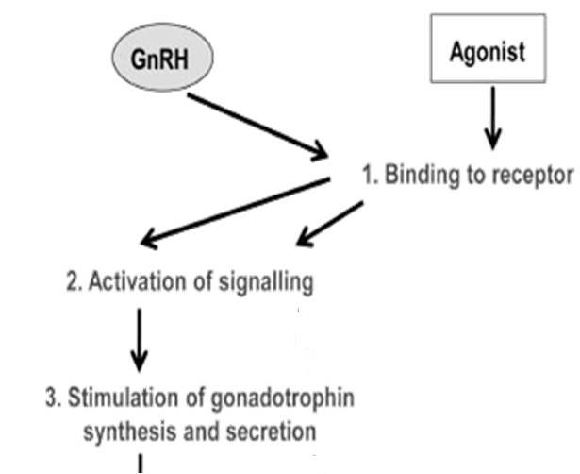
GnRH-Agonist
If PULSATILE 
Mimic native GnRH
LEUPROLIN GOSERELIN
If CONTINOUS
Block GnRH Receptors
GnRH
GnRH
GnRH-Agonist
In cancer (prostate & breast) &
other long term indications as precocious puberty, endometriosis & fibroids
Intranasal, injectable & implant formulations
Pulsatile
Continuous
FSH & LH
GONADAL ACTIVATION
Growth maturation & rupture
OVULATION INDUCTION

Slide 14
GnRH
Uses
In OVULATION INDUCTION per se
LEUPROLIN GOSERELIN
Given in hypothalmic amenorrhea (GnRH deficient)  S.C. pulsatile(drip) (1–10 µg / 60 – 120 min)   GnHs release
Start from day 2-3 of cycle up to day 10
OVUM RETRIEVAL
After 36 hrs
In ASSISTED REPRODUCTION
is part of a protocol for OVUM RETRIEVAL
ADRs
GIT disturbances, abdominal pain, nausea….etc
Headache
Hypoestrogenism on long term use 
→ Hot flashes  Libido
→ Osteoporosis  Vaginal bleeding
→ Rarely ovarian hyperstimulation  (ovaries swell & enlarge)

Slide 15
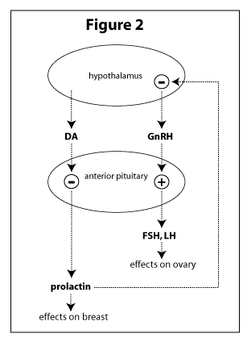
D₂ R Agonists
BROMOCREPTINE
Is an ergot derivative.
D₂ R Agonists bind to dopamine receptors in anterior pituitary  -ve PRL secretion
Bromocreptine
Mechanism
Indications
Female infertility 2^{ndry} to hyperprolactinaemia ( hypogonadotrophic)
ADRs
GIT disturbances; nausea, vomiting, constipation
Headache dizziness & orthostatic hypotension
Dry mouth & nasal congestion
Insomnia
Hyperprolactinaemia
No Ovulation

Slide 16
Drugs In
OVULATION INDUCTION
L
G
U
O
C
O
K
D

