Slide 1
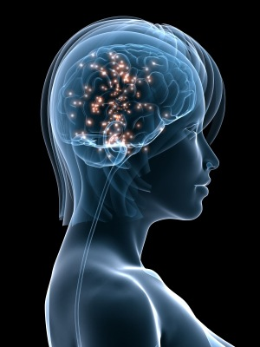
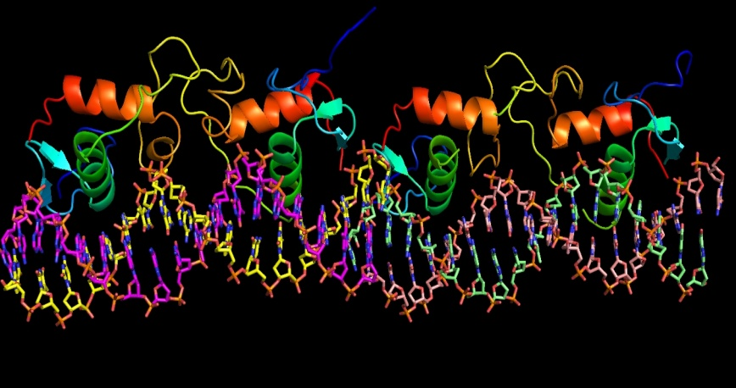
HORMONE REPLACEMENT THERAPY

Slide 2
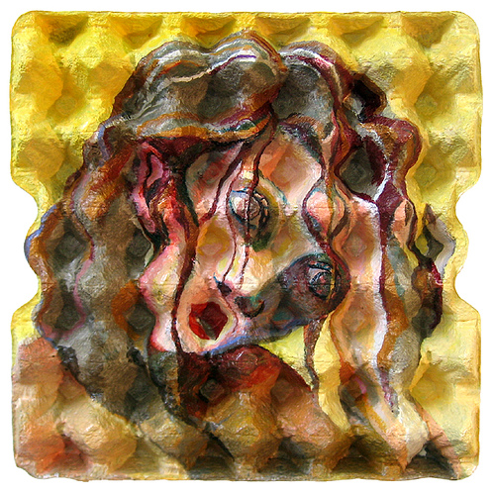
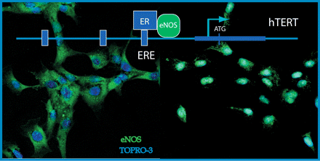
ILOs
By the end of this lecture you will be able to:
Recognize menopausal symptoms & consequences
Classify drugs used to alleviate such symptoms that are used as Hormonal Replacement Therapy [HRT]
Expand on the mechanism of action, indications, preparations, side effects & contraindications of such agents.

Slide 3
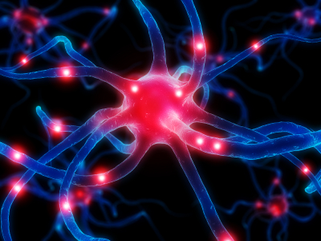
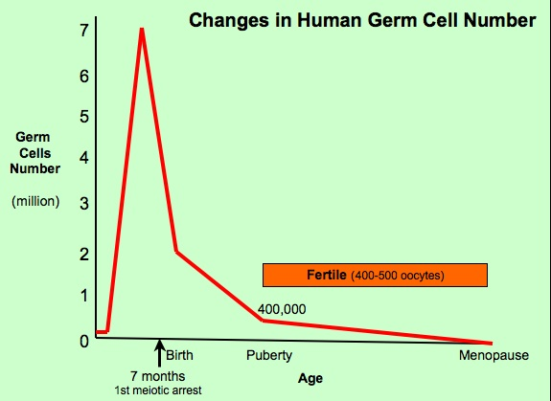
HRT
Is a system of medical treatment that is designed to artificially boost female hormones, in hope to alleviate symptoms caused by  in their circulating levels
?
PERI & POSTMENOPAUSE
MENOPAUSE
Natural, Pathological, Induced
A complex physiological change that occurs at the time when the last period ends generally as women age and loss fertility
' menos'( month)
'pausis'(cessation)
Estrogen & Progesterone
◉ Androgens
 FSH & LH
Insulin Resistance
1/3 ^{rd} of total female population
Depletion of ovum stocks
Obese women are > protected 
 relative amounts of estrone &  SHBG
45 – 55 yrs

Slide 4
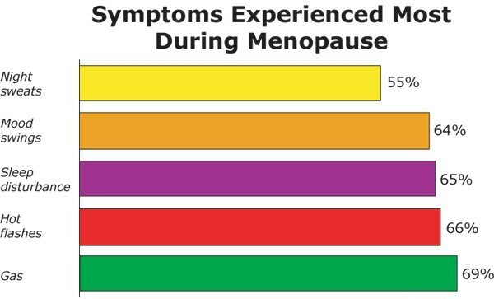
HRT
SYMPTOMS & CONSEQUENCES of MENOPAUSE
Immediate
Intermediate
Long Term
Hot Flushes / Night Sweats
Insomnia, Anxiety, Irritability
Mood Disturbances
Reduction In Sexuality & Libido
Poor Concentration / Memory Loss
20% no symptoms, 60% some symptoms, 20% severe symptoms
Rapid loss of collagen
Dyspareunia & vaginal dryness
Urethral syndrome (dysuria, urgency & frequency)
Incontinence, difficulty in voiding
Increased bruising
Generalized aches and pains
Osteoporosis
CVS Risks; LDL/HDL ratio, CHD, stroke,..
C N S deficits; Alzheimer's, dementia

Slide 5
HRT
Menopausal Symptoms
Estrogen
Replace the Estrogen
◉
Alleviate
Estrogen Some undesirable side effects

add Progestins; but not if there is hystrectomy
Selective ER-Modulators [SERMs]
Tibolone
Phytoestrogens
Androgens  responsible for sexual arousal  given only if there is loss of libido & orgasm
HRT
Given for short term; never exceed 5 years to control meno-pausal symptoms without allowing ample time for malignant transition that might be induced by estrogen
Long-term administration was only indicated in osteoporosis & CVS protection but now better drugs are available
No more preferred

Slide 6
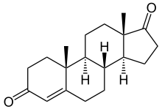
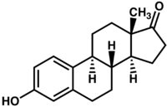
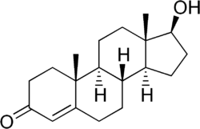
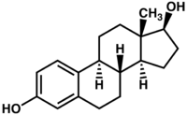
HRT
ESTROGEN
1.
In NATURE
Aromatase
Ovaries & adrenals pre-menopausal
Adrenals in menopause
Androstenedione
Estrone
Dehydrogenase
Aromatase
Ovaries in pre-menopause
Testosterone
Estradiol
As Therapy
Estradiol; Oral bioavailability is low due to its rapid oxidation in the liver so used only in transdermal patch, intradermal implant, ….
Conjugated estrogens
Esterified estrogens

Slide 7
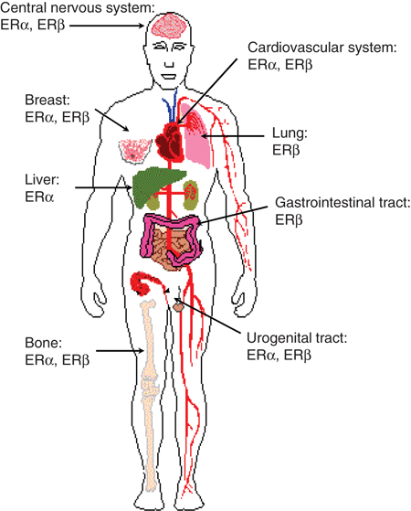
?
ESTROGEN
What does estrogen do
It binds to its receptors
Distribution of ER
Types of Estrogen Receptors [ER]
ER α 
> mediates female hormonal functions
Endometrium, breast, ovaries, hypothalamus,…
ER β 
> mediates other hormonal functions
brain, bone, heart, lungs, kidney, bladder, intestinal mucosa, endothelial cells,….

Slide 8
ESTROGEN
Estrogens bind to ER (α or β) that exist either;
Cytoplasmic; activate, translocate, dimerize on ERE of DNA  Transcription & Translation to regulatory proteins
> mediates its genomic actions  hrs– dys time scale development, neuro- endocrines, metabolism
Genomic effects
Membranous; G protein ER2nd messenger   Ca or cAMP …etc  mediates its non-genomic actions sec – min. time scale as on NO, neuro- transmitters, …..

Slide 9
ESTROGEN
INDICATIONS
A. In Menopause
Not given unless presence of symptoms;
Alone only after hysterectomy
With progestin as HRT in the rest of conditions
When given never exceed 5 years administration
Improves hot flushes & night sweats by acting on opiate, NE & 5HT regulating heat dissipation at hypothalamus.
Controls sleep disturbance & mood swings by acting on NE, DA & 5HT at reticular formation, perioptic areas & hypothalamus
Improves urethral & urinary symptoms by  epithelial thickness & vascularity, collagen content at urethra & NE transmission that contract sphincters & relax detrusal muscles
Improves vaginal dryness by  epithelial thickness & vascularity, collagen content
Increases bone density by  calcitonin release from thyroid
 osteoclast apoptosis & growth factors from osteoblasts
No. & depth of resorption cavities & release of cytokines

Slide 10
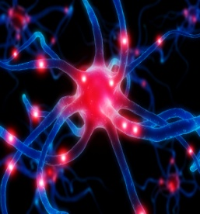
ESTROGEN
Protects CVS; enhance vasodilatation via  NO production, & cholesterol clearance via  HDL & LDL hepatic expression thus  atherosclerosis & ischemic insults
Improves insulin resistance & glycaemic control in diabetics
Improves cognitive function via  expression of ER in brain & by  amyloid deposition thus preventing Alzehimer ‘s.
Delays parkinsonism by acting on DA system in midbrain
B. Other Uses
Contraception
Primary ovarian failure
Amenorrhea & Hirsutism caused by excess androgens
Prostatic carcinoma in males ; but cause feminizing characters
so other drugs better given

Slide 11
ESTROGEN
ADMINISTRATION
Oral: -
Conjugated equine estrogen (CEE); (Estrone Sulphate + equilin sulphate +17 d dihydro equilin) from female horse
Estradiol valerate
Estrial succinate
Transdermal (estradiol);
Patches 24 hour twice weekly.
Gel 24 hours daily.
Subcutaneous implant (estradiol)  6 monthly.
Vaginal cream as such or as rings pessaries
ADRs & INTERACTIONS
See contraception
NB. If given with
SERMs additive side effects for both drugs
Aromatase inhibitors  efficacy
Corticosteroids  side effects

Slide 12
ESTROGEN
Contraindications
Absolute;
Undiagnosed vaginal bleeding
Severe liver disease
Thromboembolic manifestations
Cancer; endometrial, breast (hormone sensitive), ovarian
Relative;
Headaches; specially migraine
History of uterine fibroid or atypical ductal hyperplasia of breast
Active gallbladder disease; cholangitis, cholecystitis

Slide 13
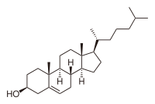
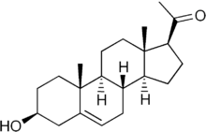
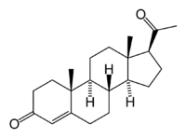
HRT
Estrogen and progestin combinations (pills or tablets)
PROGESTINs
2.
In NATURE
Produced by; Adrenal glands, Gonads, Brain, Placenta
Synthesis;
Induced by LH
Cholesterol
Pregnenolone
Progesterone
Are precursor to estrogens, androgens, and adrenocortical steroids.
As Therapy
Progesterone is destructed in GIT, so can be given only parentally
Progestins are synthetic progestogens that have progestinic effects similar to progesterone but are not degraded by GIT.
Progestin preparations; as in contraceptive pills
Binds to its receptors
What does progesterone do?
Two types of progesterone receptors [PR] PR-A & PR-B
They could exist cytoplasmic mediating genomic long term effects or membranous mediating non-genomic rapid effects

Slide 14
Estrogen and progestin combinations (pills or tablets)
INDICATIONS
PROGESTIN
A. In Menopause
As HRT, usually given in combination with estrogen Some use it alone in risk of cancer but does not  all menopausal symptoms
Protects against possibility of estrogen induced endometrial cancer
Estrogen  cell growth. If unopposed endometrial cell lining can show (atypical hyperplasia)
Progesterone beneficially matures endometrial cell lining ( become differentiated) &  apoptosis of atypical cells by activation of p53.
Natural progesterone protects against breast cancer development by anti-inflammatory & apoptotic mechanisms, BUT WITH SYNTHETIC PROGESTINS protection not confirmed so mamography every 6ms.
Confers neuroprotection,  cognition &  incidence of Alzheimer‘s
Controls insomnia & depression  precursor of melatonin & release 5HT
Contributes to CV protection   NO & has anti-atherogenic actions
Counteract osteoporosis, directly +ve osteoblasts & indirectly blocking GC induced bone resorption

Slide 15
Estrogen and progestin combinations (pills or tablets)
PROGESTIN
B. Other Uses
1. Contraception 2. Dysmenorrhea 3. Infertility due to inadequate luteal phase
Administration
Oral; Micronized progesterone or progestins see contraception
IUS; as Levonorgestrel or Progestasert
Vaginal - natural progesterone gel / pessary.
Transdermal - sequential / continuous patch.
ADRs
See contraception

Slide 16
HRT
Estrogen and progestin combinations (pills or tablets)
SERMs
3.
Tamoxifen, Raloxifene
Classified according to how they bind to ER
Antiestrogens that exhibits partial agonistic action ; acting as an agonist in bone & an antagonist in breast Raloxifene
Antiestrogens that stabilizes ER in a conformation allowing trans- cription to occur on only certain ER-responsive genes Tamoxifen
An ideal SERM for use as HRT should be agonistic in brain, bone, CV system, vagina & urinary system but antagonistic in breast & uterus
 | Brain | Uterus | Vagina | Breast | Bone | CVS
Estradiol | ++ | ++ | ++ | ++ | ++ | ++
Ideal SERM | ++ | — | ++ | — | ++ | ++
Tamoxifen | — | + | — | — | + | +
Raloxifene | — | — | — | — | + | +
Not Ideal
Tamoxifen risk of venous thrombosis & tends to precipitate vaginal atrophy & hot flushes
Raloxifene  has no effect on hot flushes.

Slide 17
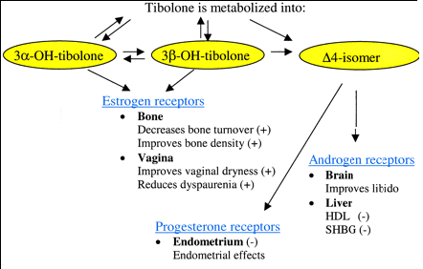
HRT
Estrogen and progestin combinations (pills or tablets)
TIBOLONE
4.
Synthetic steroid metabolized to many metabolites that have estrogenic, androgenic & progestagenic properties
Tibolone is close to being ideal HRT. WHY ???
It induces amenorrhoea
Improves urogenital symptoms
Enhances mood & libido.
Protective on CVS system
Prevents bone loss
Protective on endometrium
Least tendency of cancer breast
In Menopause
With history of endometriosis, fibroids, or treated breast cancer.
In diabetics, hypertriglyceridemics
In thromboembolic tendency
In lack of sexual arousal
INDICATIONS

Slide 18
HRT
Estrogen and progestin combinations (pills or tablets)
5.
PHYTOESTROGENS
Are supplements from plants; containing isoflavones (soya beans) or lignans (whole grains).
They mimic action of estrogen on ER-β alleviate symptoms related to hot flushes, mood swings, cognitive functions & possess CVS protective actions.
They block actions mediated by ER-α in some target tissues  lower risks of developing endometrial & breast cancer.
HRT
Estrogen and progestin combinations (pills or tablets)
ANDROGENS
6.
Testosterone is responsible for sexual arousal in females. It is given as the sole therapy to menopausal women in whom their menopausal symptoms are focused on lack of sexual arousal. It is given as adjuvant to combined estrogen & progestin if all other menopausal symptom exist.
N.B. Tibolone, can be effective in some women  has some androgen agonistic properties.

Slide 19
HRT
GOOD LUCK

