Slide 1
DRUGS AFFECTING UTERINE MUSCLE CONTRACTILITY

Slide 2
DRUGS PRODUCING UTERINE CONTRACTIONS( Oxytocic Drugs )
OXYTOCIN
Syntocinon
ERGOT ALKALOIDS
Ergometrine (Ergonovine)
Methyl ergometrine(methyl ergonovine)
PROSTAGLANDINS
a) PGE2
b) PGF2α

Slide 4
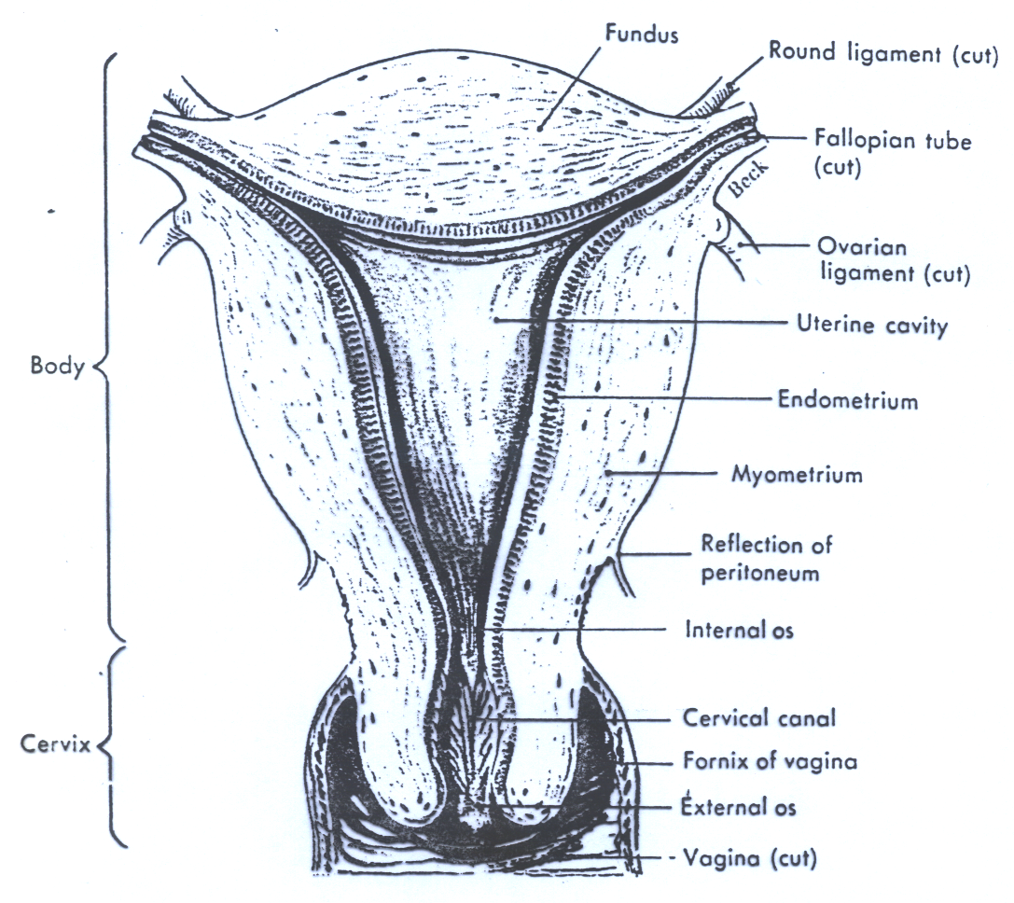

Slide 5
OXYTOCIN
(Syntocinon^{R})
Synthesis
Is a posterior pituitary hormone secreted by the posterior pituitary gland.
Oxytocin secretion occurs by sensory stimulation from cervix ,vagina , and from suckling at breast.

Slide 6
Pharmacokinetics of oxytocin
Absorption ,Metabolism and Excretion
Not effective orally
Administered intravenously
Also as nasal spray(impaired milk ejection)
Not bound to plasma proteins
Catabolized by liver & kidneys
Half life = 5 minutes

Slide 7
Role of oxytocin
Uterus
Stimulates both the frequency and force of uterine contractility particularly of the fundus segment of the uterus.
These contractions resemble the normal physiological contractions of uterus (contractions followed by relaxation)

Slide 9
Immature uterus is resistant to oxytocin.
Contract uterine smooth muscle only at term.
Sensitivity increases to 8 fold in last 9 weeks and 30 times in early labor.
Clinically oxytocin is given only when uterine cervix is soft and dilated.

Slide 10
Mechanism of action
The interaction of endogenous or administered oxytocin , with myometrial cell membrane receptor promotes the influx of ca ++ from extra cellular fluid and from S.R in to the cell , this increase in cytoplasmic calcium ,stimulates uterine contraction .

Slide 11
Therapeutic Uses of Oxytocin
  Induction & augmentation of labor**
  (slow I.V infusion)
a) Mild preeclampsia
b) Uterine inertia
c) Incomplete abortion
d) Post maturity
e) Maternal diabetes

Slide 12
  Therapeutic Uses of Oxytocin (continue)
  Post partum uterine hemorrhage
  (I.V drip)
  (ergometrine is often used)
  Impaired milk ejection
  One puff in each nostril 2-3 min before nursing

Slide 13
Side Effects:
1. Maternal death due to hypertension
2. Uterine rupture
3. Fetal death(ischaemia)
4. Water intoxication

Slide 14
Contraindications
a) Hypersensitivity
b) Prematurity
c) Abnormal fetal position
d) Evidence of fetal distress
e) Cephalopelvic disproportion
Precautions
a) Multiple pregnancy
b) Previous c- section
c) Hypertension

Slide 15
Ergot Alkaloids
Ergometrine (Ergonovine)
Methyl ergometrine(Methylergonovine)

Slide 16
Effects on the Uterus
Alkaloid derivatives induce TETANIC CONTRACTION of uterus without relaxation in between(not like normal physiological contractions)
It causes contractions of uterus as a whole i.e. fundus and cervix(tend to compress rather than to expel the fetus)
Difference between oxytocin & ergots??

Slide 18
Ergot alkaloids( pharmacokinetics)
Absorption ,fate and excretion
Absorbed orally from GIT(tablets)
Usually given I.M
Extensively metabolized in liver.
90% of metabolites are excreted in bile

Slide 19
Clinical uses
Post partum hemorrhage
Preparations
Syntometrine (ergometrine 0.5 mg
+ oxytocin 5.0 I.U), I.M.

Slide 20
Side effects
a) Nausea, vomiting, diarrhea
b) Hypertension
b) Vasoconstriction of peripheral blood vessels ( toes & fingers)
c) Gangrene

Slide 21
Contraindications:
1) Induction of labour
a) 1st and 2nd stage of labor
b) vascular disease
c) Severe hepatic and renal impairment
d) Severe hypertension

Slide 22
PROSTAGLANDINS
(PGE2 & PGF2α)
Therapeutic uses
1. Induction of abortion (pathological)**
2. Induction of labor (fetal death in utero)
3. Postpartum hemorrhage

Slide 23
Side Effects
  a) Nausea , vomiting
  b) Abdominal pain
  c) Diarrhea
  d) Bronchospasm (PGF2α)
  e) Flushing (PGE2)

Slide 24
Contraindications:
a) Mechanical obstruction of delivery
b) Fetal distress
c) Predisposition to uterine rupture
Precautions:
a) Asthma
b) Multiple pregnancy
c) Glaucoma

Slide 25
Difference B/w Oxytocin and Prostaglandins
Prostaglandins | Oxytocin | Character
Contraction through out pregnancy | Only at term | Contraction
soften the cervix | Does not soften the cervix | Cervix

Slide 26
Difference (cont’d)
Prostaglandins | Oxytocin | Character
Longer | Shorter | Duration of action
Induce abortion in 2nd trimester of pregnancy. Used as vaginal suppository for induction of labor Post partum heg. | Induce and augment labor and post partum hemorrhage | uses

Slide 27
Difference b/w Oxytocin and Ergometrine
Ergometrine | Oxytocin | Character
Tetanic contraction ; doesn't resemble normal physiological contractions | Resembles normal physiological contractions | Contractions
Only in p.partum hemorrhage | To induce &augment labor. *Post partum hemorrhage | Uses
Moderate onset Long duration of action | Rapid onset Shorter duration of action | Onset and Duration

Slide 28
UTERINE RELAXANTS

Slide 29
DRUGS PRODUCING UTERINE RELAXATION( Tocolytic Drugs ).
  Action and Uses
  Relax the uterus and arrest threatened abortion or delay premature labor.
1. β-ADRENOCEPTOR AGONISTS**
Ritodrine, i.v. drip
Selective β₂ receptor agonist used specifically as a uterine relaxant.

Slide 30
β- adrenoceptor agonists
Mechanism of action
Bind to β-adrenoceptors , activate enzyme Adenylate cyclase , increase in the level of cAMP reducing intracellular calcium level.

Slide 31
Side effects:
Tremor
Nausea , vomiting
Flushing
Sweating
Tachycardia (high dose)
Hypotension
Hyperglycemia
Hypokalaemia

Slide 32
2.CALCIUM CHANNEL BLOCKERS e.g., Nifedipine
Causes relaxation of myometrium
Markedly inhibits the amplitude of spontaneous and oxytocin-induced contractions

Slide 33
Unwanted effects
Headache, dizziness
Hypotension
Flushing
Constipation
Ankle edema
Tachycardia

Slide 34
3. Prostaglandin synthetase inhibitors
The depletion of prostaglandins prevents stimulation of uterus
NSAID,s e.g. Indomethacin
Aspirin
Ibuprofen

Slide 35
Adverse effects
ulceration
premature closure of ductus arterious.

Slide 36
Objectives
At the end of the lectures, students should be able to know and understand the:
1.Drugs used to induce & augment labor.
2.Drugs used to control post partum haemorrhage.
3.Drugs used to induce pathological abortion.
4.Drugs used to arrest premature labor.
5.The mechanism of action and adverse effects of
each drug.

