Slide 1
Teratogens and drugs of abuse in pregnancy
Prof. Hanan Hagar
Dr. Ishfaq Bukhari
Pharmacology Unit
College of Medicine

Slide 2
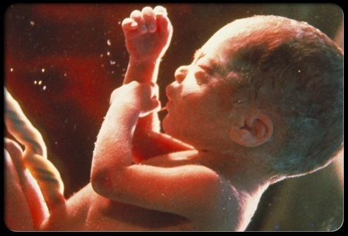
Medications in pregnancy
Placental membrane is semi-permeable.
Most drugs can cross placenta by passive diffusion.
The movement of drugs across the placenta is limited by a single layer of cell called trophoblasts.

Slide 3
Factors controlling placental drug transfer
1. Physiochemical properties of the drug
Lipid solubility or diffusion.
Molecular size.
Protein binding.
2. The stage of placental and fetal
development at the time of exposure to the drug.
3. Duration of exposure to the drug.

Slide 4
Lipid solubility of the drug
Lipophilic drugs diffuse readily across the
placenta and enter fetal circulation.
e.g.Thiopental→ crosses placenta & causes sedation, apnea in newborn infants.
Ionized drugs cross the placenta very slowly → very low conc. in the fetus.
e.g. Succinylcholine & Tubocurarine.

Slide 5
Molecular size of the drug
MW affects the rate of transfer:
250 - 500 cross placenta easily.
500 - 1000 cross placenta with more difficulty.
↑ 1000 can not cross placenta e.g. Heparin

Slide 6
Protein binding
Protein binding in maternal circulation hinders passage of drugs especially . e.g propythiouracil and chloramphenicol

Slide 7
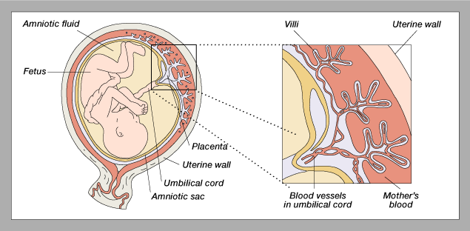
Prenatal Structures

Slide 8
The stage of mammalian
fetal development
Harmful action of drugs depend upon stage of fetal development at time of drug exposure.
Mammalian fetal development passes through
three phases:
Blastocyste formation (up to 16 days).
Organogenesis (17-60 days).
Histogenesis & maturation of function.

Slide 9
Blastocyste formation (First 2 weeks)
Occurs from (1-16 days) in the first trimester.
This is the period of dividing zygote and implantation
Pre-differentiated period (conceptus).
Drugs have an all-or-nothing effect.
Exposure to drugs during this period → Prenatal death & abortion.

Slide 10
Organogenesis: (2-8 weeks)
Occurs in (17- 60 days) in the first trimester.
The most sensitive period of pregnancy because major body organs and systems are formed.
Exposure to harmful drugs during organogenesis → major birth defect in body parts and structures or gross malformation.

Slide 11
Histogenesis and functional maturation
(8 weeks onwards)
Maturation occurs during this stage & fetus depends upon nutrients & hormonal supply.
Exposure to drugs during 2nd and 3rd (8 weeks onwards) will not induce major malformation but drugs can produce minor morphologic abnormalities, growth retardation and functional defect.

Slide 12
Three trimesters of pregnancy are:
First trimester: week 1- week 12
Second trimester: week 13-week 28
Third trimester: week 29-week 40

Slide 13
Teratogenesis
Occurrence of congenital defects of the fetus.
What is a teratogen? is any agent (medication, street drug, chemicals, disease, environmental agents) that is able to interferes with fetal development and leads to permanent birth defects.This could be severe during critical periods of development e.g. (organogenesis).

Slide 14
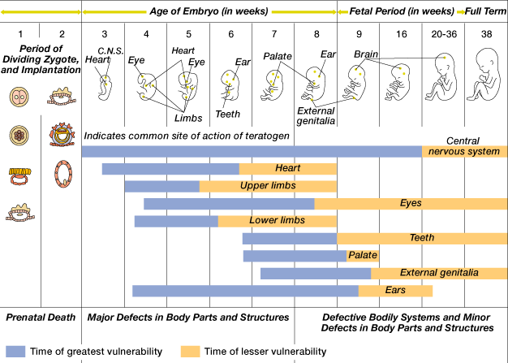
Critical Periods of Human Development

Slide 15
FDA Classification System
Category A
Controlled human studies with no risk to fetus
Drugs can be used
Category B
Adverse effects on animal studies only
Human studies did not show similar results.
Drugs can be used in pregnancy

Slide 16
FDA Classification System
Category C
Adverse effects on animal studies only
No human studies, human fetal risk is unknown.
Drugs may be used in serious situation.

Slide 17
FDA Classification System
Category D
Evidence of human fetal risk
May be used in serious diseases or life threatening situations
Category X
Proven fetal abnormalities in animal and human studies
Drugs are teratogens and contraindicated in pregnant women or planning to conceive.

Slide 18
Proven teratogens
The following drugs are contraindicated during pregnancy (category X):
Thalidomide (sedative/ hypnotics ).
Cytotoxic drugs
Folate antagonists (methotrexate ).
Alkylating agents (cyclophosphamide).
All others : smaller risk.
Lithium (valvular heart abnormality)
Alcohols (fetal alcohol syndrome).
Anticonvulsant drugs (valproic acid, phenytoin).

Slide 19
Proven teratogens
Anticoagulants (warfarin).
Antibiotics (tetracyclines, quinolones)
Angiotensin converting enzyme inhibitors (ACEIs)
Retinoids e.g.
vitamin A ( should be limited to 700 μg/day)
isotretinoin (used in treatment of acne)
Ionizing radiation (diagnostic X-ray or radiation therapy).
Radioactive iodine (I¹³¹).
Corticosteroids.
Hormones

Slide 20
Teratogenesis of drugs
Thalidomide | Phocomelia shortened or absent long bones of the limbs Anorectal stenosis Absence of external ears
Alcohol | Fetal Alcohol Syndrome (FAS) Microcephaly Intrauterine growth retardation Craniofacial abnormalities CVS abnormalities CNS abnormalities (attention deficits, intellectual disability, mental retardation)

Slide 21
Teratogenesis of drugs
Phenytoin | Fetal Hydantoin Syndrome Nail & Digital hypoplasia Oral Clefts (cleft lip and palate) Cardiac Anomalies
Valproic acid | Neural tube defect (spina bifida)
Tetracyclines | Permanent teeth staining Enamel hypoplasia altered growth of teeth and bones.
Warfarin | Chondroplasia (hypoplasia of nasal bridge)- CNS malformation
Finasteride Used in prostatic hypertrophy | Abnormal development of genitalia of male fetuses

Slide 22
Corticosteroids | Cleft lip and Palate
Hormones Estrogens Androgens diethylstilbestrol | Serious genital malformation Testicular atrophy in male fetus Fetal masculinization in female fetus Vaginal carcinoma of female offspring
Lithium | Cardiovascular anomalies mainly valvular heart defect involving tricuspid valve Ebstein's anomaly
ACE inhibitors captopril, enalapril | Renal damage Fetal & neonatal anurnia Fetal hypotension, hypoperfusion - growth retardation ACE inhibitors disrupt the fetal renin-angiotensin system, which is essential for normal renal development

Slide 23
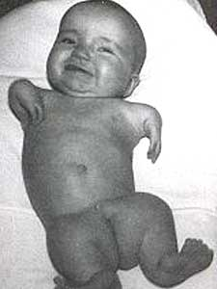
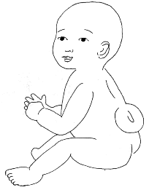
Thalidomide
Valproic acid
Phocomelia
Spina bifida

Slide 24
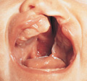
Fetal hydantoin syndrome
Cleft lip and palate

Slide 25
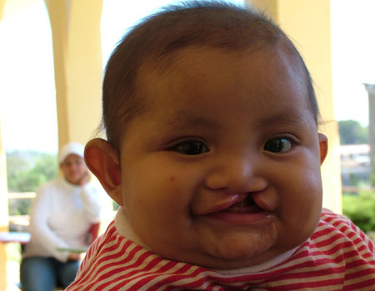
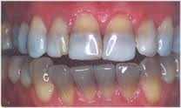
Cleft lip
Teeth staining

Slide 26
Adverse effects of drugs
During second and third trimesters
Some drugs can produce adverse effects on the fetus more likely than major malformations due to their pharmacological actions.

Slide 27
Adverse effects of drugs
Tetracyclines | Impaired teeth & bone development, yellow-brown discoloration of teeth
Aminoglycosides | Streptomycin, kanamycin Ototoxicity = 8th Cranial nerve damage
Cloramphenicol | Gray baby syndrome
Corticosteroids | Adrenal atrophy – growth retardation
Propranolol | Bradycardia, neonatal hypoglycemia, placental insufficiency, reduced uterine blood flow, fetal distress
Antithyroid drugs | Iodide, methimazole, carbimazole, propylthiouracil Risk of hypothyroidism and goiter

Slide 28
Adverse effects of drugs
NSAIDs | e.g. Aspirin-indomethacin Prostaglandin synthesis inhibitors Premature closure of fetal ductus arteriosus Pulmonary hypertension in newborns
Benzodiazepines as diazepam | Chronic use → neonatal dependence and withdrawal symptoms
warfarin | Risk of bleeding

Slide 29
Adverse effects of drugs prior to labor
NSAIDs | e.g. Aspirin-indomethacin Prostaglandin synthesis inhibitors Increase in gestation time prolong labor, neonatal bleeding Risk of postpartum hemorrhage
CNS depressants | e.g. diazepam, morphine Interference with suckling Respiratory depression Reduced blood flow, fetal distress
Sulfonamides | Displacement of bilirubin from plasma protein (neonatal hyperbilirubinemia)

Slide 30
Hypertension in pregnancy
-
Contraindicated
ACE inhibitors
Angiotensin II receptor blockers
Thiazide diuretics
Propranolol
Calcium channel blockers in mild hypertension
Probably safe
α- methyl dopa
Labetalol
Emergency
Hydralazine
Labetalol

Slide 31
Coagulation disorders in pregnancy
Contraindicated
warfarin is contraindicated in all trimesters
Cross placenta
1st trimester : Teratogenicity (Chondroplasia)
2nd, 3rd : risk of bleeding
Probably safe
Heparin
Polar, does not cross placenta
Protamine sulphate as antidote for neutralization

Slide 32
Antithyroid drugs in pregnancy
Are used in thyrotoxicosis or Grave’s disease
Propylthiouracil
Methylthiouracil (Methimazole)
Carbimazol
Radioactive Iodine (I¹³¹)
All can cross placenta
All have risk of congenital goiter and hypothyroidism
The lowest dose of antithyroid drugs should be used.
Propylthiouracil is preferable over others

Slide 33
Antibiotics in pregnancy
Contraindicated :
Aminoglycosides: ototoxicity
Tetracyclines: Teeth and bones deformity
Sulfonamides: neonatal jaundice-kernicterus
Chloramphenicol: Gray baby syndrome
Quinolones as ciprofloxacin: arthropathy (bone and cartilage damage)
Probably safe
Penicillins (ampicillin, amoxicillin)
Cephalosporins
Erythromycin and azithromycin as alternative in penicillin-sensitive individuals

Slide 34
Drugs of choice in pregnancy
Antihypertensive | α-methyl dopa Labetalol (α - β Blocker) Hydralazine (emergency only)
Antibiotics | penicillin, cephalosporins, erythromycin
Antidiabetics | Insulin, avoids oral antidiabetics
Anticoagulants | Heparin
Analgesics | Acetaminophen (paracetamol)
Antithyroid drugs | Propylthiouracil (protein-bound)
Anticonvulsants | All antiepileptics have potential to cause malformations avoid valproic acid. Folic acid should be supplied.

Slide 35
Drugs of Abuse in Pregnancy

Slide 36
Drug abuse
Drug abuse:
Habitual use of drugs not for therapeutic purposes but for alteration of one's mood or state of consciousness.

Slide 37
Drug abuse
The most commonly abused drugs are alcohol; barbiturates; benzodiazepines, opium alkaloids
amphetamines; cocaine; nicotine; marijuana.
Drug abuse may lead to organ damage, dependence, addiction, and disturbance of behavior.

Slide 38
Alcohols
The use of alcohol is contraindicated during all trimesters of pregnancy

Slide 39
Fetal Alcohol Syndrome (FAS)
Caused by chronic maternal alcohol
abuse during early weeks of first trimester of pregnancy.
Characters
Microcephaly
Craniofacial abnormalities
Growth retardation
CVS abnormalities
CNS abnormalities (mental retardation, attention deficits, intellectual disability)

Slide 40
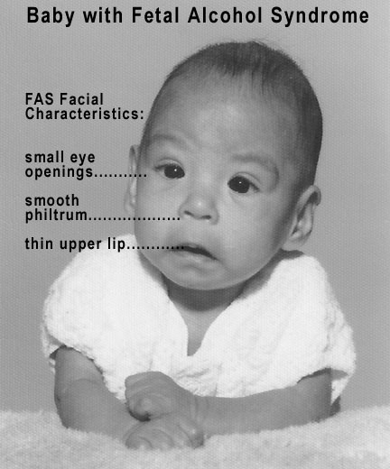
Fetal Alcohol Syndrome ( FAS )

Slide 41
Cocaine
Cocaine is low MW, water-soluble
Cocaine easily passes into fetus through placenta.
Inhibits re-uptake of sympathomimetics (epinephrine, NE, dopamine), causing vasoconstriction, rapid heart rate, hypertension (Vascular disruption).
It decreases blood flow to uterus, fetal oxygenation and intestinal blood flow.
It increases uterine contractility

Slide 42
Cocaine
Microcephaly
Prematurity
Low birth weight.
Abruptio placentae (separation of placenta from uterus wall before delivery)
Growth retardation
Mental retardation
Withdrawal symptoms

Slide 44
Tobacco
Tobacco contains nicotine and carbon monoxide that may harm fetus.
Tobacco can produce:
Decreased blood flow to placenta
Fetal hypoxia
Retarded fetal growth
Low birth weight
Increased spontaneous abortion
Preterm labor and stillbirth

Slide 45
Conclusions
The use of drugs during pregnancy should be avoided unless absolutely necessary.
Most drugs cross the placenta to some extent.
Birth defects are of great concern.
Drugs can harm the embryo or foetus depending upon the stage of foetal development.
The most critical period of pregnancy is organogenesis (17 days – 8 weeks).
Alcohol, nicotine and other addicting drugs should be avoided.

Slide 46
Thank you Questions ?
Notes:
46
46

