Slide 1
Hormones affecting the breast
Dr. Hana Alzamil

Slide 2
Objectives
Hormonal requirement for breast development (Mamogenesis)
Hormones involved in the process of lactation (Lactogenesis) and their physiological action
Physiological basis of suckling reflex and its role in lactation
Galactopoeisis
Involution (the termination of milk production).

Slide 3
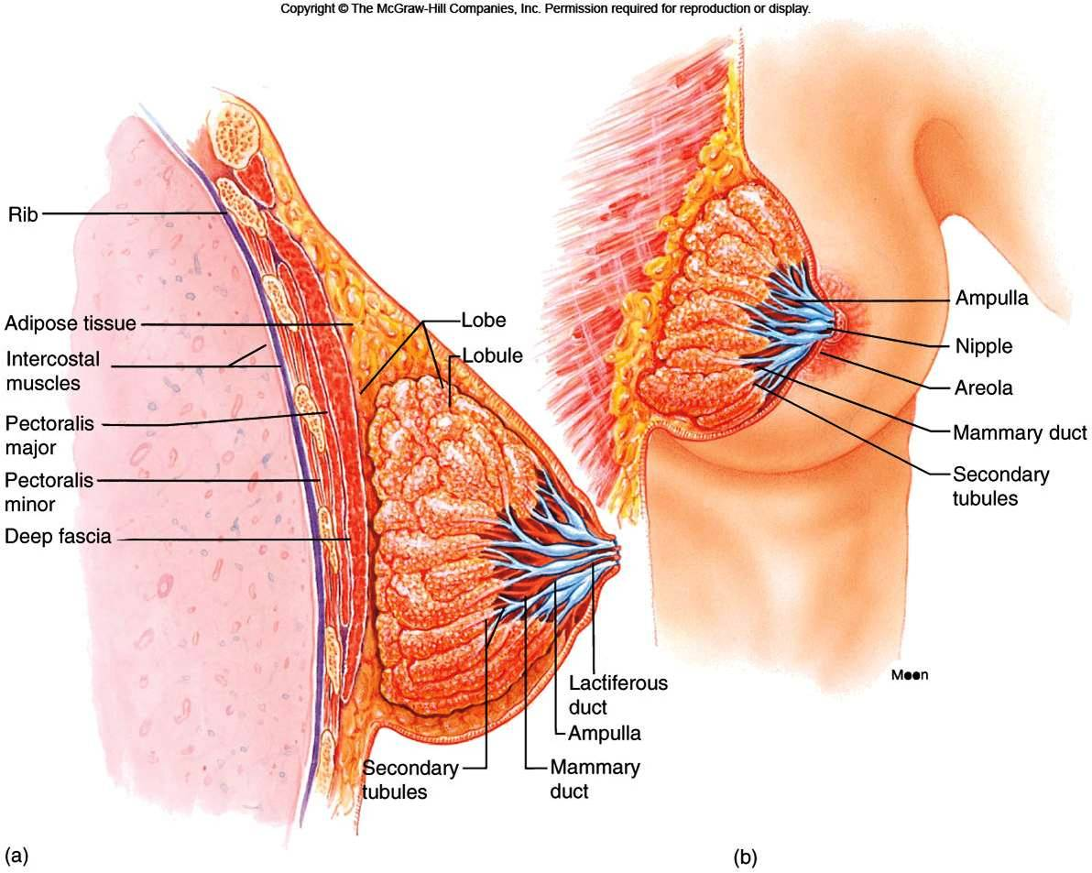

Slide 4
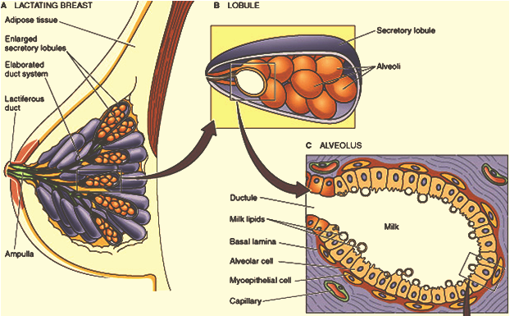

Slide 5
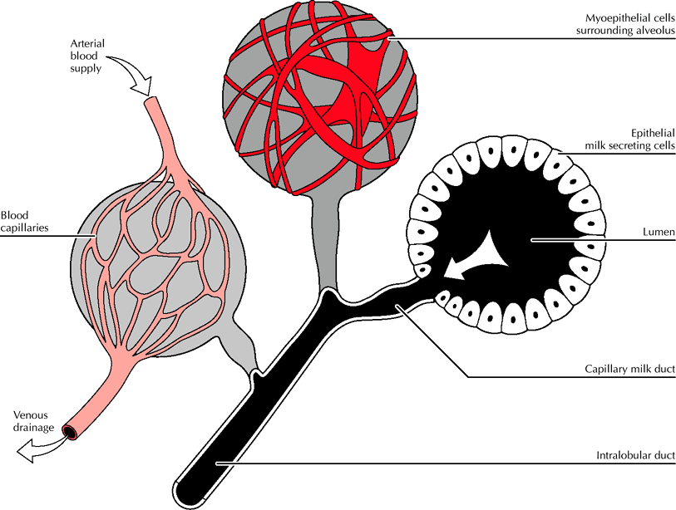
Where does milk come from?
Notes:
Milk produced in mammary epithelium within lobules
With nursing, oxytocin triggers contraction of myoepithelial cells and transfer to sinuses

Slide 6
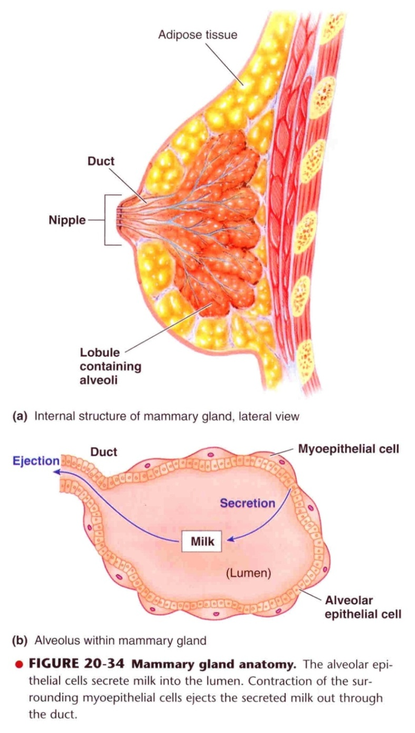

Slide 7
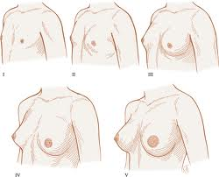
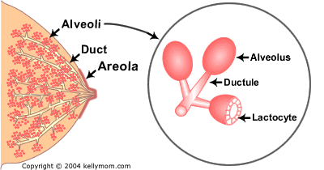
Breast development (mamogenesis)
During puberty
Estrogen stimulate proliferation of ducts and deposition of fat
Progesterone stimulate development of lobules

Slide 8
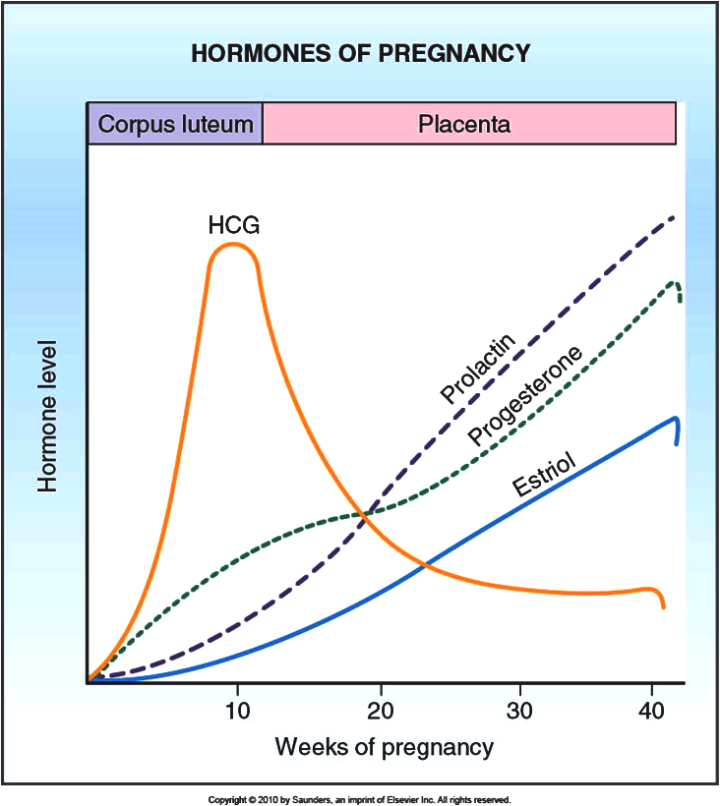
Breast development (mamogenesis)
During pregnancy
Complete development of glandular tissue

Slide 9
Breast development (mamogenesis)
Endocrine system plays a major role in synchronizing development (mamogenesis) and function (lactogenesis) of mammary gland with reproduction
Three categories of hormones:
Reproductive hormones (endocrine)
Estrogen, progesterone, prolactin, oxytocin and hPL
Metabolic hormones (endocrine)
GH, corticosteroids, thyroxin, PTH and insulin
Mammary hormones (autocrine)
GH, prolactin, PTHrP and leptin

Slide 10
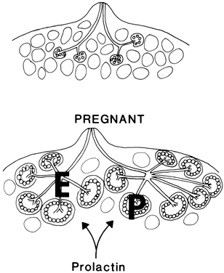
Breast development (mamogenesis)
Reproductive hormones (direct effect)
Estrogen (placenta)
Growth & branching of ductal system (with GH)
Fat deposition in the stroma
Progesterone (placenta)
Growth of lobule-alveolar system(budding of alveoli and secretory changes in epithelial cells )
Although estrogen and progesterone are essential for physical development of the breasts, they inhibit actual secretion of milk

Slide 11
Breast development (mamogenesis)
Prolactin (anterior pituitary)
Its level increases during pregnancy (10-20 times)
Its main function is milk production
Sudden drop in E & P after delivery allows milk production
It is controlled mainly by hypothalamic hormone
PIH (Dopamine)
Human placental lactogen (placenta)
Facilitate mammogenesis
Delay milk production

Slide 12
Lactogenesis
Lactogenesis: cellular changes by which mammary epithelial cells are converted from a nonsecretory state to a secretory state: 2 stages
Lactogenesis 1: (Cytologic and enzymatic differentiation of alveolar epithelial cells).
Starts in midpregnancy and characterized by expression of many genes involved in synthesis of milk components (increases in uptake transport systems for amino acids, glucose, and calcium required for milk synthesis).
Hormones involved:
Progesterone (suppresses milk secretion)
Prolactin and/or placental lactogen
Growth hormone
Glucocorticoids (Cortisol)

Slide 13
Lactogenesis
Lactogenesis 2: (Copious secretion of all milk components).
Around parturition withdrawal of progesterone + high level of prolactin leads to:
Further increase in expression of milk protein genes
Glands absorb increased quantities of metabolic substrates from the blood.
Movement of cytoplasmic lipid droplets and casein into alveolar lumina
Transfer of immunoglobulins
Secretion of colostrum followed by milk

Slide 14
Lactogenesis
Lactogenesis 2:
Suckling stimulates further increase in expression of genes involved in milk secretion with expansion of alveolar epithelium
Lactation is maintained by removal of milk
2 hormones involved
Prolactin (milk production)
Oxytocin (milk let-down)

Slide 15
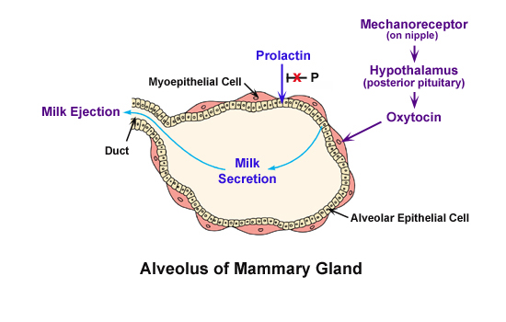

Slide 16
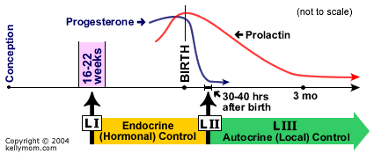
Stages of lactogenesis
Mamogenesis and Lactogenesis Galctopoesis

Slide 17
Hormonal regulation of lactogenesis
Metabolic hormones (direct effect)
GH
Can be produced locally
Its secretion is stimulated by progesterone
Increases production of IGF-1 by the liver
Mediate cell survival and ductal growth
Corticosteroids
Increases during pregnancy (fivefold)
Involved in breast development (permissive action on milk protein synthesis)

Slide 18
Hormonal regulation of lactogenesis
Thyroxin
Essential for milk production
Thyroxin & TSH level decreases during lactation
TRH increases leading to stimulation of PRL (nasal administration to treat inadequate lactation )
Insulin
Low during lactation
Shunt of nutrients from storage depots to milk synthesis

Slide 19
Hormonal regulation of lactogenesis
Mammary hormones
GH
Progesterone stimulates its secretion
Leptin
Increases during pregnancy (increase adipose tissue)
Decreases with lactation
PTHrP
Increases during lactation
Mobilizes bone calcium
Increase in alkaline phosphatase

Slide 20
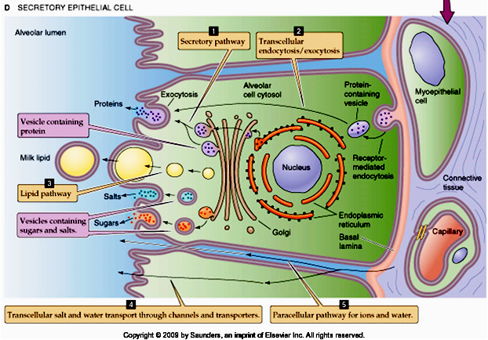

Slide 21
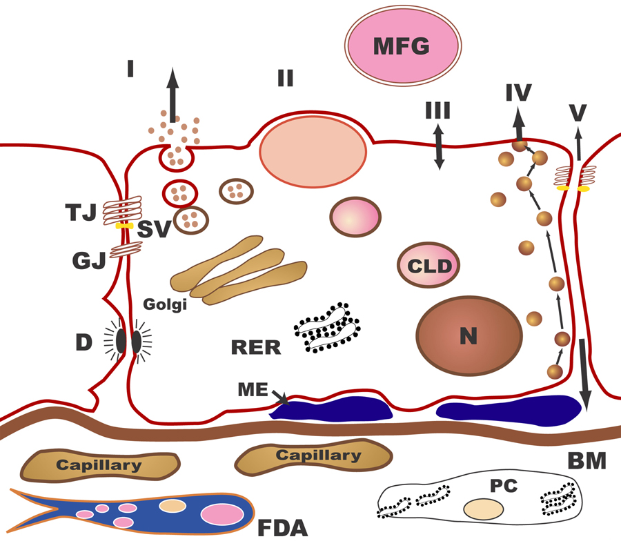
The pathways for milk secretion and synthesis by the mammary epithelial cell. I: Exocytosis of milk protein, lactose, and other components of the aqueous phase in Golgi-derived secretory vesicles. II: Milk fat secretion via the milk fat globule. III: Direct movement of monovalent ions, water, and glucose across the apical membrane of the cell. IV: Transcytosis of components of the interstitial space. V: The paracellular pathway for plasma components and leukocytes. Pathway V is open only during pregnancy, involution, and in inflammatory states such as mastitis. SV = Secretory vesicle; RER = Rough endoplasmic reticulum; BM = Basement membrane; MFG = Milk fat globule; CLD = Cytoplasmic lipid droplet; N = Nucleus; PC = Plasma cell; FDA = Fat-depleted adipocyte; TJ = Tight junction; GJ = Gap junction; D = Desmosome; ME = Myoepithelial cell.

Slide 22
Galactopoeisis
Definition: Galactopoeisis is defined as the maintenance of lactation once lactation has been established.
Role of Hormones
Prolactin: milking-induced surge is a direct link between the act of nursing (or milk removal) and the galactopoeitic hormones involved in maintaining lactation.
Growth Hormone: support increase in synthesis of lactose, protein, and fat in the mammary gland
Glucocorticoids: galactopoeitic in physiological doses
Thyroid Hormones: galactopoeitic
Ovarian Hormones :
Estrogen in very low doses is galactopoietic
Progesterone alone has no effect on galactopoeisis because there are no progesterone receptors in the mammary gland during lactation

Slide 23
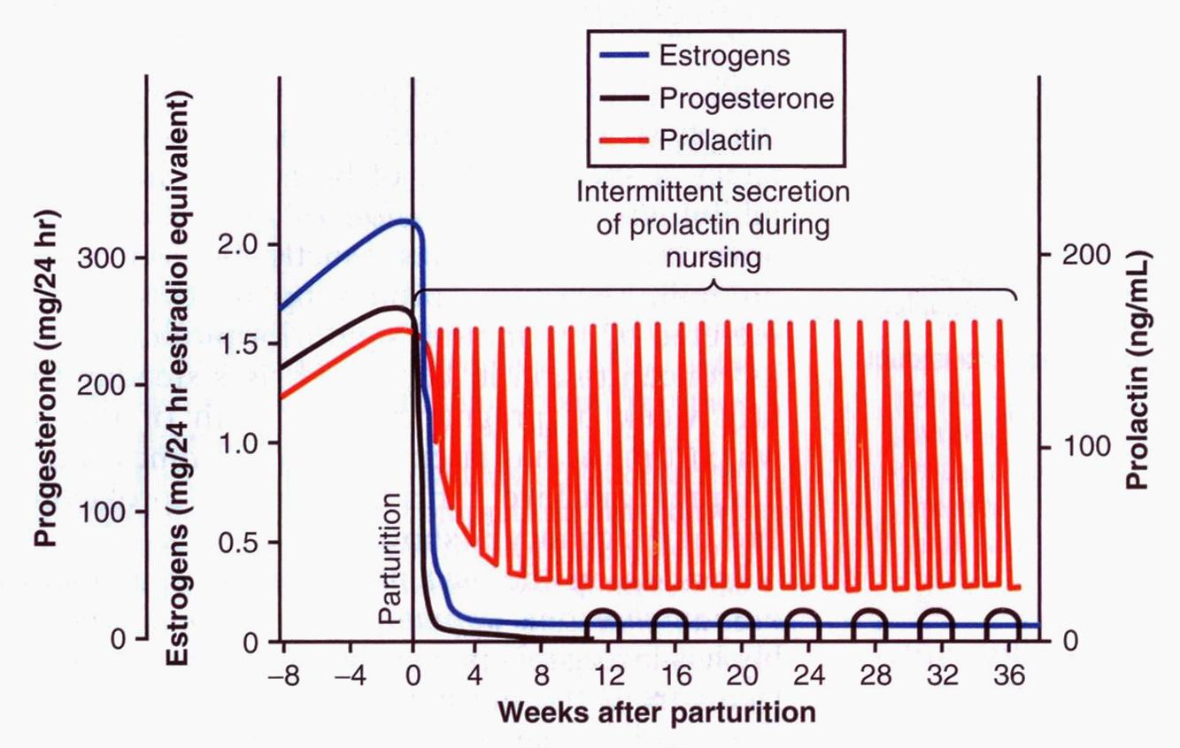

Slide 24
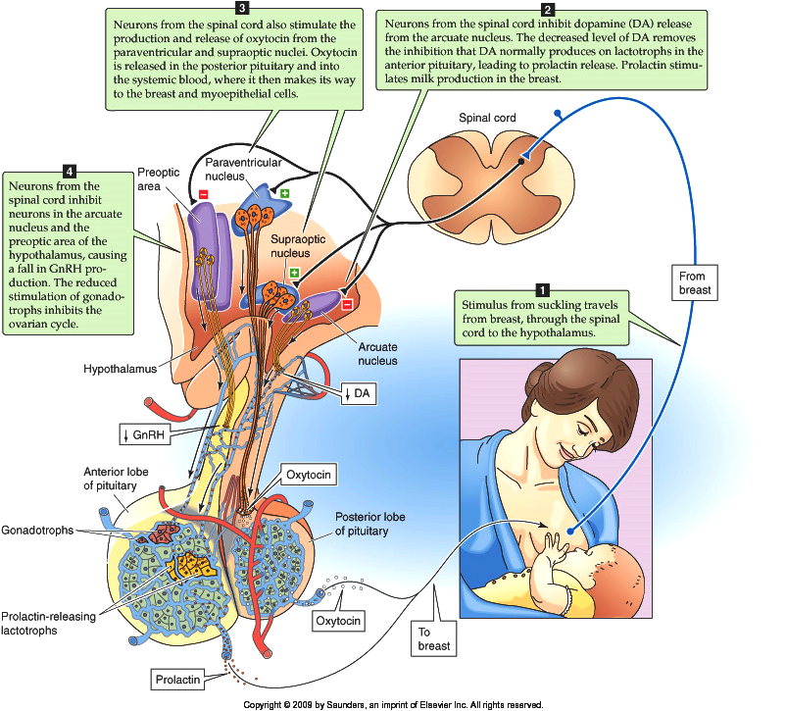
Suckling reflex

Slide 25
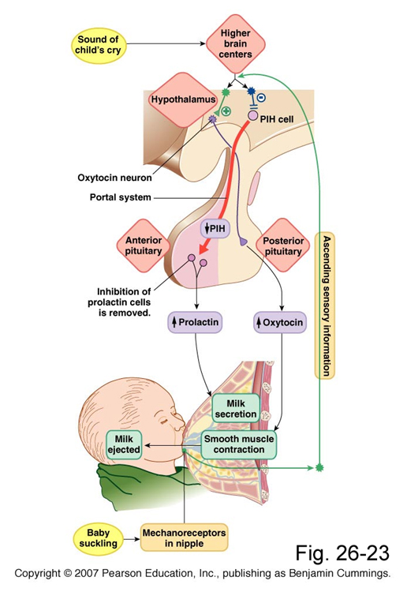
Suckling reflex

Slide 26
Milk production is a
"use it or lose it" process. The more often and effectively the baby nurses, the more milk will be produced
Milk production <100 ml/day in day 1 postpartum
Milk production by day 3 reaches 500 ml/day
Milk composition changes dramatically(↓Na⁺²& Cl⁻ ) due to closure of tight junctions that block paracellular pathway

Slide 27
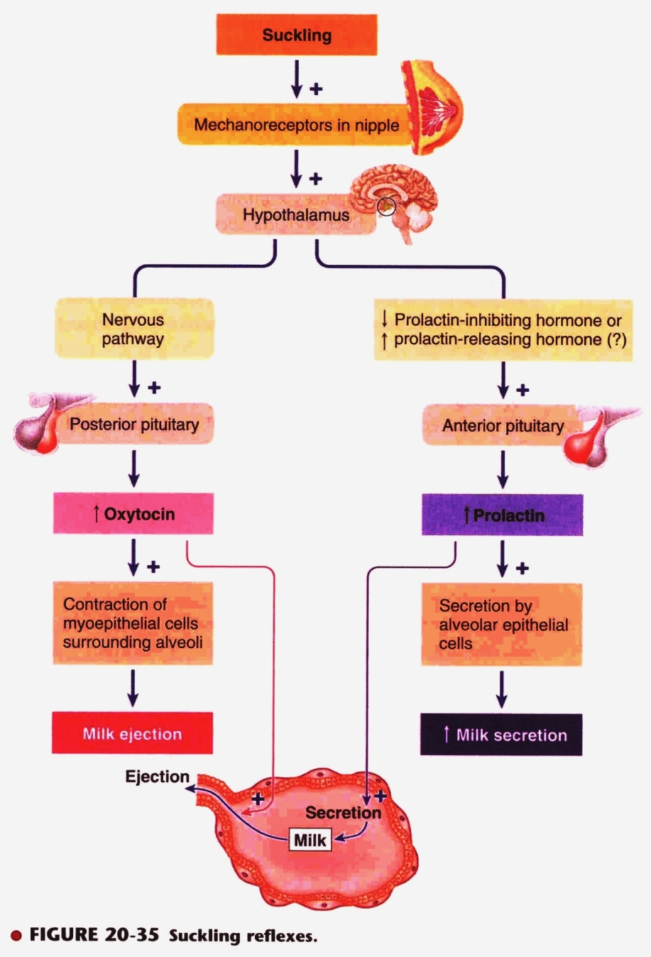

Slide 28
يقول تعالى (والوالدات يرضعن أولادهن حولينِ كاملين لمن أراد أن يُتمَّ الرضاعة) [البقرة :233] .
وفي إشارة علمية دقيقة أخرى للقرآن الكريم نراه يحدد مدة الرضاعة بما يقرب من الحولين ، كما جاء في الآية رقم (14) في سورة [لقمان]: (ووصينا الإنسان بوالديه حملته أمه وهنـًا على وهن وفصاله في عامين) ، والآية (15) في سورة [الأحقاق] : (حملته أمه كرهـًا ووضعته كرهـًا وحمله وفصاله ثلاثون شهرا) ، ويُفهم من هذا أن إرضاع الحولين ليس حتمـًا ، بل هو التمام ، ويجوز الاقتصار على ما دونه ، كما أشارت الأحكام الإسلامية الخاصة بالرضاعة إلى ذلك ، اعتماداً على قوله تعالى : (فإن أرادا فصالاً عن تراضٍ منهما وتشاورٍ فلا جناح عليهما…) الآية [البقرة : 233] .

Slide 29
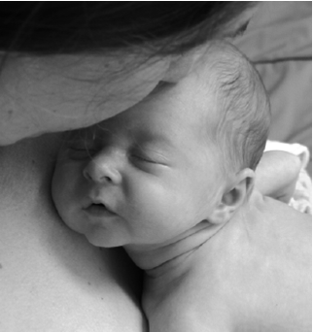
AAP Recommendations
Exclusive breastfeeding for the first six months of life
Continued breastfeeding for at least one year, ‘As long as is desired by mother and child’
American Academy of Pediatrics (2005). "Breastfeeding and the Use of Human Milk." Pediatrics 115(2): 496-506.

Slide 30
Failure of breast feeding

