Slide 1
Accountability & Professional Responsibility SKILL-221
Professor Samy Azer & Professor Hanan Habib
College of Medicine,
King Saud University
Saudi Arabia

Slide 2
Objectives
Upon completion of this lecture, students should be able to:
Understand the meaning of accountability.
Discuss the place of accountability in professionalism.
Understand why accountability is needed in the medical profession.
Understand the key components of accountability.
Discuss some practical examples about accountability.
Apply knowledge learnt to a case scenario.

Slide 3
Accountability…
“… Without doctors’ accountability medical services will never reach the standards we would like to see in our hospitals and health care systems”
- Samy Azer, 2008

Slide 4
Definition of Accountability
“…Procedures and processes by which one party justifies and takes responsibility for its activities”
It comprises responsibilities to patients.
It comprises patient-physician relationship.
It comprises responsibilities to colleagues.
It comprises responsibilities to the profession.
It comprises responsibilities to the society and public.

Slide 5
Accountability and responsibility are one of the key elements of professionalism.

Slide 6
Meanings of accountability
1.
Responsibility: that means to become responsible (accountable) to patients, their families, society, community.
To become accountable for quality of care, resolving conflict, and upholding principles.

Slide 7
Meanings of accountability
2.
Self-regulation in activities: This means that physicians’ actions and behavior should reflect legal, good ethical conduct, and no financial conflict in their performance.

Slide 8
Meanings of accountability
3.
Standard setting for current and future members of the profession: Accountability is about our willingness to maintain these professional standards in our day-to-day practices.

Slide 9
Meanings of accountability
4.
Ability to resolve conflict: Conflict might be financial, pharmaceutical. There is a need to disclose any conflict that could damage doctor’s accountability.

Slide 10
Meanings of accountability
5.
Free acceptance of duty to serve public: A doctor is accountable for improving the standards of the health care of their community, their country and worldwide.

Slide 11
Meanings of accountability
6.
Explain and give reasons for actions that could have caused harm to the patient, colleagues, and community: A doctor is accountable for actions that could cause harm.

Slide 13
Professionals are commitment to :
Professional competence
Honesty with patients
Patient confidentiality
Maintaining appropriate relations with the patients
Improving quality of care and health of the community
Improving access to care

Slide 14
Just distribution of finite resources
Scientific knowledge
Maintaining trust by managing conflicts of interest
Cooperation and collegiality
Open and honest relationships with colleagues and third parties.

Slide 15
Responsible style
Promise only what can be delivered
Commitment ,delivered on time, accountability
Support the basic tents of the profession
Develops a philosophy and sound rationale for professional practice
Thinks before reacting
Foresees possible outcomes of professional, actions
Evaluates his/her professional practice
Confronts discrepancies between intentions and actions

Slide 16
Why do we need accountability
???

Slide 17
Practical Example 1
Dr Jamal Ahmad is a known urology surgeon working in one of the Ministry of Health hospitals. One of his patients has a chronic renal failure and is recommended for a kidney transplantation. Dr Jamal agrees to conduct the operation. Over the next four weeks he works on preparing the patient for the operation. Two days before the operation, Dr Jamal’s nurse rang the family and inform them that Dr Jamal is travelling overseas and the operation will be postponed. They will be informed about the time of the operation when Dr Jamal is back in two month.
What do you think about Dr Jamal attitude? Explain your views.
What would you do differently if you were doctor Jamal?

Slide 18
Practical Example 2
Dr Hamdy is a known surgeon . One of his patients has undergone an abdominal operation. Although the operation was successful several complications occurred postoperatively. Dr Hamdy became unhappy with these outcomes. Instead of helping the patient to recover, he blamed his registrar and the nursing staff for the patient’s problems. He became unable to resolve the conflict with the patient. The patient’s family also was not happy with these outcomes.
What do you think about Dr Hamdy attitude?
What would you do if you were in Dr Hamdy situation? Explain why

Slide 19
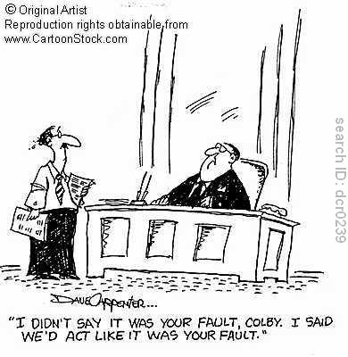

Slide 20
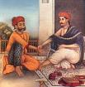
Take Home Message
1
Accountability = Responsibility.

Slide 21
Take Home Message
2
To be accountable you need to have self-regulation in your day-to-day actions.

Slide 22
Take Home Message
3
Accountability requires that we maintain standard setting.

Slide 23
Take Home Message
4
Accountability requires that we resolve conflicts (financial, ethical, moral, pharmaceutical etc).

Slide 24
Take Home Message
5
Accountability requires that we accept duties for the public.

Slide 25
Take Home Message
6
As medical students we need to demonstrate accountability in our small group discussion, student-led seminars, and when we are working with others in teams.

