Slide 1
Initiative, Integrity, Trustworthiness Professionalism course, SKILL 221 Prof. Hanan Habib Department of Pathology ,KSU
روح المبادرة , النزاهة , الجدارة بالثقة

Slide 2
Objectives
Upon completion of this lecture ,students should be able to :
Discuss the meaning and principles of initiative, integrity and trustworthiness.
Discuss the place of initiative , integrity and trustworthiness in medical professionalism.
Discuss practical examples about initiative, integrity & trustworthiness.
Apply knowledge learnt to a case scenario.

Slide 3
Initiative
Definitions:
The action of creating or starting.
To make a conscious effort to do things without being told to and to find alternatives if an option is not possible.

Slide 4
Characteristics of an Initiative
People with initiative character are starters and self-motivators.
Have the ability to begin or to follow energetically with a plan or task.
Took the initiative in trying to solve the problem.
Have the power to or right to introduce a new legislative measure.

Slide 5
Trustworthiness
Deserving of trust or confidence.
Synonyms: true, accurate, honest, faithful.
Trustworthiness is the most complicated of the core ethical values .

Slide 6
Importance of Trustworthiness
The corner stone of the practice of medicine
Without trust a good doctor-patient relationship cannot exist.
The demonstration of compassion, service and altruism that earns the medicine profession the trust of the public.

Slide 7
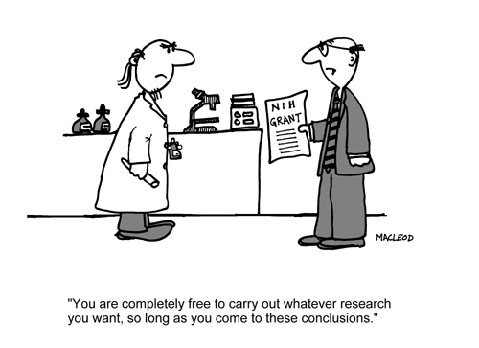

Slide 8
Trustworthiness
Trustworthy people keep their promise
Are honest, reliable and principled
Never inappropriately betray a confidence.
It embodies FOUR ethical principles:
a- Integrity c- Promise – Keeping
b- Honesty d- Loyalty

Slide 9
Integrity
The most important factor in trust.
Integrity carries the sense of wholeness: a person of integrity, like a whole number, is a whole person, undivided, complete.

Slide 10
Person with Integrity
Stand up for their beliefs openly and boldly.
Listen to their consciences and live by their principles no matter what others say and no matter the personal cost.
Are honorable and upright in all actions.
Have the courage to do what is hard or costly or failure is probable.
Build and guard their reputations.
Don’t do any thing he feels is wrong.
Don’t lose heart if they fail.

Slide 11
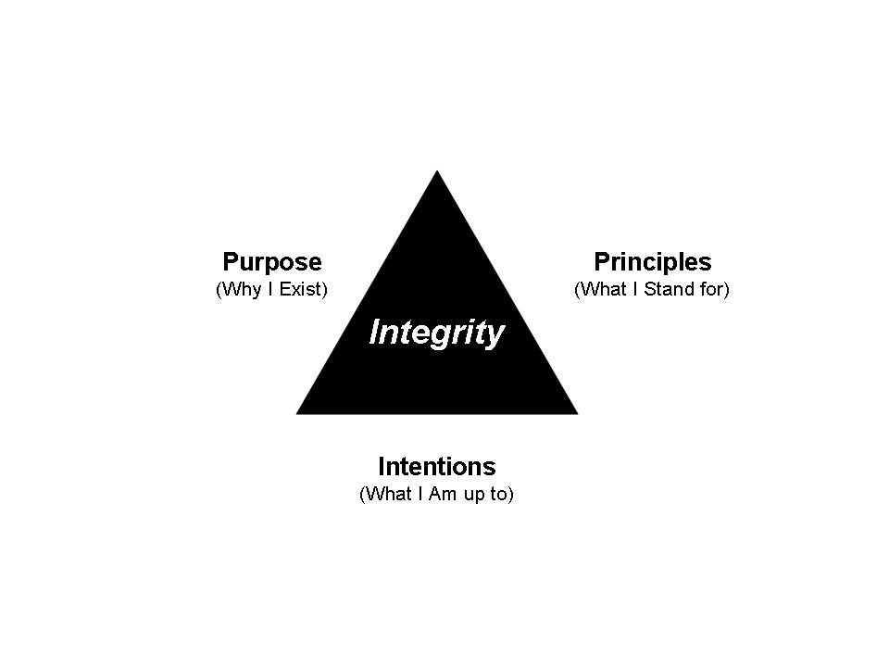

Slide 12
Honesty
Two types : Communications & Conduct
Communicating honesty :
a-Being truthful in representing facts and intentions to the best of one’s knowledge.
b- Sincerity and candor
.

Slide 13
Honesty
Being honest in our conduct means playing by the rules and being trustworthy of another’s property and belongs.
Dishonest conduct by ways of cheating can come in many forms, such as trickery ,fraud, misleading ,deliberately violating the rules, and swindling.

Slide 14
Academic dishonesty include:
Cheating:
Using unauthorized materials to achieve better grade.
Falsification or invention of any information.
Attempting to help another person in an act of cheating.
Plagiarism:
Submitting an assignment as if it were one’s own work.

Slide 15
Continue..
Submitting a work that is purchased or obtained from internet source.
Incorporating a word or ideas of an author into one’s paper without giving the author due credit.

Slide 16
Promise -Keeping
A vital moral aspect of reliability.
Create duties beyond legal obligations.
Promise is a vow, pledge, a declaration assuring that one will or will not do something.

Slide 17
Two Areas of Promise -Keeping
Good Work Habits
There is an ethical dimension to good work habits-the work ethic-when others depend on us to show up on time, we are prepared and ready to do our work and dedicated to stick with the job until it is done well.

Slide 18
Reliability
Means keeping your word, honoring your commitments, and being dependable.
Dependability requires one to do what is supposed to be done, eg. return what you borrow, pay your debts, show up on time, and be prepared.

Slide 19
Loyalty
A steadfast and devoted attachment that is not easily turned aside.
This could be loyalty to an oath, one’s family, or an ideal
It implies the unfailing fulfillment to one’s duties and obligations and strict adherence to vow or promise.

Slide 20
Do
Stand by, stick up for ,and protect your family, friends and country.
Bee a good friend
Look out for those who care about you
Keep secrets

Slide 21
Don’t
Betray a trust
Let your friend hurt themselves
Ask a friend to do anything wrong
Spread hurtful rumors of gossip

Slide 22
Trustworthiness in medicine
The patient must always be confident that the physician has put the needs of the patient first.
Physicians are expected to make patients’ needs the first priority.
Physicians should consider their contributions to their individual patients, to their own practice, the community and the health care system

Slide 23
Physicians should :
Demonstrate professional competence
Be aware of their deficiencies .
Obtain help when needed.
Be honest and communication of information in complete confidence.
In communications with the community, physicians must ensure that representations they make are, to the best of their knowledge, truthful.

Slide 24
Case scenario
Nahid is a graduate of medical school. She has just moved to a non-English speaking country for post-graduate study. It was hard for her to fit in ,understand the language and make friends and concentrate in the class.
She is taking a basic science exam, which turned to be harder than she thought it would be. The answers has to be marked on a separate computer sheet. Nahid could not answer most of the MCQs. She hands in her answer sheet and sits down at her desk await the end on the class.

Slide 25
To her right , Samar is working on her exam sheet and seems to have no trouble in answering . Glancing at Samar answer sheet, Nahid sees that she marked several answers differently than her. Nahid asked the invigilator to get back her answer sheet, saying that she just remembered she did not correctly put her ID number.

Slide 26
She quickly erased and changed some answers to reflect what she saw on Samar’s paper and hands back it again. Sometime later , the instructor inform Nahid that the invigilator saw her change her answers. She is going to be given an ‘F’ for the test. Nahidthinks her action do not constitute plagiarism or academic dishonesty ,and the sanction is too harsh especially after she describes about her situation.

Slide 27
Questions about the case
Is Nahid right in her behaviors ? What do you think about what she has done ?
Does Nahid have to accept the instructor’s sanction ?
Do you have any idea about better ways for Nahid to handle her problem in the future.
If you were in the exam and saw a student behaving similar to Nahid what do you do ?

Slide 28
Quotes
If you have made mistakes, even serious ones, there is always another chance for you. What we call failure is not the failing down, but the staying down.
Mary Pickford
Integrity without knowledge is weak and useless, and knowledge without integrity is dangerous and dreadful.
Samule Johnson

Slide 29
TAKE HOME MESSAGES
To be an initiator you need to communicate, train and hope.
Trustworthiness is the cornerstone of the practice of medicine.
Integrity is the most important factor in trust.

