Slide 1
Self Awareness & Self Care Professionalism Course - skill 221
Prof.Hanan Habib
Pathology Department ,Microbiology Unit
College of medicine , ksu

Slide 2
Objectives
Upon completion of this lecture, students should be able to:
Describe the meanings of self awareness and self care.
Describe why self awareness and self care are important in medical professionalism .
Discuss the key components of self awareness.
Describe how self awareness can be developed.
Describe options for self care .
Apply knowledge learned to a case scenario.

Slide 3
What is Self Awareness ?
Self awareness refers to those activities individuals undertake in promoting their own health, preventing their own disease, and restoring their own health.
These activities are undertaken without professional assistance.

Slide 4
What is Self Awareness ?
Self awareness means that we focus our attention on ourselves ,we evaluate and compare our current behavior to our internal standards and values.

Slide 5
Why Self Awareness is important?
To have a better understanding of our empowered to make changes.
To build on our areas of strength .
To identify where we would like to make improvements.
To explore our individual personalities, value systems, natural inclinations and tendencies.
People will be negatively affected if they don’t live up to their personal standards.

Slide 6
Examples of Self Awareness
Preferred learning styles
Aptitude for specific career fields
Natural academic ability ( athletics, mathematics, …etc)
Personality traits ( introvert, extrovert, sensitive, judgmental,..etc)
Religious beliefs
Political viewpoints
Values ( ethical, with integrity,…..etc)

Slide 7
Self Awareness in Medicine
Physicians should provide mentorship, support and care to one another, in order to ensure their patients receive quality care, as well as to maintain their own personal wellness.

Slide 8
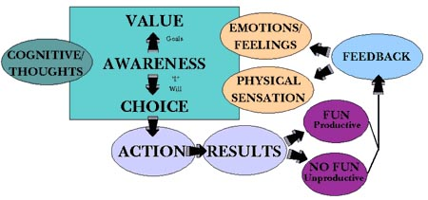
Components of Self Awareness

Slide 9
How to develop Self Awareness ?
Identify your strengths
Accept your weaknesses
Recognize your motives
Discover your passion

Slide 10
Identify your Strengths
Know what you are good at and develop a realistic view of those skills.
Which ones should you utilize ?
Which ones do you need to continue to hone in and improve ?
Focus on developing those strengths
Get your bearings straight and build your leadership around your natural abilities will lead to success.

Slide 11
Accept your Weaknesses
You may be more hesitant to expose areas of vulnerability
Recognizing weaknesses will help you determine how to compensate for them .
Learn skills that you could learn.
Do not spend too much time focusing on your weaknesses

Slide 12
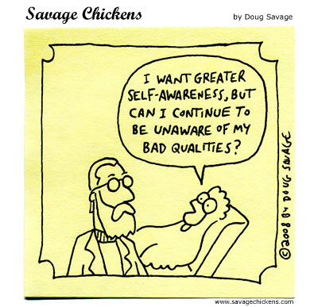

Slide 13
Recognize your Motives
Our deep underlying motives is often self-promotion and recognition.
Fear, jealously and resentment are motives that hinder our performance
Learning what our true intentions are will help to respond to ideas, obstacles and crisis objectively.

Slide 14
Discover your Passion
Leader lead best when they are passionate about what they are leading
What is it that gets your fired up ?
What stirs your heart into action ?
What worth fighting for ?
Capitalize on your natural zeal
Utilize your passion so that you can communicate and cast your vision to others .

Slide 15
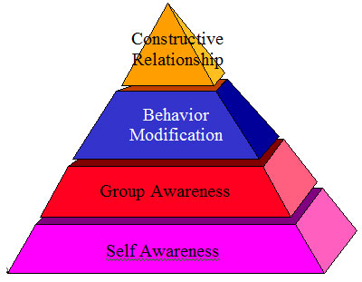
Development of Self Awareness

Slide 16
Self Awareness Basics
Self awareness is the basic form of leadership.
Taking time and effort to learn about who you are and what you’re capable of will go a long way in helping you achieve your leadership goals.

Slide 17
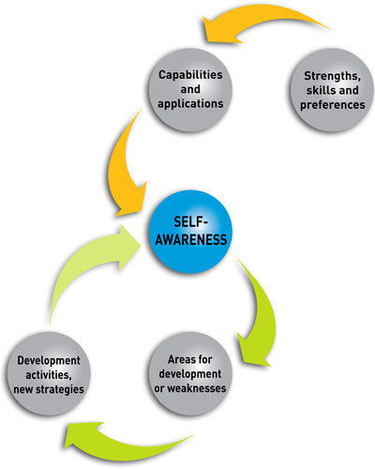
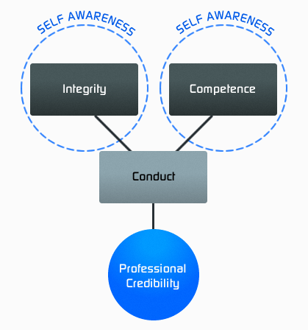

Slide 18
Self care includes caring for the:
Health
Family
Career
Relationships with others
Environment.

Slide 19
Self Care and Professionalism
Physicians often face competing demands from patients, or the health care professionals, the health care system ,and from the expectations hold for him .
Stress, fatigue, exhausion and frustration have an impact on him personally and the care he provide to his patients.

Slide 20
Why health self-care is important ?
To know if your health concern requires professional attention.
How to seek medical attention if it’s needed.
How you can treat yourself, if medical attention isn’t needed.

Slide 21
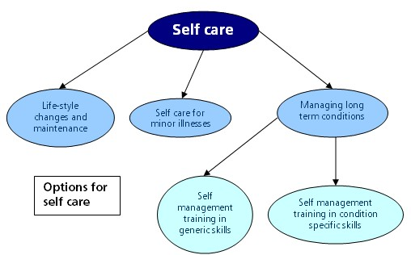
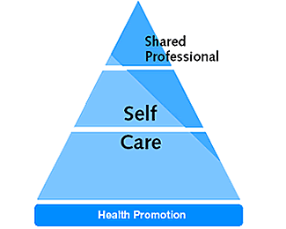
Options of self care

Slide 22
Wellness of the Physician
It is the condition of good physical and mental health necessary to provide high quality care to patients and to fulfill the duties .
Physician wellness is a critical component of the professional practice of medicine.
Physicians cannot serve their own patients if they are not well.

Slide 23
To ensure that patients receive high quality care, physicians have the responsibility to :
1- Be aware of their own health.
2- Obtain help from colleagues, or others.
3- Balance his/her work schedule and life demands .
4-Create a healthy work space .
5-Develop a short list of top priorities each day.
6-Minimize postponement and maximize a sense of control

Slide 24
If physician knows that he /she has serious condition that can be passed on to patients, or his/her judgment or performance could be significantly affected by a condition or illness, or its treatment, he/she should seek professional advice about ongoing clinical practice.

Slide 25
Case
Fatima is an excellent third year medical student. The primary care consultant has asked the student to conduct a research on the urinary tract infection among children seen at the clinic. Fatima went to the library and searched the internet .She found many researched done in this field. Fatima choose one done in Africa and copied it and submit it to the doctor on time. Her friend Amina asked her why she behaved like this ? Her answer was that she cannot conduct good research because she has low abilities and she is busy caring for her ill mother.
What do you think is wrong with Fatima behavior?
What is the impact on her future career?
How can she cope with her mother illness and her study ?

