Slide 2
Continuous Professional Development
Dept. of Medical Education
College of Medicine
King Saud University

Slide 3
Contents/Overview
Who is Professional?
What is Competence? Levels?
How to develop & maintain competency?
What is Continuous Prof Devp (CPD)
Methods of keeping updated (CPD).
Reflective learning & Practice
Summary.

Slide 4
عن عائشة رضي الله عنها أن رسول اله صلى الله عليه وسلم قال:
” إن الله يحب إذا عمل أحدكم عملا أن يتقنه“ رواه الطبراني

Slide 5
Today Questions?
Define competence?
Why Continuous Professional Development (CPD) in medical education is needed?
What is learning reflection activity? Give an example from your own experience.

Slide 6
WHAT MEDICAL COLLEGES WANT?
Proficiency
Communication skills
Interpersonal skills
Confidence
Critical thinking & problem solving skills
Flexibility
Self motivation
Leadership
Teamwork

Slide 7
Deanship of all Medical Colleges
Saudi-Med
Documents

Slide 8
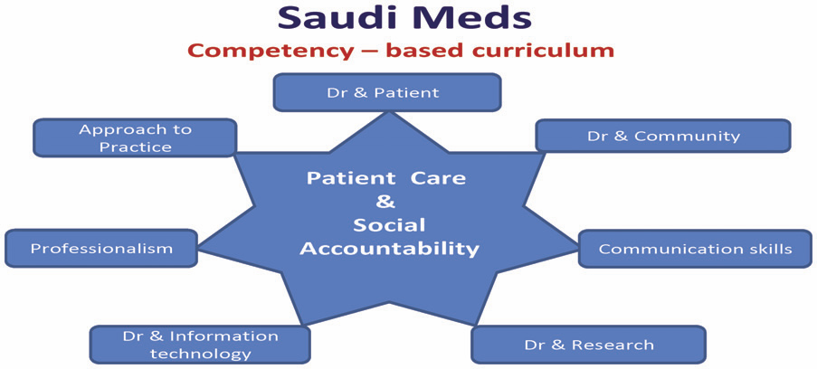
Core competencies
The national competence framework that has been developed by medical schools in the Kingdom of Saudi Arabia (SAUDI MEDS)
Saudi Meds: A competence specification for Saudi medical graduates
RANIA G. ZAINI, KHALID A. BIN ABDULRAHMAN, ABDULAZIZ A. AL-KHOTANI, ABDOL MONEM A. AL-HAYANI, IBRAHIM A. AL-ALWAN & SADDIG D. JASTANIAH Medical Teacher, 2011; 33: 582–584

Slide 10
KSU Medical College Outcomes
Communication and consultation skills
Clinical care
Health promotion and disease prevention
The family and community context of healthcare
Personal and professional development
Use of technology and information gathering
Attitudes, ethics and professionalism
Research

Slide 11
Think, Pair & Share
Every five of you.
How you can analyze the following case Scenario.

Slide 12
Scenario (1):
A 50-year-old healthy man came to clinic. He says that today he passed stool which was red in color . He says that he has taken some “Vimto” drink which was red.
He added that, possibly, this red colored stool is due to this drink.

Slide 13
Level of competence:
Consultant
Intern
Medical student
Registrar
Resident

Slide 14
Levels of competence:
Medical student
Resident
Senior resident
Consultant
Novice
Advanced beginner
Competent
Proficient
Expert

Slide 15
What is Competence?

Slide 16
Definition of competence:
Competence can be defined as:
“ the ability to perform a specific task in a manner that yields desirable outcomes”.
Notes:
The last objective is kept here that we are ready to apply it in our daily work.

Slide 17
Different Aspect of Competence
Competence is defined in the context of particulars:
Knowledge
Skills
Abilities
Competence develops over time and is nurtured by reflection on experience

Slide 18
Attitudes
Skills
Does
Shows how
Professionalism
Knows how
Knowledge/
Cognition
Knows
Miller’s Triangle

Slide 19
Bloom’s Taxonomy
Evaluation
Synthesis
Analysis
Application
Comprehension
Knowledge

Slide 20
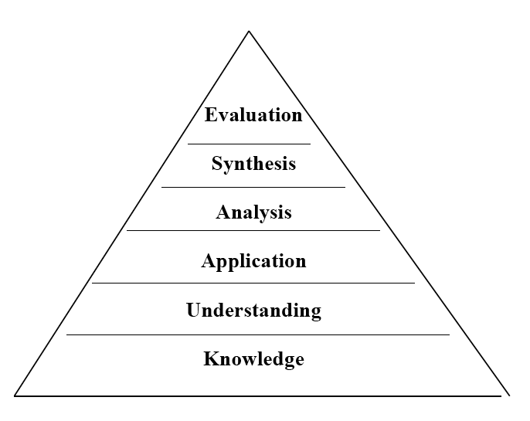
Hierarchy of Knowledge Bloom’sTaxonomy, 1956
Knowledge - What is the most common cause of...?
Understand - If you see this, what must you consider…?
Application - In this patient, what is causing…?
Analysis,synthesis,evaluation - critical thinking?

Slide 21
Skills:
Skill is the capacity to perform specific actions: a person’s skill is a function of both knowledge and the particular strategies used to apply knowledge.

Slide 22
Abilities:
The power or capacity to do something or act physically, mentally, legally, morally, etc.
Abilities are the attributes that a person has inherited or acquired through previous experience and brings to a new task.
Abilities are gained or developed over time and, as a result, are more stable than knowledge and skills.

Slide 23
Types of Competence
Technical
Non-Technical

Slide 24
Technical Competencies:
Patient care
Medical knowledge
Practice base learning and improvement
Interpersonal and communication skills
Professionalism
Systems-based practice

Slide 25
Non-technical elements of competence:
Six key areas:
Communicating Skills.
Principles and organization of the health care system.
Teamwork
Shared learning across professional boundaries
Clinical audit and reflective practice
Leadership

Slide 26
How is competence acquired:
It is gained in the healthcare professions through:
pre-service education
in-service training
work experience
Continuous Professional Development (CPD).

Slide 27
Think Pair & Share
Every five of you

Slide 28
For the following scenario:
Identify main hypotheses to explain phenomenon
Identify strengths and weakness of each
State and defend most likely explanation
Suggest course of action

Slide 29
Scenario (2) :
A 65 year old man known case of hypertension, not taking prescribed treatment.
You have been call to see this gentleman, who complains of severe chest pain and sweating. On questioning ha said that I have gas problem, I eaten “heavy dinner”.
He added, I think it is due to that food, otherwise I am OK.

Slide 30
Contents/Overview
Who is Professional?
What is Competence? Levels?
How to maintain competency?
What is Continuous Prof Devp (CPD)
Methods of keeping updated (CPD).
Reflective learning & Practice
Summary.

Slide 31
Continuing Professional Development (CPD)

Slide 32
Competence is an ongoing process:
Initial development during undergraduate & postgraduate studies
Maintenance of knowledge and skills
Remediation and redevelopment
Acquiring new knowledge / skills

Slide 33
What is CPD?
The conscious updating of professional knowledge and the improvement of professional competence throughout a person's working life.

Slide 34
What is CPD?
It is a commitment to being professional, keeping up to date and continuously seeking to improve.
It is the key to optimizing a person's career opportunities, both today and for the future.

Slide 35
Why CPD?
Requirement by the governing bodies of the profession
This is only a superficial reason

Slide 36
Why CPD?
Main reasons:
Half-life of what we learn is very short.
If we do not update, we will practice obsolete medicine.
There is a high chance that patients will not get optimal care.

Slide 37
Example of outdated knowledge
Infectious hepatitis – now hepatitis A
Serum hepatitis – now hepatitis B
Diabetes was checked formerly by urine ketones instead of blood glucose
HRT was used to protect the heart – now considered harmful
Flu vaccine under age 5 was routinely recommended in the past

Slide 38
How is CPD different?
CPD is for professionals not in a formal educational setting
There are no class rooms, prescribed curricula, prescribed learning events, etc.
Therefore, the learner needs to learn from whatever he/she does in the workplace
Also, there are no formal examinations
Motivation to learning comes from the necessity to improve practice.

Slide 39
Strategies for PDP
.

Slide 40
How can we achieve CPD?
.

Slide 41
Strategies for
Formal:
Lecture programs
Conferences
Workshops
CME courses
etc
Informal:

Slide 42
How can we achieve CPD?
Many methods have been tried in the past
Currently, reflective practice/learning is the most favoured

Slide 43
What is Reflective learning

Slide 44
Reflection
Reflection relates to a complex and deliberate process of thinking about and interpreting experience, in order to learn from it.
Reflection : stages
An awareness of uncomfortable feeling
Examination of situation
Exploration of alternative actions
Reflective thoughts results in action

Slide 45
Reflection
Focusing on strengths & ‘weaknesses’ in one’s performance
Focusing on identifying actions to undertake –learning requirements
Goal to improve performance

Slide 46
What is reflection?
Systematic revisiting of a learning experience with a view to learning from it
Why reflection?
Key to become a lifelong learner – if not most learning opportunities are lost

Slide 47
Reflection - cyclical process
- many ways
Kolb’s cycle
Concrete experience
Reflective observation
Active experimentation
Abstract conceptualisation

Slide 48
Reflective log: a simplified version
1. What is the learning event?
2. What did I learn?
3. What more do I have to learn?
4. How can I learn it?
5. Evidence for further learning / change of practice?

Slide 49
Reflection
What is the event?
Evidence for learning / change of practice
Concrete experience
Reflective observation
Active experimentation
What did I learn?
How can I learn?
What more do I have to learn?
Abstract conceptualisation

Slide 50
A scenario (3) :
A 55 year old man came to clinic with complaint of low back pain (LBP).
You have examined his back which was ok. His height was 160 cm, and weight is 100 kg.
You would like to manage this patient’s LBP contributed due to his excess body weight.

Slide 51
Example (LBP)
1. Learning experience – This obese person who needed to reduce weight.
2. What did I learn? Learned how the patient’s activities have been affected by obesity.
3. What do I have to learn more? Did not know the advice that should be given to the patient with a given BMI. Are there guidelines for interpreting BMI?
4. How do I learn it? (SDL) Refer a book/article. Talk to the dietician.
5. Evidence / change of practice – BMI was accurately interpreted. Patient was advised about the dietary/lifestyle changes and referred to an obesity clinic. References of books referred.

Slide 52
Reflective practice
1. Reflection-on action
2. Reflection-in action

Slide 53
Assessing reflective ability
1. What is the learning event?
Descriptive
Analytical
Evaluative
2. What did I learn?
3. What more do I have to learn?
4. How do I learn it?
5. Evidence for further learning / change of practice?

Slide 54
Competence vs. performance
Competence is different from performance
Performance is something that people actually do
It can be observed
It is what the organization hires one to do, and do well
Knowing and showing how to act does not necessarily guarantee that the doctor will act in that way in every practice

Slide 55
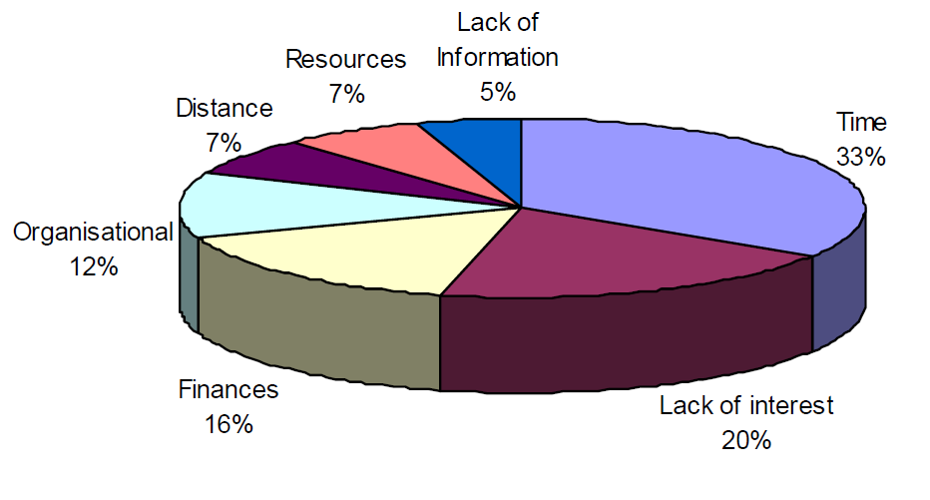
Barriers towards attending educational activities
http://www.aare.edu.au/07pap/sid07623.pdf

Slide 56
Benefits of CPD
Build confidence and credibility
Earn more
Achieve your career goals
Cope positively with change
Be more productive and efficient

Slide 57
How CPD benefits the organisation
Helps maximise staff potential by linking learning to actions and theory to practice.
Helps set SMART (specific, measurable, achievable, realistic and time-bound) objectives
Promotes staff development.
Helps give a positive image/brand to organisations.
…

Slide 58
Summary:
Levels of competence
It is acquired through
Contentious Professional Development
Reflection & Reflective Practice

Slide 59
Questions ???

Slide 60
THANK YOU

