Slide 1
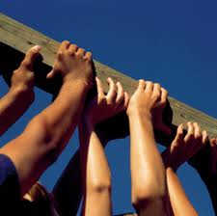
Concept of COMMUNITY SERVICES
PROF.HANAN HABIB (DR.LEENA KASEM)
DR. KAMRAN SATTAR

Slide 2
You have been given this life But Once
In it
Do all the good that you can do
To all the people you can do
For as long as you can do
Ceccere

Slide 3
OBJECTIVES students should be able to understand and describe;
The concept of social contract.
The concept of community service.
The social, public and community responsibilities of the professional.
The concept of Volunteering.

Slide 4
Social contract Definition
The social contract is the concept that human beings have made an agreement with their government, whereby the government and the people have distinct roles and responsibilities.

Slide 5
What are you doing for others?
Dr. Martin Luther King, Jr.
(January 15, 1929 – April 4, 1968)

Slide 6
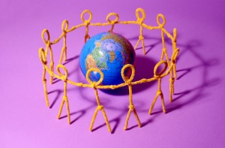
Definition of Community
The word "community" is derived from the old French communité which is derived from the Latin communitas (cum, "with/together" + munus, "gift"), a broad term for fellowship or organized society.
(OXFORD UNIVERSITY PRESS)

Slide 7
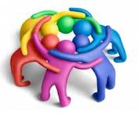
Definition of community (cont.)
A group of interacting people, living in some proximity (i.e., in space, time, or relationship).
Community usually refers to a social unit larger than a household that shares common values and has social cohesion.

Slide 8
Definition of Community service (cont.)
Donated service or activity that is performed by someone or a group of people for the benefit of the public or its institutions

Slide 9
Community service
Service is the rent we pay for living.
Marian Wright Edelman,
President of the Children’s Defense Fund

Slide 10
Community service
Some people associate community service with punishment, since it is often offered to small-time offenders as an alternative to fines or jail time.
However, community service can also be altruistic, and it is a vital part of many small communities.

Slide 11
Community servise
In all cases, community service work is performed by volunteers who are not paid for their time.

Slide 12
Examples of community service
Basically anything which benefits the society in any way can be considered as a community service project or activity.

Slide 13
Examples of Community service
community service include:
Visiting and spending time with lonely elderly
Tutoring needy students in their studies for free
Helping out at organizations such as libraries

Slide 14
The concept of Volunteering
Volunteering is generally considered an altruistic activity, intended to improve human quality of life.

Slide 15
People also volunteer
For their own skill development.
To meet others
To make contacts for possible employment.
To have fun.
and a variety of other reasons.

Slide 16
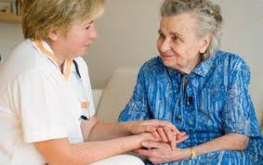
What do the volunteers earn?
Volunteers earn Respect and Favors
instead of money.

Slide 17
Community volunteering
Is done by Volunteers who work to improve community enhancement efforts in the area in which they live.

Slide 18
Why to carry out community service?
Benefits the community
The volunteers in the activities also gain
a sense of accomplishment
Better social communication skills
Exposure to new peoples and cultures
Overall improved mental health
When you cease to make a contribution, you begin to die. Anna Eleanor Roosevelt
(October 11, 1884 – November 7, 1962)

Slide 19
Physicians and the community
Physicians are members of the community.
Affect it and are affected by it.
Responsibilities of physicians are not limited to those within the hospital and clinical care.

Slide 20
Physicians and the community
Usually the focus is on the physician - patient relation
The broader sense of responsibility of physicians is towards their community

Slide 21
Society
Group of patients with a medical condition
Individual Patient

Slide 22
Broad understanding of Health
Health depends not only on medical care but also on other factors including:
1.Individual behavior
2.Genetic makeup
3.
Social and economic conditions

Slide 23
Individual health
Genetic
Social
Psychological
Environmental

Slide 24
A Community perspective
The array of influences on health identified also suggests that there are many public and private entities that have a stake in or can affect the community's health.

Slide 25
A framework for improvement
Many entities in the community share the responsibility of maintaining and improving its health.

Slide 26
Who are the Stakeholders
Health care providers
Public health agencies
Community organizations
Government agencies
Schools
Social services organizations

Slide 27
Physicians and the community
Physicians role in the community extends to:
Public Health
Prevention of illnesses
Educational roles
Improving health care access
Setting policies
Assurance of competence
International Aid
Fund raising

Slide 28
10 Essential services
Monitor health status to identify community health problems.
Diagnosis and investigate health problems and health hazards in the community.
Inform, educate, and empower people about health issues.
Mobilize community partnerships to identify and solve health problems.
Develop policies and plans that support individual and community health efforts.

Slide 29
10 Essential services
Enforce laws and regulations that protect health and ensure safety.
Link people to needed personal health services and assure the provision of health care when otherwise unavailable.
Assure a competent public and personal health care workforce.
Evaluate effectiveness, accessibility and quality of personal and population-based health services.
Research for new insights and innovative solutions to health problems.

Slide 30
Public Health
The science and practice of preventing diseases and promoting health in populations
and it
Depends largely on epidemiology
Largely performed by governmental organizations

Slide 31
Public Health
Traditional objective:
To control communicable diseases
Safety of water and food supply
Response to national disasters

Slide 32
Educational Role
Educating the public about:
Causes of illness
Preventive measures
Predisposing factors
Changes in lifestyle

Slide 33
Improving health access
Improve the level and ease of access of individuals to health care services

Slide 34
Aim of improving access
Improving the health of a population by reducing
inequalities: HOW ?
“Treat Equals Equally”

Slide 35
International Aid
In some areas of the world, health care is very limited and almost non- existent
Most people suffer from diseases such as Malaria, Tuberculosis, Typhoid, and AIDS
Many of the illnesses can be improved or eliminated by basic medical care and other measures e.g.

Slide 36
International community services
Done through:
Organizations providing humanitarian needs
Medical Organizations
Governments

Slide 37
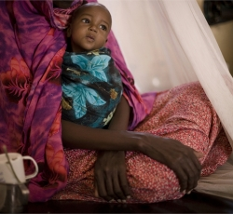
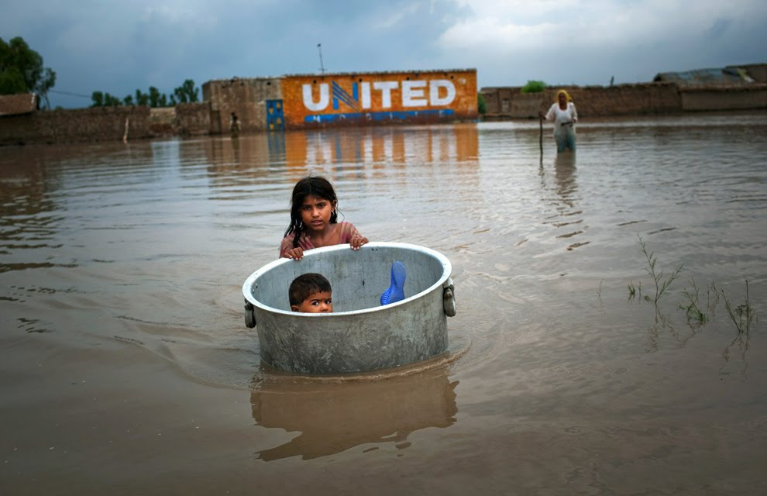
A small boy is held by his mother at the therapeutic feeding center of the MSF Holland hospital in Galcayo south, Puntland. OCHA Humanitarian Bulletin #25 UNITED NATIONS OFFICE FOR THE COORDINATION OF THE HUMANITARIAN AFFAIRS A girl floats her brother across flood waters while salvaging valuables from their flood ravaged home on August 7, 2010 in the village of Bux Seelro near Sukkur, Pakistan. (Daniel Berehulak/Getty Images)

Slide 38
General Organizations
They provide:
Clean water supplies
Clothing
Education

Slide 39
Medical Organizations
Medical teams provide:
Medical care
Medications
Immunizations
Medical supplies
Teach communities about nutrition and preventive measures
Training of local health care providers

Slide 40
Governments
Aid to other countries during time of need
May include sending:
Medical professionals
Medical equipments
Medications

Slide 41
Fund raising
May not apply locally since health care services are provided by the governments
Funds may be raised to help those individuals who cannot afford to purchase medications or medical equipments.

Slide 42
Doctors are to be committed
Professional Attributes
1. Integrity 2. Compassion
3. Altruism
4. Continuous improvement
5. Excellence
?
Working in partnership with members of the other health care teams

Slide 43
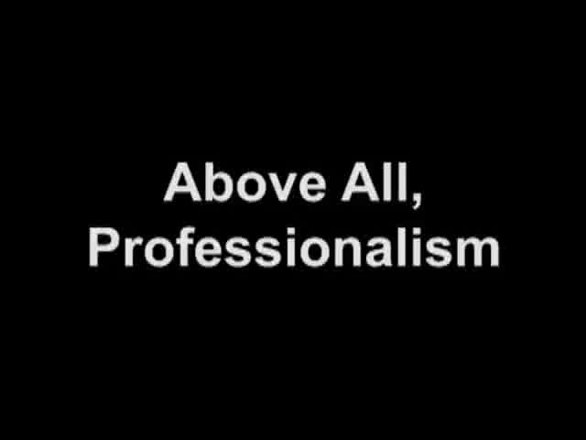

Slide 44
لَيْسَ الْبِرَّ أَنْ تُوَلُّوا وُجُوهَكُمْ قِبَلَ الْمَشْرِقِ وَالْمَغْرِبِ وَلَٰكِنَّ الْبِرَّ مَنْ آمَنَ بِاللَّهِ وَالْيَوْمِ الْآخِرِ وَالْمَلَائِكَةِ وَالْكِتَابِ وَالنَّبِيِّينَ وَآتَى الْمَالَ عَلَىٰ حُبِّهِ ذَوِي الْقُرْبَىٰ وَالْيَتَامَىٰ وَالْمَسَاكِينَ وَابْنَ السَّبِيلِ وَالسَّائِلِينَ وَفِي الرِّقَابِ وَأَقَامَ الصَّلَاةَ وَآتَى الزَّكَاةَ وَالْمُوفُونَ بِعَهْدِهِمْ إِذَا عَاهَدُوا ۖ وَالصَّابِرِينَ فِي الْبَأْسَاءِ وَالضَّرَّاءِ وَحِينَ الْبَأْسِ ۗ أُولَٰئِكَ الَّذِينَ صَدَقُوا ۖ وَأُولَٰئِكَ هُمُ الْمُتَّقُونَ
ALLAH ALMIGHTY SAYS
“It is not righteousness that ye turn your faces towards East or West: But it is righteousness that ye believe in GOD, and the Last Day and the Angles, and Book, and the Messenger. To spend of your substance out of love for Him, for your kin, for orphans, for the needy, for the wayfarer, for those who ask, and for the ransom of slaves, to be steadfast in prayers and practice regular charity; to fulfill the contracts that ye have made. And be firm and patient in pain ( or suffering ) and adversity and throughout all period of panic. Such are the people of truth, GOD fearing.”
( AL BAQR-177)

Slide 45
Summary
Broader concept of physician role should be adopted to go past the individual and include the community as well.

Slide 46
Take home message
You have been given this life But Once
In it
Do all the good that you can do
To all the people you can do
For as long as you can do
Ceccere

Slide 47
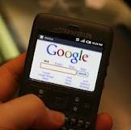
FOR YOUR READING
1. An Introduction to Community Health
James F. McKenzie
2. Community Health and Wellness:
Primary Health Care in Practice Anne McMurray and Jill Clendon
3. Volunteers: a social profile
Indiana University Press, 2008 - Social Science
Marc A. Musick, John Wilson32 Reviewshttp://books.google.com.sa/books/about/Volunteers.html?id=u8Tabf5HcRcC Indiana University Press, 2008
4.Evolution of the Social Contract, Brian Skyrms

