Slide 1
UNPROFESSIONAL BEHAVIOR
DR. KAMRAN SATTAR
Dept: of Medical Education
King Saud University

Slide 2
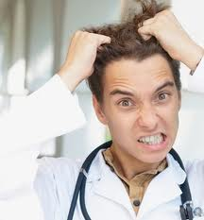
Who among you would like to behave like him?

Slide 3
OBJECTIVES By the end of this lecture You should be able to;
Define unprofessional behavior
Identify various elements of human nature that contribute to unprofessionalism
Provide examples of such behaviors
Know how to avoid(and deal with) unprofessional behaviors.

Slide 4
Scenario 1 ( a senior doctor )
A senior doctor, head of a high profile department, is known to bring in research dollars, to be very hard working and adept at specialized medical procedures. S/he is well known for shouting at nurses, throwing instruments back at them, and humiliating junior medical staff. S/he is often absent from department, Complaints are made to hospital administration from staff members; increased numbers of "critical incidents" and staff resignations are noted.

Slide 5
Scenario 2 (A general practitioner)
A general practitioner is consistently late or absent for pre-scheduled sessions. S/he gives no explanation, leaving the partners to fill in and make excuses. When confronted, s/he becomes abusive in front of office staff and patients.

Slide 6
Scenario 3 (medical student)
A final-year medical student has caused disruptions throughout the course by monopolizing time in tutorials, behaving inappropriately with patients and being unwilling to heed advice. Many patients refuse to be interviewed by her/him and have complained to staff. S/he has not failed any exams, but several tutors and nurses have raised concerns about the student's "attitude" and ability to work as an intern.

Slide 7
Scenario 4 (Nurse)
A 54 year old male patient is admitted for the fourth time in two months for complaints of severe ridiculer pain(radiculitis) following several attempts at decompressive back surgery. His pain has been sub-optimally controlled with very high-dose narcotics and other adjuvant pain-management medications. The nursing staff take his vital signs at the start of every shift but otherwise only appear when his medications are due or he rings the call bell. The pain waxes and wanes but is so severe at times that he cries out. The medication orders for breakthrough pain is ineffective. When he tells one nurse this, she responds, sighing, :you have had your medication and you’ll just have to wait three hours for your next does. I’m going on break, so don’t bother to ring the bell”

Slide 8
What is Professionalism?
Attributes and behaviors that serve to maintain patient interests above physician self-interest.
It is the unconditional caring of the patient, putting others before self.
IT IS NOT WHAT WE DO BUT HOW WE DO IT

Slide 9
Professional Attributes (A QUICK REVIEW)
Honesty/integrity
Openness
Reliability
Responsibility
Respect
Presence
Compassion/empathy
Competence
Commitment
Confidentiality
Autonomy
Self-improvement
Self-awareness / knowledge of limits
Communication /collaboration
Altruism
Morality and ethical conduct
Self regulation
Teamwork

Slide 10
Professional Attributes (EASY TO REMEMBER)
HAIRCAP
Honesty Altruism Integrity Responsibility
Compassion Autonomy Punctuality

Slide 11
What is Unprofessionalism?
Not pertaining to the characteristic of a profession.
At variance with or contrary to professional standards or ethics.

Slide 12
Medical Unprofessionalism:
Not necessary to show adverse effects on patient care.
Do not have to wait until patient dies to determine that medical care suffered.

Slide 13
Unprofessional behavior:
"Unprofessional behavior /conduct" is a broad term
Which results in;
Increased workplace difficulties
Decreased morale in other staff
Decline in patient care

Slide 14
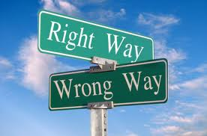
Unprofessional behavior: In general terms, acts that may be characterized as “unprofessional” fall into five categories:
1. Illegal or criminal acts
2. Immoral acts
3.Business related acts
4. Acts that violate acceptable medical practices
5. Plagiarism

Slide 15
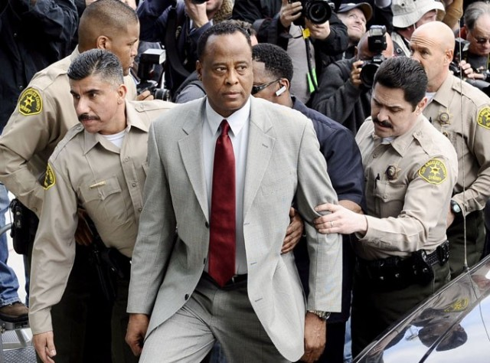
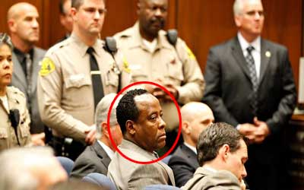
1. Illegal or Criminal acts:
Doctor found responsible for Jackson’s death, handcuffed Katrina Jones - Nov 8th, 2011
http://www.thenewstribe.com/2011/11/08/jury-finds-jackson%E2%80%99s-doctor-guilty-of-his-death/By

Slide 16
1. Illegal or Criminal acts:
In addition to the penalties imposed by the legal system for a criminal conviction, a physician may also be disciplined and lose his medical license based solely on the fact that he was convicted for a crime or offense.

Slide 17
2. Immoral acts:
“Immoral” acts generally fall into the limited category of sexual activity with individuals that may be patients.

Slide 18
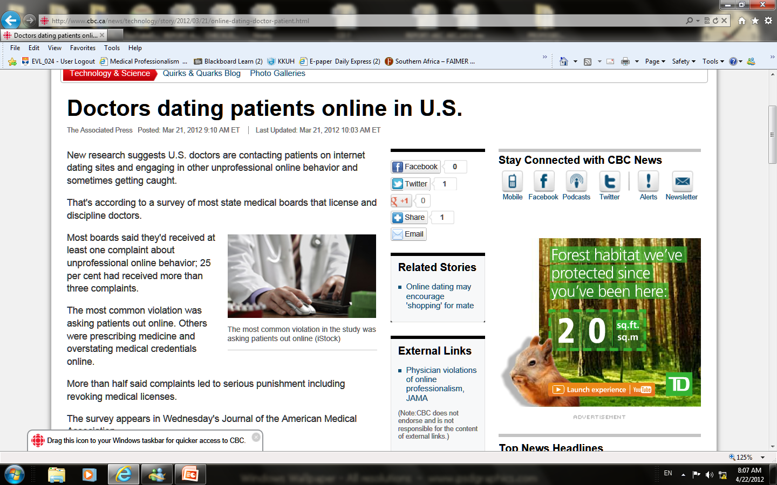
Immoral acts (example)

Slide 19
2. Immoral acts:
Physicians should not take advantage of the doctor-patient relationship
Because
Some patients are particularly vulnerable
Trust in the profession will be undermined
The patient's medical care may be compromised

Slide 20
3. Business related acts:
These acts are related to the operation of the business, not the quality of the care
Obtain, maintain, or renew a license to practice medicine by bribery, fraud or misrepresentation
The use of false, misleading, inaccurate or incomplete statements, in an attempt to renew or to obtain a medical license
Aiding, assisting, employing or advising, either directly or indirectly, any unlicensed person to engage in the practice of medicine

Slide 21
3. Other Business related acts:
Receive compensation (in the form of fee, commission, or others)
Charge for visits which did not occur, or services not rendered

Slide 22
3. More business related acts:
False, deceptive or misleading MEDICAL advertising
Practicing or attempting to practice medicine under another name

Slide 23
3. Still more business related acts:
Referring a patient to a health facility, medical laboratory or commercial establishment in which the doctor has a financial interest
Attempting to retain or obtain a patient, or discourage a second opinion, through the use of deception. This influence may be direct or indirect.

Slide 24
4. VIOLATION OF MEDICAL PRACTICES: 3 categories of conduct :
Violations
Quality of care
Negligent practice
Administrative

Slide 25
4.2. Negligent practices: (may range from minor to severe )
Deals with the way the doctor performs his duties.

Slide 26
4. 2. Negligent practices Negligence=Medical malpractice
Failure to maintain records of a patient, relating to diagnosis, treatment and care
Altering medical records
Failure to make medical records available for inspection

Slide 27
4. 2. Negligent practices:
Is an act by a health care provider in which the treatment provided falls below the accepted standard of practice in the medical community and causes injury or death.
Standards and regulations for medical malpractice vary by country and jurisdiction within countries.

Slide 28
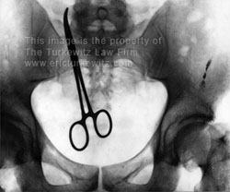
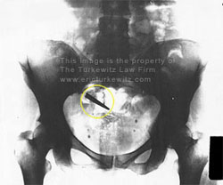
Negligent practices(example)
Surgical mistakes/errors
Taken from
http://www.turkewitzlaw.com/surgical-mistakes.htm

Slide 29
4. 2. Negligent practices:
In order to prove negligence it must prove four elements:
A duty of care was owed by the physician;
The physician violated the applicable standard of care;
The person(patient) suffered a compensable injury;
The injury was caused by the substandard conduct.

Slide 30
4. 3. Administrative errors:
Physician’s Failure to report about any person who :
Is in violation of the law
Is in violation of the code of professional conduct
Is impaired or disruptive

Slide 31
Administrative errors
How to deal ?

Slide 32
5. Plagiarism
Is an unethical, dishonest act whereby an individual uses the work of another, commit literacy theft, or present work as an original idea without crediting the source or stating that it is derived from an existing source.

Slide 33
5. Plagiarism
examples:
Using data for example; statistics, graphs, and drawings without acknowledging sources
Repeating another person’s apt phrase without acknowledgement
Using another person’s sentences or arguments as if they were your own.
Presenting another person’s idea, opinion, or theory in the development of an argument as though it is your own.

Slide 34
Plagiarism
How to avoid ?

Slide 35
Unprofessional physician
Impaired
Disruptive behavior
Dishonest
Greedy
Abuses power
Lacks interpersonal skills
Self-serving

Slide 36
Impairment:
When physician is unable to exercise prudent medical judgment
and/or
Is unable to practice with reasonable skills and safety without jeopardy to patient care

Slide 37
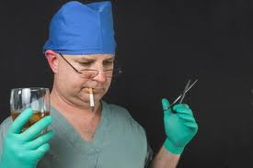
Impairment:
Impairment means more than making incorrect diagnosis. e.g.
1. Avoidance of patients and their psychological needs
2. Dehumanized care
3. Inappropriate treatment
4. Over involvement in care with sexual exploitation as the most serious form of violation.

Slide 38
Magnitude of the problem
Estimates of the magnitude of the problem of impaired physicians at some point in their careers vary
3–5%
15%
(Boisaubin & Levine 2001; Leape & Fromson 2006).

Slide 39
Disruptive behavior
Include repeated episodes of:
Sexual harassment
Racial or ethnic slurs
Abusive language
Persistent lateness in responding to calls at work

Slide 40
Why are we more sensitive to such behavior?
Patients are better informed and more assertive
Higher expectations of patients and families
Complaint mechanisms are more accessible
Medico-legal concerns
Laws, policies, and guidelines

Slide 41
Disruptive behavior
Q: How to deal ?
Ans: Check early warning signs

Slide 42
Disruptive Behavior (Early warning signs)
Late or incomplete charting
Delayed or no responses to call or pagers
Abusive treatment of staff
Unkempt appearance and dress
Inability to accept criticism
Gender or Religious bias

Slide 43
Complaints as indicators of unprofessional behavior
20–25% apparently disappoint their patients
More than 2/3 of physicians never or very rarely generate patient complaints (Hickson et al. 2002, 2007a,2007b).
A total of 6% of doctors, however, received 25 or more complaints over a 6-year period
Nurse surveys suggest that 4–5% of physicians display such behavior
(Diaz & McMillin 1991; Rosenstein and O’Daniel 2005a)

Slide 44
The eyes and ears of patients, visitors and healthcare team members are considered to be the most effective surveillance tools for detecting unprofessional behavior.

Slide 45
Who else hears and watches us

Slide 46
How should we deal with such behavior?

Slide 47
Dealing with unprofessional behavior
Surveillance
Registration

Slide 48
Disruptive behavior pyramid
No change
Vast majority of doctors: no professionalism issues
Single ‘unprofessional’ incident
Apparent pattern
Pattern persists

Slide 49
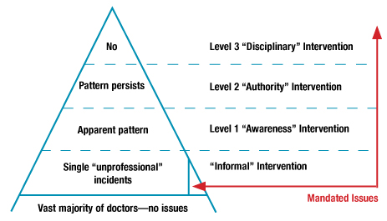

Slide 50
What does formalizing a response need?

Slide 51
Cost
Time
Formalizing a response

Slide 52
Potential benefits of formalizing a response
1. cost-saving
2. Builds the trust of public/patient
3. Improves the healthcare services

Slide 53
عن أبي تميم بن أوس رضي الله عنه ، أن النبي صلى الله عليه وسلم قال : ( الدين النصيحة ، قلنا : لمن يا رسول الله ؟
قال : (الله ، ولكتابه ، ولرسوله ، ولأئمة المسلمين وعامتهم رواهالبخاري ومسلم
Abu Tameem ibn Aws may Allah be pleased with him, that the Prophet peace be upon him said: (Debt advice, we say: To whom, O Messenger of God? Said: (Allah and His Book, His Messenger, the leaders of the Muslims and their common folk Ruahalboukhara and Muslim
Notes:
IN THE FOURTH LINE “ ALLAH “

Slide 54
Summary
Not pertaining to the characteristic of a profession.
Unprofessional behavior fall into five categories:
Illegal or criminal acts
Immoral acts
Business related acts
Acts that violate acceptable medical practices
Plagiarism
Do not have to wait until patient dies to determine that medical care suffered.

Slide 55
FOR YOUR READING
Unprofessional Behavior among Medical Students
http://www.nejm.org/doi/full/10.1056/NEJMc060089
Unprofessional physicians http://www.ncbi.nlm.nih.gov/pmc/articles/PMC1237990/pdf/westjmed00257-0121.pdf
Unprofessional or Disruptive Conduct by Physicians
http://macmedlaw.hubpages.com/hub/Unprofessional-or-Disruptive-Conduct-by-Physicians
The Unprofessional Student Objectives Professionalism
web1.aapa.org/10ACSyllabi/1509UnprofessionalStudent.pdf

Slide 56
THANK YOU VERY MUCH
& &

