Slide 1
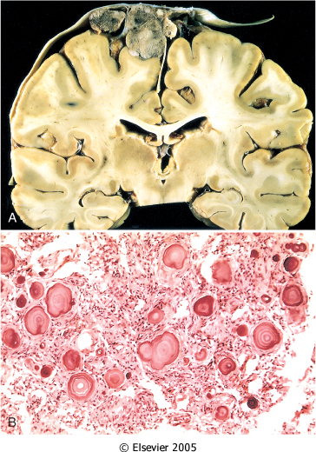
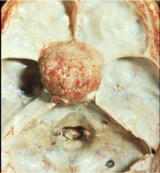
Gross : Rounded mass attached to the dura compress the underlying brain.
1) Meningioma
multilobular meningioma
Meningioma at the base of the skull

Slide 2
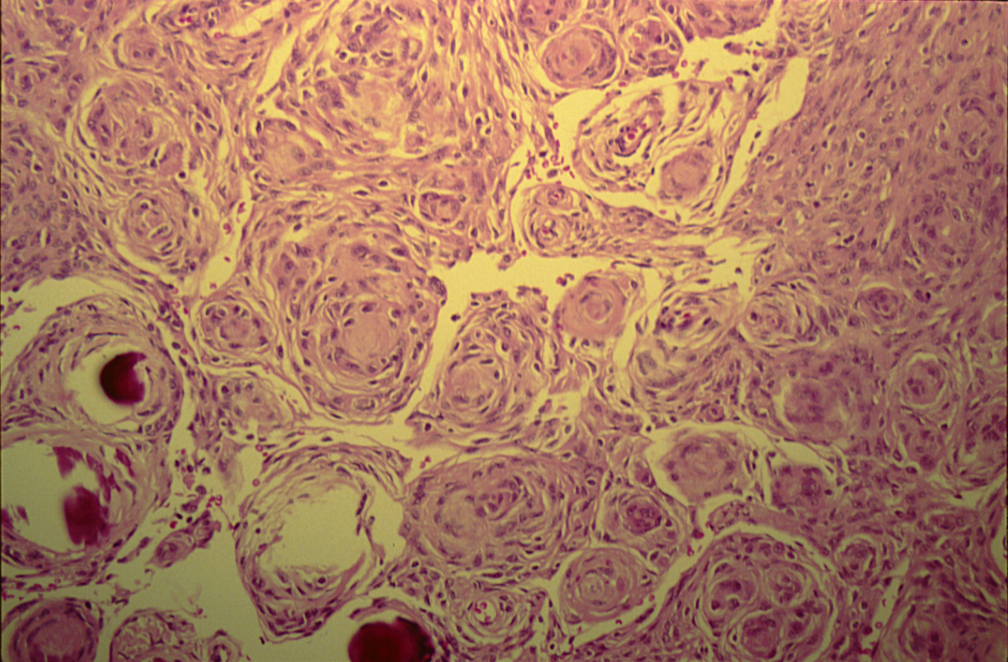
Histo :
whorled pattern of tumor cell.
psammoma bodies.
Spindle and oval cell shape with esinophilic cytoplasm .
Additions :
Benign tumor .
H.E stain
Origin : Meningothelial cells .

Slide 3
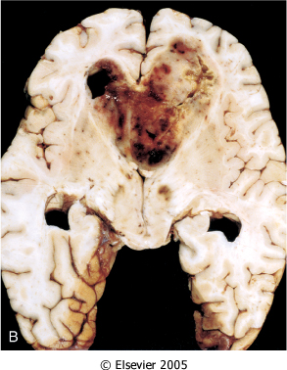
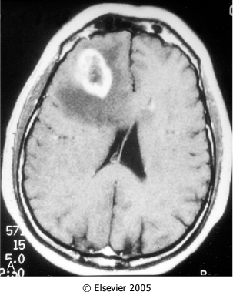
2) Glioblastoma multiforme
Gross :
necrotic, hemorrhagic, infiltrating mass located intraparenchymal.
(CT) scan of a large tumor showing signal enhancement with contrast .

Slide 4
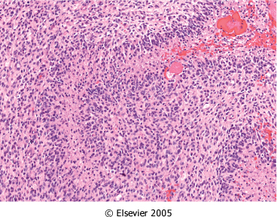
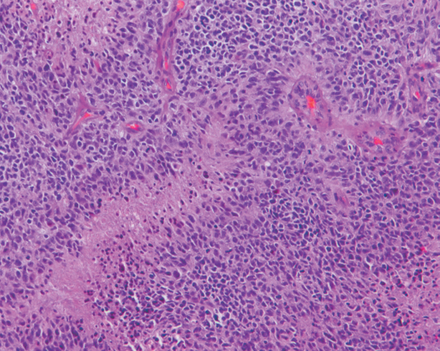
Histo :
pseudopalisading of malignant nuclei .
Foci of necrosis
endothelial cell proliferation.
Additions :
Malignant Grade 4 tumor .
Genetic Affected : P53
Treatment : Radiotherapy and Chemotherapy

Slide 5
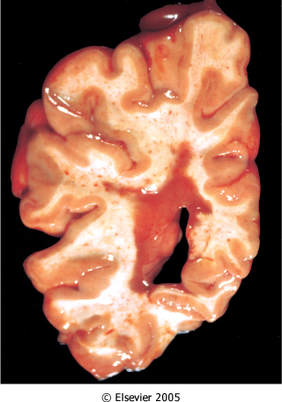
Gross : Brown plaque surrounding the lateral ventricle
3) Multiple sclerosis
Additions :
Definition :
Auto immune disease that demyelinated of axons.
Risk Factor :
Genetic and Enviromental .

Slide 6
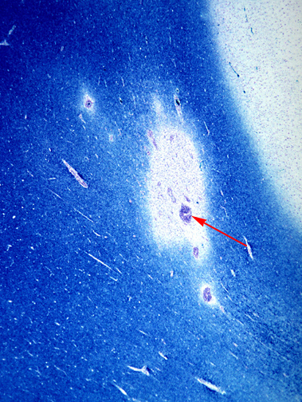
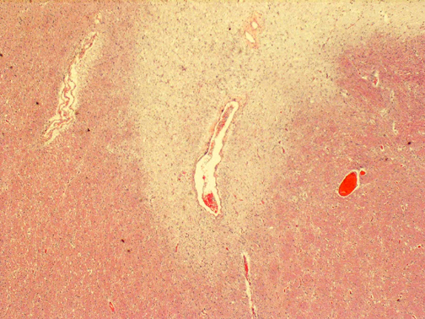
Histo :
Intermittent unmyelinated area .
Preserved of axons.
infiltration of lymphocytes Inflammatory cells .
luxol fast blue stain / PAS
Silver stain
H&E stain

Slide 7
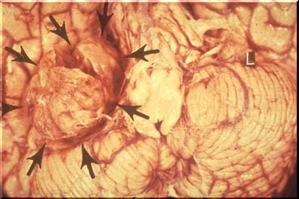
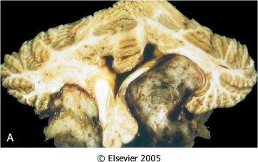
4) Schwannoma
Gross :
Well circumscribed mass at the cerebello-pontine angle.
Additions :
A schwannoma is a benign tumor which can be cured by local excision .
Association with neurofibromatosis Type 2 Syndrome .
Bilateral eighth nerve schwannomas

Slide 8
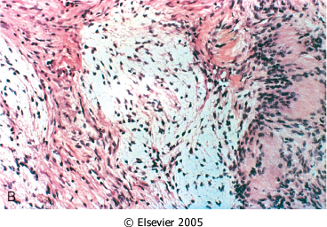
Histo :
Cellular area with pseudopalisading nuclei (Antoni A) .
looser area with fibromyxoid change ( Antoni B ) .
verocay bodies.
Elongated spindle shaped Schwan cells.
( Antoni B )
( Antoni A )

Slide 9
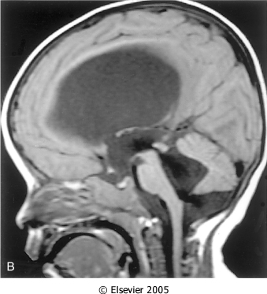
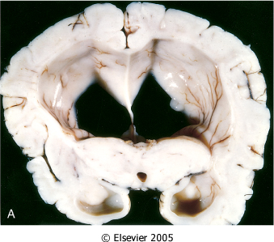
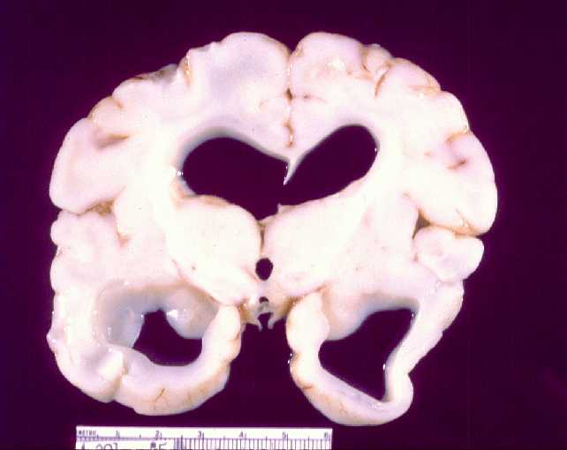
5) Hydrocephalus
Additions :
Definition : Accumulation of excessive CSF in ventricular system .
Causes : Congenital atrophy of brain , Meningitis
Gross :
Marked dilatation of the ventricles.
MRI shows communicating hydrocephalus, involving all ventricles..
Dilated lateral ventricles through the midthalamus.

Slide 10
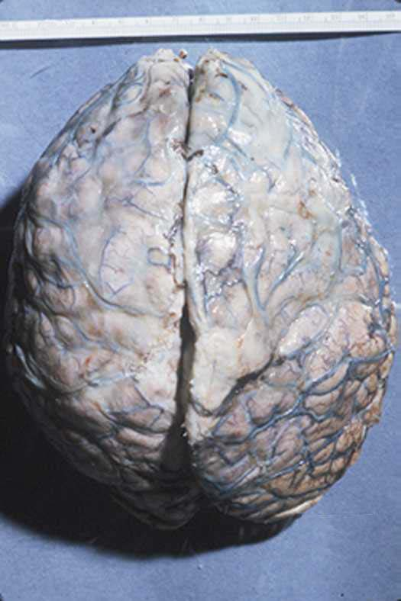
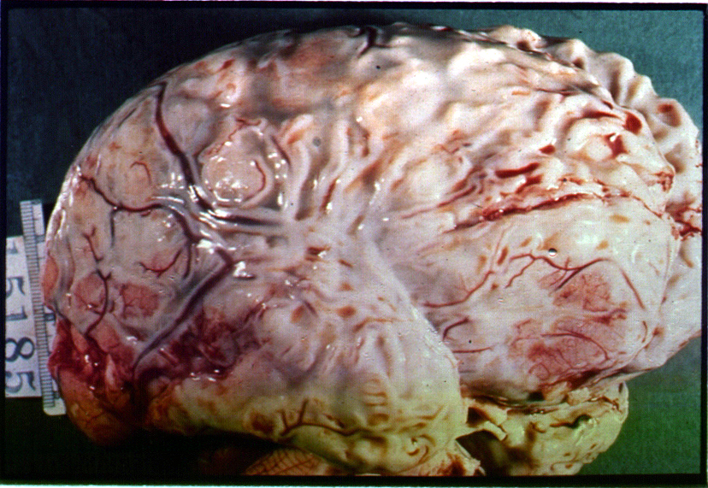
6) Pyogenic ( bacterial ) meningitis
Gross :
A thick layer of supurative exudate covers the brain hemispheres and meninges .

Slide 11
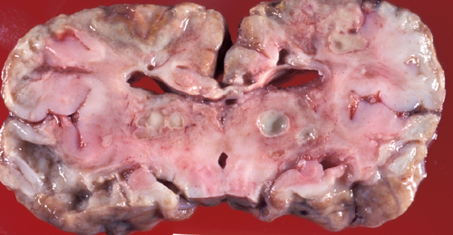
7) Brain abscess
Gross :
Capsulated lesions with central liquefactive necrosis.

Slide 12
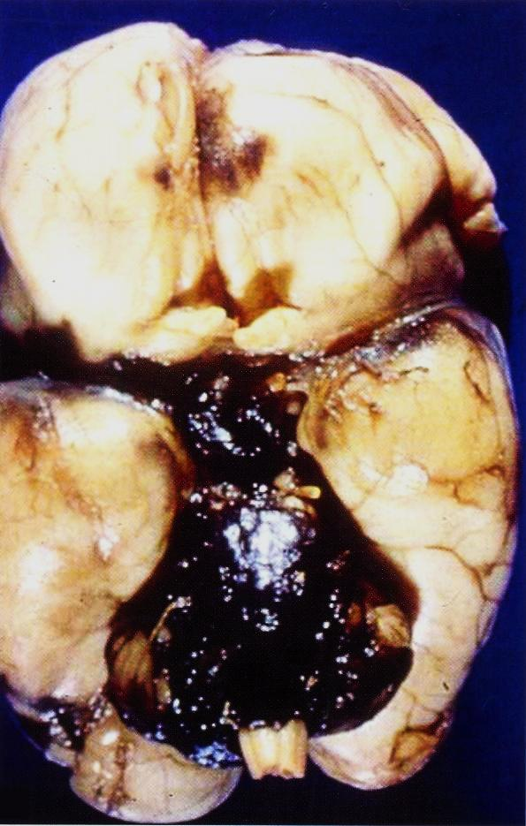
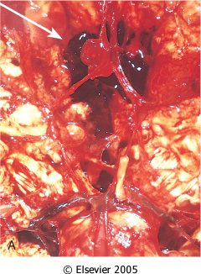
8) subarachnoid hemorrhage
Extensive hemorrhage in the pons extension to fourth ventricle.
Aneurysm of the anterior
cerebral artery

Slide 13
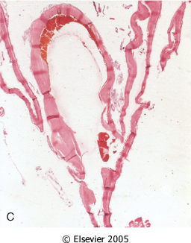
Additions :
Causes :
- Rupture of Berry Aneurysm .
- Polycystic Kidney Syndrome.
Types of Aneurysms :
Berry ( sacular ) .
Fusiform .
Common sites of aneurysms:
Anterior communicating
artery , In circle of Willis
Subdural Hemorrhage causes by dural veins But subarachnoid hemorrhage causes by cerebral arteries .
Hyalinized fibrous vessel wall.

Slide 14
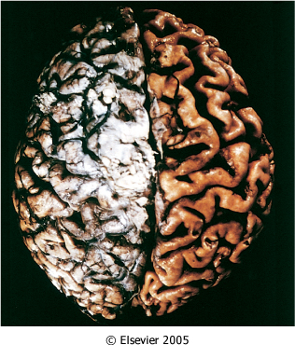
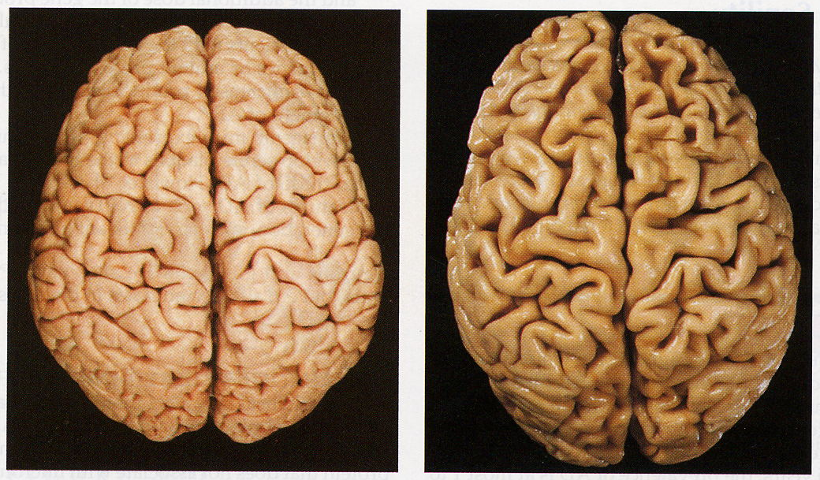
9) Alzheimer disease
Gross :
Cortical atrophy with thin gyri and widening sulci.

Slide 15
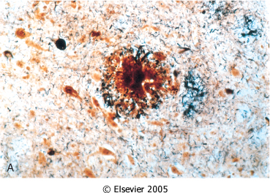
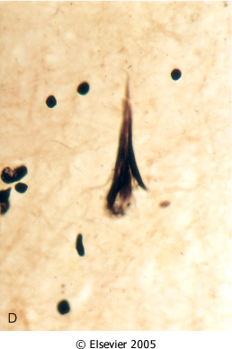
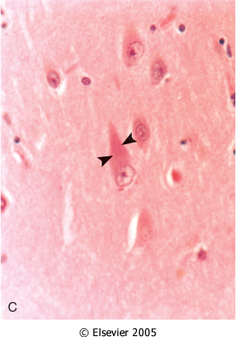
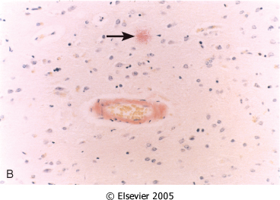
Histo :
Neuritic plaque.
Neurofibrillary tangles.
Amyloid deposition.
Neuritic plaque
Neurofibrillary tangles
present within the neuronal cytoplasm.
Neurofibrillary tangles
present within the neurons.
Amyloid deposition in the blood vessels. ( Congo red stain )

Slide 16
Good Luck ..
Done By :
Abdulaziz Alanazi
Abdulmajeed Altammami

