Slide 1
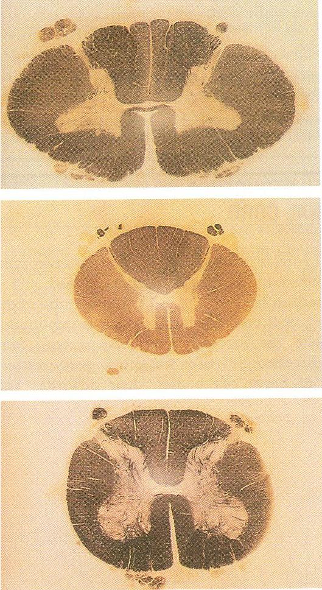

Slide 2
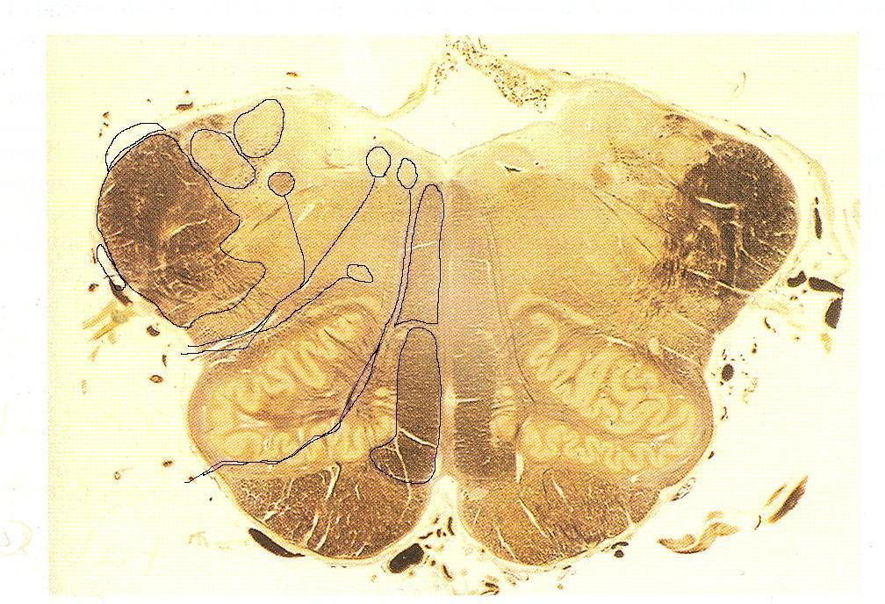

Slide 3
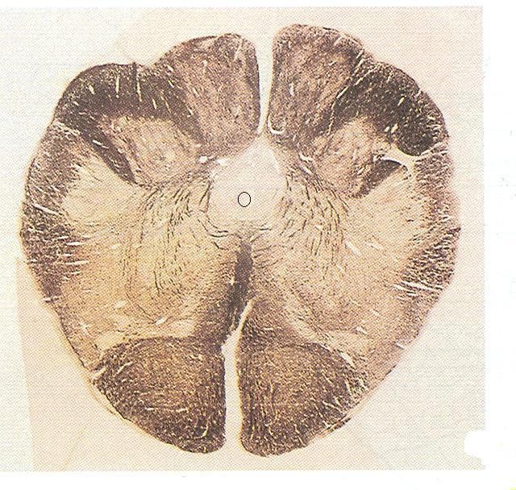

Slide 4
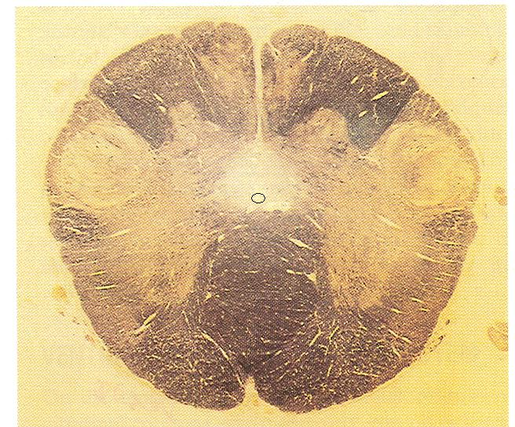

Slide 6
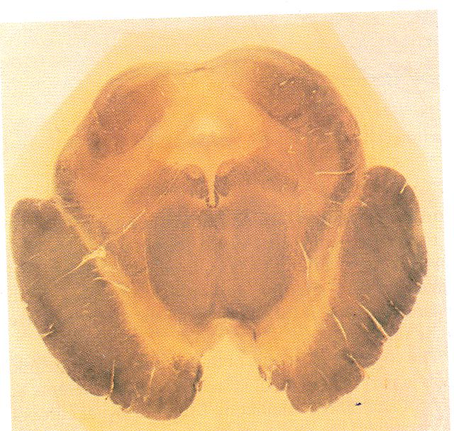

Slide 7
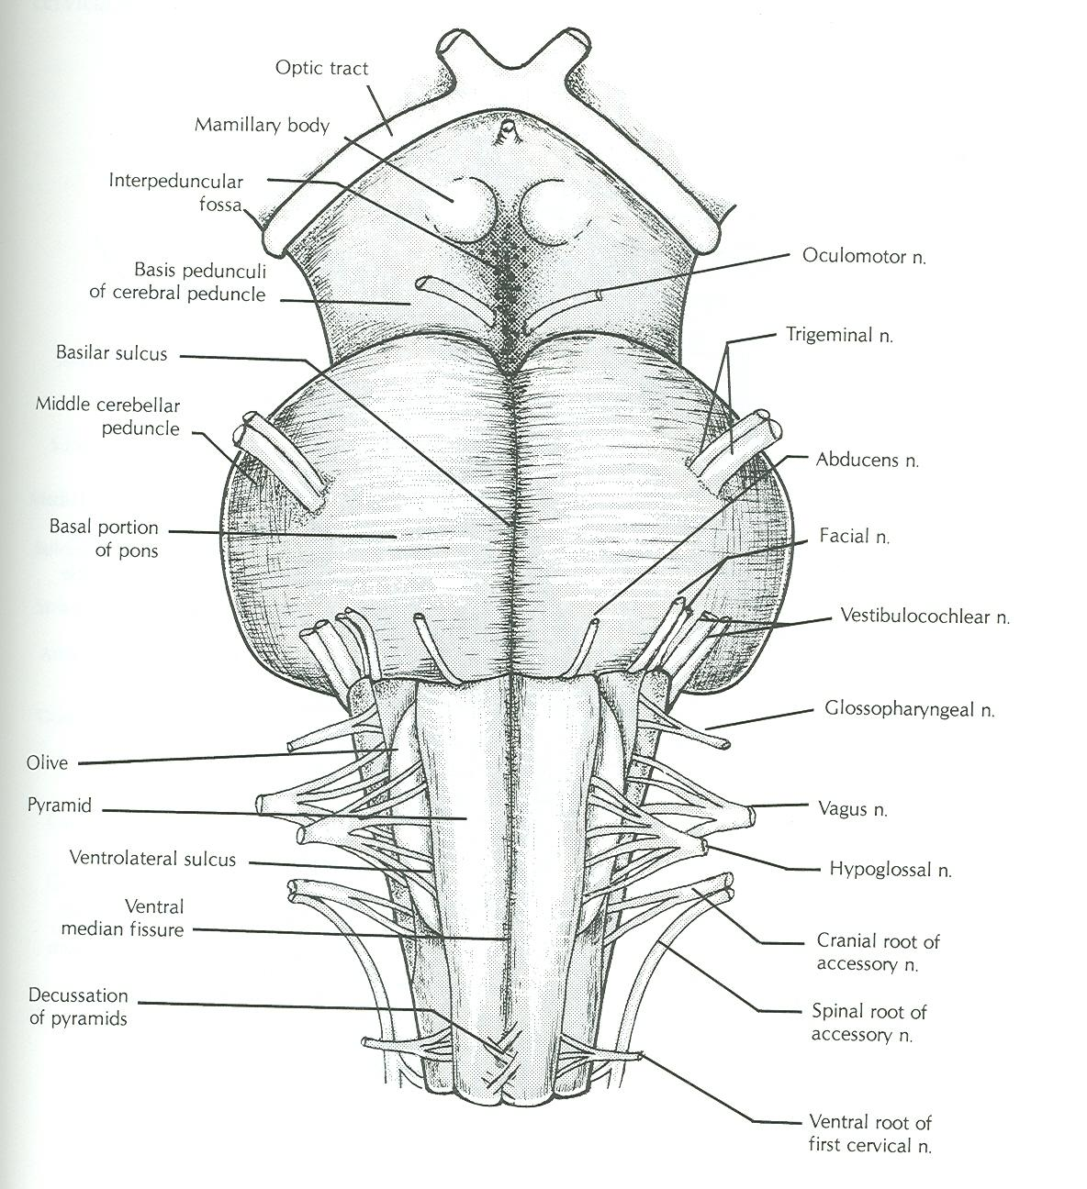

Slide 8
Name of gyri, sulci, important functional areas, blood supply

Slide 9
Name of gyri, sulci, important functional areas, blood supply
Corpus callosum
Fornix
Thalamus
Crus cerebri
Cerebellum
Pons
Medulla

Slide 11
Don’t forget main afferents and efferents of important parts of CNS

Slide 12
Peripheral nerves
Root values of each nerve
Name of plexus from which arise
Name of cords from which arise
Name of muscles or groups of muscles supplied by nerve and their main action
Areas of skin supplied by the nerve
Name of lesion or deformity caused by nerve lesion

Slide 13
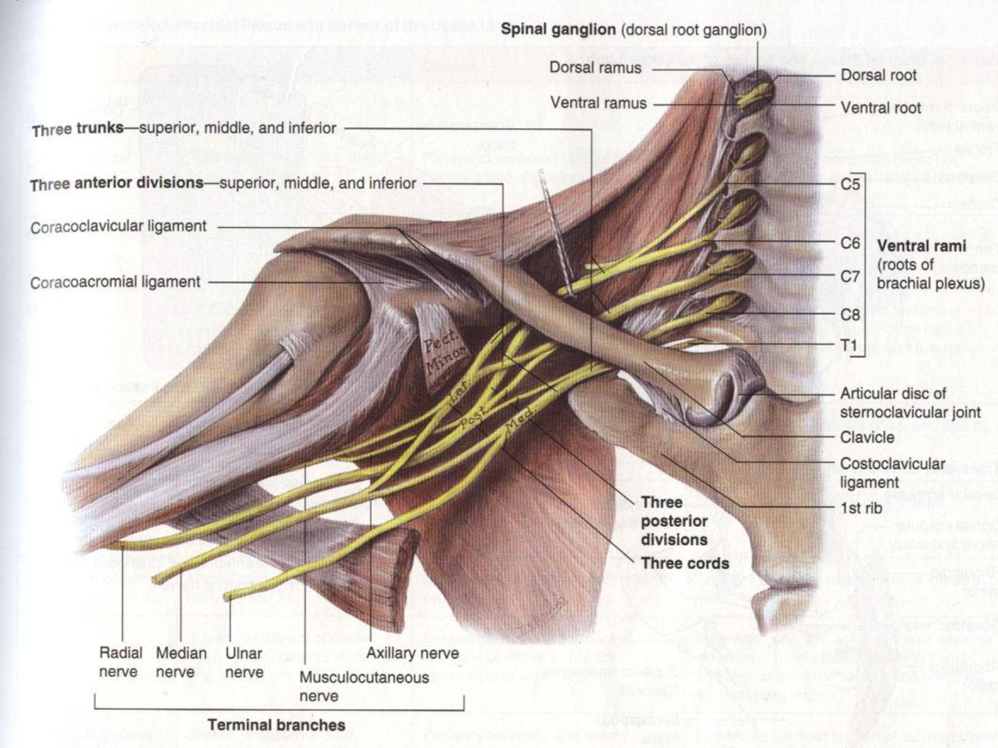

Slide 15
