Slide 1
Second CNS pathpractical session
28-10-13

Slide 2
Case No. 5

Slide 3
9 months infant was suffering from enlarged head size and admitted to hospital with convulsions, went into coma and died. Autopsy was done and the brain was large with dilated ventricles . What is your provisional diagnosis?

Slide 4
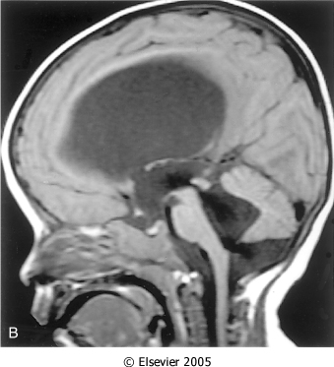
Mid-sagittal magnetic resonance image of a child with communicating hydrocephalus, involving all ventricles.

Slide 5
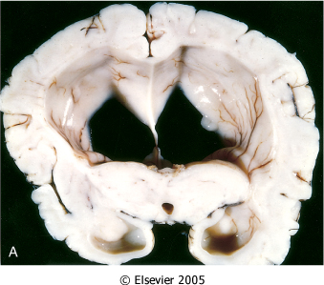
Hydrocephalus. Dilated lateral ventricles seen in a coronal section through the midthalamus.
Markedly dilated lateral ventricles
Notes:
Causes of hydrocephalus: Meningitis, obstruction of CSD flow (obstruction of foramen of Monro or compressed aqueduct) by tumors. Lack of CSF resorption secondary to brain atrophy

Slide 6
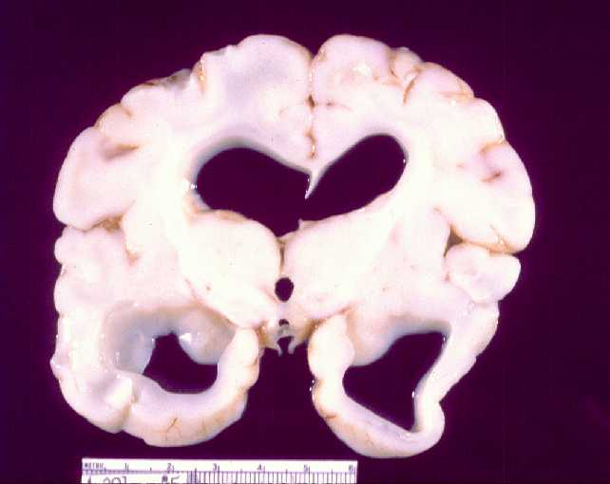
Cross section of brain showing marked dilatation of the ventricles.

Slide 7
Hydrocephalus

Slide 8
Case No. 6

Slide 9
4 years old child who was treated from otitis media and suddenly complained from headache, vomiting, fever and stiff neck. CSF was found to be clouded with abnormal increase of neutrophils, increased protein and absence of sugar. Gram stain of the CSF fluid showed meningiococci . What is your diagnosis ?

Slide 10
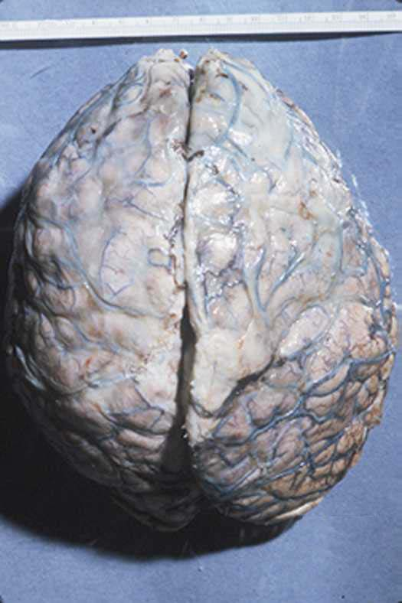
A thick layer of supurative exudate covers the brain hemispheres and meninges

Slide 11
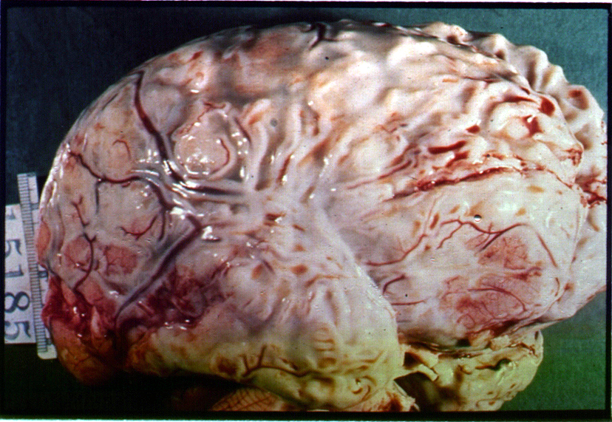
A thick layer of supurative exudate covers the brain hemispheres, with thickens Leptomeninges

Slide 12
Pyogenic ( bacterial ) meningitis

Slide 13
Case No. 7

Slide 14
35 years old lady complains from otitis media . Suddenly she suffers from headache and convulsions. Brain MRI reveals 5 cm. fluid filled cavity in the temporal lobe. Examination of the CSF shows increased pressure with lymphocytes and increased protein but there is no change of sugar content. What is your diagnosis ?

Slide 15
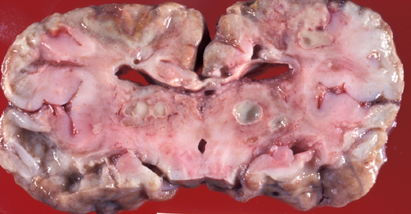
Multiple discrete lesions with central liquefactive necrosis. There is a surrounding fibrous capsule and marked edema

Slide 16
Brain abscess

Slide 17
Case No. 8

Slide 18
A previously healthy 31-year-old woman experiences a severe headache and loses consciousness within an hour. An emergent head CT scan reveals extensive subarachnoid hemorrhage at the base of the brain. She is a febrile. A lumbar puncture yields cerebrospinal fluid with many red blood cells, but no white blood cells. The CSF protein is slightly increased, but the glucose is normal. What is your provisional diagnosis ?

Slide 19
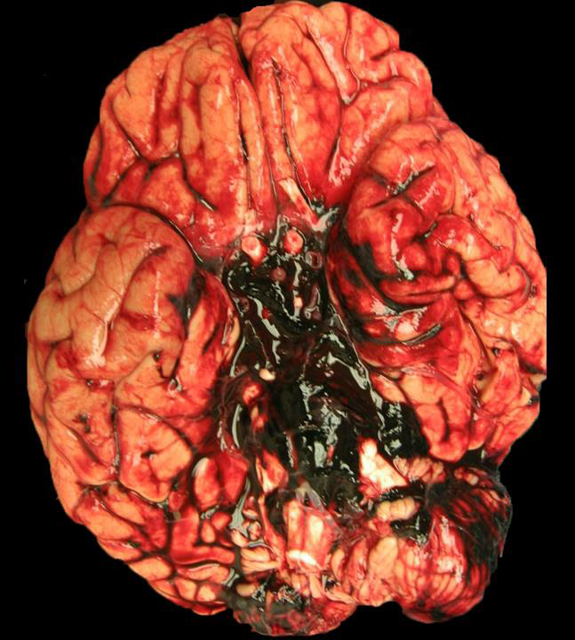
Subarachnoid hemorrhage in the pons.

Slide 20
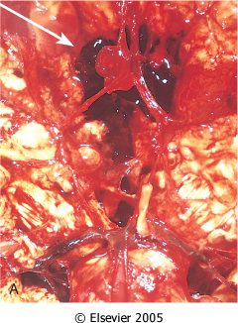
View of the base of the brain, dissected to show the circle of Willis with an aneurysm of the anterior cerebral artery (arrow).

Slide 21
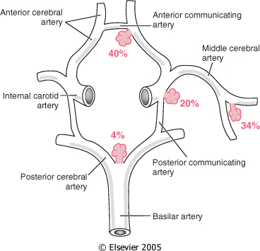
Common sites of saccular (berry) aneurysms in the circle of Willis

Slide 22
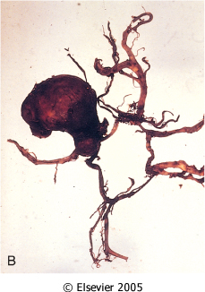
B, Dissected circle of Willis to show large aneurysm.

Slide 23
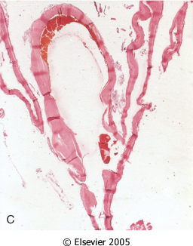
Saccular aneurysm
C, Section through a saccular aneurysm showing the hyalinized fibrous vessel wall.

Slide 24
Ruptured berry aneurysm causing subarachnoid hemorrhage

Slide 25
Case No.9

Slide 26
An 85 years old man complains of progressive loss of memory, disorientation and alterations in mood and behavior since 20 years. He was admitted to hospital because he was disabled and immobile and he died in hospital after one week of admission. Autopsy was done and the brain cortex was found to be atrophied. What is your diagnosis ?

Slide 27
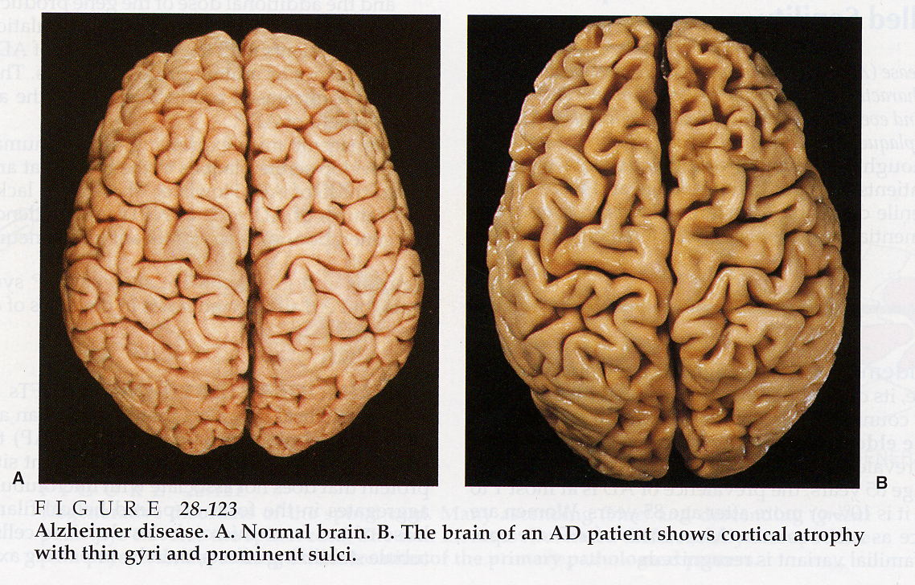
Brain atrophy, flat gyri and widened sulci

Slide 28
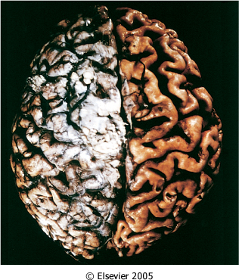
Alzheimer disease with cortical atrophy most evident on the right, where meninges have been removed.
Notes:
Notice the deep and wide sulci and narrow gyri .

Slide 29
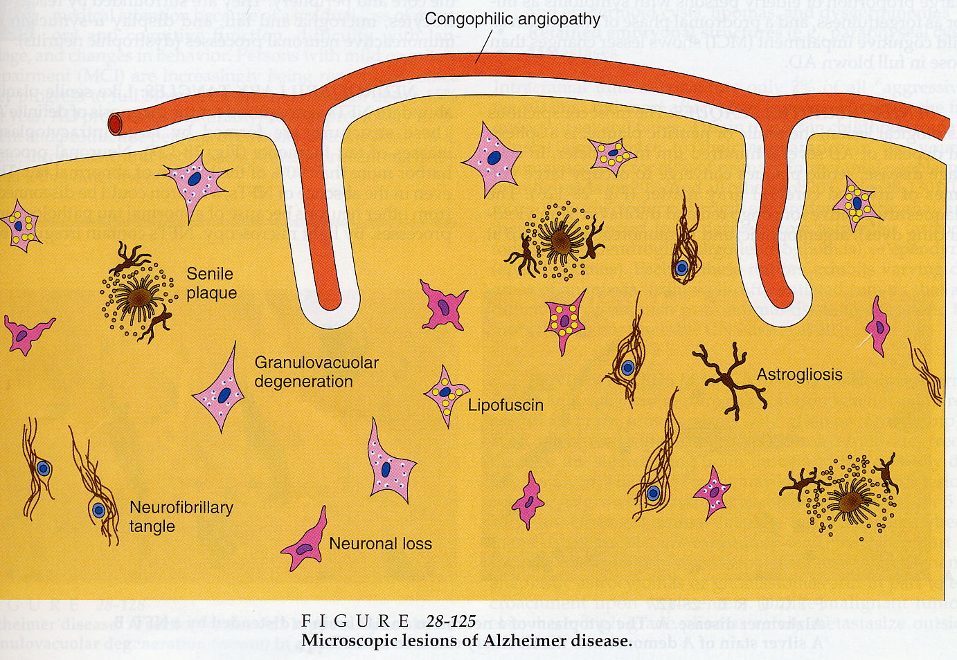

Slide 30
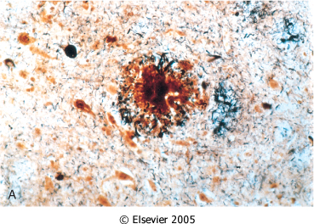
Alzheimer disease. A, Neuritic plaque with a rim of dystrophic neurites surrounding an amyloid core.

Slide 31
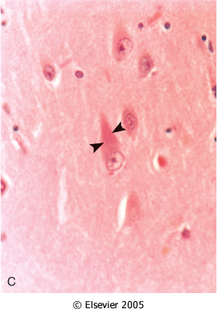
Neurofibrillary tangles (arrowheads) are present within the neurons.

Slide 32
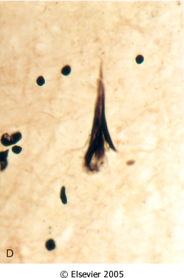
Alzheimer Disease. D, Silver stain showing a neurofibrillary tangle within the neuronal cytoplasm.

Slide 33
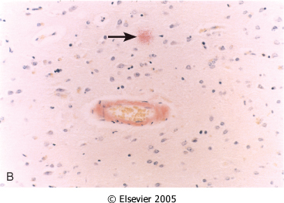
Alzheimer Disease. B, Congo red stain of the cerebral cortex showing amyloid deposition in the blood vessels and the amyloid core of the neuritic plaque (arrow)

Slide 34
Alzheimer disease

Slide 35
Alzheimer Disease
Macroscopic examination of the brain shows a variable degree of cortical atrophy with widening of the cerebral sulci that is most pronounced in the frontal, temporal, and parietal lobes
Microscopic: neuritic (senile) plaques, neurofibrillary tangles, and amyloid angiopathy

