Slide 1
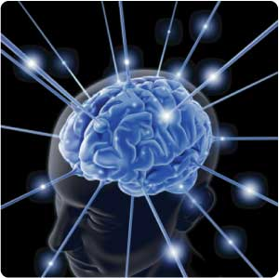
DRUGS USED IN
HEADACHE AND MIGRAINE
Prof. Omnia Amin Nayel
&
Dr. Abdul latif Mahesar

Slide 2
ILOs
Differentiate between types of headache regarding their symptoms, signs and pathophysiology.
Recognize drugs used to prevent migraine
Identify drugs used to rescue and abort migraine
Elaborate on the pharmacokinetics, dynamic and toxic profile of some of these drugs.

Slide 3
HEADACHE
Pain anywhere in the region of the head or neck
It can be a symptom of a number of different conditions of the head or neck or any where in the body or a referred pain.
It is caused by disturbance of the
Pain – Sensitive Structures around the brain
Within the cranium
Outside the cranium
( blood vessels, meninges, cranial nerves)
(the periosteum of the skull, muscles, nerves , arteries ,veins, subcutaneous tissues ,eyes, ears and other tissues)

Slide 4
Classification
Primary:
Migraine, tension type headache, cluster headache, trigeminal cephalgias and others where cause in unknown
 NSAIDs
Secondary: Based on the etiology
Trauma: of head or neck
Vascular disorders: ischeamic stroke, intracrainial hemorrhage.
Disease: intracranial tumors,infection,
Homeostasis disorders: high BP, fastening, hypothroidsm.
Others……
 Treat the etiology

Slide 5
Recurrent attacks of throbbing headache
Unilateral / or on both sides
Lasting from > 2 up to 72 hrs.
+ Preceded (or accompanied) by AURA
MIGRAINE
Perceptual disturbance of motor < sensory nature
visual [ Photophobia (↑sensitivity to light) ]
auditory [ Phonophobia (↑ sensitivity to sound) ]
olfactory unpleasant smell …..
Develops over 5-20 min. & last fewer than 60 min.

Slide 6
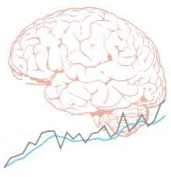
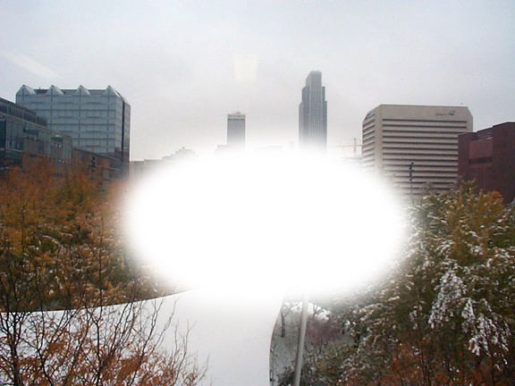
Phases of Migraine
1. Prodrom Phase; a change in mood or behavior that starts hours or days before headache. It is experienced by 60% of migraineurs.
2. Aura Phase; Sensory > motor symptoms starts 5-20 min before the migraine attack. It is experienced by 20% of migraineurs.
3. Headache Phase; moderate to severe pain,  with activity + anorexia, vomiting,
Intolerance to light, sounds, odors
Blurry vision /Blocked nose /Pale face Sensations of heat or coldness /Sweating /Tenderness of the scalp
4. Postdrom Phase: still not normal, either;
* More likely fatigued → irritability /impaired concentration /scalp tenderness /mood changes / GIT symptoms, ……
* Less likely refreshed, hyperactive, apprehensive….

Slide 7
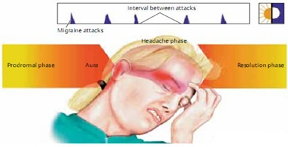
Curtain like effect over one eye
TYPES OF MIGRAINE
COMMEN
Classic
Without Aura [80%]
With Aura [20%]

Slide 8
Migraine Triggers
Diet
Aged cheese, Alcohol, Chocolate, Caffeine, Hot dogs, Luncheon meats, Avocado, Fermented or pickled foods, Yeast or protein extracts, Onions Nuts, Aspartame.
Stresses
Hormonal changes
Climate
Diseases
Therapy
Antibiotics, Antihypertensives, H₂ blockers, Vasodilators, Oral contraceptives
Life Style
?
?
?
Theories

Slide 9
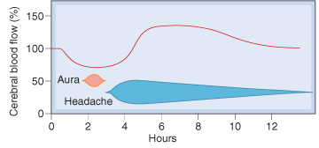
Migraine Causal Theories
Vascular
Triggers
↓
Intracranial vasoconstriction → migraine aura
↓
focal ischemia → ↑ mediators → rebound vasodilatation → ↑ permeability & leak → inflammatory reaction → activates perivascular nociceptive nerves → migraine headache
Cortical Spreading Depression
Neurovascular theory ?
Mediators [ Serotonin ]
↓
It throbs as blood flow at these sensitive area with each heart beat
Dopaminergic Hypersensitivity
Magnesium Deficiency
Immunological theory

Slide 10
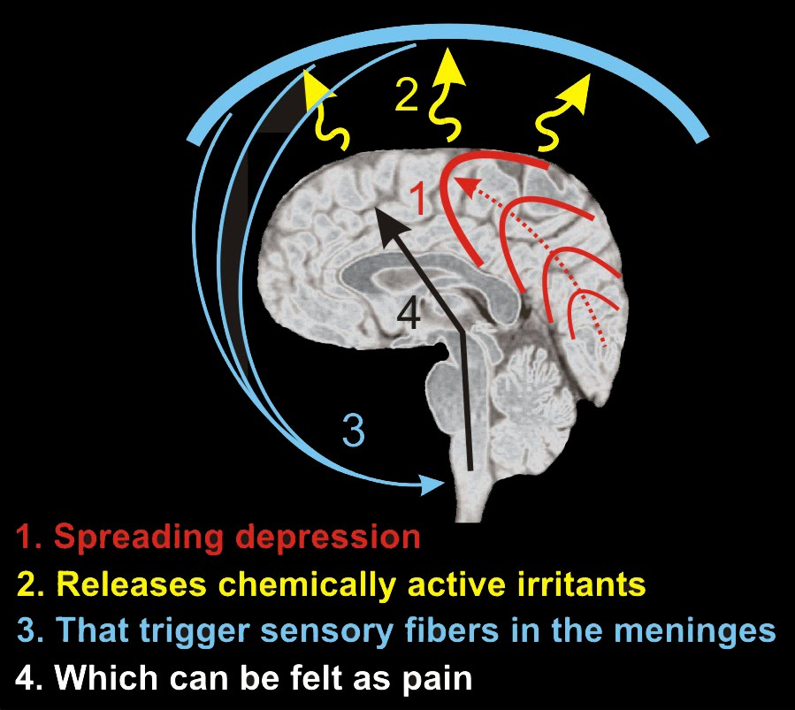
Migraine Causal Theories
Vascular
Cortical Spreading Depression
Triggers
↓
Release K / glutamates
↓
Creates a slowly well-defined depolarizing wave → depolarize adjacent tissues → propagating at a rate of 2-6 mm/min → vasoconstriction → migraine aura
↓
Along its spread H⁺ and K⁺ ions diffuse to the pia matter → activate C-fiber meningeal nociceptors →release proinflammatory soup of neurochemicals (CGRP, SP, ….) → activate trigeminovascular complex → vasodilation → migraine headache
Neurovascular theory ?
Mediators [ Serotonin ]
Dopaminergic Hypersensitivity
Magnesium Deficiency
Immunological theory
Which is Pry
Which is secondary

Slide 11
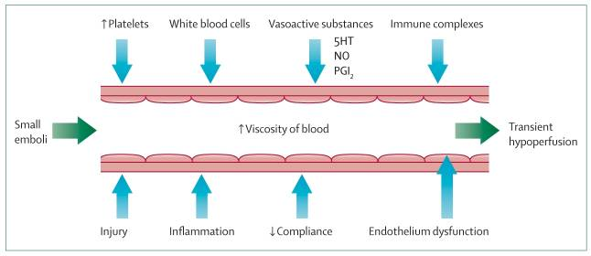
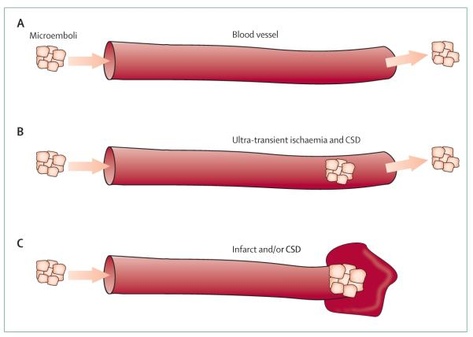
Migraine Causal Theories
UNIFYING
Transiently occlude to initiate CSD
Prolonged occlusion will cause tissue microinfarction

Slide 12
TREATMENT STRATEGY
ACUTE ATTACK
PREVENT RECURRENCE
Controls attack.
recurrence frequency, severity, duration & / or disability
responsiveness to abortive therapy
RESCUE THERAPY
ABORTIVE THERAPY
N.B. Full effect of therapy needs several weeks to manifest
& should continue for 6 m.
& can be repeated
Non-specifically target individual symptoms i.e. alleviating
pain, emesis and associated symptoms
They specifically target pathways of migraine by ⬇ meningeal dilatation & ⬇ neural activation via 5HT₁ agonism ➔ i.e. stopping headache as it is evolving.
Abortive medications > effective if taken early, losing effectiveness once the attack has begun
So they must be rapidly acting
Mild-Moderate
Severe/ Disabling

Slide 13
TREATMENT of Acute Attack
RESCUE THERAPY
➔ Analgesics
NSAIDs / Aspirin< Acetaminophen
Mild-opioid: μ agonist; tramadol act on 5HT & NE receptors
Sedatives
➔ Antiemetics
Dopamine Antagonists
+ Gastro-prokinetic
Domperidone
↑ Absorption & bioavailability
of abortive therapy
Phenothiazines
Dopamine antagonists
+ Sedation
Promethazine
5HT₃ antagonists
Ondanseteron
Granisetron
 H₁ antagonist
Antihistamine + Anticholinergic
Meclizine
➔ Others; Steroids

Slide 14
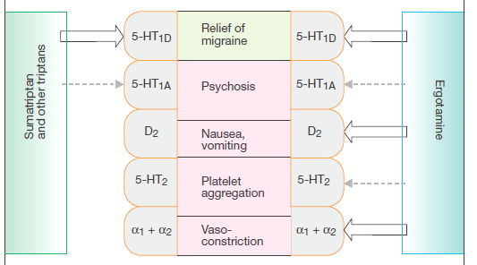
TREATMENT of Acute Attack
ABORTIVE THERAPY
5HT₁
AGONISTS ➔ TRIPTANS
> selective
PARTIAL AGONISTS ➔ ERGOTS
non-selective
➔CGRP Antagonists

Slide 15
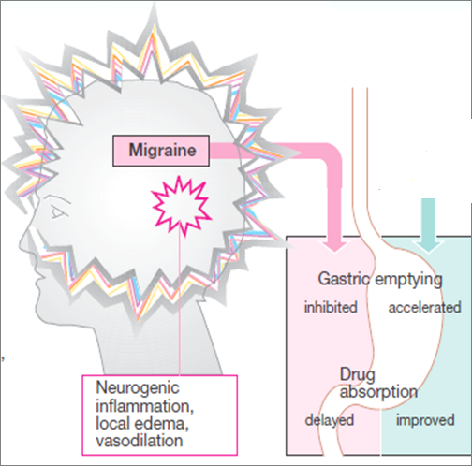
TREATMENT of Acute Attack
Prokinetics;
Domperidone
Help
Absorption
ABORTIVE THERAPY

Slide 16
TREATMENT of Acute Attack
ABORTIVE THERAPY
ERGOTS
Product of Claviceps purpurea; a fungs growing on rye & other grains
Non-Selective
Agonism at 5HT₁ receptors
At presynaptic trigeminal nerve endings→
↓release of vasodilating peptides
↓excessive firing of these nerve endings
At blood vessels → ↓vasodilation & stretching of the pain endings ↓ transmitter release in the perivascular space.
Partial agonist effect on α-adrenoceptors → vasoconstriction
Antagonist to some dopaminergic & serotonergic receptors
Ergotamine tartarate
Dihydroergotamine
Oral, sublingual, rectal suppository, inhaler & injectable forms
Nasal spray, inhaler & injectable forms
Caffeine
Cafergot

Slide 17
ERGOTS
Ergotamine tartarate
Oral absorption Incomplete (erratic) + slow → low bioavailability Sublingual Low bioavailability
Rectal suppository Better bioavailability
Elimination Extensive hepatic 1st pass metabolism
Excretion 90% of metabolites in bile
Traces unmetabolized → in urine and feces
Despite t_{1/2} nearly 2 hours, ergotamine produces vasoconstriction → 24 hours or longer due to high and long tissue binding ability.
Dihydroergotamine
Dihydroergotamine is eliminated more rapidly than ergotamine, presumably due to its rapid hepatic clearance
Indications
They are only used to abort the attacks [ Exception Dihydroergotamine can be given for severe, recurrent attacks ]
Their use is restricted to patients with frequent, moderate attack or infrequent but severe attacks.

Slide 18
ADRs
ERGOTS
Nausea ,vomiting , abdominal pain and diarrhea
Feeling of cold and numbness of limbs, tingling
Pericardial distress, anginal pain due to coronary spasm, and disturbed cardiac rhythm ( tachycardia or bradycardia )
Prolong use → rebound headache due to vasodilatation followed by vasoconstriction.
Prolong use and high dose → paraesthesia & gangrene
Hallucination.
Contraindications
Pregnancy; fetal distress and miscarriage
Peripheral and coronary vascular diseases
Hypertension
Liver and kidney diseases
Fever, sepsis
For prophylaxis of migraine.
In concurrent use with triptans( at least 6 hrs from last dose of tryptans or 24 hrs from stopping ergotamine)
In concurrent use with β-blockers

Slide 19
TREATMENT of Acute Attack
ABORTIVE THERAPY
TRIPTANES
Selective
Agonism at 5HT₁ receptors
At presynaptic trigeminal nerve endings→
↓release of vasodilating peptides
↓excessive firing of these nerve endings
At meningeal , dural , cerebral vessels → ↓vasodilation & stretching of the pain endings.
No α₁, α₂, β –adrenergic , dopamine or muscarinic receptors.
SUMATRIPTAN
Present in →nasal spray, and injectable forms
Oral bioavailability low / Subcutaneous bioavailability is 97%, peaks after 2 min & t_{1/2} nearly 2 hours
ZOLMITRIPTAN
Present in →nasal spray, and injectable forms
Oral bioavailability 40%, peaks after 2 hrs & t_{1/2} nearly 3 hours
NARATRIPTAN
Present in addition → + Oral preparations
Oral bioavailability 70%, peaks after 2 hrs & t_{1/2} nearly 6 hours

Slide 20
Indications
TRIPTANES
To abort attacks in patients with frequent, moderate
or infrequent but severe attacks.
In cluster headache
ADRs
Mild pain and burning sensation at the site of injection.
Paraesthesia, tingling ,warmth, heaviness
Flushing / Dizziness
Vasospasm
Ischemic heart; Angina → M.I
Hypertension
Arrhythmias
ZOLMITRIPTAN
Chest & neck tightness
Somnolence
Contraindications
Peripheral vasospastic diseases
Uncontrolled hypertension
History of ischemia
Cerebrovascular disorders
In concurrent use with ergots or others inducing vasospasm
In concurrent use with MAO Is, lithium, SSRIs, ….→(5HT)
RIZO & ZOLMITRIPTAN
Renal or hepatic impairment
NARA > RIZOTRYPTAN

Slide 21
DECIDING WHETHER BETTER WITH A TIYPTAN OR WITH DHE.
For patients with headache episodes lasting 2 or 3 days at a time, DHE is often the optimal choice because of long t_{1/2}
For patients with migraines a day or less and need rapid relief of pain, tryptans are often a better choice
The form of drug preparation could influence the choice
Injectable sumatriptan reaches T_{max} the fastest followed by DHE nasal spray and rizatriptan
DHE nasal spray, naratriptan, eletriptan, and frovatriptan have lower recurrence rates

Slide 22
CHOOSING A TRIPTANS
Differences in the time to peak blood concentration T_{max}, equates with faster relief of head pain.
Differences in t_{1/2} → a clinical effect in terms of recurrence of headache
For extremely fast relief within 15 min. injectable sumatriptan is the only choice.
If onset could start within a couple of hrs, oral rizatriptan, zolmitriptan, eletriptan, or sumatriptan nasal spray are appropriate choices
If expected re-dosing is needed & / or recurrence of headache Naratriptan , frovatriptan, have slower onset, fewer side effects, and a lower recurrence rate

Slide 23
TREATMENT STRATEGY
ACUTE ATTACK
PREVENT RECURRENCE
Antispastic muscle relaxants;
Botulinum toxins, Tizanidine
Antiepileptics;
Block Na channel & augment GABA at GABA-A receptors
Topiramate; weight loss & dysthesia.
Valproic; weight gain, hair loss, polycystic ovary not given to young females
Gabapentin ?
Antidepressants
Pizotifen; Like TCA + 5HT₂ antagonist + mild antimuscarinic & anti-histaminic activity. Drowsiness, ↑appetite  weight gain.
Not given with other CNS depressants  sedation
Not given with MAO Is
TCA; Ami & nortriptyline  Dopamine antagonists
SSRIs ?
Antihypertensives
blockers; Propranolol, atenolol, metoprolol, Not in young & anxious nor in elderly & depressed, diabetic...etc
Ca Channel Blockers
Cinnarazine, flunarizine, verapamil.....etc.
ACEIs lisinopril & ARBs candesartan ??

Slide 24
DRUGS USED IN
HEADACHE AND MIGRAINE
L
G
U
O
C
O
K
D

