Slide 1
ANTIDEPRESSANTS
New Antidepressants

Slide 2
Fluoxetine
Fluvoxamine
Citalopram Sertraline
Paroxetine
Selective Serotonin Reuptake Inhibitors SSRIs
Venalafaxine
Serotonin Norepinephrine Reuptake Inhibitors (SNRIs)
Reboxetine
Norepinephrine Reuptake Inhibitors (NRIs)
Noradrenergic & Specific Serotonergic Antidepressants (NaSSAs)
Mirtazapine
Bupropion
Norepinephrine Dopamine Reuptake Inhibitors (NDRIs)
Serotonin Antagonists & Reuptake Inhibitors (SARIs)
Trazodone
Nefazodone

Slide 3
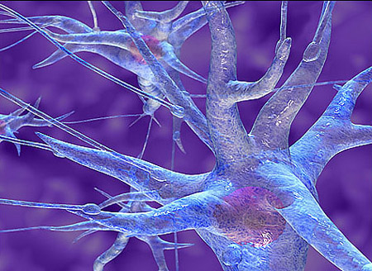
SSRIs

Slide 4
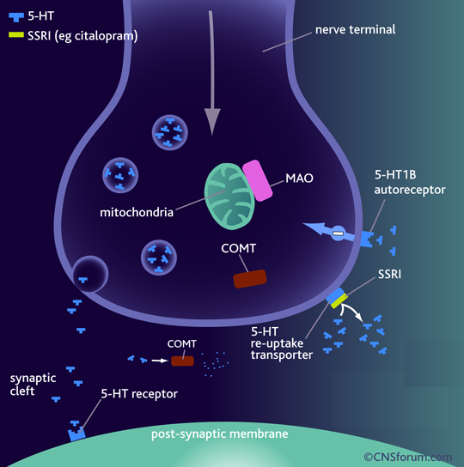
Fluoxetine
Fluvoxamine
Citalopram Sertraline
Paroxetine
Binds to SERT ➔  5-HT levels in synapse
No effect on NET
No block to mAch, H, or α₁ Adrenoceptor ➔ so no antimuscarinic nor sedative effects
They are nearly of comparable efficacy but of preferential response in each individual

Slide 5
Pharmacokinetics
t_{1/2} :
Too long (3-11 days): Fluoxetine (Prozac)
 Moderate length (~24hr): Sertraline, Paroxetine, Citalopram.
Metabolism: P450 then conjugation
They are enzyme inhibitors
 Weak inhibitors < Sertraline, Citalopram  interaction
 Strong inhibitors > Fluoxetine, Paroxetine  metabolism of TCA, neuroleptic, some antiarrhythmic, β-blockers.
Primarily excreted through kidney; not paroxetine & sertraline undergo partially fecal excretion.
Fluoxetine differs from others members of this class in :
1- It has a longer t_{1/2} (50hrs).
2- Available  as sustained release preparations once weekly.
3- Metabolite norfluoxetine = potent as parent drug t_{1/2} 10 days.

Slide 6
Clinical Indications
First choice for most depression. Comparable efficacy as TCAs but much safer < sedation & antimuscarinic side effects
< toxicity in over doses
Fluoxetine is approved in children, adolescence, elderly males with prostatic hypertrophy & relatively safe in pregnancy.
Used in:
Anxiety and panic disorders
Obsessive-compulsive disorders
Some eating disorders (bulimia)
Pain associated with diabetic neuropathy
Premature ejaculation
Premenstrual syndrome.
Alcohol abuse.
Anorexia nervosa.
Generalized anxiety disorder (GAD).

Slide 7
ADRs
Insomnia, anxiety, agitation, nervousness > fluoxetine > citalopram
 useful in fatigued patients
Sedation & lassitude > paroxetine, sertraline
 useful in patients with difficult sleep .
GIT upset ( nausea, vomiting, diarrhea) (indirect stimulation of 5-HT₃ receptors in the enteric nervous system )
Anorexia & weight loss
Impotence & sexual dysfunction; loss libido, delayed ejaculation (Indirect CNS stimulation of 5-HT₂)
 useful in patients who have premature ejaculation.
Mild CV & minimal antimuscarinc side effects unlike TCAs
Withdrawal manifestation < intensity than TCAs

Slide 8
Interactions
Serotonin Syndrome if combined with MAOIs > other ADDs
[Autonomic instability (changes in BP, pulse, hyperthermia), muscle rigidity, respiratory depression, mental confusion, shivering, sweating and diarrhea ]
Enzyme inhibitors  metabolism =  toxicity of TCA, neuroleptic, some antiarrhythmic, β-blockers.

Slide 9
Reuptake Inhibitors & Mixed Action Novel ADDs

Slide 10
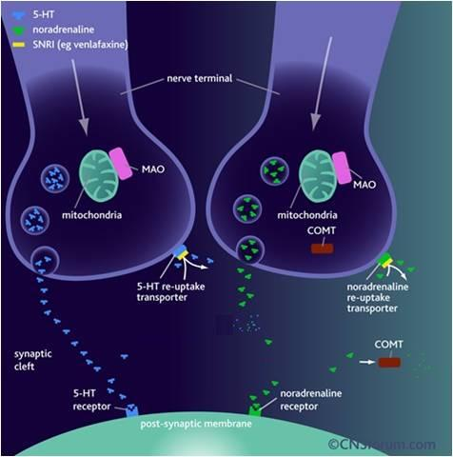
Serotonin Norepinephrine Reuptake Inhibitors [ SNRIs ]
Venalafaxine
Restore the levels of NE & 5HT in the synaptic cleft by binding to NET & SERT Has mild antimuscarinic effect
Short t_{1/2}
HR & BP
Side effects similar to SSRI drugs but may be withdrawal manifestations on discontin-uation  may need dosage tapering

Slide 11
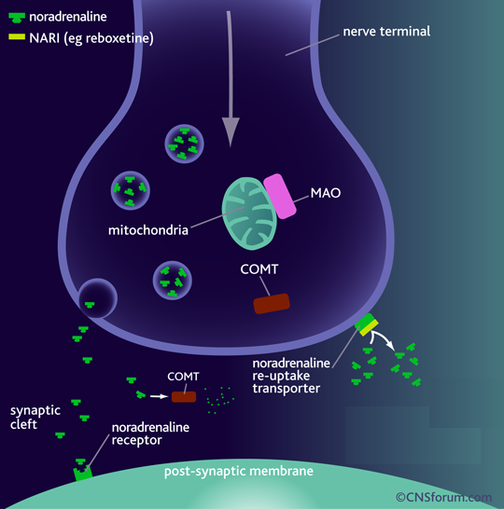
Norepinephrine Reuptake Inhibitors [ NRIs ]
Reboxetine
Block only NET
No affinity for 5HT, DA, ADR, H, mAch receptors
So, has positive effects on the concentration and motivation in particular.
Safe to combine with SSRIs
Minimal side effects only related to activation of ADR system as tremor, tachycardia, and urinary hesitancy

Slide 12
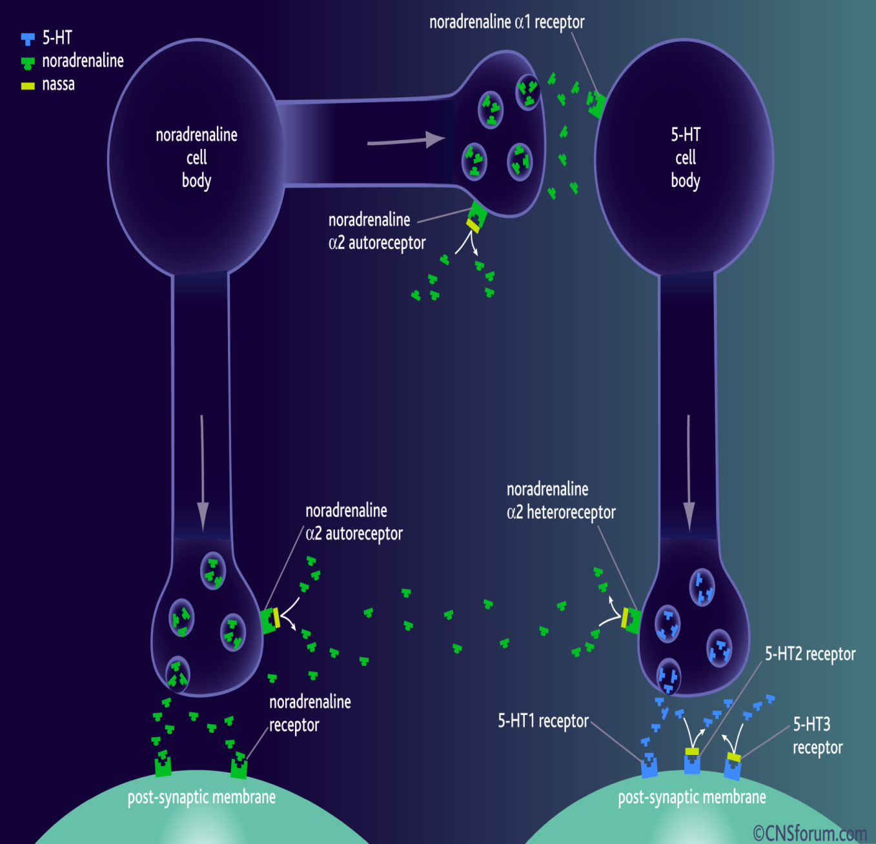
Noradrenergic & Specific Serotonergic Antidepressants [ NaSSAs ]
Mirtazapine
Blocks presynaptic α₂ adrenoceptors + 5HT₃ > 5HT₂ receptors
Preferred in cancer patients because:
1. Improves appetite
2- nausea & vomiting ( 5-HT₃ blocking)
3-  body weight
4- Sedation (potent antihistaminic)
5- Less sexual dysfunction (5-HT₂ blocking)
6- Has no anti-muscarinic effect .
Side effects; drowsiness, appetite, and weight gain.

Slide 13
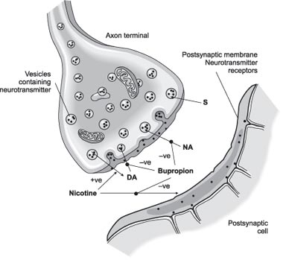
Norepinephrine Dopamine Reuptake Inhibitors (NDRIs)
Bupropion
Is unique in possessing significant potency as NE and DA reuptake inhibitor, with no direct action on 5HT. Acts as a nAch antagonist
Therapeutic uses:
1- Treatment of major depression and bipolar depression.
2- Can be used for smoking cessation.
As it reduces the severity of nicotine craving & withdrawal symptoms
Advantages: No sexual dysfunction given in young
No weight gain [ No 5HT effect ]
No orthostatic hypotension.
Side effects: Seizures; it  threshold of neuronal firing

Slide 14
Serotonin Antagonists & Reuptake Inhibitors (SARIs)
Trazodone
Nafazodone
Psychtropic drug Trazodone is its precursor
Weak block of SERT > NET
Block 5-HT₂
α- blocking effect ( hypotension) No
Potent H₁- blocker( sedation ) No
High protein bound
Extensive hepatic metab Inhibit Cyt450
Urine excretion
Cause priapism (α antagonisim ) Hepatic failure
Arrythmogenic

Slide 15
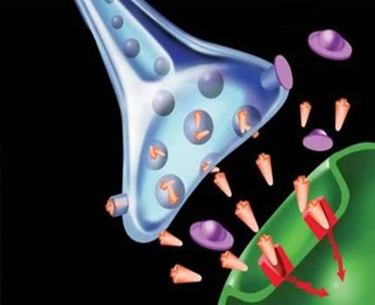
Augmenter drugs
Some antidepressants work better in some patients when used in combination with another drug.
This "augmenter" drugs include:
Buspirone
Antipsychotics; typical or atypical
Lithium; is used to augment ADDs in resistant unipolar depression
Trazadone, Nafazodone, Bupropion are sometimes included among augmenters but there use as such should be under strict clinical supervision

Slide 16
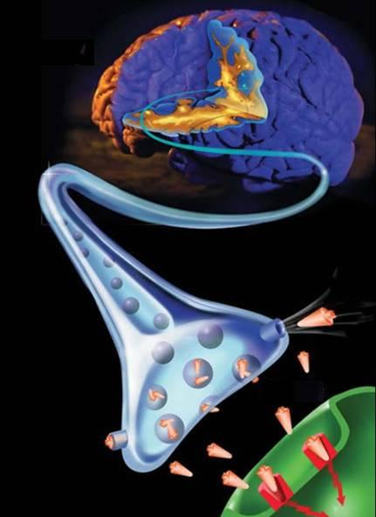
ANTIDEPRESSANTS
L
G
U
O
C
O
K
D
ANTIDEPRESSANTS

