Slide 1
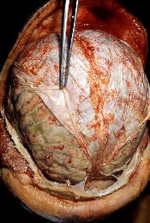
Meningitis

Slide 2
OBJECTIVES
Students should
Specify microorganisms causing meningitis
Delineate the therapeutic strategy
Classify the relevant antibiotics used
Expand on the pharmacokinetic and dynamic patterns of each antibiotic and specify its indications, contraindications& adverse effects.
List prophylactic measures taken against meningitis

Slide 3
Definition
Is an inflammation of the protective membranes covering the brain and the spinal cord .

Slide 4
Causes
Bacterial
Viral
Parasitic
Non-infectious as spread of cancer to meninges

Slide 5
Bacterial meningitis
IS A SERIOUS, LIFE –THREATING DISEASE THAT IS CAUSED BY AN INFECTION OF BACTERIA.

Slide 6
Microorganisms In BACTERIAL MENINGITIS
Neisseria meningitid-is
Haemophil-us influenzae
Streptococcus pneumoni-ae
Listeria monocyto-genes
Mycobacte-rium tuberculos-is

Slide 7
Route of transmission
The bacteria are carried by humans in the nose and throat and spread into the air by coughing and/ or sneezing. They can be picked by anyone .
The pathogens spread from the respiratory tract to the blood stream and to the nervous system and cause bacterial meningitis .

Slide 8
SYMPTOMS OF BACTRIAL MENINGITIS
FEVER
HEADACHE
STIFF NECK
IRRITABILITY
To light
NAUSEA & VOMITING

Slide 9
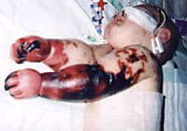
TREATMENT PRINCIPLES
Emergency hospitalization
Antibiotics
Measures for treatment of complications

Slide 10
Empiric antibiotics
Treatment without exact diagnosis ( antibiotics are given to a person before the specific microorganism causing an infection is known)
Empiric therapy may be changed after the culture sensitivity reports are avilable.
Antibiotic selected must reach the meninges in a adequate quantities.
Regimen chosen must have potent activity against known or suspected pathogens in a particular geographical place.

Slide 11
Inhibitors of cell wall synthesis (β-Lactam Antibiotics )
PENICILLINS
Cephalosporins
Carbapenems ( Imipenem )

Slide 12
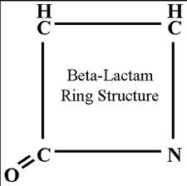

Slide 13
Penicillins Bactericidal antibiotics

Slide 14
Mechanism of action
Irreversibly inhibits transpeptidase enzyme that catalyze the final step in cell wall synthesis.
( Inhibits the synthesis of peptidoglycan layer of bacterial cell wall )

Slide 15
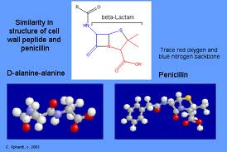

Slide 16
Extended Spectrum Penicillins
Amoxicillin
Ampicillin

Slide 17
Active against gram positive & gram negative microorganism.
Inactivated by β- lactamase enzyme, (now a days combination with B-lactamase inhibitors are available e.g Amoxicillin + Clavulanic acid and ampicillin + sulbactam, are more effective against B-lactamase producing pathogens) .
Amoxicillin and ampicillin are acid stable (effective orally )
Can also be given parenterally (I.V or I.M)
Amoxicillin is better absorbed from the gut & not affected by food.

Slide 18
Narrow Spectrum Penicillin
Penicillin G
Narrow spectrum
Destroyed by gastric acidity
Inactivated by β- lactamase
Short acting ( 4-6 hrs )

Slide 19
Adverse effects of penicillins
Hypersen-sitivity
Diarrhea
Nephritis
Neurotoxi-city

Slide 20
Cephalosporins
Bactericidal Antibiotics

Slide 21
Cephalosporins ( cont.)
3rd generation
Ceftriaxone
Ceftazidime
Ceftriaxone

Slide 22
Mechanism of action
Inhibits bacterial cell wall synthesis

Slide 23
Bacterial Spectrum of 3rd Generation Cephalosporins
Highly effective against Gm –ve bacilli
Anaerobic microbes
Pseudomonas ( ceftazidime)
Highly resistant to β- lactamase

Slide 24
Ceftazidime & Ceftriaxone
Both of them are given by intravenous injection
Ceftriaxone is excreted mainly through the biliary tract

Slide 25
Effective in Gm-ve meningitis

Slide 26
Adverse effects
Allergy
Thrombophl-ebitis
Renal toxicity
Superinfect-ions

Slide 27
Carbapenems
Imipenem
Bctericidal, inhibit bacterial cell wall synthesis.
Has a wide spectrum of activity
Resistant to most β lactamases except metallo-β lactamase .

Slide 28
Pharmacokinetics
Not absorbed orally, taken by I.V.I.
Inactivated by dehydropeptidases in renal tubules, so it is given with an inhibitor cilastatin for clinical use.
Penetrates body tissues and fluids including C.S.F.

Slide 29
Adverse effects
Nausea, vomiting, diarrhea
Skin rash and reaction at the site of infusion
High doses in patients with renal failure may lead to seizures
Patients allergic to penicillins may be allergic to carbapenems .

Slide 30
Other inhibitor of cell wall synthesis

Slide 31
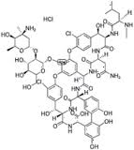
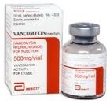

Slide 32
Vancomycin
Bactericidal
Cell wall inhibitor
Poorly absorbed orally
Used orally to treat GIT infections caused by clostridium defficile e.g colitis.
Given intravenously

Slide 33
Vancomycin
Active only against Gm+ve bacteria
Used in combination with3rd generation cephalosporins for treatment of meningitis caused by penicillin resistant pneumococci.
Good drugs used against Methicillin resistant S. aureus (MRSA).
May be combined with ampicillin or ceftazidime as an initial therapy of meningitis in infant, elderly and immunocompromised patients .

Slide 34
Adverse Effects (vancomycin is more toxic drug , used only when the infection is resistant to other safer drugs)
Phlebitis
Ototoxicity Toxicity increase with aminoglycosides
Nephrotoxicity
Histamine release [red man ( red neck ) syndrome] (flushing and hypotension), minimized if injected slowly.
Hypotension

Slide 35
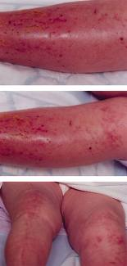

Slide 36
Fluoroquinolones
Bactericidal drugs

Slide 37
Mechanism of action
Block bacterial DNA synthesis by inhibiting
bacterial topoisomerase 11( DNA gyrase )
& topoisomerase1V

Slide 38
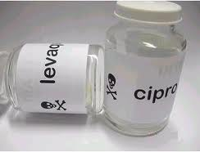
e.g. Ciprofloxacin

Slide 39
Bacterial Spectrum
Effective against :Gm-ve organisms
Limited activity :against Gm+ve organisms
Effective against :intracellular pathogens such as: Legionella, Chlamydia, some mycobacteriae

Slide 40
Pharmacokinetics
Well absorbed orally
Absorption is impaired by divalent cations ; iron, zinc or those in antacids as aluminium, magnesium
Half-life 3hrs

Slide 41
Pharmacokinetics
Widely distributed in body fluids & tissues
Penetrates into CSF
Highly concentrated in bone, kidney, prostate, lung
Excreted through kidney & appear in breast milk

Slide 42
Adverse effects
GIT upset
CNS
Headache , dizziness, insomnia
Abnormal liver function tests
Skin rash & photosensitivity

Slide 43
Adverse effects
Cartilage damage ( arthropathy)
Tendon damage ( tendinitis )
Enzyme inhibitor

Slide 44
Contraindications
Growing children ( below 18 years )
Pregnancy
Lactation
History of epilepsy or CNS disorder

Slide 45
Preventtion better than cure
Haemophilus influenzae type b (Hib) bacterium, a leading cause of bacterial meningitis in children.
New Hib vaccines — available as part of the routine childhood immunization schedule have greatly reduced cases of this type of meningitis.
Pneumococcal polysaccharide vaccine (PPSV) for older children and adults
Meningococcal conjugate vaccine , also a requirement for people going to Hajj.

