Slide 1
Spasticity and Increased Muscle Tone Prof/Faten zakareia Physiology Department , College of Medicine , King Saud University , Riyadh, KSU

Slide 2
Increased Gamma efferent discharge is the main cause of increased muscle tone. how?

Slide 3
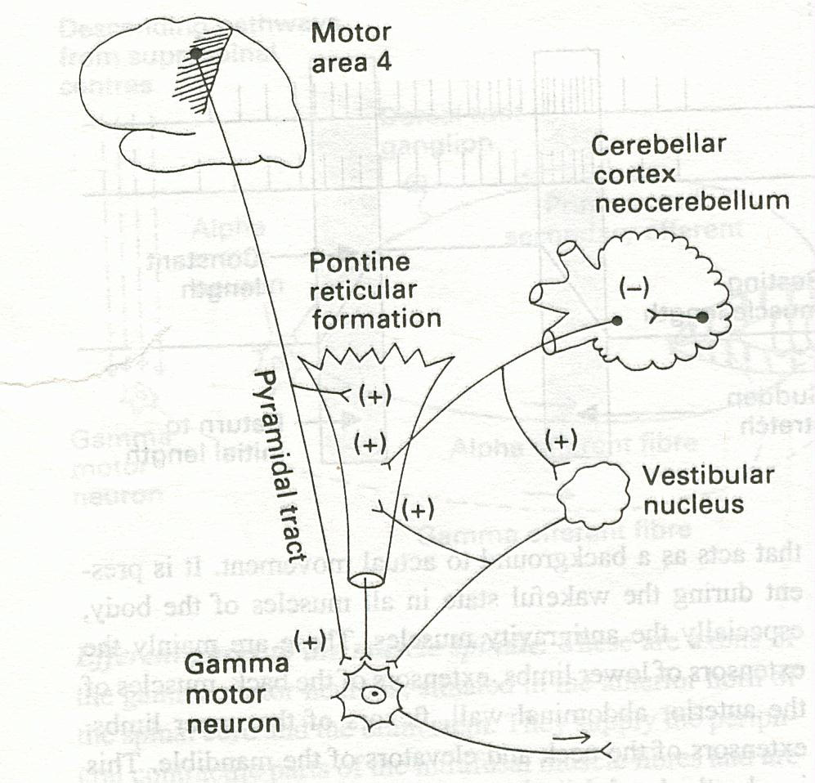
Facilitatory supra spinal centers to gamma motor neurons

Slide 4
-Spasticity (hypertonia) is a feature of altered muscle performance -occurring in disorders of the central nervous system which give rise to the Upper Motor Neuron Syndrome (UMNS ). - Spasticity can be defined as increased resistance to passive stretch. -Patients complain of stiffness & inability to relax

Slide 5
- Spasticity is a motor disorder, characterised by:- 1- increase in tonic static stretch reflexes (muscle tone) as one component of the upper motor neurone (UMN) syndrome 2- Exaggerated tendon jerks, resulting from hyper-excitability of the dynamic stretch reflex as one component of the upper motor neurone (UMN) syndrome

Slide 6
nantagonised
Features of UMN Syndrome
(1) Weakness and decreased muscle control .
(2) No remarkable muscle wasting , but disuse atrophy
(3) Spasticity ( hypertonia ) , frequently called
“ clasp-knife spasticity ”= increased resistance at the begining of muscle stretch due to increased extensor muscle tone then a sudden collapse in resistance due to inhibition of extensor motor neurons by GTOs (golgi tendon organs)
(4) Clonus Repetitive jerky motions (clonus), especially when limb moved & stretched suddenly
(5) Exaggerated tendon jerks
(6) Extensor plantar reflex = Babinski sign ( dorsiflexion of the big toe and fanning out of the other toes )
(7) Absent abdominal reflexes

Slide 7
- In UMN syndrome the motoneurones are free from the descending inhibitory influence of the Higher Motor-inhibitory centers(which centers?) resulting in unantagonized excitatory input ( from which centers?) to gamma motoneurones causing hypertonia &pasticity

Slide 8
Causes of spasticity:- A-(UMNS) syndrome include : • (1) Cerebral palsy • (2) Stroke • (3) Spinal cord injury • (4) Multiple Sclerosis • (5) Acqiured brain injury ( trauma , etc ) B-Parkinsonism C- Decerebrate & decorticate rigidity

Slide 9
• (1) Cerebral palsy -Caused by brain damage due to lack of oxygen, as (near drowning or near suffocation ) that cause damage to the motor control centres of the developing brain - it can occur during pregnancy , during stressed childbirth ( or after birth up to about age three by meningitis)

Slide 10
(2) Multiple Sclerosis - is an auto-immune demyelinating disease , in which the body's own immune system attacks and damages the myelin sheath of myelinated nerves mainly of brain, SC ,and optic nerve • Loss of myelin sheath (demyelination) prevents axons from saltatory conduction of action potentials causing muscle weakness& wasting. • Disease onset usually occurs in young adults, and it is more common in females . • The disease can attack any part of the CNS , and when it causes demyelination, the subject develops spasticity and other signs of UMNS . • The disease frequently remits and relapses because of remylination & restore of function

Slide 11
3-STROKE:-Causes : • a-Haemorrhagic stroke as in cerebral hemorrhage b- Ischaemic stroke as in thrombosis or embolism in brain bl.v -Both cause death of brain tissues→ results in paralysis in the opposite half of the body . • A lesion in Corona Radiata on one side can cause Monoplegia in a contralateral limb (UL or LL , according to site). • A lesion in the Internal Capsule on one side may cause Hemiplegia or Hemiparesis on the contralateral side • with the picture of upper motor neuron syndrome UMNL .

Slide 12
4-Complete transection of spinal cord:- e.g. following tumor or trauma . •1- If the transection is in the upper cervical region immediate death follows. Why? •2- In the lower cervical region below the 5th cervical segment diaphragmatic respiration is still possible, but the patient suffers of (quadriplegia). • 3-Transection lower down in the thoracic region allows normal respiration but the patient ends up with (paraplegia)--

Slide 13
Stages :- A/ Spinal shock ( 2-6 weeks ) B/ Recovery of reflex activity C/ Paraplegia in extension A/ Spinal shock In the immediate period following transection there is : (1) Loss of all sensations (anaesthesia) and voluntary movement ( paralysis) below the level of the lesion (3) Loss of tendon reflexes and superficial reflexes. (5) The loss of muscle tone (flaccidity) and absence of any muscle activity (muscle pump )

Slide 14
(6) The wall of the urinary bladder becomes paralysed and urine is retained until the pressure in the bladder overcomes the resistance offered by the tone of the sphincters and dribbling occurs. This is known as (retention with overflow). (7)Loss of vasomotor tone &vasodilatation causes a fall in blood pressure; -This stage varies in duration but usually lasts a maximum of 2-6 weeks, after which some reflex activity recovers.

Slide 15
B/ Stage of return of reflex activity • As the spinal shock ends , spinal reflex activity appears again this partial recovery may be due to:- - increase in degree of excitability of the spinal cord neurons below the level of the section , due to :_ 1-disinhibition of motoneurons as a result of absence of inhibitory impulses from higher motor centres -sprouting of fibres from remaining neurons -supersensitivity to excitatory neurotransmitters . • Features of the stage of recovery of reflex activity • (1) Gradual rise of arterial blood pressure due to return of spinal vasomotor activity in the lateral horn cells. - vasoconstrictor tone in arterioles and venules

Slide 16
2) Return of spinal reflexes: - Flexor tendon reflexes return earlier than extensor ones. -Babiniski sign - Flexor spastic tone & paraplegia in flexion. - (2) Recovery of visceral reflexes: return of micturition, defecation & erection reflexes. - However , voluntary control over micturition and defecation , and the sensation of bladder and rectal fullness are permanently lost .( AUTOMATIC MICTURITION)

Slide 17
• (5) Mass reflex appears in this stage → • A minor painful stimulus to the skin of the lower limbs will not only cause withdrawal of that limb but will evoke many other reflexes through spread of excitation (by irradiation) to many autonomic centres. So the bladder and rectum will also empty, the skin will sweat, the blood pressure will rise -Voluntary movements and sensations are permanently lost;
-

Slide 18
• C/ Stage of extensor paraplegia • (1) During this stage the tone in extensor muscles returns gradually to exceed that in the flexors. The -Extensor reflexes become exaggerated, as shown by tendon jerks and by the appearance of clonus. -The positive supportive reaction becomes well developed and the patient can stand on his feet with appropriate support. • (2) The flexor withdrawal reflex which appeared in the earlier stage is associated during this stage with the crossed extensor reflex.

Slide 19
Hemisection of the Spinal Cord ( Brown-Sequard syndrome)

Slide 20
• Occurs as a result of unilateral lesion or hemisection of the spinal cord ( e.g. due to stab injury, bullet , car accident,or tumor ). On the same side at the level of lesion 1.Paralysis of the lower motor neuron type,. 3. Loss of all sensations in the areas supplied by the afferent fibres that enter the spinal cord in the damaged segments +/- band of hyperesthesia

Slide 21
B/ Ipsilaterally below the level of the lesion : 1. UMNL/spastic lower limb (spasticity)&CLONUS 2. Fine touch, two-point discrimination, position and vibration sense are lost. why? C/ Contralaterally below the level of the lesion : Pain and temperature sensations are lost, Why ?

Slide 22
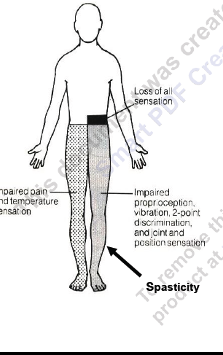

Slide 23
B-Parkinsonism rigidity is of two types:- -Cog-wheel rigidity -Lead-pipe rigidity
C- Decerebrate & decorticate rigidity

