Slide 2
The Autonomic Nervous System
Autonomic Nervous System
Assess Prof. Fawzia Al-Rouq
Department of Physiology
College of Medicine
King Saud University

Slide 3
LECTUR (1)
Functional Anatomy & Physiology of Autonomic NS

Slide 4
INTRODUCTION

Slide 5
THE NERVOUS SYSTEM
INTRODUCTION
The nervous system monitors and controls almost every organ / system through a series of positive and negative feedback loops.
The Central Nervous System (CNS): Includes the brain and spinal cord.
The Peripheral Nervous System (PNS): Formed by neurons & their process present in all the regions of the body.
It consists of cranial nerves arises from the brain & spinal nerves arising from the spinal cord.
The peripheral NS is divided into
Somatic Nervous system
Autonomic nervous system

Slide 6
OBJECTIVES

Slide 7
Anatomy and physiology of Autonomic Nervous System
At the end of this lectutre (1)the student should be able to:-
-appreciate the anatomy of symathetic& parasympathetic nervous system.
-explain physiological functions of Symathetic &parasympathetic nerves in head&neck,chest,abdomen and pelvis

Slide 8
FUNCTIONAL ANATOMY OF THE AUTONOMIC NERVOUS SYSTEM

Slide 9
Basic anatomical difference between the motor pathways of the voluntary somatic nervous system (to skeletal muscles) and those of the autonomic nervous system
Somatic division:
Cell bodies of motor neurons reside in CNS (brain or spinal cord)
Their axons (sheathed in spinal nerves) extend all the way to their skeletal muscles
Autonomic system: chains of two motor neurons
1st = preganglionic neuron (in brain or cord)
2nd = gangionic neuron (cell body in ganglion outside CNS)
Slower because lightly or unmyelinated

Slide 10
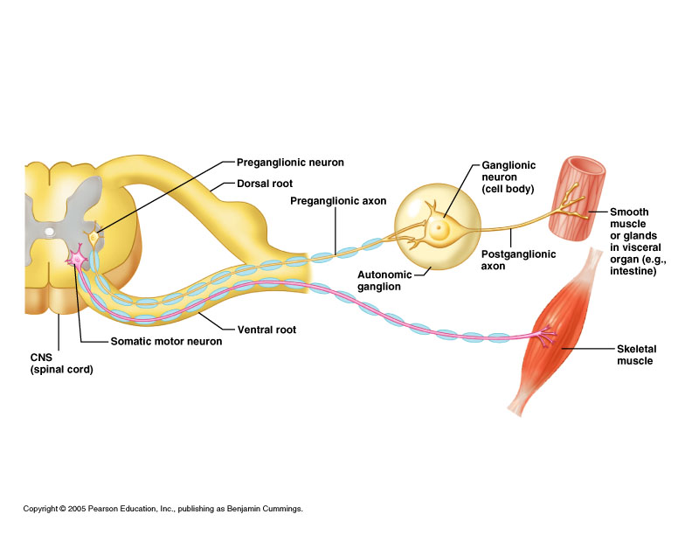
Basic anatomical difference between the motor pathways of the voluntary somatic nervous system (to skeletal muscles) and those of the autonomic nervous system

Slide 11
The Autonomic Nervous System
The Autonomic Nervous System 1.Visceral sensory
2.Visceral motor

Slide 12
ANS is the subdivision of the peripheral nervous system that regulates body activities that are generally not under conscious control
Visceral motor innervates non-skeletal (non-somatic) muscles
Composed of a special group of neurons serving:
Cardiac muscle (the heart)
Smooth muscle (walls of viscera and blood vessels)
Internal organs
Skin

Slide 13
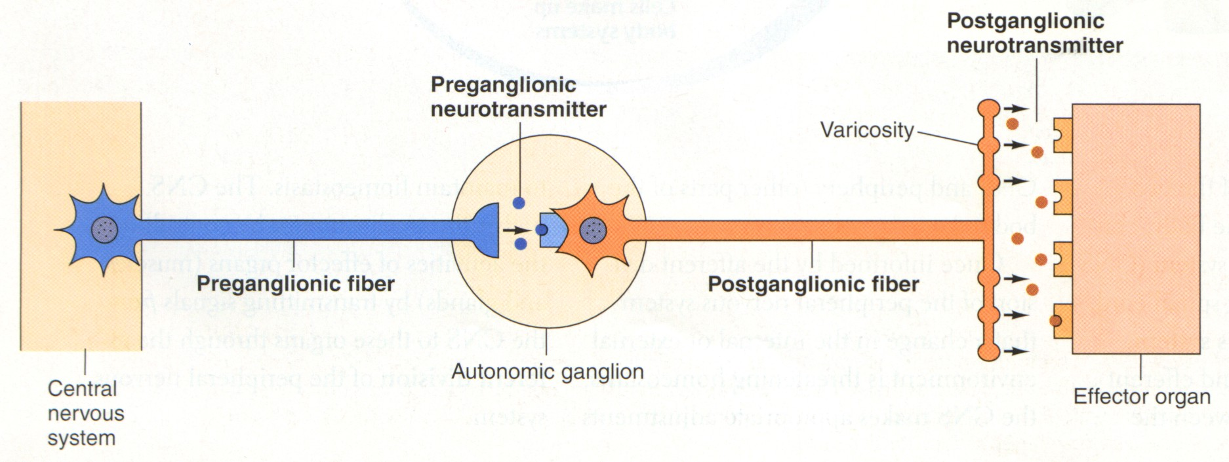
Axon of 1st (preganglionic) neuron leaves CNS to synapse with the 2nd (ganglionic) neuron
Axon of 2nd (ganglionic) neuron extends to the organ it serves
this dorsal root ganglion is sensory

Slide 14
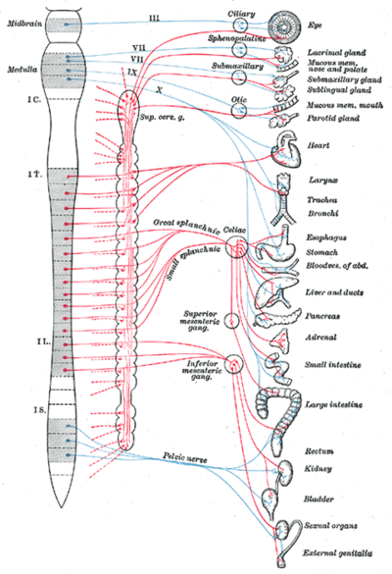
Overview of actions
LOCATIONS OF AUTONOMIC GANGLIA
Sympathetic Ganglia:
Trunk (chain) ganglia near vertebral bodies
Prevertebral ganglia near large blood vessel in gut :celiac ,superior mesenteric &
inferior mesenteric

Slide 15
Parasympathetic Ganglia:
Terminal ganglia in the wall of organ

Slide 16
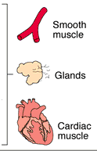
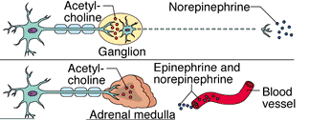
Sympathetic Innervation of Visceral Targets
Short, lightly myelinated preganglionic neurons
Long, unmyelinated postganglionic neurons
Ganglia close to spinal cord
Spinal Cord
Notes:
The target organs whose activities are regulated by the ANS are innervated by two neurons in tandem which synapse in ganglia * between the Central Nervous system and the target organ. The first ( preganglionic neuron) arises from the CNS * and carries information to the ganglion, * while the second carries information from the ganglion to the target organ (postganglionic neuron). *
The particular arrangement of these neurons that is characteristic of the Sympathetic division, includes a short, lightly myelinated preganglionic neuron and a much longer, unmyelinated postganglionic neuron which reaches from the ganglion to the target organ. Since the preganglionic neurons are short, the ganglia in which the sympathetic neurons synapse are located very close to the spinal cord itself. * Thus the innervation of visceral targets in the sympathetic division include a short preganglionic neuron, a ganglion that is close to the spinal cord and a much longer postganglionic neuron that reaches out to the target organ. *

Slide 17
Parasympathetic Innervation of Visceral Targets
Ganglia close to or on target organs
Preganglionic neurons - long
Post ganglionic neurons - short
Notes:
The Parasympathetic division of the ANS is characterized having the ganglia * very close to or on the target organs. * As a result, the preganglionic neurons * must be long to reach from the spinal cord to the ganglia. The postganglionic neurons * are relatively short, since they only must reach from the ganglia to the target organ the ganglia are already near or on. *

Slide 18
SYMPATHETIC & PARASYMPATHETIC NERVOUS SYSTEM ORIGIN
Blue= Para symp; Red symp

Slide 19
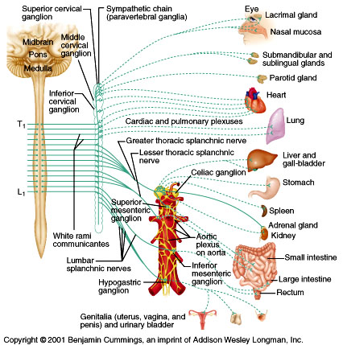
Sympathetic - Origin
Thoracolumbar lateral horns of the spinal segments T1-L2.
Nerve fibers originate between T1 & L2
Notes:
The Sympathetic division of the ANS is sometimes referred to as the “thoracolumbar” branch * because its nerve fibers * arise from the central nervous system (spinal chord) between the first thoracic and the second lumbar vertebrae. * *

Slide 20
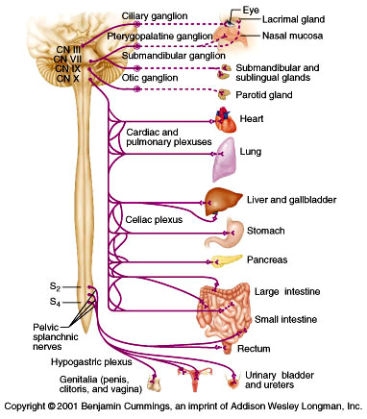
Parasympathetic - Origin
Craniosacral Cell bodies of the motor nuclei of the cranial nerves III, VII, IX and X in the brain stem
Second, third and fourth [S2-S4] sacral segments of the spinal cord
Nerve fibers emerge from brain &
sacrum cranio-sacral outflow
Notes:
The Parasympathetic division of the ANS is sometimes referred to as the “craniosacral” division because its nerve fibers arise from the Central Nervous System directly from the brain in the cranium * and from spinal chord between the sacral vertebrae. *

Slide 21
PARASYMPATHETIC NERVOUS SYSTEM
The cranial nerves III, VII and IX affect the pupil and salivary gland secretion
Vagus nerve (X) carries fibres to the heart, lungs, stomach, upper intestine and ureter
The sacral fibres form pelvic plexuses which innervate the distal colon, rectum, bladder and reproductive organs.

Slide 22
PHYSIOLOGICAL FUNCTIONS OF THE AUTONOMIC NERVOUS SYSTEM

Slide 23
SYMPATHETIC NERVOUS SYSTEM FUNCTIONS
FEAR, FLIGHT OR FIGHT
The sympathetic system enables the body to be prepared for fear, flight or fight
Sympathetic responses include an increase in heart rate, blood pressure and cardiac output
Diversion of blood flow from the skin and splanchnic vessels to those supplying skeletal muscle
Increased pupil size, bronchiolar dilation, contraction of sphincters and metabolic changes such as the mobilisation of fat and glycogen.
Notes:
23

Slide 24
FUNCTIONS OF SYMPATHETIC NERVOUS SYSTEM
Bronchioles dilate, which allows for greater alveolar oxygen exchange.
It increases heart rate and the contractility of cardiac cells (myocytes), thereby providing a mechanism for the enhanced blood flow to skeletal muscles.
Sympathetic nerves dilate the pupil and relax the lens, allowing more light to enter the eye.
Notes:
24

Slide 25
PARASYMPATHETIC NERVOUS SYSTEM FUNCTIONS
The parasympathetic nervous system has "rest and digest" activity.
In physiological terms, the parasympathetic system is concerned with conservation and restoration of energy, as it causes a reduction in heart rate and blood pressure, and facilitates digestion and absorption of nutrients, and consequently the excretion of waste products
The chemical transmitter at both pre and postganglionic synapses in the parasympathetic system is Acetylcholine (Ach).
Notes:
25

Slide 27
THE AUTONOMIC
NERVOUS SYSTEM
Subdivision | Nerves Employed | Location of Ganglia | Chemical Messenger | General Function
Sympathetic | Thoracolumbar | Alongside vertebral column | Norepinephrine | Fight or flight
Parasympathetic | Craniosacral | On or near an effector organ | Acetylcholine | Conservation of body energy

Slide 28
PHYSIOLOGICAL FUNCTIONS OF THE AUTONOMIC NERVOUS SYSTEM

Slide 29
The Autonomic Nervous System
Structure | Sympathetic Stimulation | Parasympathetic Stimulation
Iris (eye muscle) | Pupil dilation | Pupil constriction
Salivary Glands | Saliva production reduced | Saliva production increased
Oral/Nasal Mucosa | Mucus production reduced | Mucus production increased
Heart | Heart rate and force increased | Heart rate and force decreased
Lung | Bronchial muscle relaxed | Bronchial muscle contracted

Slide 30
The Autonomic Nervous System
Structure | Sympathetic Stimulation | Parasympathetic Stimulation
Stomach | Peristalsis reduced | Gastric juice secreted; motility increased
Small Intes | Motility reduced | Digestion increased
Large Intes | Motility reduced | Secretions and motility increased
Liver | Increased conversion of glycogen to glucose
Kidney | Decreased urine secretion | Increased urine secretion
Adrenal medulla | Norepinephrine and epinephrine secreted
Bladder | Wall relaxed Sphincter closed | Wall contracted Sphincter relaxed
Notes:
30

Slide 31
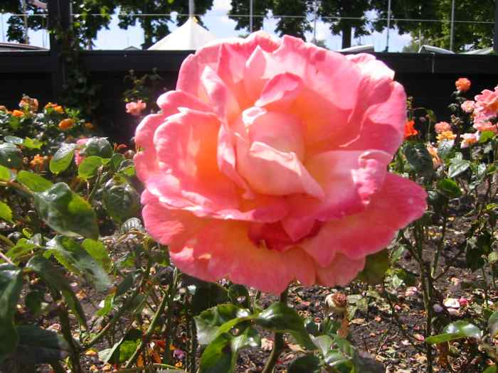
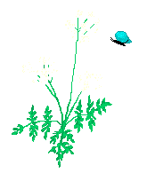
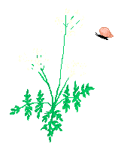
THANK YOU

