Slide 1
Organization of The Nervous System
PROF. SAEED ABUEL MAKAREM

Slide 2
Objectives
At the end of the lecture, the students should be able to:
List the parts of the nervous system.
List the function of the nervous system.
Describe the Structural & Functional Organizations.
Define the terms:
Nervous tissue, grey matter, white matter, nucleus, ganglion, tract, nerve.
List the parts of the brain.
List the structures protecting the central nervous system.

Slide 3
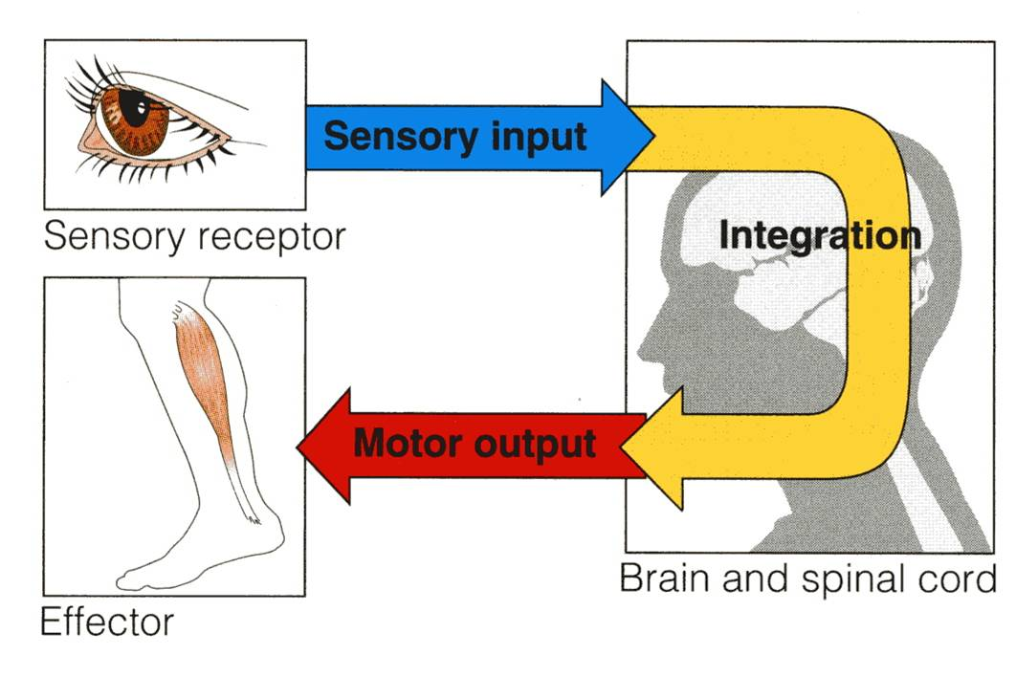
How does the nervous system work ?
INTRODUCTION
The nervous system has three functions:
Collection of sensory input:
Identifies changes occurring inside or outside the body by using sensory receptors. These changes are called stimuli.
Integration:
Processes, analyzes and interprets these changes and makes decisions.
Motor output, or response by activating muscles or glands (effectors).

Slide 4
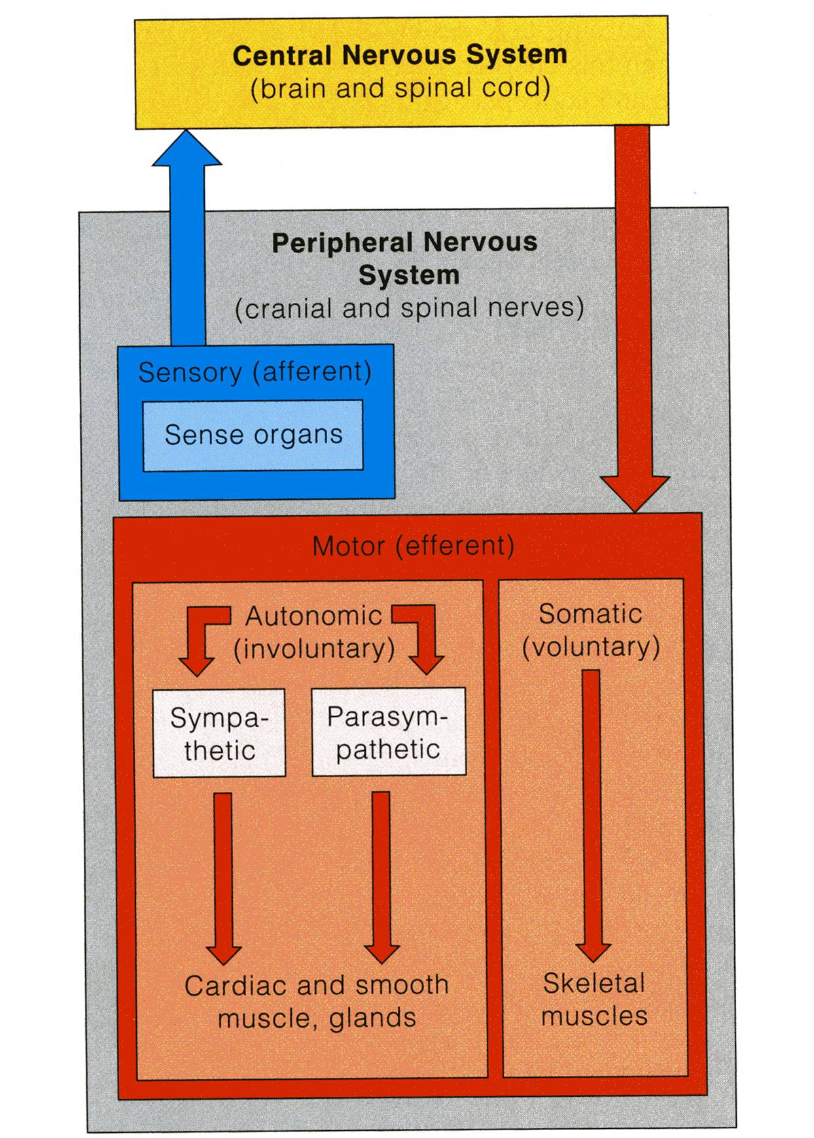
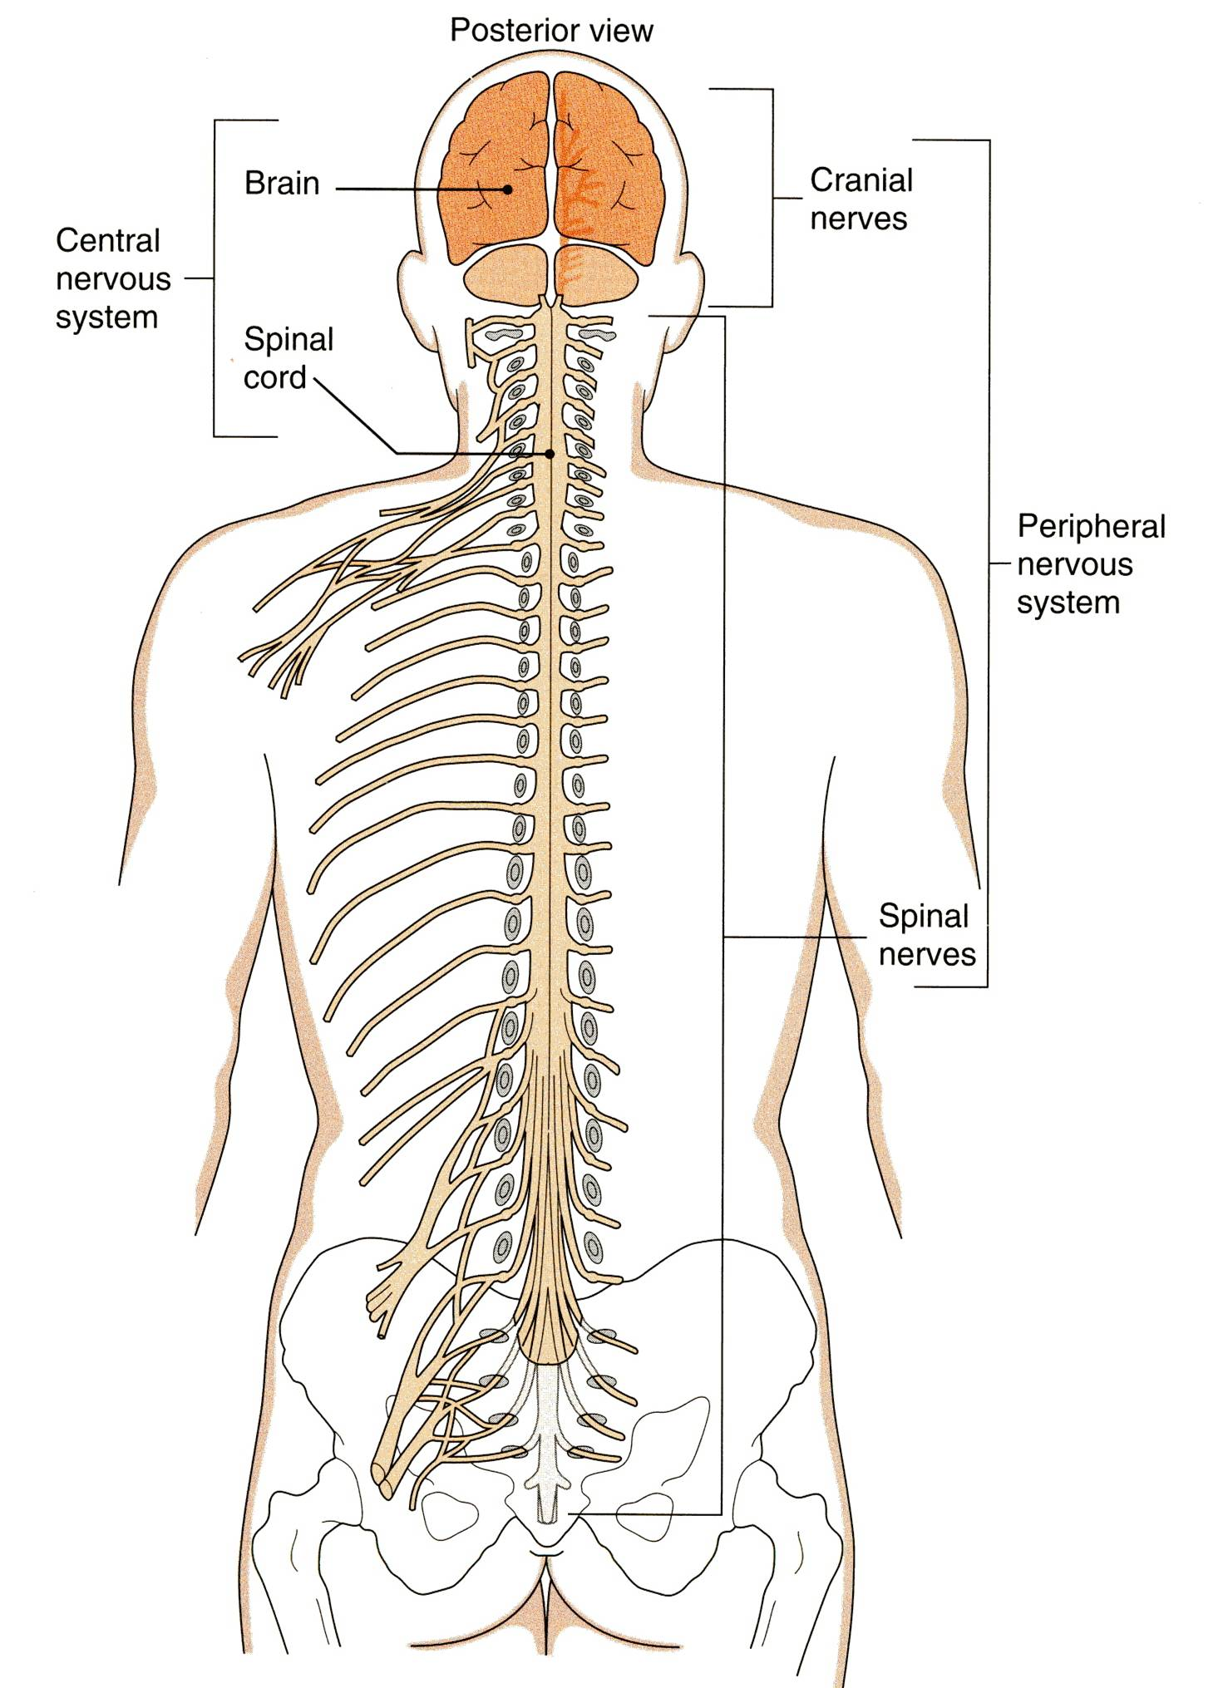
CLASSIFICATION
I- Anatomical or structural classification:
1- Central NS
2- Peripheral NS
II- Physiological or functional classification:
1-Sensory division (Afferent)
2-Motor division (Efferent)
Autonomic
Somatic

Slide 5
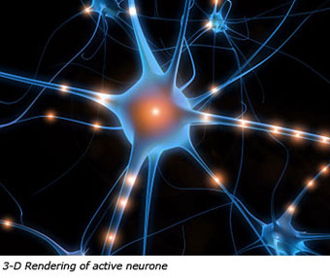
The Nervous System
It is the major controlling, regulatory & communicating system in the body.
It is the center of all mental activity including:
Thought,
Learning,
Behavior and
Memory.
Together with the endocrine system, the nervous system is responsible for regulating and maintaining homeostasis.

Slide 6
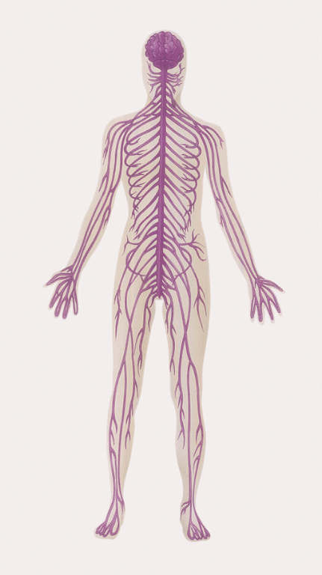
Structural Organization
Two subdivisions:
Central Nervous System (CNS)
Consists of Brain & Spinal cord
Occupies the dorsal body cavity
Acts as the integrating and command centers.
Peripheral Nervous System (PNS)
Consists of nerves, ganglia, receptors.
It is the part of the nervous system outside the CNS.

Slide 7
Functional Organization
Two subdivisions:
Sensory or afferent division:
Consists of nerve fibers that convey impulses from receptors located in various parts of the body, to the CNS.
Motor or efferent division:
Consists of nerve fibers that convey impulses from the CNS to the effector organs, muscles and glands.
Both sensory and motor subdivisions are further divided into:
Somatic division: concerned with skin, skeletal muscles and joints.
Autonomic division: concerned with the visceral organs.

Slide 8
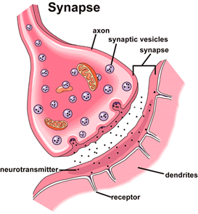
Nervous Tissue
Nervous system is composed of nervous tissue, which contains two types of cells:
1- Nerve cells or neurons
2- Supporting cells or neuroglia (glia).
Nervous system contains millions of neurons that vary in their shape, size, and number of processes.
The junction site of two neurons is called a “synapse or relay”.
In the synapses the membranes of adjacent cells are in close apposition (contiguity=contact, not continuity).

Slide 9
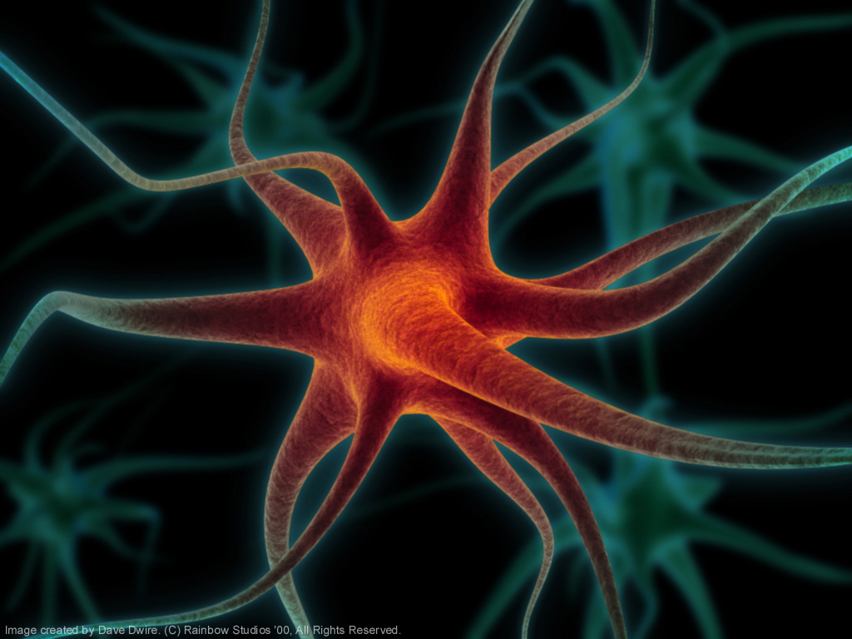
Neurons
What is neurone?
It is the basic structural (anatomical), functional and embryological unit of the nervous system.
The human nervous system is estimated to contain about 10¹⁰.

Slide 10
Nervous tissue is organized as:
Grey matter, Which contains 1- Cell bodies &
2- Processes of the neurons,
3- Neuroglia and
4- Blood vessels.
White matter, Which contains:
1- Processes of the neurons
2- Neuroglia and
3- Blood vessels
NO cell bodies in the white matter.

Slide 11
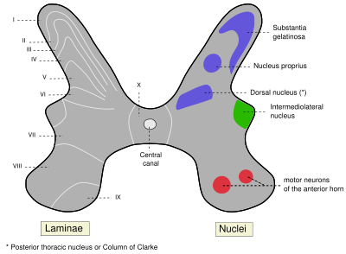
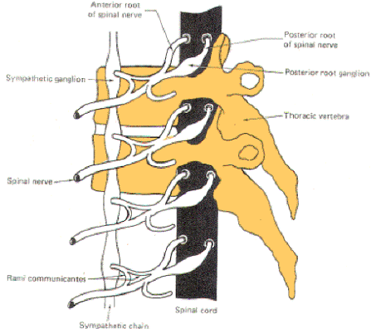
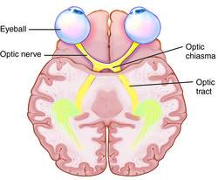
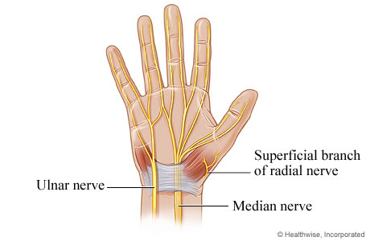
Ganglion= A group of neurons outside the CNS
Nucleus= A group of neurons within the CNS
Remember…
Tract =A group of nerve fibers (axons) within the CNS
Nerve =A group of nerve fibers (axons) outside the CNS

Slide 12
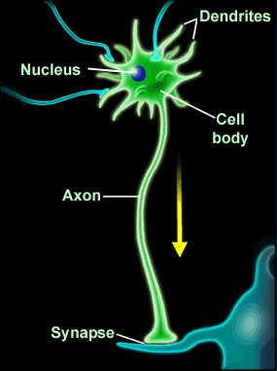
Most of the processes of the cell body are short with variable numbers and are receptive in function.
They are known as Dendrites.

Slide 13
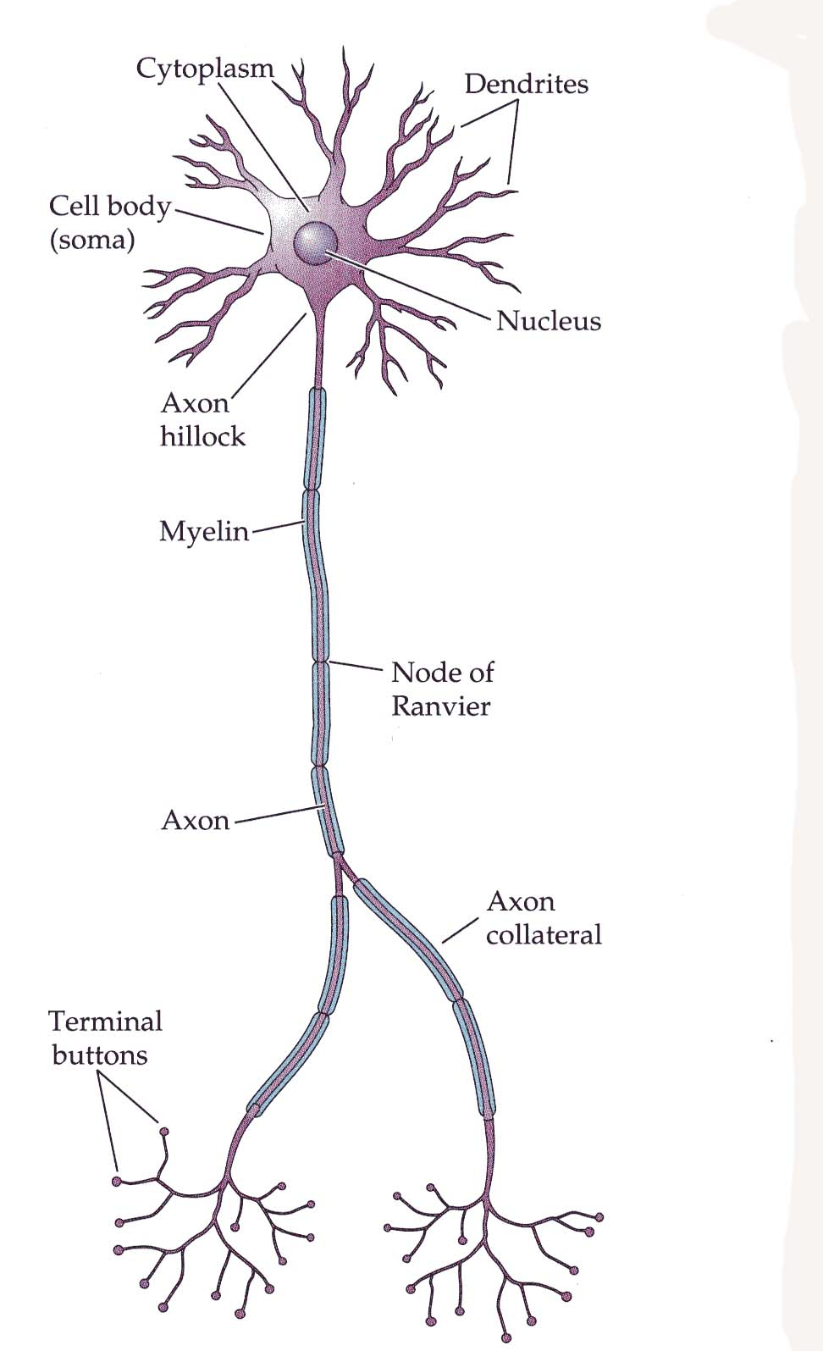
One of these processes leaving the cell body is called the axon which carries information away from the cell body.
Axons are highly variable in length and may divide into several branches or collaterals through which information can be distributed to a number of different destinations.
At the end of the axon, specializations called terminal buttons occur.
Here information is transferred to the dendrites of other neurones.

Slide 14
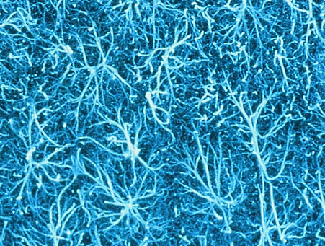
Neuroglia or glia or glial cells
Neuroglia, or glia cells constitute the other major cellular component of the nervous tissue.
It is a specialized connective tissue supporting framework for the nervous system.
Unlike neurones, neuroglia do not have a direct role in information processing but they are essential for the normal functioning of the neuron.

Slide 15
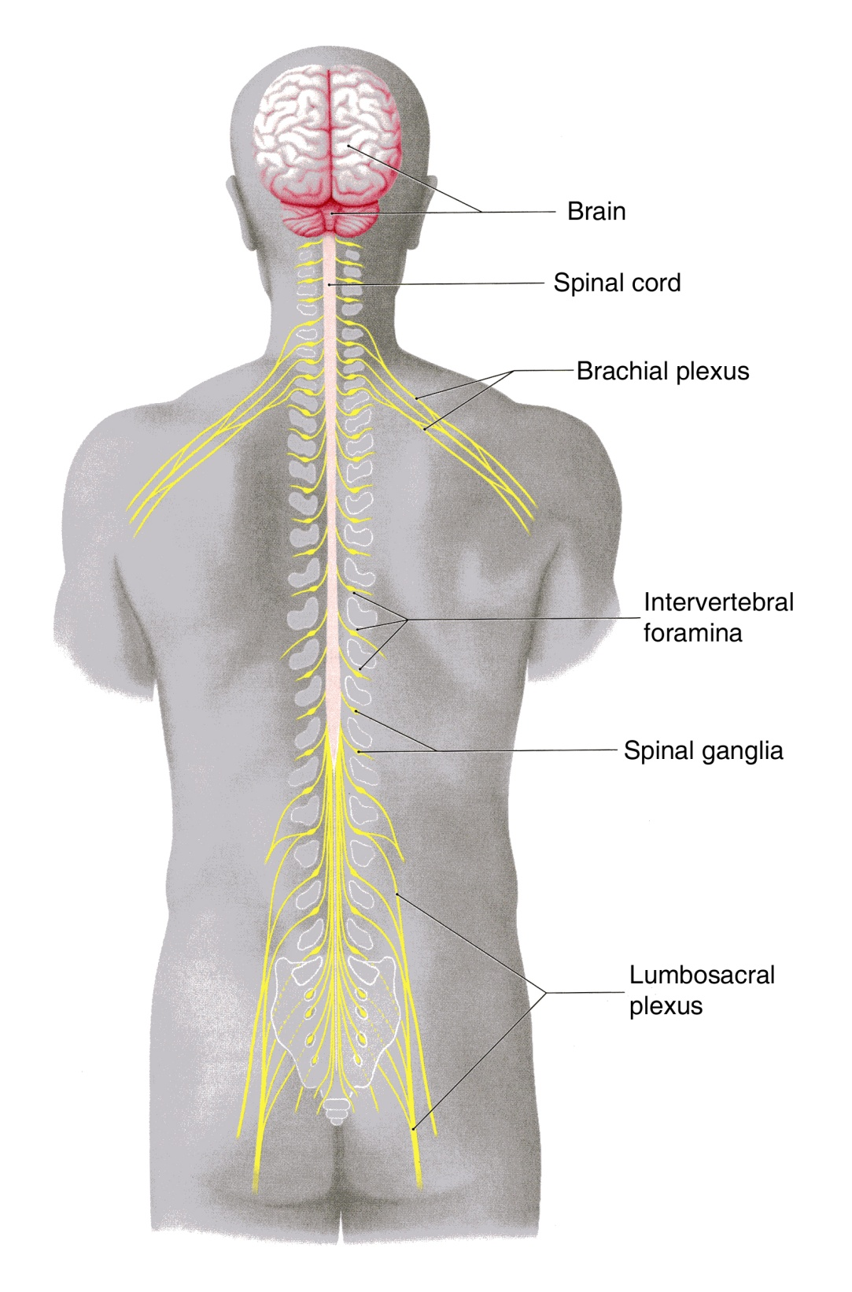
Spinal nerves supplying the upper or lower limbs form plexuses e.g. brachial or lumbar plexus.
Nerve cell bodies that are aggregated outside the CNS are called GANGLIA

Slide 16
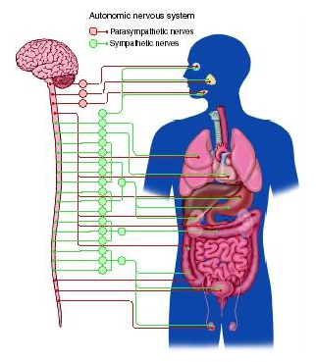
Autonomic Nervous System
Neurones that detect changes and control the activity of the viscera are collectively referred to as the autonomic nervous system.
Its components are present in both the central and peripheral nervous systems.

Slide 17
SYMPATHETIC & PARASYMPATHETIC SYSTEMS
The autonomic nervous system is divided into two anatomically and functionally distinct parts:
Sympathetic: Or
Thoracolumbar outflow
Parasympathetic: Or
Craniosacral outflow.
Sympathetic and parasympathetic , divisions are generally have antagonistic effects on the structures that they innervate.
E.g. Sympathetic increases the heart rate, while the parasympathetic decreases the heart rate.

Slide 18
The autonomic nervous system innervates:
Smooth muscles,
Cardiac muscle,
Secretory glands.
It is an important part of the homeostatic mechanisms that control the internal environment of the body with the endocrine system.

Slide 19
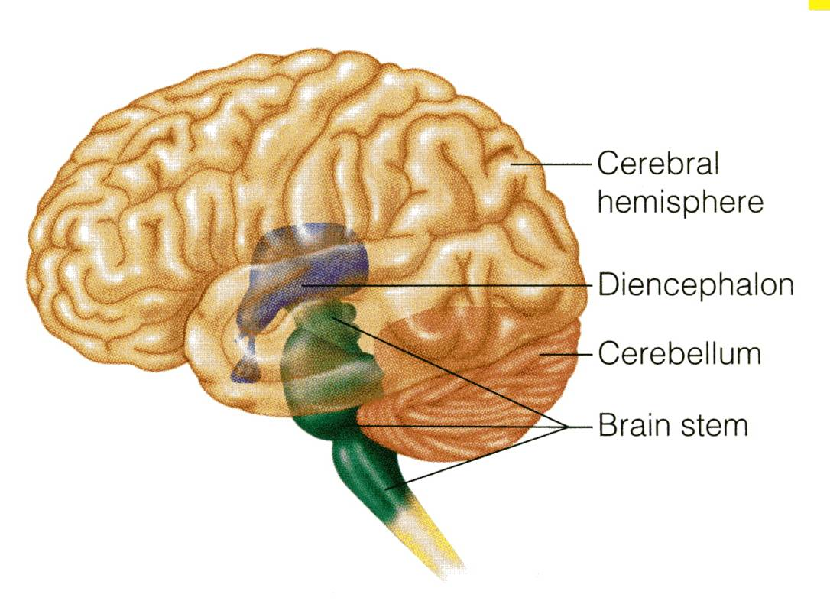
PARTS OF THE BRAIN
The brain composed of 4 parts:
Cerebral hemispheres
Diencephalon
Cerebellum
Brain stem

Slide 20
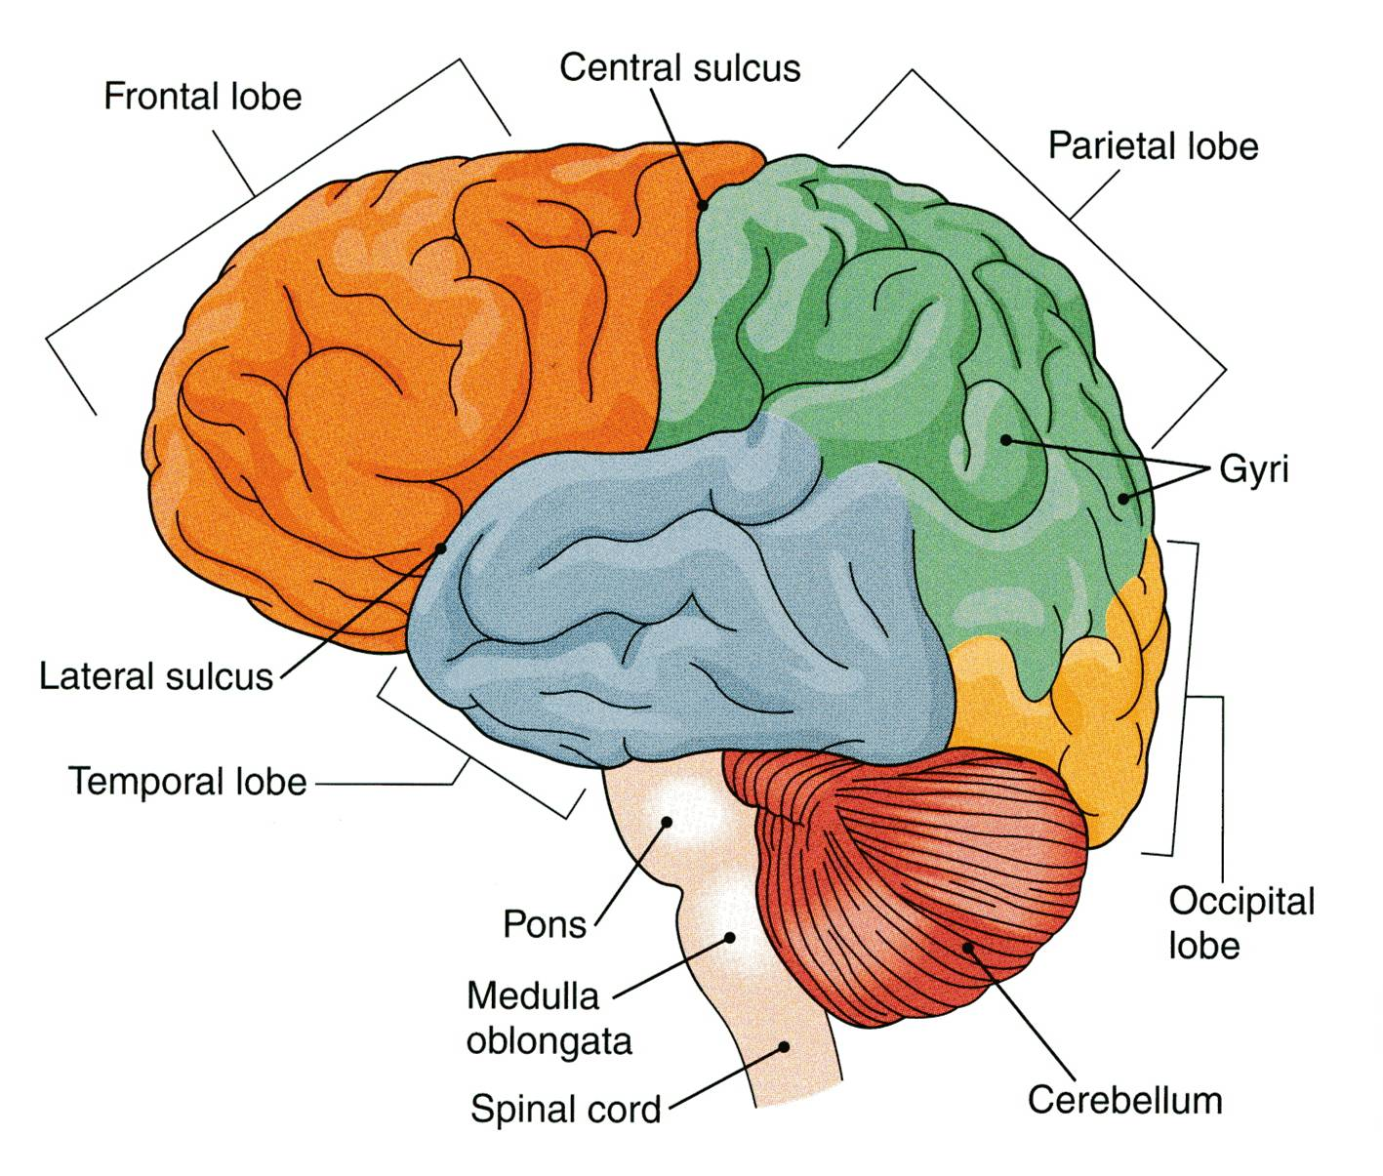
CEREBRAL HEMISPHERES
The largest part of the brain.
They have elevations, called gyri.
Gyri are separated by depressions called sulci.
Each hemisphere is divided into 4 lobes named according to the bone above.
Lobes are separated by deeper grooves called fissures or sulci.
PARIETAL
FRONTAL
TEMPORAL
OCCIPITAL

Slide 21
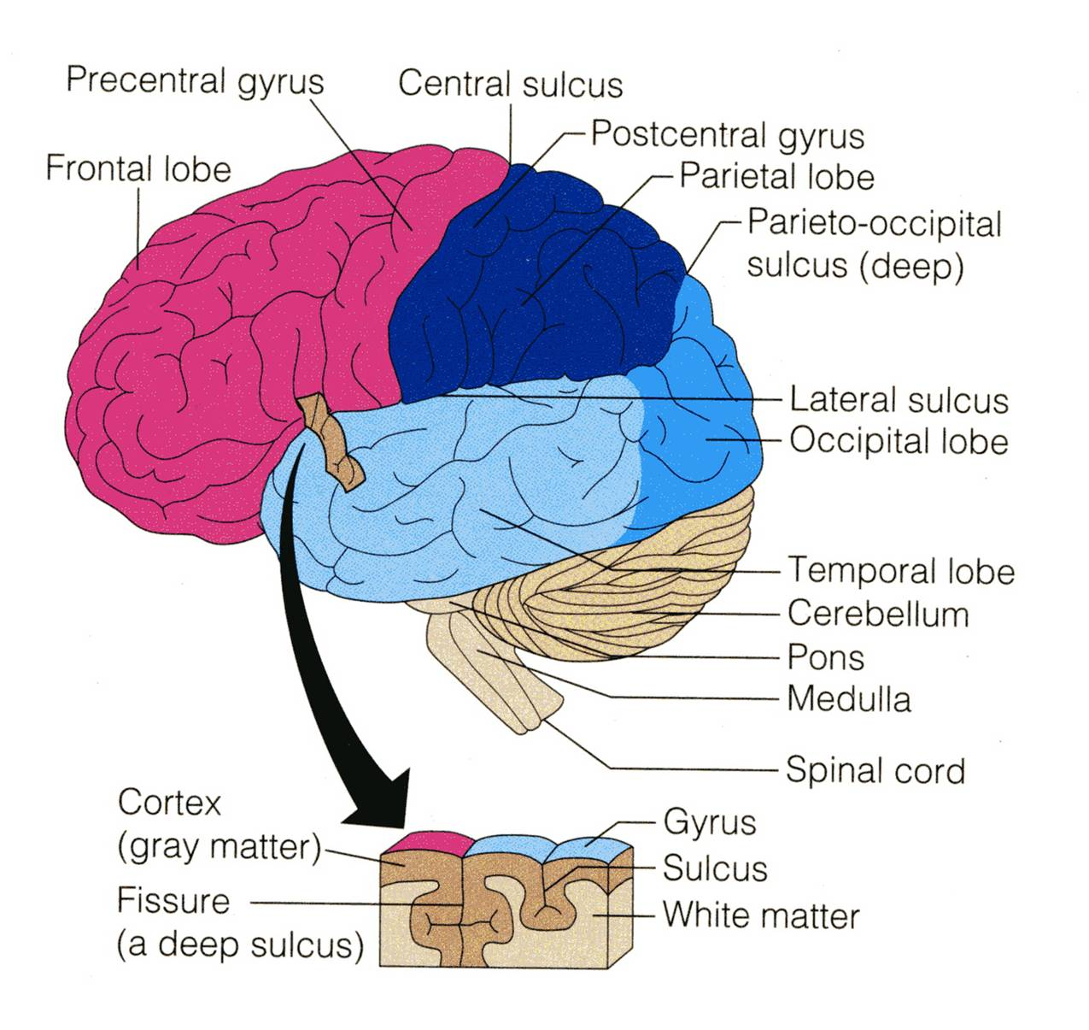
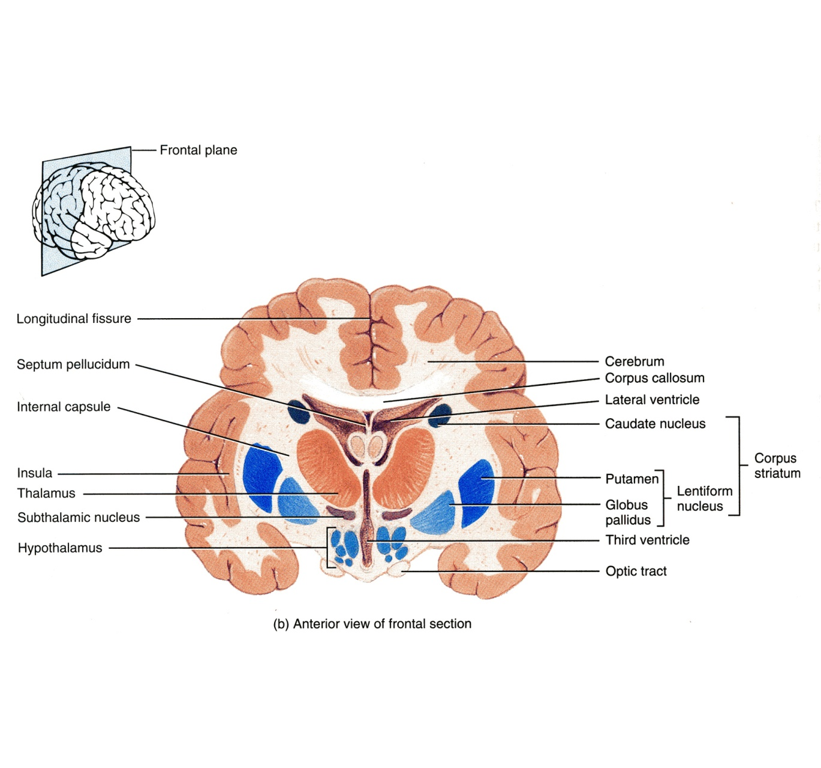
TISSUE OF THE CEREBRAL HEMISPHERES
The outer layer is the gray matter or cortex
Deeper is located the white matter, composed of bundles of nerve fibers, carrying impulses to and from the cortex
Basal nuclei are gray matter that are located deep within the white matter
They help the motor cortex in regulation of voluntary motor activities.
Basal nuclei

Slide 22
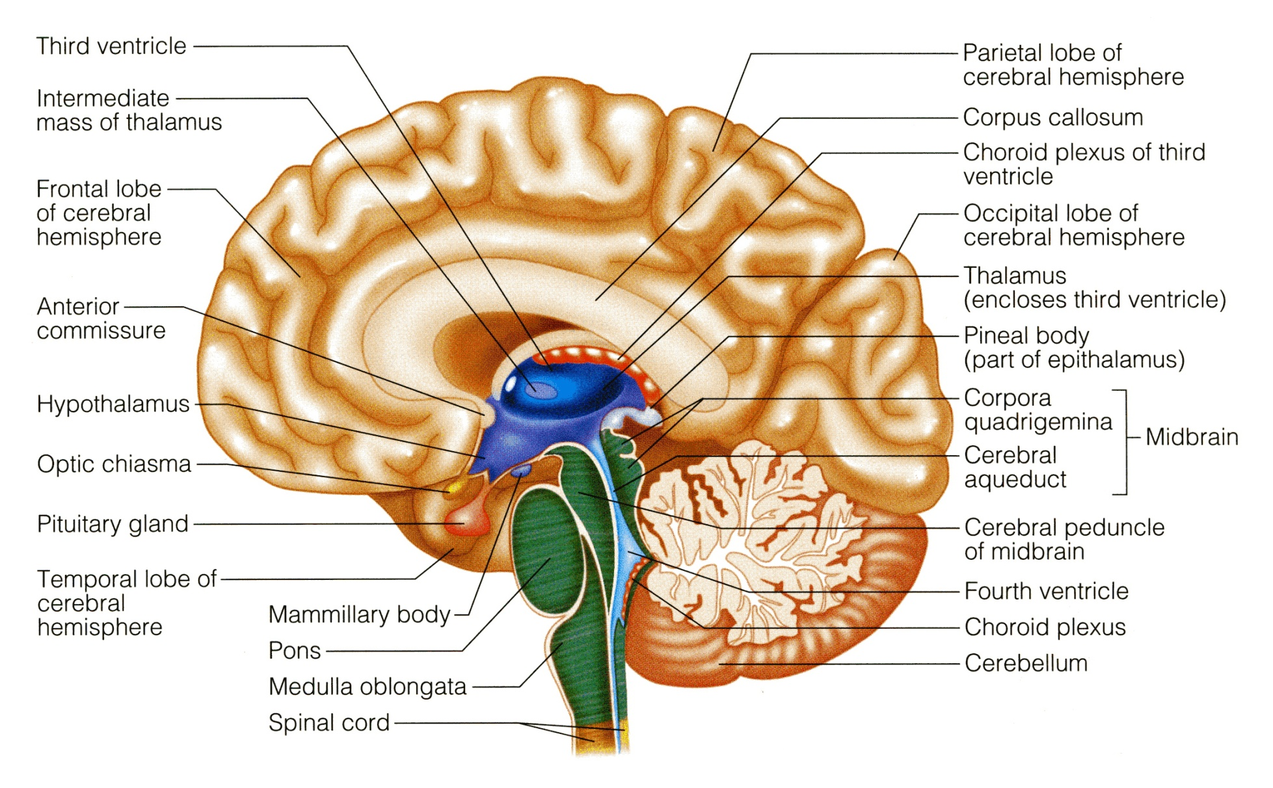
DIENCEPHALON
The diencephalon is located between the 2 cerebral hemispheres and is linked to them and to the brainstem.
The major structures of the diencephalon are the Thalamus, Hypothalamus, Subthalamus and Epithalamus.

Slide 23
BRAIN STEM
It is connected to the cerebellum with
3 paired peduncles
Superior, middle and inferior
The brainstem has three parts: midbrain, Pons and medulla oblongata.

Slide 24
CEREBELLUM
Cerebellum has 2 cerebellar hemispheres with convoluted surface.
It has an outer cortex of gray matter and an inner region of white matter.
It provides precise coordination for body movements and helps maintain equilibrium.

Slide 25
MENINGES
There are three connective tissue membranes invest the brain and the spinal cord.
These are from outward to inward are:
1- Dura mater.
2- Arachnoid mater.
3- Pia mater.

Slide 26
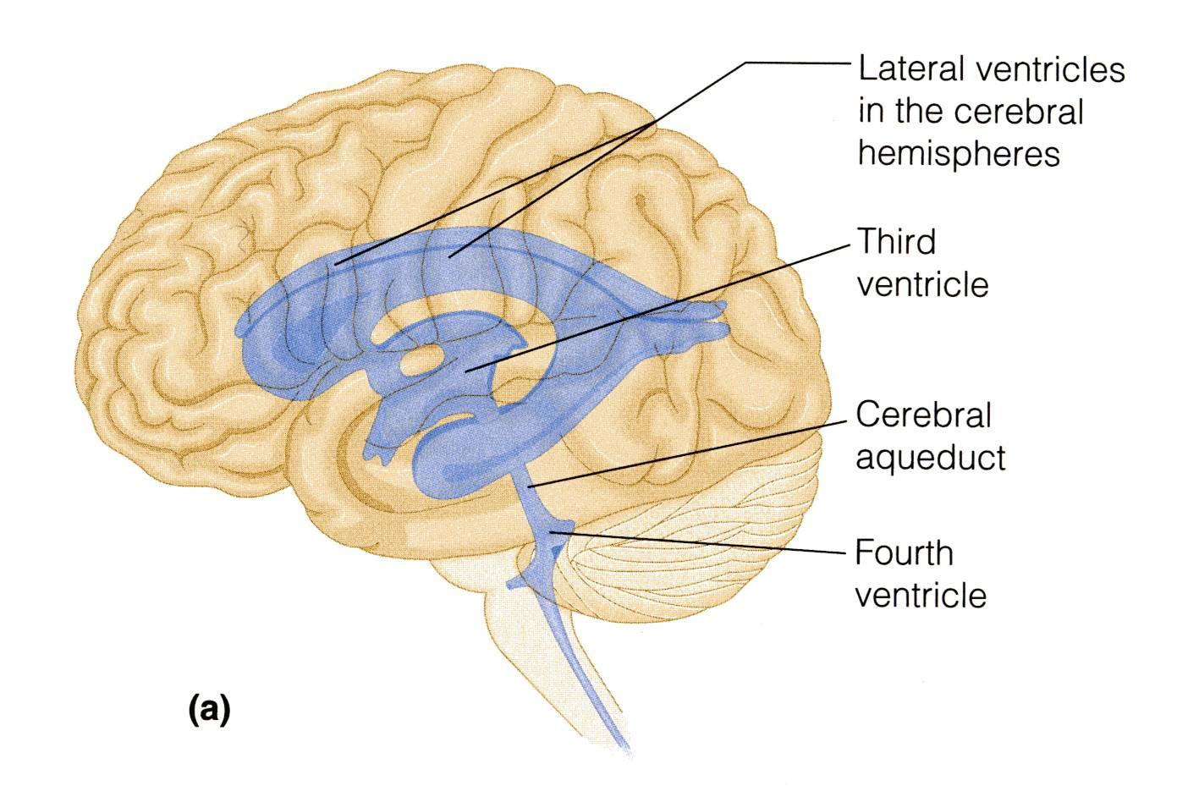
BRAIN VENTRICLES
Brain is bathed by the cerebrospinal fluid (CSF).
Inside the brain, there are 4 ventricles filled with CSF.
The 4 ventricles are:
2 lateral ventricles:
One in each hemispheres.
3rd ventricle:
in the Diencephalon.
4th ventricle:
between Pons, Medulla oblongata & Cerebellum.
N.B. Cerebral aqueduct: connects the 3rd to the 4th ventricle.

Slide 27
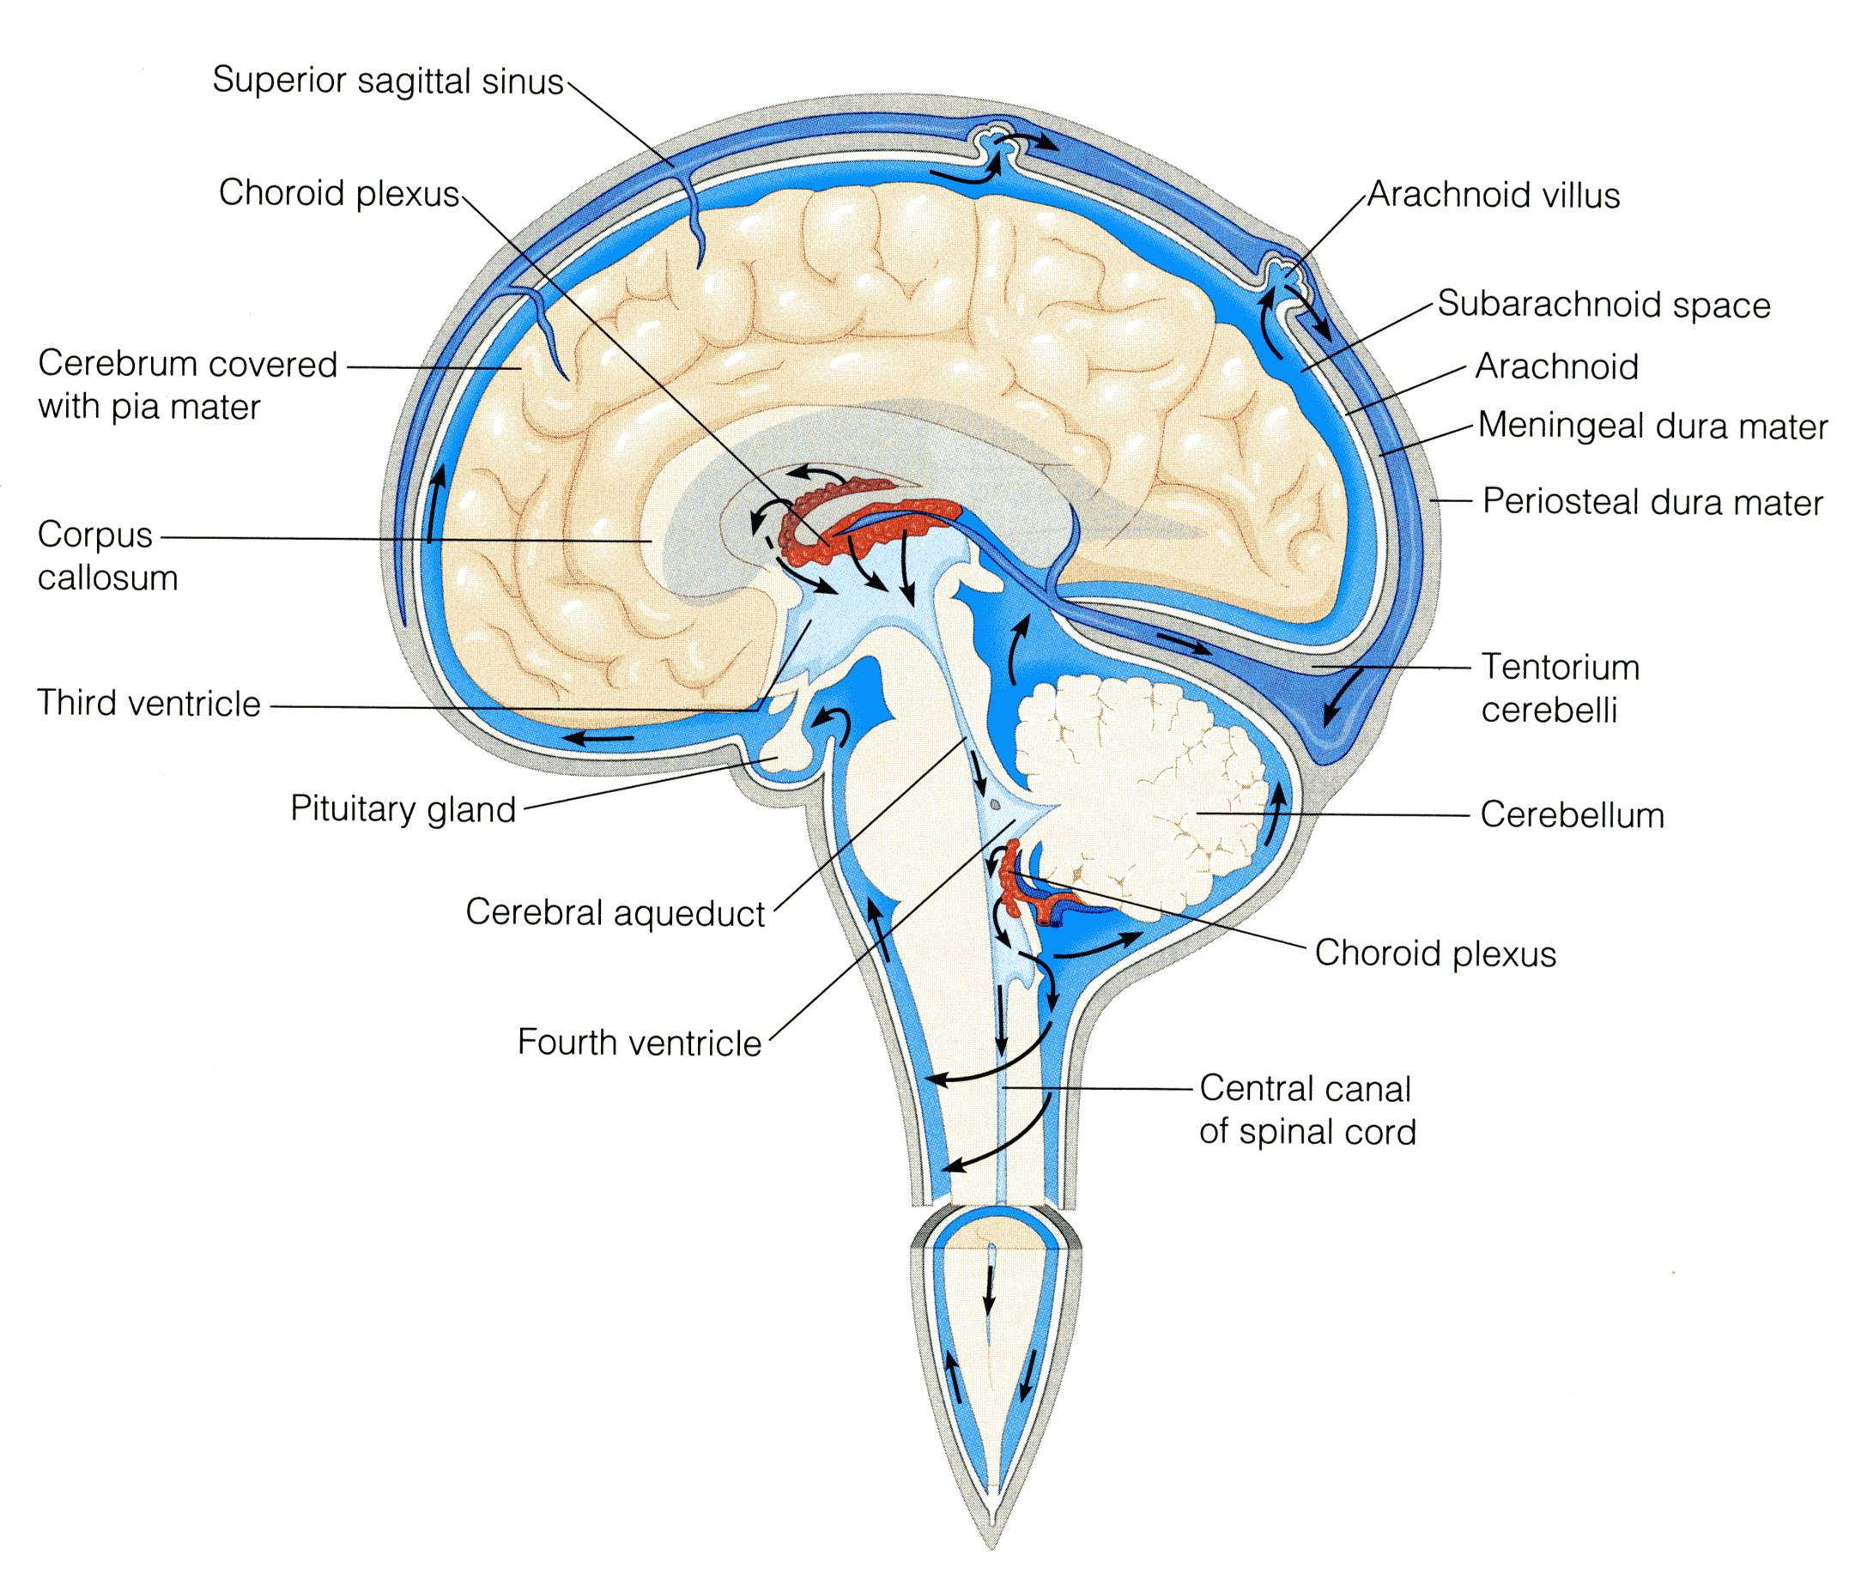
CEREBROSPINAL FLUID
CSF is constantly produced by the choroid plexuses inside the ventricle.
Arachnoid villi are small protrusions of the arachnoid (the second layer covering the brain) through the dura.
Villi absorb cerebrospinal fluid and return it to the dural venous circulation.
Inside the brain, CSF flows from the lateral ventricles to the 3rd and 4th ventricles
Most of the CSF drains from the 4th ventricle to distribute in the subarachnoid space around the brain and returns to the dural sinuses through the arachnoids villi.
From the 4th ventricle, part of the CSF flows down in the central canal of the spinal cord.

Slide 28
THANK YOU AND GOOD LUCK

