Slide 1
Brachial Plexus & Radial Nerve
Dr. Saeed Vohra
&
Dr.Sanaa Alshaarawy

Slide 2
Objectives
At the end of this lecture, the students should be able to :
Describe the formation of brachial plexus (site,roots & stages).
List the main branches of brachial plexus
Describe the course of radial nerve
List the motor & sensory distribution of radial nerve
Describe the effects in cases of lesion of the brachial plexus & radial nerve

Slide 3
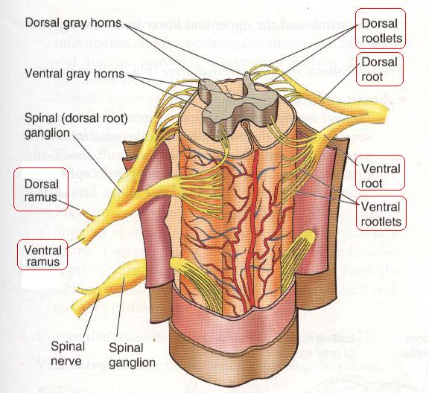
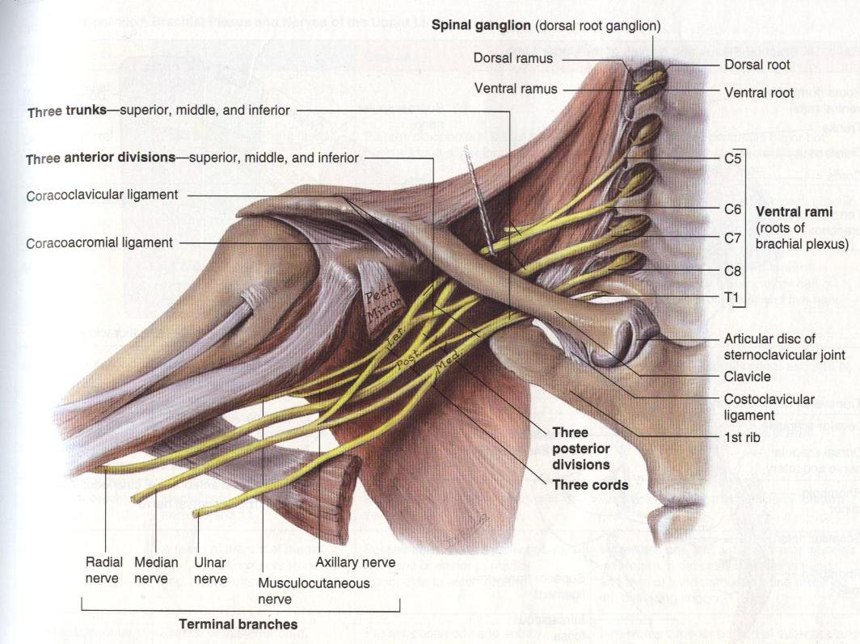
FORMATION OF BRACHIAL PLEXUSES
It is formed in the posterior triangle of the neck.
It is the union of the anterior rami of the 5th ,6th ,7th ,8th cervical and the 1st thoracic spinal nerves

Slide 4
DIVISIONS
The plexus is divided into :
Roots
Trunks
Divisions
Cords
Terminal branches

Slide 5
TRUNKS
Upper trunk
Union of the roots of C5 & 6
Middle trunk
Continuation of the root of C7
Lower trunk
Union of the roots of C8 & T1

Slide 6
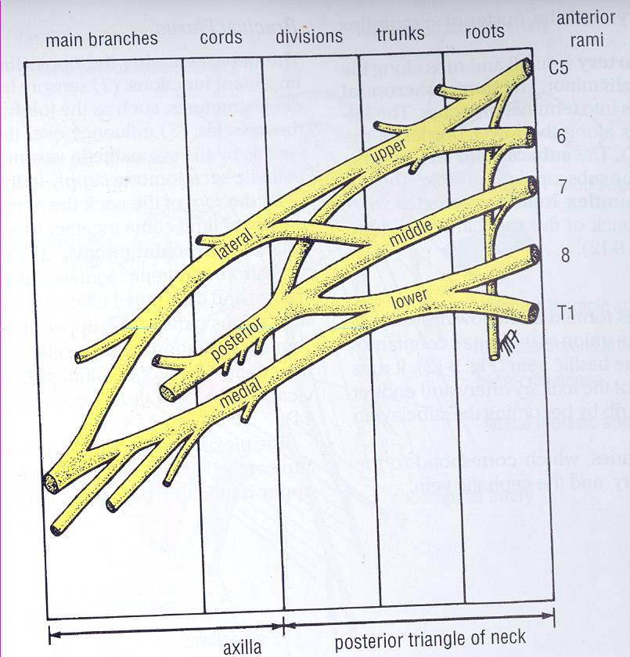
DIVISIONS & CORD
Each trunk divides into anterior and posterior division
Posterior cord:
From the three posterior divisions
Lateral cord:
From the anterior divisions of the upper and middle cords

Slide 7
CORDS & BRANCHES
Medial cord
It is the continuation of the anterior division of the lower trunk
Branches
All three cords will give branches, those will supply their respective regions

Slide 8
The Brachial Plexus
Long Thoracic
Nerve to Subclavius
Dorsal Scapular
upper
trunk
Suprascapular
roots
lateral Cord
(2LM)
C5
C6
middle
trunk
C7
lower
trunk
C8
posterior Cord
(ULTRA)
T1
medial Cord
(4MU)
Anterior divisions
Posterior divisions

Slide 9
The Plexus can be divided into 5 stages:
Roots: in the posterior∆
Trunks: in the posterior∆
Divisions: behind the clavicle
Cords: in the axilla
Branches: in the axilla
The first 2 stages lie in the posterior triangle, while the last 2 sages lie in the axilla.

Slide 10
BRANCHES
(A) From Roots:
1. C5: Nerve to rhomboids (dorsal scapular nerve).
2. C5,6 &7: Long thoracic nerve
(B) From Trunk (upper trunk):
Nerve to subclavius
Suprascapular nerve (supplies supraspinatus & infraspinatus)

Slide 11
The Brachial Plexus
Long Thoracic
Nerve to Subclavius
Dorsal Scapular
upper
trunk
Suprascapular
roots
Lateral Cord
(2LM)
C5
C6
middle
trunk
C7
lower
trunk
C8
Posterior Cord
(ULTRA)
T1
Medial Cord
(4MU)
Anterior divisions
Posterior divisions

Slide 12
(C)BRANCHES From Cords
Lateral Cord
(2LM)
.Lateral pectoral n
.Lateral root to median n
.Musculocutaneous n
C5
C6
C7
C8
T1
Medial cord
(4MU)
.Medial pectoral n.
.Medial root to median n.
.Medial cutaneous n of arm.
.Medial cutaneous n of forearm.
.Ulnar n.
Posterior Cord
(ULTRA)
.Upper subscapular n
.Lower subscapular n
.Thoracodorsal n
.Radial n
.Axillary n

Slide 13
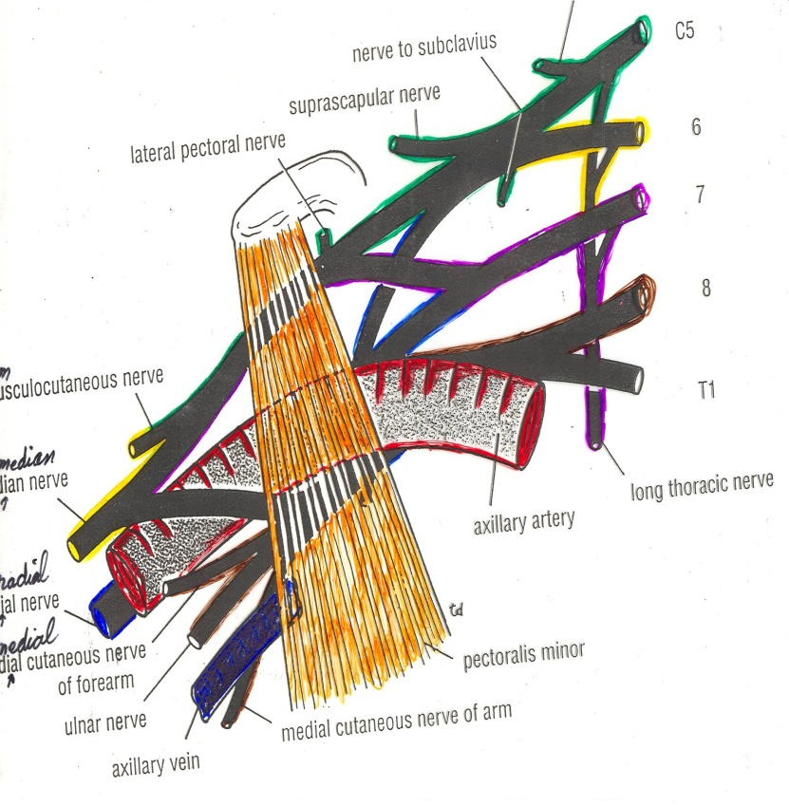
RELATION TO AXILLARY ARTERY
TO (1ST Part):
The three cords are above and lateral
TO (2ND Part):
The cords are given names according their relations with axillary artery.
Medial cord: medial
Lateral cord: lateral
Posterior cord: behind

Slide 14
RELATION TO AXILLARY ARTERY
TO (3RD Part):
Has the same relationship with the terminal branches of the brachial plexus.

Slide 15
Radial Nerve (C5, 6, 7, 8, & T1)
Origin: It is a continuation of the posterior cord of brachial plexus.
Course & relation:
In the axilla it lies behind 3rd part of axillary artery

Slide 16
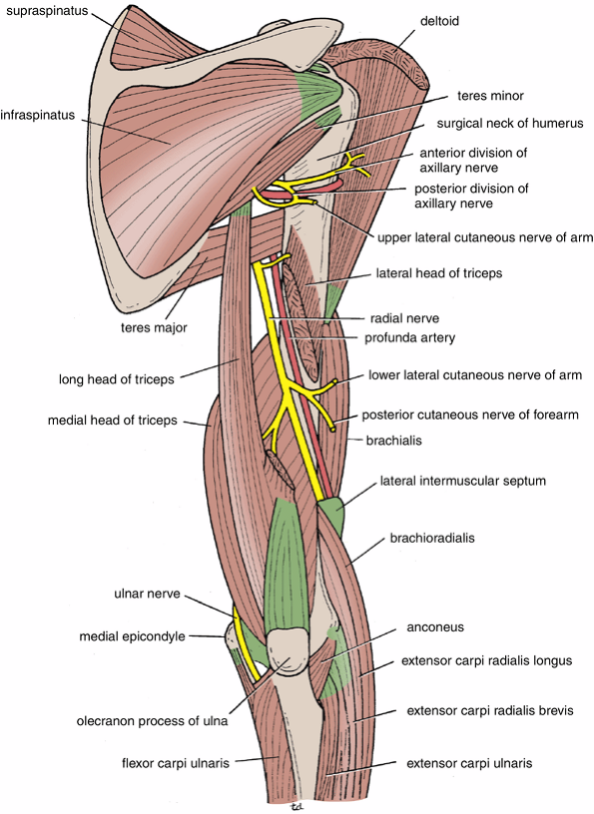
Radial nerve in the arm
In the posterior compartment of the arm, It runs in the spiral groove of humerus, deep to lateral head of triceps.
At the lateral end of the spiral groove,, it turns forwards and pierces the lateral intermuscular septum to enter the anterior compartment of the arm in groove between brachialis medially and brachioradialis laterally

Slide 17
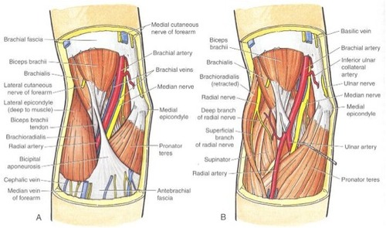
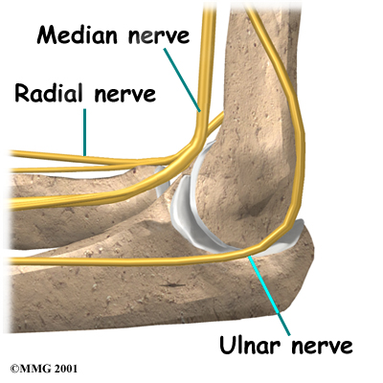
Radial nerve in the forearm
In the cubital fossa, it lies in front of lateral epicondyle, then under cover of brachioradialis, it terminates by dividing into 2 terminal branches:
Superficial branch
Deep branch (posterior interosseous nerve)
Medial Epicon.

Slide 18
Branches of Radial Nerve
In the axilla:
Muscular: long head & Medial heads of triceps.
Cutaneous: posterior cutaneous nerve of arm supplies the skin at back of arm
In the spiral groove:
Muscular: medial & lateral heads of triceps + anconeus
Cutaneous:
1 - Lower lateral cutaneous nerve of the arm
2 - Posterior cutaneous nerve of forearm

Slide 19
Branches of Radial Nerve
In anterior compartment of the arm in the groove between brachialis & brachioradialis:
Muscular:
Lateral fibres of brachialis
Nerve to brachioradialis
Nerve to extensor carpi radialis longus.
Terminal branches:
Superficial branch
Deep branch (posterior interosseous nerve).

Slide 20
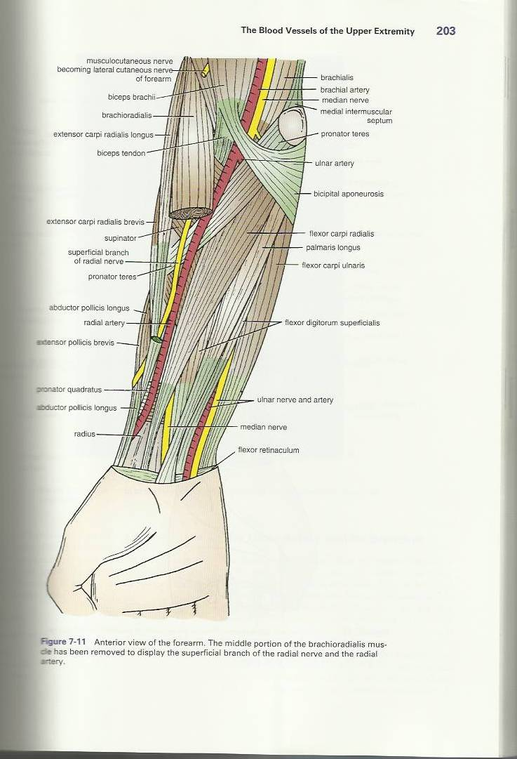
Superficial Terminal branch of Radial Nerve
It is a continuation of the radial nerve
It descends in front of lateral side of forearm to reach the dorsum of the hand
It has No branches in the forearm

Slide 21
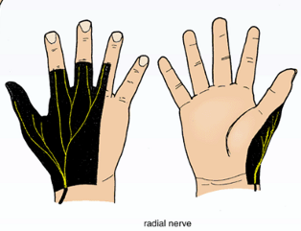
Superficial Terminal branch of Radial Nerve
Above wrist: it turns posterior to pass superficial to extensor retinaculum to supply:
skin of lateral 2/3 of back of hand.
Skin over the back of proximal phalanges of lateral 3 ½ fingers.

Slide 22
Deep branch of Radial nerve (posterior interosseous nerve)
It pierces the supinator muscle & turns around the neck of radius to reach back of forearm, descending between superficial & deep muscles of the back of the forearm
It supplies the muscles of posterior compartment the of forearm

Slide 23
Cutaneous & digital areas supplied by Radial

Slide 24
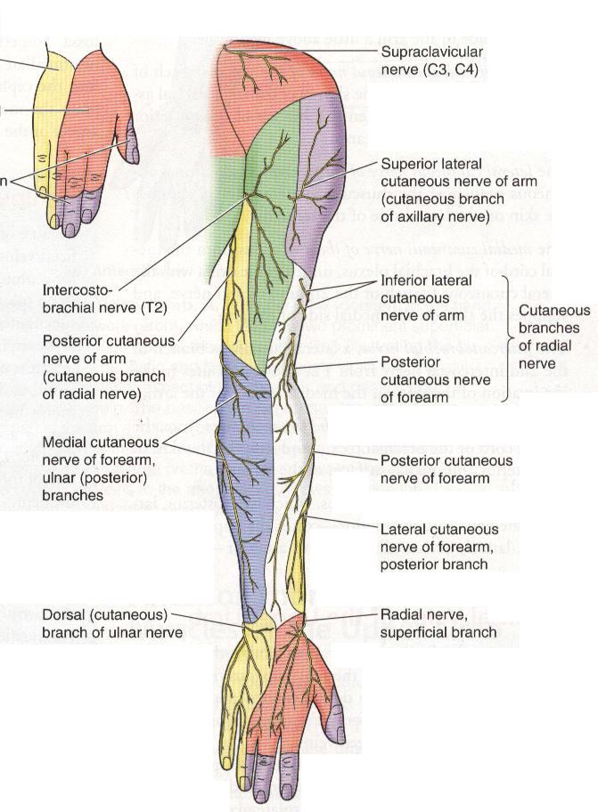
posterior view
cutaneous nerves

Slide 25
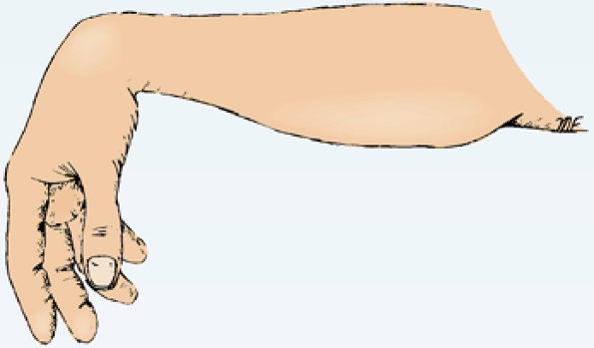
Injuries to the Radial Nerve in the Axilla
In the axilla
Motor
The triceps, the anconeus, and the long extensors of the wrist are paralyzed.
The patient is unable to extend the elbow joint, the wrist joint, and the fingers. So The characteristic deformity is Wrist drop, or flexion of the wrist.
Sensory
A small loss of skin sensation in posterior surface of the lower part of the arm and down a narrow strip on the back of the forearm.
Sensory loss on the lateral part of the dorsum of the hand and on the dorsal surface of the roots of the lateral 3 ½ fingers.

Slide 26
Brachial Plexus Injuries
The roots, trunks, and divisions of the brachial plexus reside in the lower part of the neck, whereas the cords and most of the branches of the plexus lie in the axilla.
So, Complete lesions involving all the roots of the plexus are rare.

Slide 27
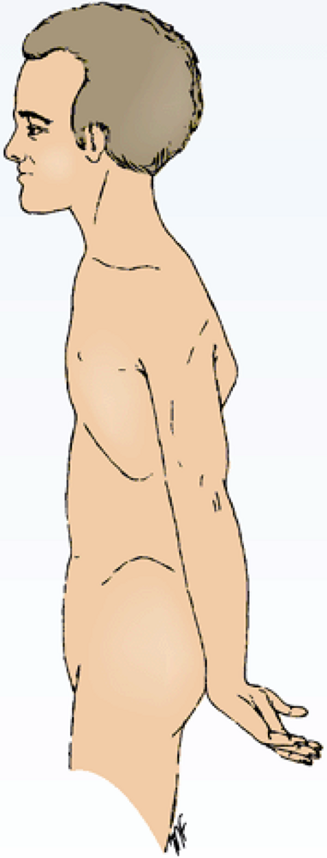
Brachial Plexus Injuries
Upper Lesions of the Brachial Plexus Upper Trunk C5,6 (Erb-Duchenne Palsy ”waiter's tip position”.
Resulting from excessive displacement of the head to the opposite side and depression of the shoulder on the same side (a blow or fall on shoulder).
The position of the upper limb in this condition has been likened to that of a porter or waiter hinting for a tip or policeman’s tip hand.
The arm hangs by the side and is rotated medially. The forearm is extended and pronated.
Erb-Duchenne’s paralysis due to injury of Upper Trunk of Brachial Plexus.

Slide 28
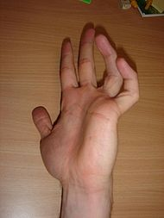
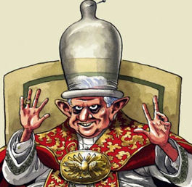
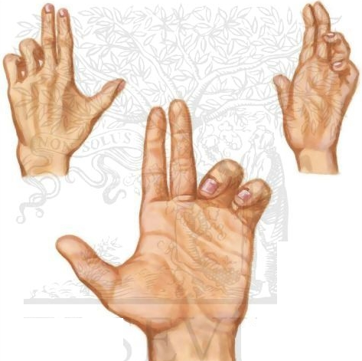
Brachial Plexus Injuries
Lower Lesions of the Brachial Plexus, (Klumpke Palsy)/ LowerTrunk (C8,T1)Lesion
Lower lesions of the brachial plexus are usually traction injuries caused by a person falling from a height clutching at an object to save himself. The first thoracic nerve is usually torn.
The nerve fibers from this segment run in the ulnar and median nerves to supply all the small muscles of the hand. The hand has a clawed appearance due to ulnar nerve injury.
Hand of Benediction or Pop’s Blessings (APE HAND) will result from median nerve injury.

Slide 29
Thank you

Slide 30
1. Lesion of the upper trunk of the brachial plexus leads to :
Klumpke palsy.
Erb-Duchenne palsy.
Drop wrist & hand.
Ape hand.
2. Which one of the following nerves is a branch of posterior cord of brachial plexus?
Ulnar.
Radial.
Median.
Musclocutanous.
3. In spiral groove of humerus which muscle is supplied by radial nerve?
Biceps .
Triceps .
Supinator.
Brachialis.

