Slide 1
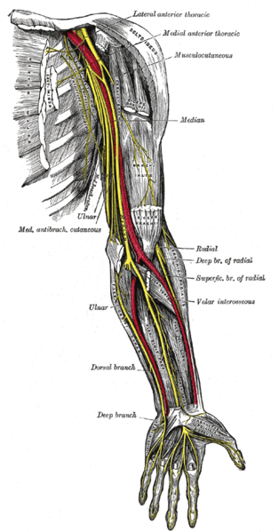
MEDIAN & ULNAR NERVES
By Dr. Vohra
&
Dr. Sanaa Al-Shaarawy

Slide 2
OBJECTIVES
At the end of the lecture, the student should be able to :
Describe the origin of the median & ulnar nerves.
Describe the course & relation of median & ulnar nerves.
List the motor & sensory distribution of median & ulnar nerves.
Describe the carpal tunnel syndrome.
Describe the main motor & sensory effects in cases of lesion of median & ulnar nerves (Applied Anatomy)

Slide 3
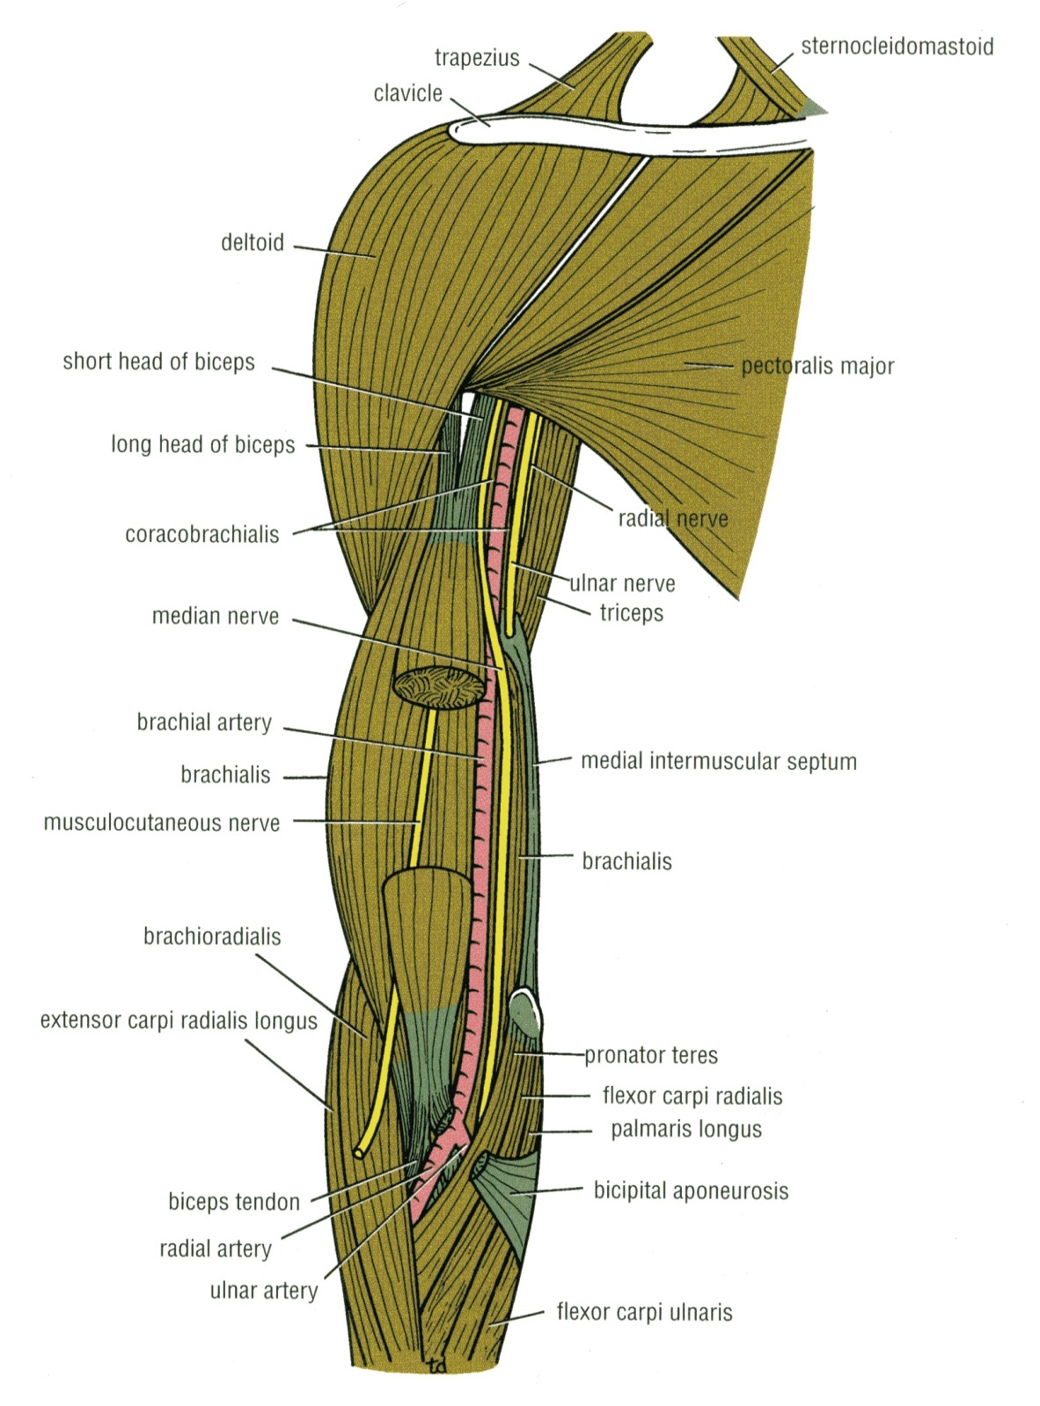
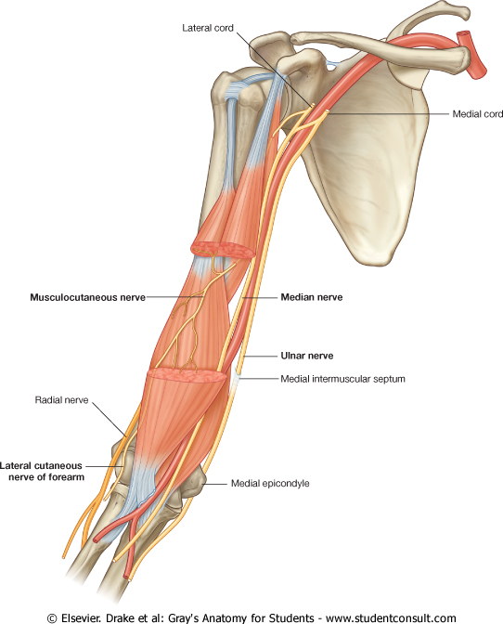
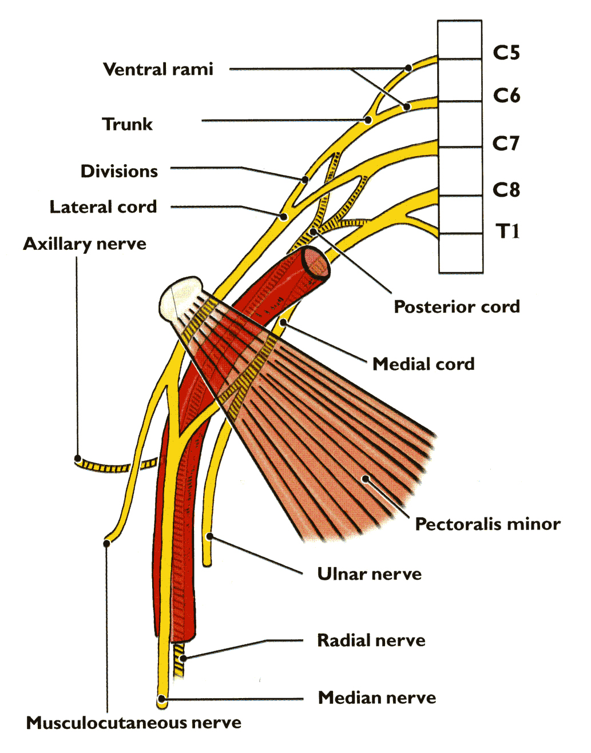
MEDIAN NERVE C5,6,7,8 &T1
Origin:
By 2 roots from the medial and lateral cords of brachial plexus.
The medial root crosses the 3rd part of axillary artery to join the lateral root.
It runs downward on the lateral side of the brachial artery.
At the middle of the arm, it crosses the brachial artery from lateral to medial and continues downward on its medial side.
At the elbow, it lies medial to the tendon of biceps & it is crossed by the bicipital aponeurosis.
It has no branches in the arm.

Slide 4
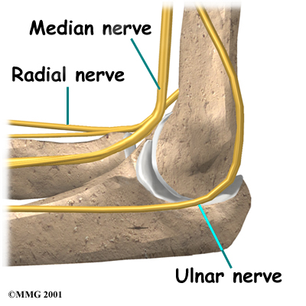
MEDIAN NERVE
In the cubital fossa it lies deep to the bicipital aponeurosis.
It leaves the fossa in front of medial epicondyle.
It leaves the fossa between the 2 heads of the pronator teres.
Then it descends between the flexor digitorum superficialis & the flexor digitorum profundus.
It passes to the palm deep or through the carpal tunnel lateral to the tendon of flexor digitorum superficialis, and deep to the tendon of palmaris longus.

Slide 5
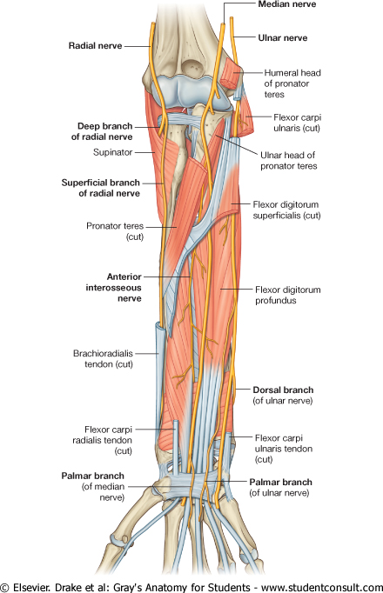
BRANCHES OF THE MEDIAN NERVE IN THE FOREARM
Muscular: To
Pronator teres,
Flexor carpi radialis,
Palmaris longus,
Flexor digitorum superficialis.
Palmar cutaneous branch:
It arises at the distal part of forearm.. It descends superficial to flexor retinaculum to supply skin of the lateral 2/3 of the palm.
Articular: To elbow joint.
Anterior interosseous nerve:
Descends between flexor pollicis longus and flexor digitorum profundus, anterior to the interosseous membrane.
It supplies : FPL+PQ+ lateral half of FDP.
It gives an articular branches to wrist & distal radioulnar joint.

Slide 6
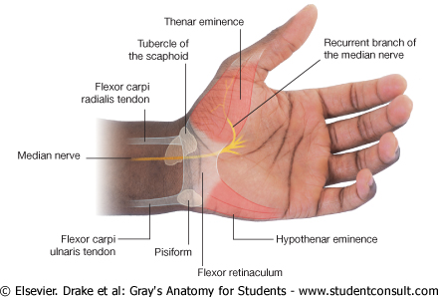
Median nerve in the palm
It enters the palm through the carpal tunnel, deep to the flexor retinaculum.
Then it divides into lateral & medial branches.
Lies a fingerbreadth distal to the tubercle of scaphoid.
Branches:
Muscular: To ( 5 Muscles).
Abductor pollicis brevis.
Flexor pollicis brevis.
Opponens pollicis (deep to the above 2 ms.).
Lateral 2 lumbrical (1st & 2nd ).
Digital cutaneous branches :
Cutaneous branches to the palmar aspect of the lateral 3 & ½ fingers
Thenar Eminenece Ms.

Slide 7
LESION OF MEDIAN NERVE I- ABOVE THE ELBOW
Weakness of flexion of wrist due to paralysis of flexor carpi radialis & palmaris longus.
Loss of pronation due to paralysis of pronator teres & pronator quadratus.
Loss of flexion of middle phalanges of medial 4 fingers due to paralysis of flexor digitorum superficialis.
Loss of flexion of terminal phalanges of index & middle fingers due to paralysis of lateral ½ of the flexor digitorum profundus.

Slide 8
LESION OF MEDIAN NERVE I- ABOVE THE ELBOW (Continued)
Loss of flexion of thumb due to paralysis of flexor pollicis longus & brevis
Loss of opposition of thumb due to paralysis of opponens pollicis.
Flatting of the thenar eminence due to atrophy of thenar muscles.
The characteristic deformity in the hand ‘APE HAND’ because the thenar eminence is flattened and the thumb is hyperextended.
Loss of cutaneous sensations on the hollow of palm of hand + palmar surfaces of lateral 3 ½ fingers.

Slide 9
LESION OF MEDIAN NERVE II- ABOVE THE WRIST
Loss of opposition of thumb due to paralysis of opponens pollicis.
Flattening of the thenar eminence due to atrophy of thenar muscles.
The characteristic deformity ‘APE HAND’ is present.
Loss of cutaneous sensations on the palmar surfaces of the lateral 3 ½ fingers.

Slide 10
CARPAL TUNNEL SYNDROME
It results from compression of median nerve in the carpal tunnel.
Slight flattening of thenar eminence due to wasting of ms. of thenar eminence supplied by median nerve.
This is accompanied by burning pain or ‘pin and needles’ and diminished cutaneous sensations on palmar aspect of lateral 3 ½ fingers.
No paresthesia occurs over the thenar eminence (because this area of skin is supplied by palmar cutaneous branch of median N. arises in the distal part of forearm and descends superficial to the flexor retinaculum..

Slide 11
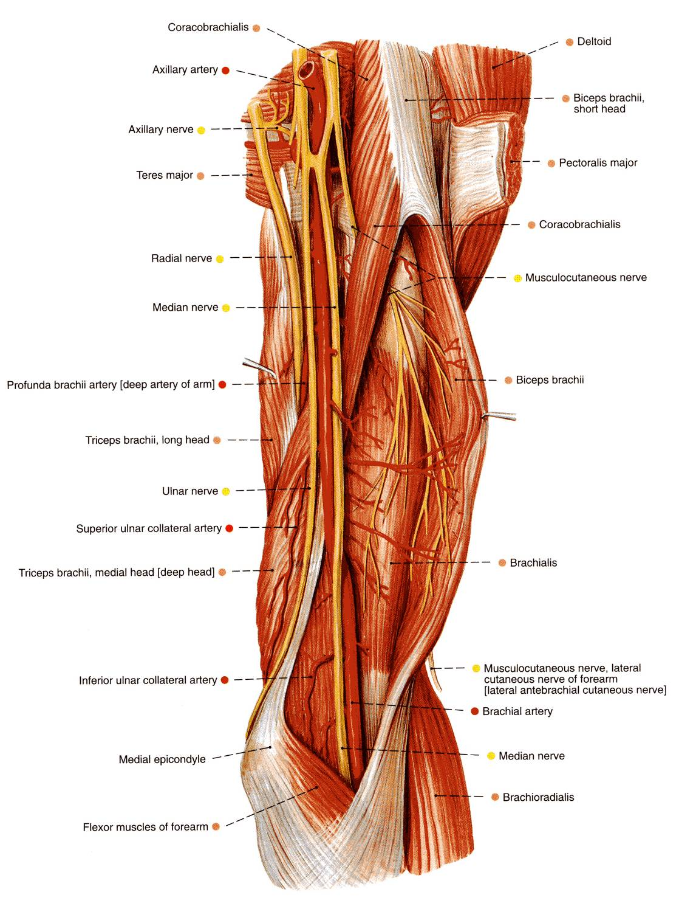
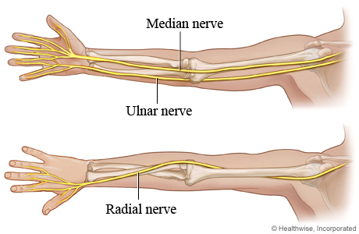
ULNAR NERVE C 7, 8 &T1
Origin:
From the medial cord of the brachial plexus.
It runs downward on the medial side of the brachial artery as far as the middle of the arm.
At the insertion of the coracobrachialis, it pierces the medial intermuscular septum and, accompanied by the superior ulnar collateral artery, to enter the posterior compartment of the arm.
At the elbow, it passes behind the medial epicondyle.
It has no branches in the arm.

Slide 12
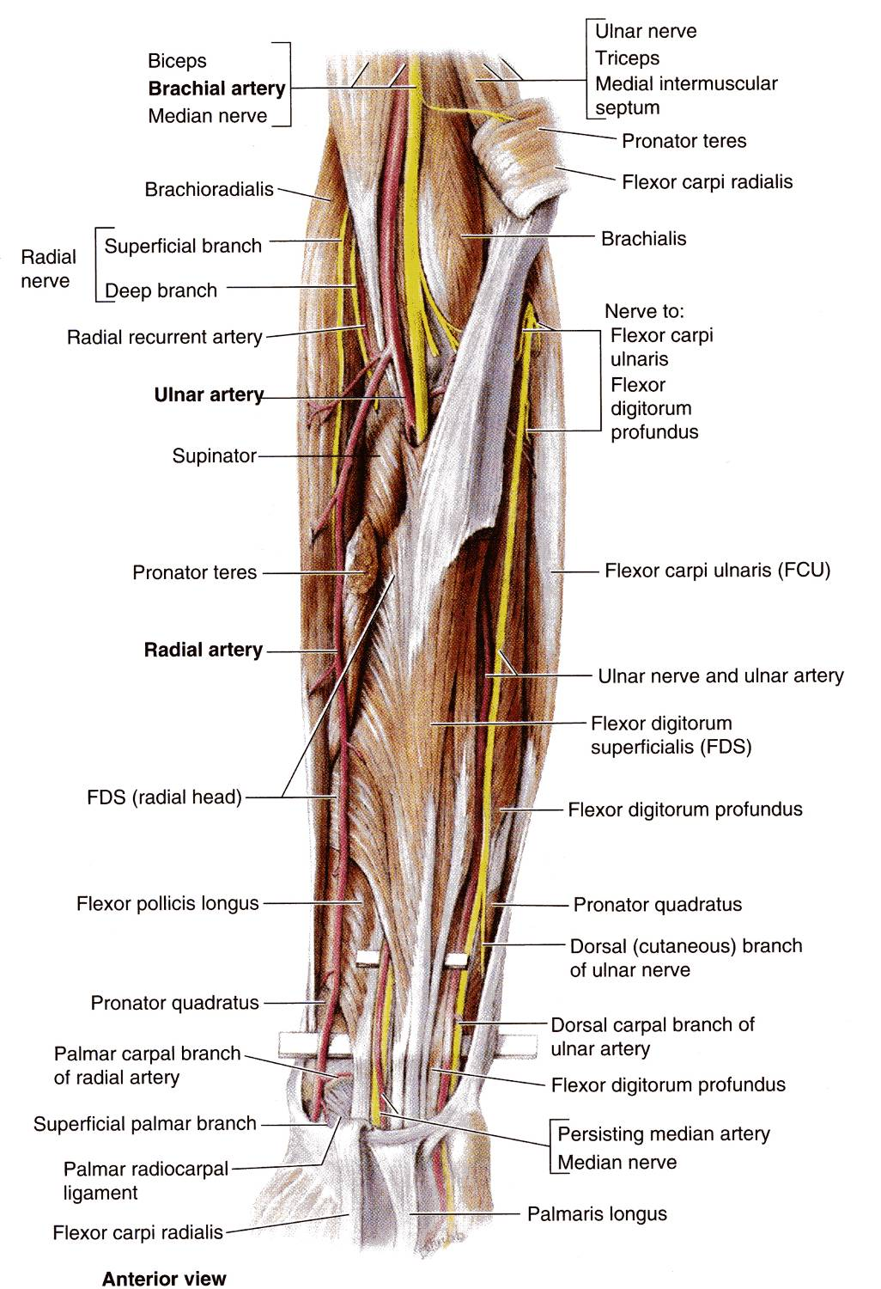
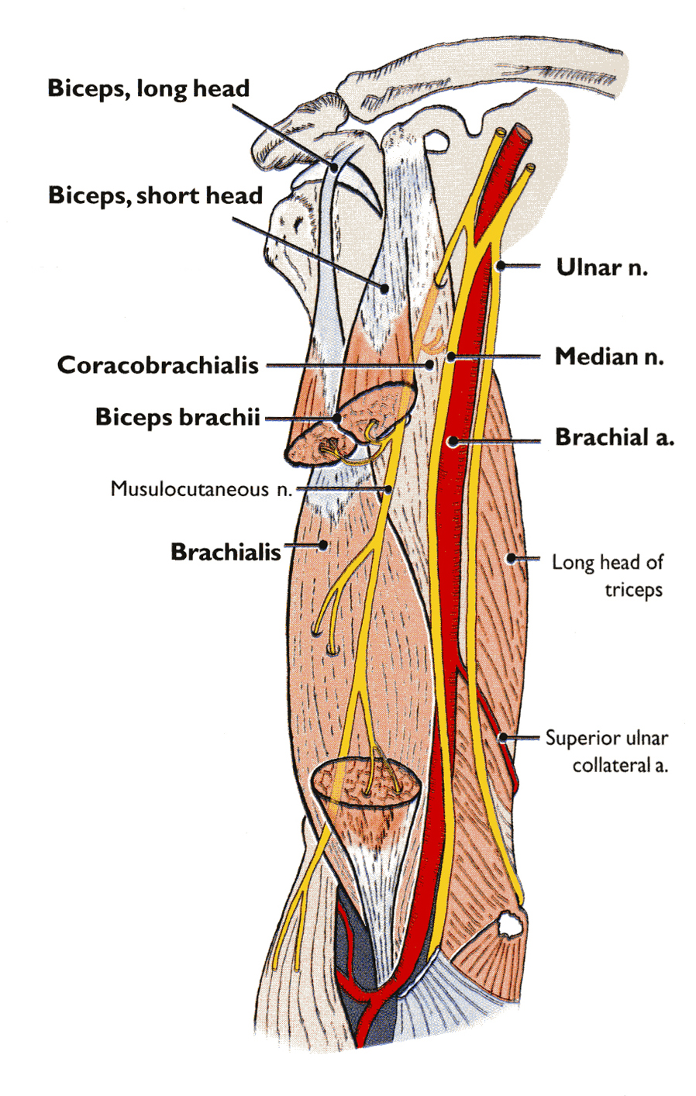
ULNAR NERVE in the Forearm
It continues downward to enter the forearm between the two heads of the flexor carpi ulnaris.
It runs down the forearm between FCU and FDP.
In the lower half of the forearm it lies medial to the ulnar artery.

Slide 13
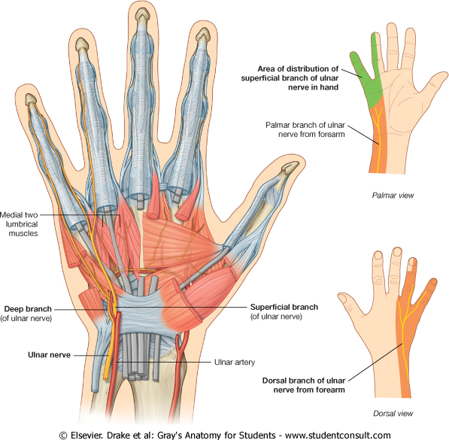
ULNAR NERVE in the Forearm
Branches:
Muscular: To 1 & ½ muscles.
Flexor carpi ulnaris.
Medial ½ of FDP
Articular: To elbow joint.
Dorsal or posterior cutaneous branch:
To the dorsal surface medial 1/3rd of the hand and 1½ fingers.
Palmar cutaneous branch : to supply skin of palm of hand.

Slide 14
ULNAR NERVE in the Hand
Enters the palm superficial to the flexor retinaculum, close to the lateral border of pisiform bone.
Then it divides into superficial & deep branches.
Superficial branch:
It supplies palmaris brevis & palmar aspect of the medial 1 & ½ fingers.

Slide 15
Ulnar nerve in the hand
Deep branch:
Runs between abductor digiti minimi & flexor digiti minimi.
It pierces opponens digiti minimi.
Then passes laterally within the concavity of deep palmar arch.
It lies deep to the flexor tendons.
It supplies 14 muscles :
Three hypothenar muscles.
Adductor pollicis.
All dorsal & palmar interossei.
Medial 2 lumbrical.

Slide 16
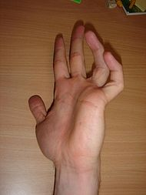
Lesion Of Ulnar Nerve Above Elbow
Weakness of flexion of wrist due to paralysis of flexor carpi ulnaris.
Loss of flexion of terminal phalanges of ring & little fingers due to paralysis of medial 1 & ½ of flexor digitorum profundus.
Paralysis of all interossei & medial 2 lumbricals (3rd & 4th ).
The characteristic deformity is called
Partial Claw Hand
Atrophy of hypothenar muscles.
The fingers are hyperextended at metacarpophalangeal joints and flexed at interphalangeal joints in the ring & little finger.
Loss of adduction of hand & thumb due to paralysis of flexor carpi ulnaris & adductor pollicis
Atrophy of hypothenar muscles

Slide 17
LESION OF ULNAR NERVE ABOVE ELBOW
Loss of cutaneous sensations on the front & dorsum of medial 1/3 of hand + medial 1 & ½ fingers.

Slide 18
LESION OF ULNAR NERVE ABOVE WRIST
It leads to paralysis of intrinsic muscles of hand as described above.
The deformity is called ‘claw hand’
Loss of cutaneous sensations of medial 1 & ½ fingers.

Slide 19
THANK YOU

Slide 20
1. Which one of these nerves is concerning with the carpal tunnel syndrome ?
a.The ulnar nerve.
b.The radial nerve.
c.The median nerve.
d.The axillary nerve.
2. Which muscle has double nerve supply ?
Biceps.
Extensor digitorum superficialis.
Extensor digitorum profundus.
Triceps.
3. Ape hand is the characteristic deformity due to lesion of :
Radial nerve.
Ulnar nerve.
Median nerve.
Axillary nerve.

