Slide 1
The Cranial Nerves XI-XII Accessory Nerve and Hypoglossal Nerve
Dr. Zeenat Zaidi Dr. Essam Eldin Salama

Slide 2
Objectives
At the end of the lecture, the students should be able to:
List the nuclei related to accessory and hypoglossal nerves in the brain stem.
Describe the type and site of each nucleus.
Describe site of emergence and course of accessory and hypoglossal nerves.
Describe important relations of accessory and hypoglossal nerves in the neck.
List the branches of accessory and hypoglossal nerves.
Describe the main motor effect in case of lesion of accessory and hypoglossal nerves.

Slide 3
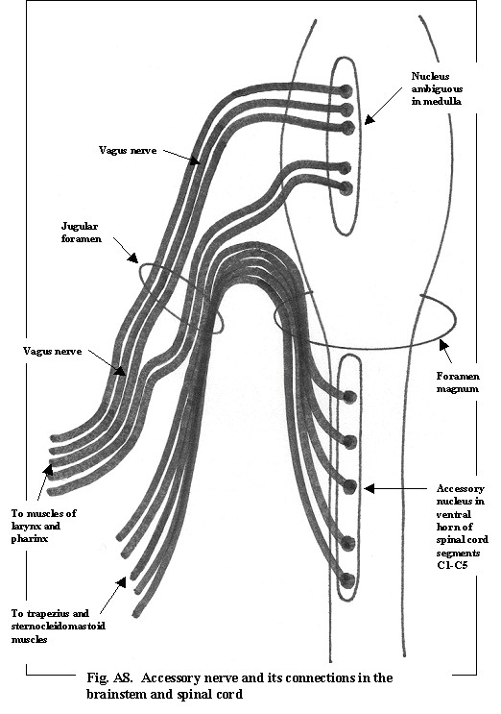
11th CN Accessory Nerve
It is Purely Motor nerve
Has two parts:
Cranial
Spinal.
the cranial part carries fibres that originate in the caudal part of nucleus ambiguus.
The spinal root arise from motor neurones in ventral horn of the spinal gray matter at levels C1-C5

Slide 4
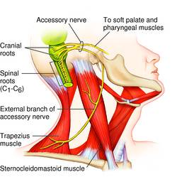
The cranial part
Emerges from lateral aspect of the medulla as a linear series caudal to rootlets of the vagus nerve.
at the side of medulla they join the spinal root briefly
They separate ones again as the verve leave the cranial cavity through the Jugular foramen.
At the level of jugular foramen these fibres join the vagus nerve and distribute with it to muscles of the soft plate pharynx and larynx

Slide 5
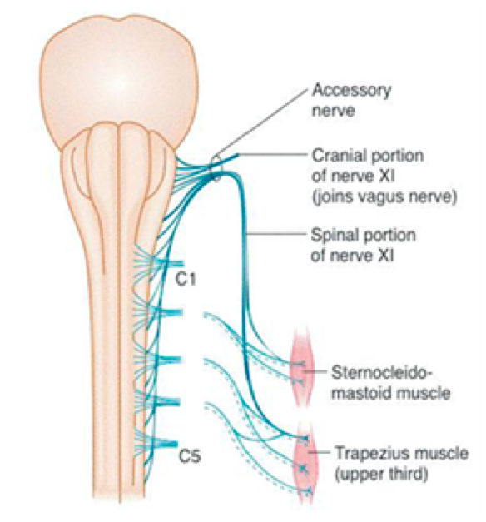
The spinal root
Arise from motor neurones in ventral horn of the spinal gray matter at levels C1-C5
The axons leave the cord via series of rootlets emerge laterally midway between the dorsal and ventral roots.
They course upwards and enter the cranial cavity through the foramen magnum,
at the side of medulla they join the cranial root briefly
They separate ones again as the verve leave the cranial cavity through the Jugular foramen.
The fibres of the spinal root pass to sternomastoid and trapezius muscles .

Slide 6
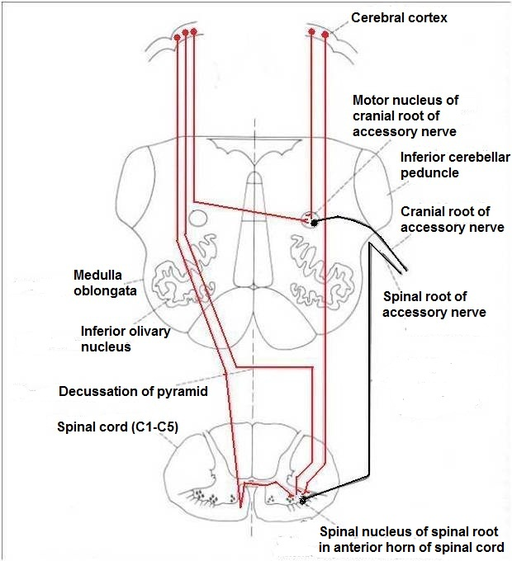
The nucleus ambiguus and the spinal nucleus receive bilateral corticonuclear fibers (from both cerebral hemispheres)

Slide 7
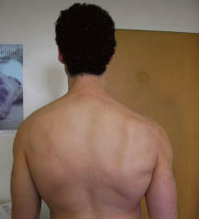
Accessory Nerve
Function:
Controls the movements of neck.
Movements of the soft palate, larynx, pharynx.
Lesion results into:
Inability to turn the head and raise the shoulder
Winging of scapula.
Difficulty in swallowing and speech

Slide 8
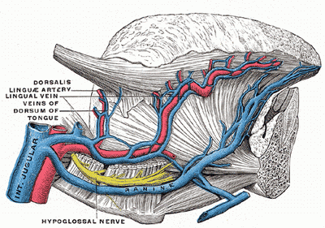
12th Cranial Nerve Hypoglossal Nerve
It is purely motor nerve
Innervates both the extrinsic and intrinsic muscles of the tongue.
It serves both to move and to change shape of the tongue.

Slide 9
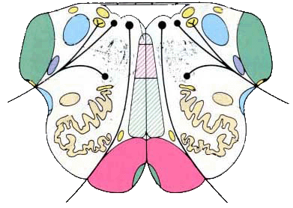
Hypoglossal Nerve
The axons originate in the Hhypoglossal nucleus
Which lies immediately beneath the floor of 4th ventricle, near middle line.
Axons course through medulla and
emerge as rootlets from ventral aspect of medulla,
between pyramid and olive.

Slide 10
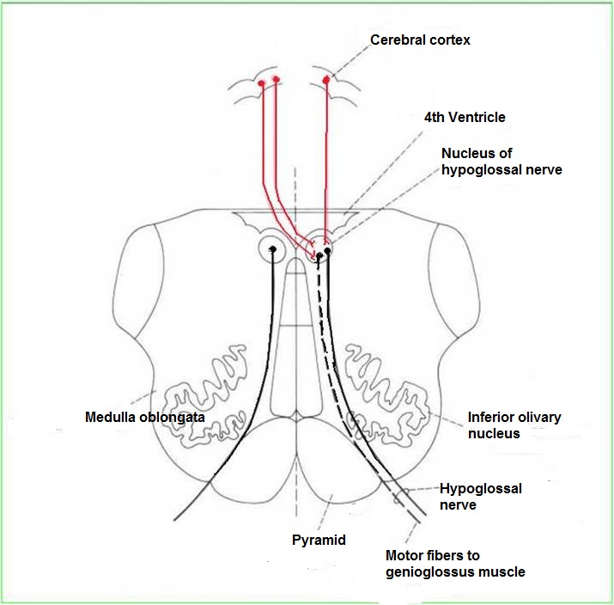
The hypoglossal nucleus receives corticonuclear fibers from both cerebral hemispheres EXCEPT
the region that supplies genioglossus muscle (receives contralateral supply only)
Also receives afferent fibers from nucleus solitarius and trigeminal sensory nucleus.

Slide 11
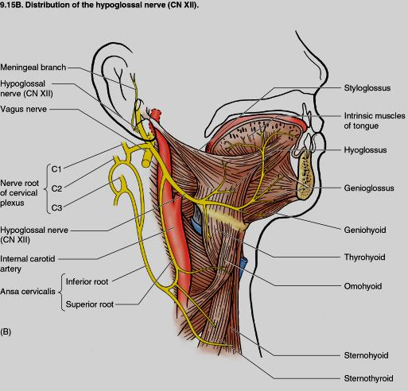
Hypoglossal Nerve
Course:
It emerges through the hypoglossal canal
Descends downward with cervical neurovascular bundle (internal carotid artery, internal Jugular vein, vagus nerve)
Curves forward behind mandible to supply the tongue.
During its initial course, it carries C1 fibers which leave in a branch to take part in the formation of ansa cervicalis.

Slide 12
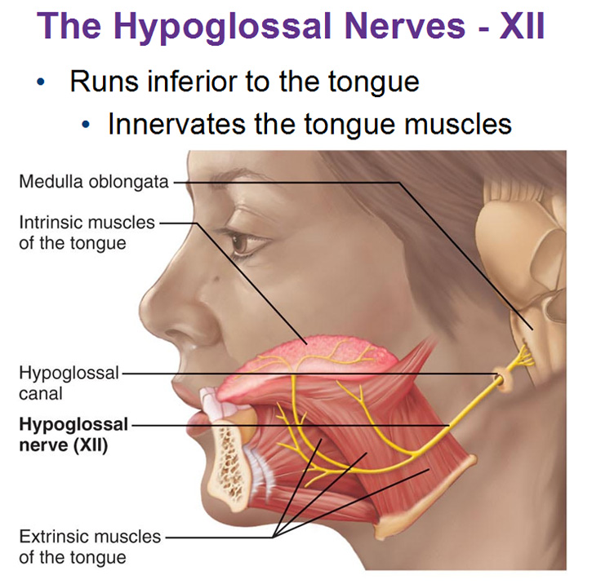
Distribution
Supplies motor innervations to all of the muscles of the tongue except the palatoglossus (which is supplied by the vagus).
Carries proprioceptive afferents from the tongue muscles.

Slide 13
Hypoglossal Nerve
Function:
Controls the movements and shape of the tongue during speech and swallowing.
Lesion; (LMN paralysis) results into:
Loss of tongue movements
Difficulty in chewing and speech
The paralyzed tongue, atrophies, becomes shrunken and furrowed on the affected side.
Unilateral lesion; the protruded tongue deviates to the affected side.
Bilateral lesion; the person can’t protrude the tongue.

Slide 14
Thank you& Good Luck

