Slide 1
BODY FLUIDS: Cerebrospinal Fluid
Dr. Amr S. Moustafa, MD, PhD
Clinical Biochemistry Unit, Pathology Dept.
College of Medicine, King Saud University

Slide 2
CSF Definition & Functions
CSF definition:
The liquid surrounding the brain and spinal cord
It flows in subarachnoid area (the space between the arachnoid & pia matter)
Functions:
Physical support & protection
Provides a controlled chemical environment → nutrient supply & waste removal
Intra- & extracerebral transport: Neuroendocrine function

Slide 3
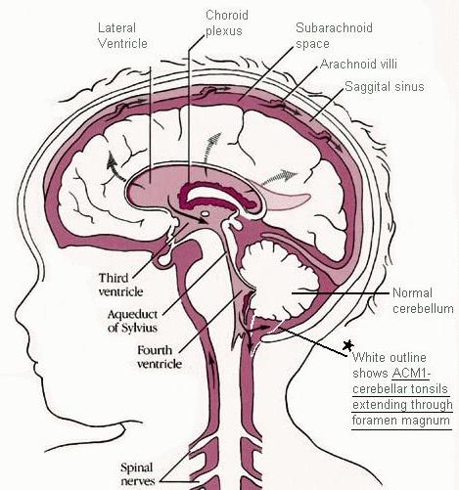
CSF Formation & Circulation
CSF is formed at the choroid plexuses & by the cells lining the ventricles.
Normal blood brain barrier is important fot the normal chemistry results of CSF
Rate of formation:
500 ml/day
Mechanism of formation:
Selective ultrafiltration of plasma
Active secretion by epithelial membranes
Mechanism of excretion (absorption):
Excretion volume = production volume → constant CSF volume
Absorption occurs at the arachnoid villi protruding through the dura to the venous sinuses of the brain→ bloodstream

Slide 4
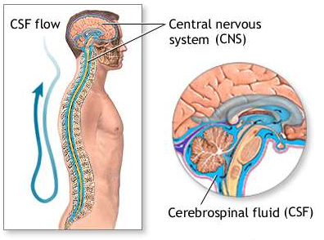
CSF Circulation

Slide 5
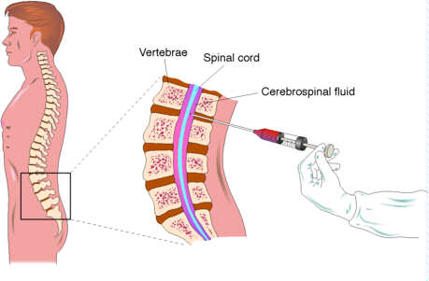
Method of CSF Sampling
Traumatic tap (damage to blood vessel during specimen collection) → blood in CSF

Slide 6
CSF Specimen Collection
Obtained by lumbar puncture (At the interspace L3-4, or lower)
Using aseptic technique
CSF is separated into 3 aliquots:
for chemistry & serology
for microbioloy
for cell count
Immediate analysis
It’s a precious sample: Preserve any remaining sample

Slide 7
Contraindications for performing lumbar puncture:
Bleeding diathesis
Increased intracranial pressure
Infection at site of needle insertion

Slide 8
Indications for laboratory investigation of CSF:
CNS infection
Demyelinating diseases
CNS Malignancy
Hemorrhage in CNS

Slide 9
Examination of CSF: 1- Physical examination
Normal CSF is:
Colorless
Clear
Free of clots
Free of blood
If CSF is cloudy (turbid) → perform microscopic examination:
is usually due to leucocytes
may be due to micro-organisms

Slide 10
Blood & Hemoglobin pigments in CSF
Traumatic tap
→ bright red color
→ RBCS in decreasing number as the fluid is sampled
Subarachnoid hemorrhage (SAH)
→ Xanthochromia (hemoglobin breakdown pigments) = RBCs lysis & metabolism previously occurred (at least 2 hr earlier)

Slide 11
When would Xanthochromia indicate hemorrhage?
If you exclude:
Prior traumatic tap
Hyperbilirubinemia (bilirubin > 20 mg/dL)

Slide 12
Examination of CSF: 2- Biochemical analysis of CSF
Tests of interest:
Glucose
Protein
Total
Specific:
Albumin
Immunoglobulin
Others (e.g. myelin basic protein; MBP)
Lactate
Glutamine (replaced by measuring plasma [ammonia])
√
√
The most reliable diagnostically &
accessible analytically

Slide 13
Glucose in CSF
Glc enters CSF via facilitative transporter (GLUT)
CSF [glucose] is ~ 2/3 that of plasma
50 - 80 mg/dl
A plasma sample must be obtained ~ 2-4 hr before CSF sample
In hypoglycemia: [CSF glucose] may be very low
In hyperglycemia: [CSF glucose] is raised.
Measure CSF [Glucose]:
immediately
or preserve the specimen with and antiglycolytic e.g. fluoride ion

Slide 14
Abnormal CSF [Glucose]
↓CSF [glucose] (hypoglycorrhachia):
Disorder in carrier-mediated transport
e.g. TB meningitis, sarcoidosis
Active metabolism of glucose by cells or organisms:
e.g. acute purulent, amebic, & fungal meningitis
Increased metabolism by the CNS
e.g. by CNS neoplasm
In viral meningitis CSF [glucose] is usually normal

Slide 15
Protein in CSF
Proteins, mostly albumin are found in the CSF (0.15-0.45 g/L)
Source of CSF proteins:
80% from plasma by ultrafiltration
20% from intrathecal synthesis

Slide 16
Abnormal CSF [total proteins]
↑ CSF [total protein]:
Must be compared to the serum [protein]
Useful nonspecific indicator of pathological states:
Lysis of contaminant blood (traumatic tap)
↑ premeability of the epithelial membrane due to:
Bacterial or fungal infection
Cerebral hemorrhage
↑ production by CNS tissue in:
Multiple sclerosis (MS)
Subacute Sclerosing Panencephalitis (SSPE)
Obstruction e.g. in:
Tumors
Abscess

Slide 17
CSF Albumin
CSF Albumin (mg/dL)
=
CSF serum albumin index:
If < 9 = intact BBB
Serum Albumin (g/dL)
Albumin is produced solely in the liver
Its presence in CSF must occur through BBB

Slide 18
CSF Immunoglobulin
CSF IgG/Serum IgG
=
CSF IgG index:
Normally: < 0.7
CSF serum Albumin index
CSF IgG can arise:
from plasma cells within CSF
& from the blood through BBB
↑CSF [IgG] without concomitant ↑ in CSF [Alb] suggests local production of IgG:
multiple sclerosis (MS)
subacute sclerosing panencephalitis (SPEE)

Slide 19
What to do if ↑ CSF [protein] was detected?
Perform electrophoretic separation
If multiple banding of the IgG band is detected (oligoclonal bands):
MS
SSPE
inflammatory diseases

Slide 20
Other Chemical Components of CSF
CSF [Calcium], [Potassium] & [Phosphates] are lower than their levels in the blood
CSF [Chloride] & [Magnesium] are higher than their levels in the blood
Abnormal CSF [Chloride]
marked ↓↓ in acute bacterial meningitis
slight ↓ in viral meningitis & brain tumors

Slide 21
Normal composition of CSF
Clear ,Colorless | Appearance
<5/mm³ | Lymphocytes
Nil | Polymorphs
7.4 | pH
100 - 150 ml | Total Volume
450 - 500 ml | Daily Secretion
1.006 - 1.007 | Specific Gravity
0.15 – 0.45 g/L | Protein
50 - 80 mg/dL (2.8-4.2 mmol/L) (>50% plasma level) | Glucose
115 - 130 mmol /L | Chloride
1.0 - 1.40 mmol/L | Calcium
0.4 - 0.7 mmol/L | Phosphorus
1.2 - 1.5 mmol/L | Magnesium
2.6 - 3.0 mmol/L | Potassium

Slide 22
Abnormal findings of CSF in some pathological conditions
Condition |  |  | Parameter
Viral Meningitis | Tuberculous Meningitis | Bacterial Meningitis (pyogenic)
Usually clear | Often fibrin web | Often turbid | Appearance
Mononuclear | Mononuclear | Polymorphs | Predominant cell
50-1000 | 10-1000 | 90-1000+ | Cell count/mm³
None seen or cultured | Often none in smear | In smear & culture | Bacteria

Slide 23
Abnormal findings of CSF in some pathological conditions, continued..
Condition |  |  | Parameter (reference range)
Viral Meningitis | Tuberculous Meningitis | Bacterial Meningitis (pyogenic)
<1 (Normal) | 1-5 (↑ ↑) | >1.5 (↑ ↑) | Protein (0.15-0.45 g/L)
>1/2 plasma (Normal or slightly ↓) | <1/2 plasma (↓ ↓) | <1/2 plasma (↓ ↓) | Glucose (2.8-4.2 mmol/L)
Normal or ↓ | ↓ ↓ | ↓ ↓ | Chlorides (115 - 130 mmol/L)

Slide 24
Otorrhea & Rhinorrhea
Otorrhea: leakage of CSF from the ear
Rhinorrhea: leakage of CSF into the nose
How to identify it as CSF?
Measure β-transferrin (a protein unique to the CSF)

Slide 25
TAKE HOME MESSAGE
CSF is formed in the choroid plexus
It is essential for the physical protection of the CNS
The physical & chemical analysis of CSF is essential for diagnosis of certain diseases

Slide 26
THANK YOU

