Slide 1
DEVELOPMENT OF VERTEBRAL COLUMN & SPINAL CORD
Prof. Ahmed Fathalla Ibrahim
Professor of Anatomy
College of Medicine
King Saud University
E-mail: ahmedfathala@hotmail.com

Slide 2
OBJECTIVES
At the end of the lecture, students should be able to:
List the layers of the spinal cord and its contents.
List subdivisions of mantle & marginal zones.
List meningeal layers and describe positional changes of spinal cord.
Describe development of vertebral column from sclerotomic portion of paraxial mesoderm.
Describe chondrification & ossification stages in vertebral development.
Describe spina bifida and its types.

Slide 3
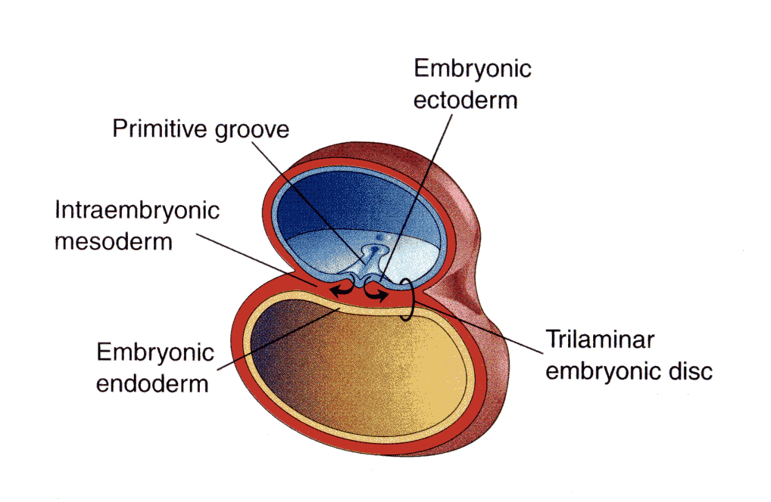
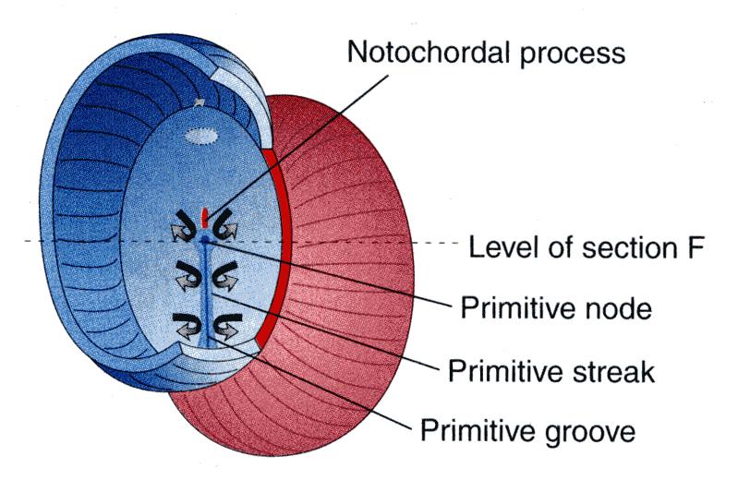
Embryo
Amniotic
cavity
Embryo
Yolk sac

Slide 4
DEVELOPMENT OF SPINAL CORD

Slide 5
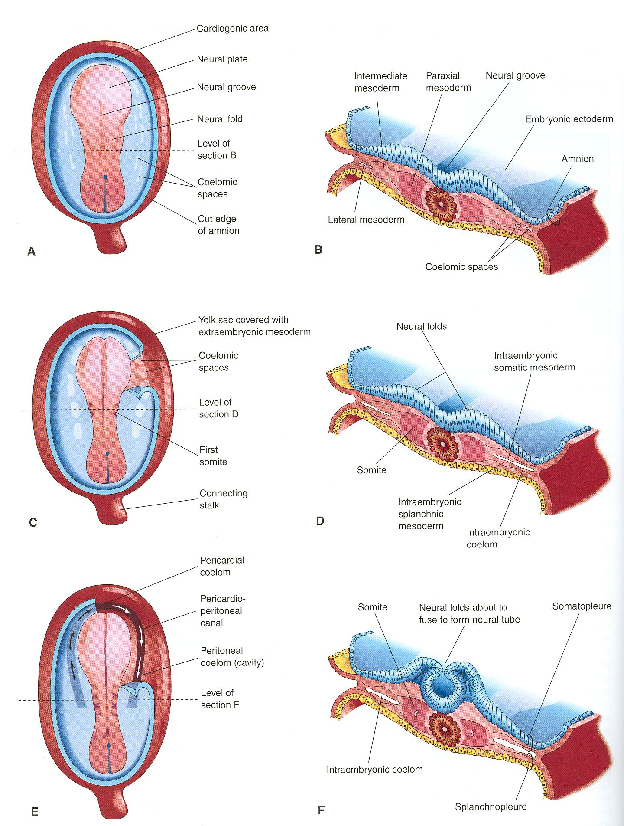
DEVELOPMENT OF NEURAL TUBE
Ectodermal cells dorsal to
notochord thickens to form
the neural plate.
A longitudinal groove develops
in the neural plate (neural groove).
The margins of the neural plate
(neural folds) approach to each
other and fuse to form the
neural tube.

Slide 6
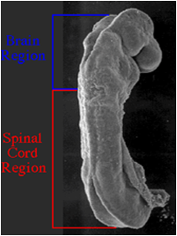
DEVELOPMENT OF SPINAL CORD
The spinal cord develops from the caudal 2/3 of the neural tube

Slide 7
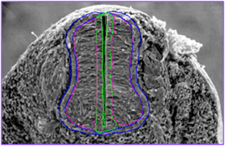
DEVELOPMENT OF SPINAL CORD
The cells of neural tube form:
An inner ventricular zone of undifferentiated cells
A middle mantle zone of cell bodies of neurons (future grey matter)
An outer marginal zone of nerve fibers or axons of neurons (future white matter)

Slide 8
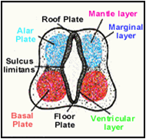
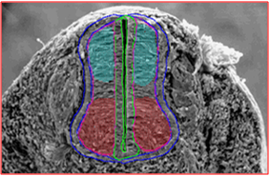
MANTLE LAYER OF SPINAL CORD
Neurons of mantle layer (future grey matter) differentiate into:
A dorsal alar plate (future dorsal horn): containing sensory neurons
A ventral basal plate (future ventral horn): containing motor neurons
The 2 areas are separated by a longitudinal groove (sulcus limitans).

Slide 9
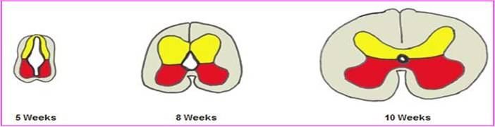
MANTLE LAYER OF SPINAL CORD
Dorsal median septum
Central canal
Ventral median septum
Proliferation and bulging of both alar & basal plates cause:
Formation of longitudinal dorsal & ventral median septa
Narrowing of the lumen to form a small central canal

Slide 10
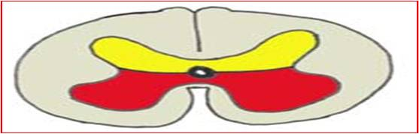
MARGINAL LAYER OF SPINAL CORD
Dorsal
funiculus
Lateral
funiculus
Ventral funiculus
Marginal layer increases in size due to addition of ascending, descending & intersegmental nerve fibers.
Myelination of nerve fibers starts at 4th month & continues during the 1st postnatal period. Motor fibers myelinate before sensory fibers.
Marginal layer (future white matter) is divided into: dorsal, lateral and ventral funiculus (white column)

Slide 11
MENINGES
They are 3 membranes covering the neural tube:
Outer thick dura matter: mesodermal in origin
Middle arachnoid matter: ectodermal in origin
Inner thin pia matter: ectodermal in origin
A cavity appears between arachnoid & pia (subarachnoid space) & becomes filled with cerebrospinal fluid.

Slide 12
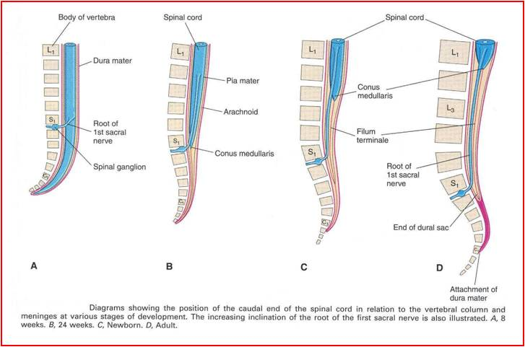
POSITIONAL CHANGES OF SPINAL CORD
8 weeks: spinal cord
at end of vertebral column
24 weeks: spinal cord
at level of S1
Birth: spinal cord
at L3
Adult: spinal cord
at L1-L2
Initially, the spinal cord occupies the whole length of the vertebral canal.
As a result a faster growth of vertebral column, the caudal end of spinal cord (conus medullaris) shift gradually to a higher level.

Slide 13
Notochord
stimulates :
Neural tube
formation
Vertebral column formation
Neural tube

Slide 14
INTRAEMBRYONIC MESODERM
Proliferates between Ectoderm & Endoderm EXCEPT in the central axis of embryo where NOTOCHORD is found.
Differentiates into 3 parts:
Paraxial mesoderm
Intermediate mesoderm
Lateral mesoderm
Paraxial mesoderm divides into units (somites).
Each somite divides into 3 parts:
Sclerotome
Myotome
Dermatome

Slide 15
DEVELOPMENT OF VERTEBRA
Notochord
Neural tube
Sclerotome
Sclerotome
1
1
2
2
3
3
1- Sclerotome around neural tube: forms vertebral (neural) arch
2- Sclerotome around notochord: forms body of vertebra
3-Sclerotome in body wall near to neural tube & notochord : forms costal process (gives ribs in thoracic region)

Slide 16
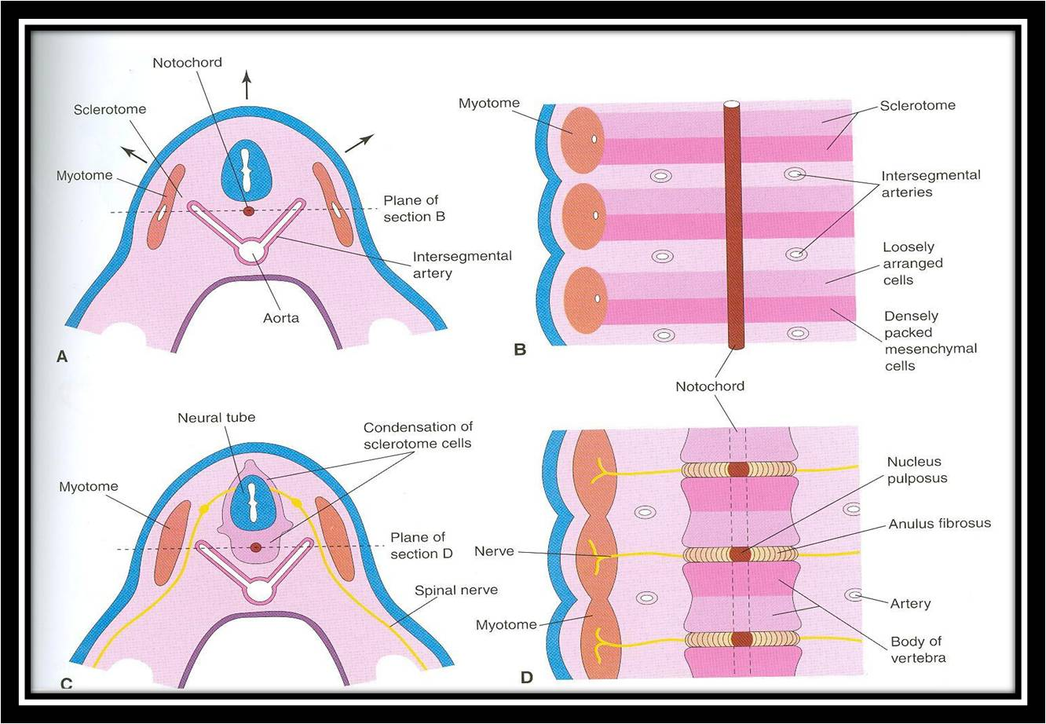
1- Loosely arranged cells
2- densely packed cells

Slide 17
FORMATION OF BODY OF VERTEBRA
At 4th week, each sclerotome is formed of:
A cranial part of loosely arranged cells
A caudal part of densely packed cells
The caudal part of each sclerotome fuses with the cranial part of succeeding sclerotome to form the centrum (body primordium)
Each centrum develops from 2 adjacent sclerotomes.

Slide 18
FATE OF NOTOCHORD
In the region of the bodies of vertebrae: It degenerates .
Between bodies of vertebrae: It forms the intervertebral discs (nucleus pulposus).
N.B.: Annulus fibrosus part of the intervertebral discs are formed by the mesoderm surrounding the notochord.

Slide 19
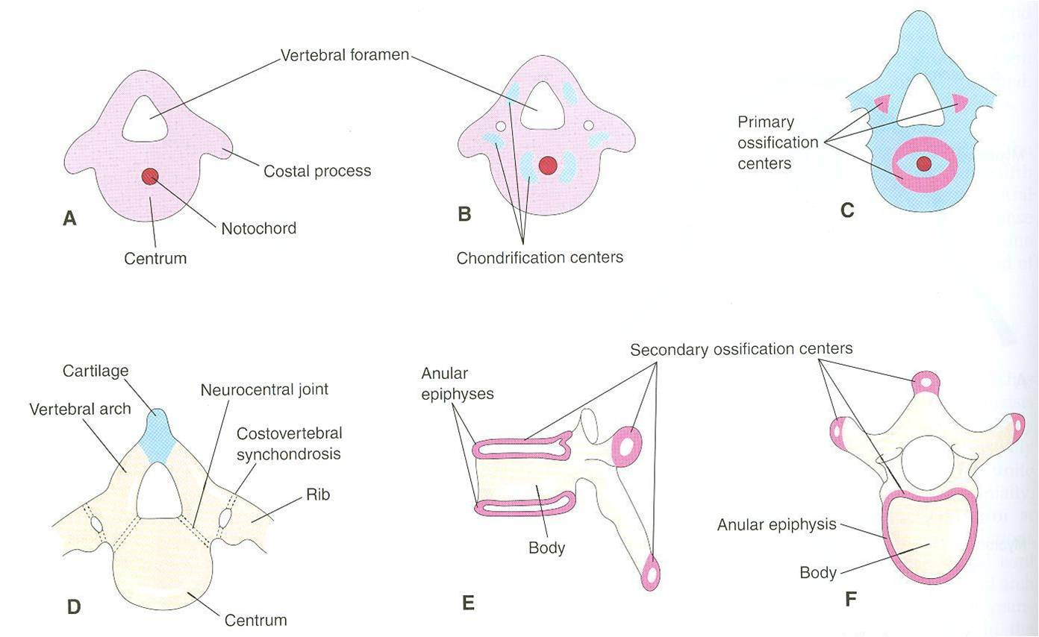
VERTEBRAL DEVELOPMENT
3
appear at end
of 8th week
appear at 6th week
Fusion occurs at 3-5 years
5
appear at puberty
Fusion occurs at 4-6 years
All centers unite around 25 years

Slide 20
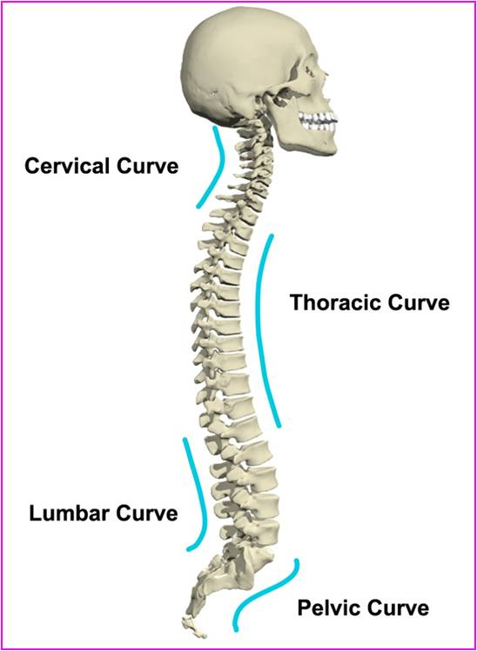
CURVATURES OF VERTEBRAL COLUMN
Primary curves (thoracic & pelvic or sacral): develop prenatally
Secondary curves: develop postnatally
Cervical: as a result of lifting the head
Lumbar: as a result of walking

Slide 21
SPINA BIFIDA
Cause: Failure of fusion of the halves of vertebral arches
Incidence: 0.04-0.15%
Sex: more frequent in females
Types:
Spina bifida occulta (20%)
Spin bifida cystica (80%)

Slide 22
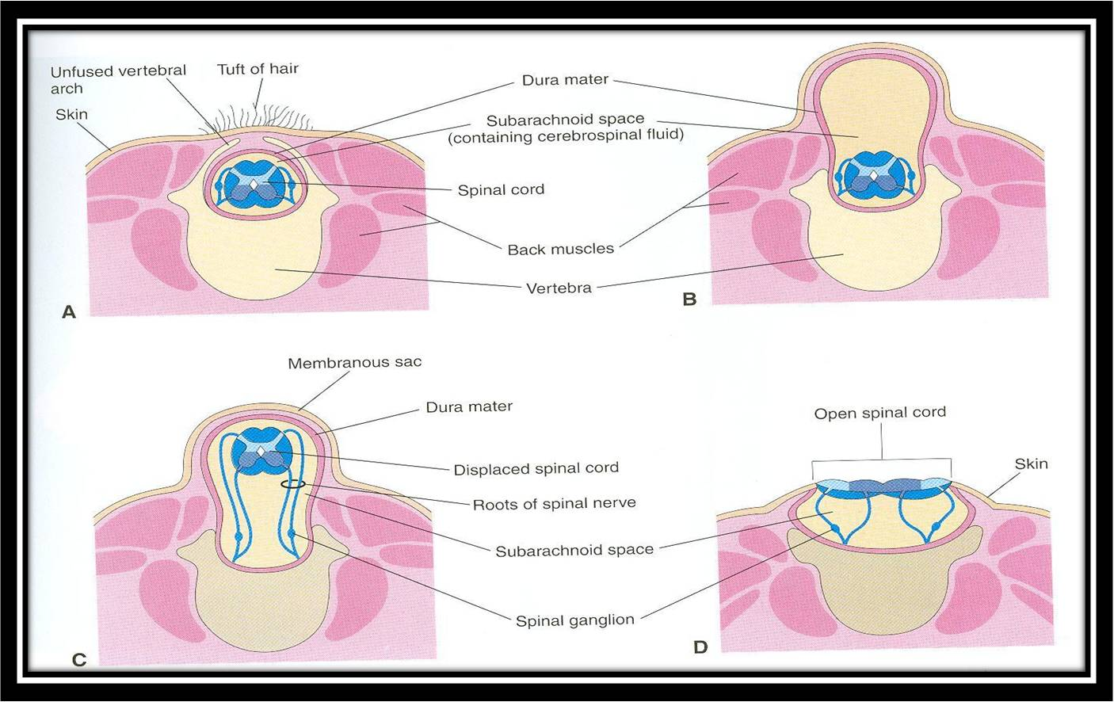
Spina bifida occulta
Spina bifida with meningocoele
Spina bifida with meningomyelocoele
Spina bifida with myeloschisis

Slide 23
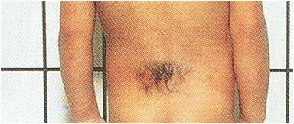
SPINA BIFIDA OCCULTA
The closed type
Only one vertebra is affected
No clinical symptoms
Skin overlying it is intact
Sometimes covered by a tuft of hair

Slide 24
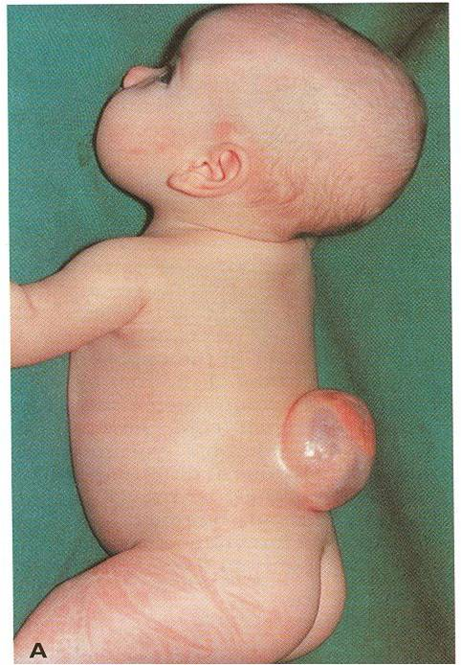
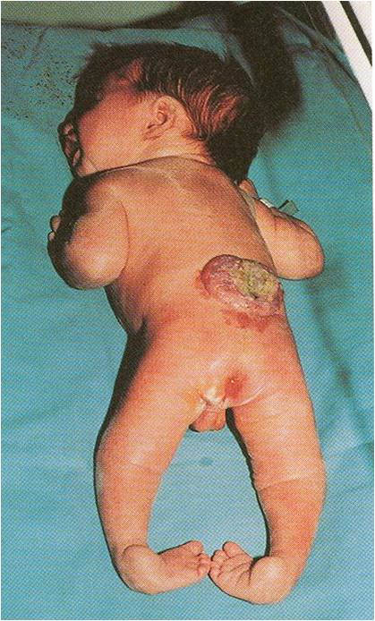
SPINA BIFIDA CYSTICA
With meningomyelocoele
With myeloschisis

Slide 25
SPINA BIFIDA CYSTICA
The open type
Neurological symptoms are present
Subdivided into:
Spina bifida with meningocoele: protrusion of sac containing meninges & cerebrospinal fluid
Spina bifida with meningomyelocoele: protrusion of sac containing meninges with spinal cord and/or nerve roots
Spina bifida with myeloschisis: spinal cord is open due to failure of fusion of neural folds

Slide 26
SUMMARY OF DEVELOPMENT OF SPINAL CORD
The spinal cord develops from the caudal 2/3 of the ectodermal neural tube.
Layers of spinal cord are (from inside outward): ventricular, mantle (future grey matter) and marginal (future white matter).
Mantle layer differentiates into dorsal alar plate (with sensory neurons) & ventral basal plate (with motor neurons) separated by sulcus limitans.
Marginal layer is divided into dorsal, lateral & ventral funiculus.

Slide 27
SUMMARY OF DEVELOPMENT OF SPINAL CORD
Myelination of nerve fibers starts at 4th month & continues during the 1st postnatal period. Motor fibers myelinate before sensory fibers.
Meninges are 3 membranous sac covering the neural tube (from outside inward): dura (mesodermal in origin), arachnoid and pia (both are ectodermal in origin).
A cavity between arachnoid & pia matters (subarachnoid space) contains cerebrospinal fluid.
During development the end of spinal cord shifts its position: at 24 weeks (level of S1), at birth (level of L3), adult position (level of L1-L2).

Slide 28
SUMMARY OF DEVELOPMENT OF VERTEBRAL COLUMN
Vertebral column develops from sclerotomic portion of paraxial mesoderm.
Sclerotome around neural tube forms vertebral (neural) arch.
Sclerotome around notochord forms body of vertebra. Each body develops from 2 adjacent sclerotomes.
Notochord forms nucleus pulposus portion of the intervertebral discs.
Chondrification centers appear at 6th week.
Three primary ossification centers appear at 8th week.

Slide 29
SUMMARY OF DEVELOPMENT OF VERTEBRAL COLUMN
Fusion between halves of neural arch occurs at 3-5 years, between neural arch & body at 4-6 years.
Five secondary ossification centers appear at puberty and fuse around 25 years.
Spina bifida is due to failure of fusion of the halves of the neural (vertebral) arch. It may be occulta (20%, closed type, no symptoms) or cystica (80%, open type, with symptoms).

Slide 30
QUESTION 1
Which one of the following regions of spinal cord contains cell bodies of sensory neurons?
Alar plate
Ventricular zone
Basal plate
Dorsal funiculus

Slide 31
QUESTION 2
At which one of the following periods of life fusion between vertebral arch & body of vertebra occurs?
8th week
Puberty
4-6 years
Around 25 years

Slide 32
QUESTION 3
Regarding spina bifida which one of the following statements is correct?
The closed type is more frequent than the open type.
The closed type presents with clinical symptoms.
Spina bifida is due to failure of fusion between the halves of vertebral arch.
In cases of spina bifida with meningocoele, the spinal cord is open.

Slide 33
THANK YOU

