Slide 1
CEREBRAL TB AND OTHER CHRONIC CEREBRAL INFECTIONS

Slide 2
Symptoms and signs of chronic cerebral and meningeal infections: over a long period of time or can be recurrent
SYMPTOM
Chronic head ache
Neck or back pain
Change in personality
Facial weakness
Double vision ,visual loss
Arm and leg weakness
clumsiness
SIGN
+/-Papilloedema
Brud Zinc or Kerning 'positive sign sof meningeal irritation
Altered mental status, memory loss, etc
Seventh nerve palsy
3,4,6 th,Nerve palsy
Ataxia
Hydrocephalus

Slide 3
Microbiological Causes Of Chronic Cerebral Infection And Meningities
A –Bacterial, Most important
a)Tuberculosis most common in Saudi Arabia
b)Brucellosis
c) Partially treated acute meningitis
d) Syphilis-caused by Treponema Pallidium
E) Liptospirosis- caused by L.Icter haemorraghia
F) Lyme disease-caused by Borrelia burgdorferi[ not common in Saudi Arabia]
g)Nocardiosis-caused by Nocardia speciese.g N.Asteroids
h) Cerebral abscesses can also same present as chronic infection

Slide 4
B- Fungal Causes
a- Cryptococcus neoformans
b-Candida species in Saudi Arabia mainly Candida albicans in immunocompromised patients
c- Aspergillus species
d- Histoplasma capsulatum

Slide 5
Cryptococcus neoformanse

Slide 6
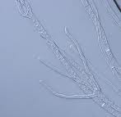
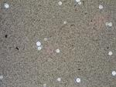
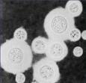
Cryptococcus neoformanse

Slide 7
C- Parasitic
a- Toxoplasma gonodii(most common)
b- Trypanosoiasis:caused by
T.gambiense
T.
c- Rare causes Acanthamoeba spp

Slide 8
D- Viruses
Some virus can some time present as chronic meningitis these include:
a- Mumps
b-Herpes simplex
c- HIV

Slide 9
The most important causes of chronic bacterial cerebral and meningeal infections in saudi arabia are
1- Tuberculosis
2- Brucellosis
They should be differentiated on the basis of:
a- Clinical History
b- Occupation
c- Clinical symptoms
d- Clinical signs in other organs eg chest in tb
e- Cerebrospinal fluid findings

Slide 10
Brucellosis
Is a common disease in Saudi Arabia
It affect people who are in contact with domestic animals or those who consume raw milk and milk products
It usually presents with Pyrexia( fever) of unknown organism of intermittent nature for more than 3 weeks
The fever is accompanied by night sweating, in between the attacks of fever the patient is not very ill.
Some times it can caused chronic cerebral infection and meningitis
The commonest causes in Saudi Arabia is Br.melitensis

Slide 11
Tuberculosis
Is caused by Mycobacterium tuberculosis and other memebers of the tb complex
M. tuberculosis infect one third of human race
The patient usually presents with fever of long duration
Symptoms of cough and coughing of blood (Haemoptoysis) when the chest is affected
In some cases it present as meningitis and cerebral infection presenting with chronic neurological symptoms and signs

Slide 12
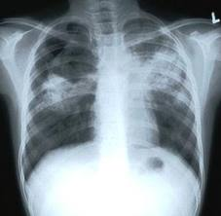

Slide 13
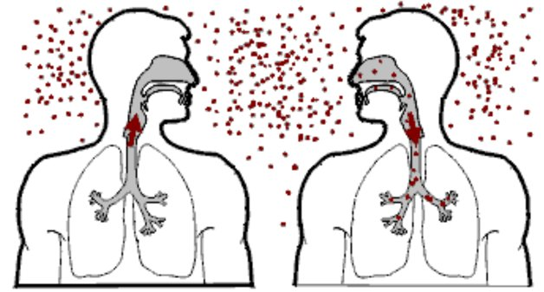

Slide 14
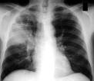
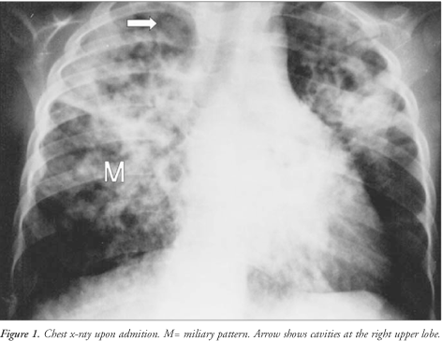

Slide 15
Tuberculosis brain abscess

Slide 16
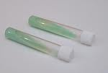
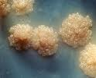
LJ media and culture morophology

Slide 17
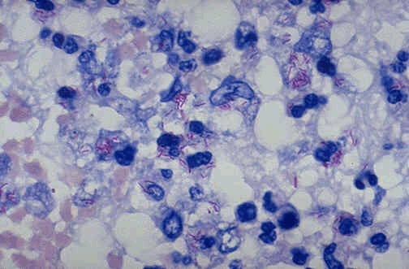
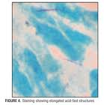

Slide 18
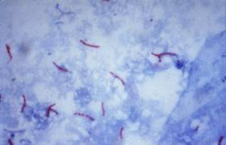

Slide 19
Chronic cerebral and meningeal infection can produce:-
a) Neurological disability and, may be
b) Fatal if not treated
They usually have:-
a) Slow insidious on set
b) with progression of signs and symptoms over a period of weeks
They differ from those of acute infection which have
a) Rapid on set of symptoms and signs
They are usually diagnosed ,if the neurological syndrome exists for > 4 weeks

Slide 20
Diagnosis of chronic cerebral and meningeal infections
a- History as mentioned for Brucellosis and Tuberculosis if suggestive
b-Clinical examination for symptoms and signs
c- Imaging by x- ray ,MRI or ultrasound
d- Laboratory findings

Slide 21
Laboratory Findings
This is mainly related to the laboratory examination of cerebrospinal fluid including:-
a-Collect of 2-5 ml of CSF and checking for the pressure level indicating intracranial pressure
b- Bio chemical investigation for :
1- Total protein
2- Glucose level in comparison to the
serum glucose level
c- Microscopy:
1- Presence of organisms
2- Total white cell count
3- Differential count mainly for:-
a- Polymorphes
b- Lymphocytes

Slide 22
As in acute pyogenic infections, in chronic cerebral and meningeal infections the following CSF finding will be as follows
a- Increased CSF pressure indicating increased intra cranial pressure
b- Increased protein level due to presence of inflammatory indicators, dead organism, proteins and WBC
c- Reduced glucose level ( Normally is 2/3 of serum glucose level)may normal in viral infections
d- Increased total white cell count but in chronic infection the differential shows lymphocytosis while in acute infections there is increased % of polymorphs
e- Gram stain can same time rarely shows causative organism
f- Z-N Stain can show AFB of T.B while modified Z-N can show Nocardia

Slide 23
Diagnosis continued
g- VDRL and other specific serological tests for syphilis
h- Wet preparation of CSF for fungal and parasites
i- India ink for Cryptococcus neoforman
j- Culture for CSF for Brucella,T.B Mycobacterium tuberculosis, Leptospira other Bacteria

Slide 24
Laboratory diagnosis of cerebral and meningetic Tuberculosis and Brucellosis
a) Mantoux test, Tuberculin skin test(TST)
b)Chest x-ray for focus of tb infection
c) CSF microscopy for AFB
d) CSF culture an solid medium [L.J ]or fluid medium[MIGT]
e) PCR or other molecular bioLOGY tests for presence of bacterial element tb and others
f) Culture of CSF for Brucella
g) Serology for Brucella
Combination of these finding with clinical history and examination finding

Slide 25
Treatment for cerebral and meningeal Tuberculosis and Brucellosis
Tuberculosis
4 Drugs are used these are:-
1- Rifampicin
2- Isonized(INH) for 2 month
3- Ethambutol
4-Pyrazinamide
Then,
Rifampicin for 4-6 month
INH

Slide 26
Brucellosis Treatment
Two of the following 3 drugs
a- Tetracycline
b- Rifampicin
c- Cotrimoxazole
Usually Rifampicin and Cotrimoxazole are preferred as they have good penetration power in the blood brain- barrier

Slide 27
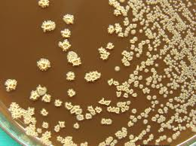
Nocardia growth on blood agar

Slide 28
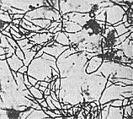
Nocacria gram stain

