Slide 1
Central nervous system block Neuropathology practical

Slide 2
First practical session

Slide 3
Brief review of Normal anatomy and histology

Slide 4
Cerebrum, Cerebellum and Brain Stem
C71.0
C71.3
C71.1
C71.4
C71.6
C71.2
C71.7

Slide 5
Meninges
Notes:
CSF is produced by the choroid plexus within the lateral and fourth ventricles. It circulates the ventricular system and enters the cisterna magna at the base of brain stem through the foramina of luschka and magendie. It is circulating in the subarachinoid space and absorbed by arachinoid granulations.

Slide 6
CNS Cells
Two cell types
Neuron
Conducts nerve impulses
Cannot be replaced if destroyed
Neuroglial cells
Support, nourish, and protect the neurons
Include astrocytes, oligodendrocytes, ependymal cells and microglia
Notes:
The organs of the CNS contain two types of cells. The neurons are cells that conduct nerve impulses. Mitosis or cell division cannot take place in neurons so neurons cannot be replaced if they are destroyed.
The neuroglia or glia is the supporting structure of nervous tissue. The neuroglial cells support, nourish, and protect the neurons. Mitosis does take place in neuroglia. The types of neuroglial cells include astrocytes, oligodendrocytes, and microcytes. A large percentage of brain tumors originate in neuroglial cells.

Slide 7
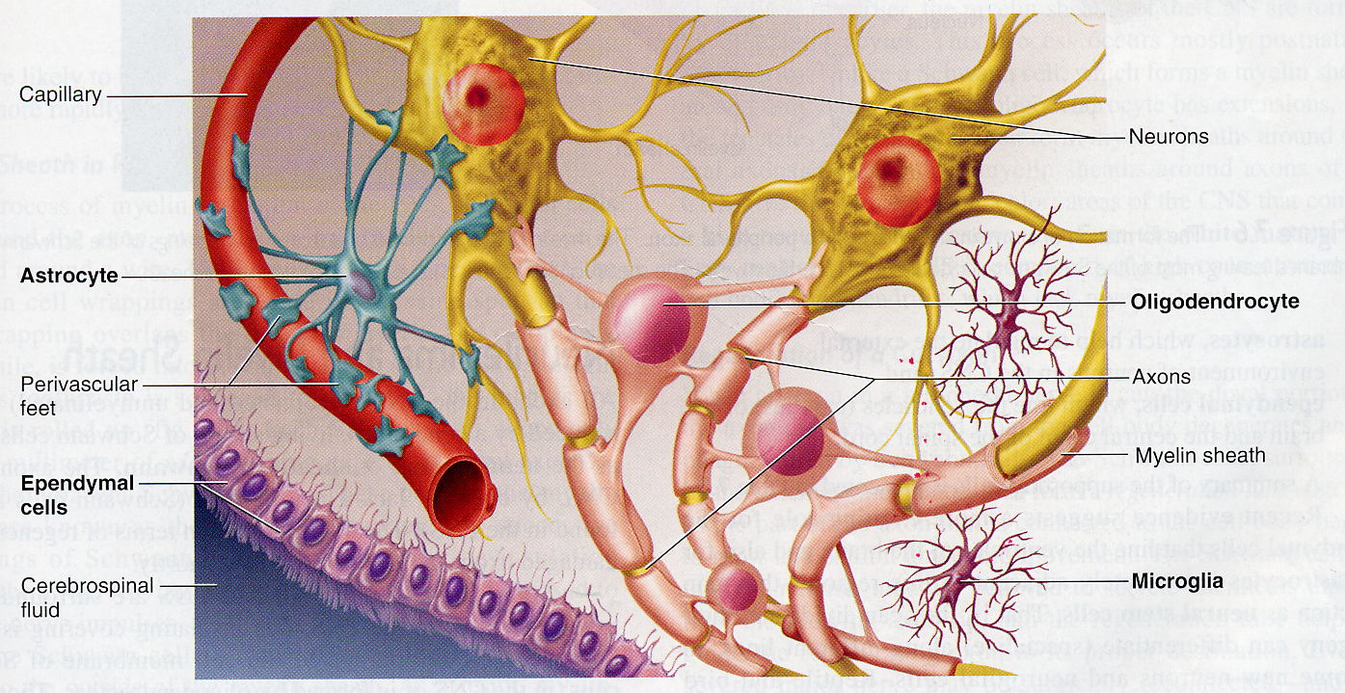

Slide 9
Gross and microscopic findings of selected CNS diseases

Slide 10
Case No. 1

Slide 11
43 years old female complained of headache and two attacks of seizures in the past 4 months . Brain MRI revealed a 3 cm. extra-axial mass in the parietal region. It was dural based with mild edema in surrounding brain tissue. What is your provisional diagnosis?

Slide 12
A rounded mass attached to the dura compress the underlying brain but is easily separated from it.

Slide 13
Meningioma arising from the dura at the base of the skull

Slide 14
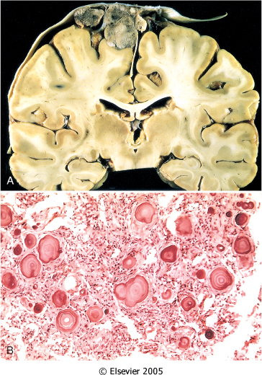
A, parasagittal multilobular meningioma attached to the dura with compression of underlying brain.
B, Meningioma with a whorled pattern of cell growth and psammoma bodies.

Slide 15
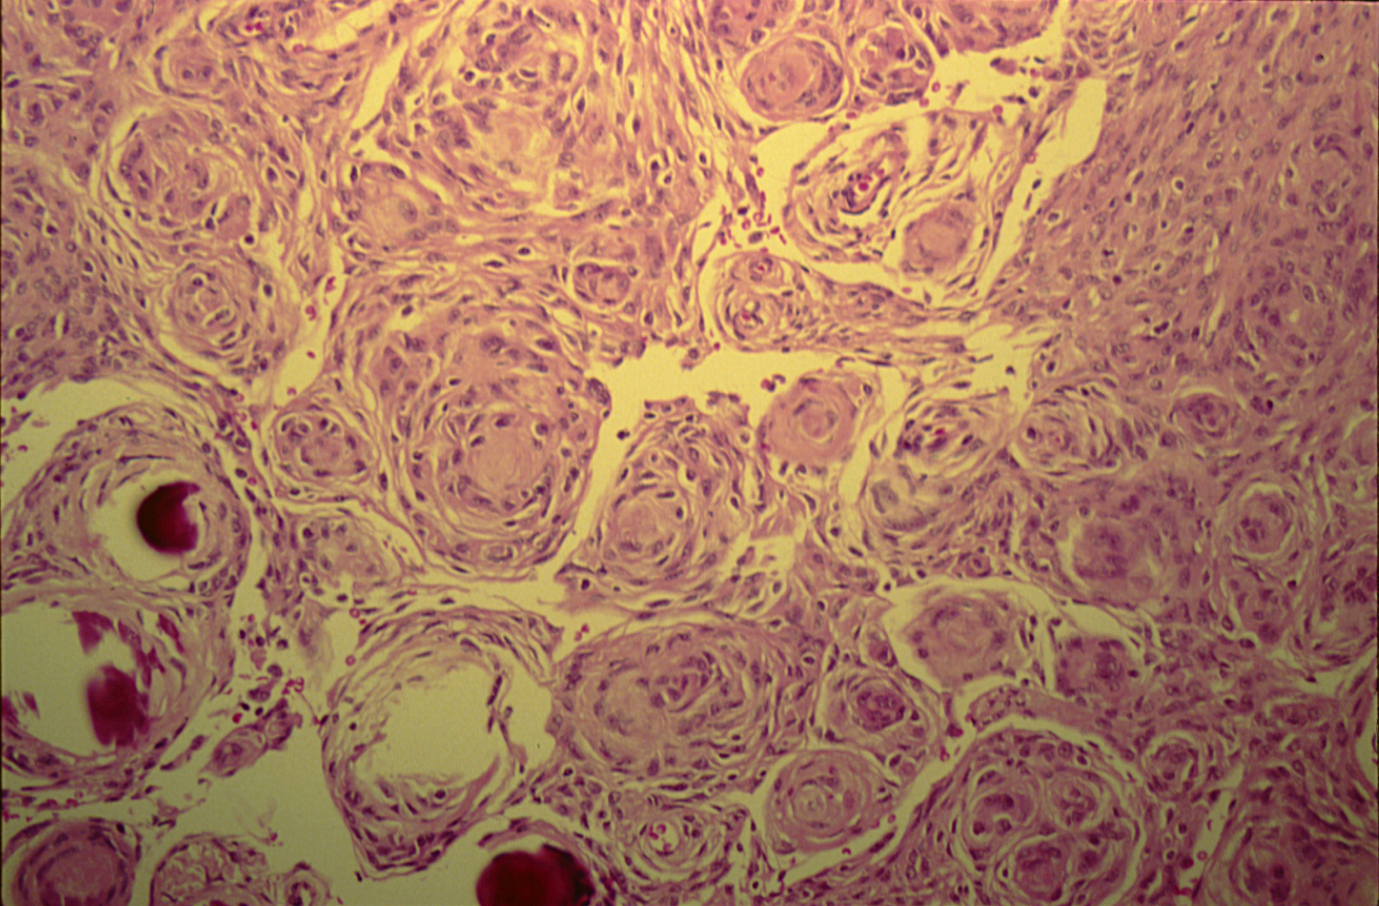
MENINGIOMA(DURA-BRAIN)

Slide 16
Meningioma: Section of tumour shows:
Whorls of fibrocellular tissue.
Cells are oval, spindle shape or elongated and lack mitosis.
Psammoma bodies (spherical calcified particles) are also seen within the tumour.

Slide 17
Meningioma

Slide 19
Case No. 2

Slide 20
55 years old man complained of headache for the last 2 months . Brain MRI reveals a 3 cm. frontal intra-parenchymal space occupying lesion with rim enhancement on contrast studies. What is your provisional diagnosis ?

Slide 21
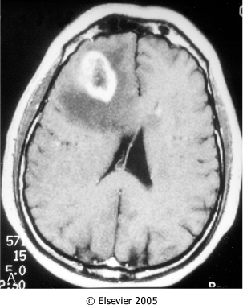
Computed tomographic (CT) scan of a large tumor in the cerebral hemisphere showing signal enhancement with contrast material and pronounced peritumoral edema.

Slide 22
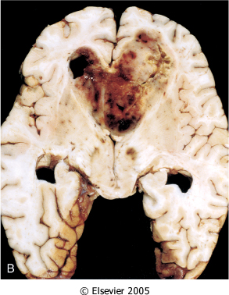
Glioblastoma multiforme appearing as a necrotic, hemorrhagic, infiltrating mass.

Slide 23
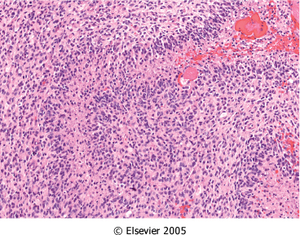
Glioblastoma. Foci of necrosis with pseudopalisading of malignant nuclei.

Slide 24
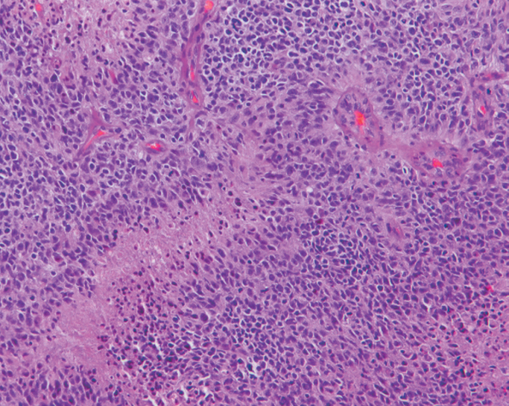
Glioblastoma. Foci of necrosis with pseudopalisading of malignant nuclei and endothelial cell proliferation

Slide 25
Glioblastoma multiforme

Slide 27
Case No. 3

Slide 28
27 years old woman presents with a sudden onset of right sided blindness and weakness in her left leg. There is no history of trauma. However, she experienced a similar episode 8 months ago and was diagnosed as aseptic meningitis.

Slide 29
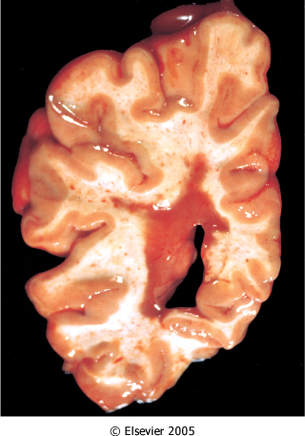
What is your provisional diagnosis?
Multiple sclerosis. Section of fresh brain showing brown plaque around occipital horn of the lateral ventricle.
Notes:
Brown and hemorrhagic periventricular plaque and slightly dilated and irregular lateral ventricle .

Slide 30
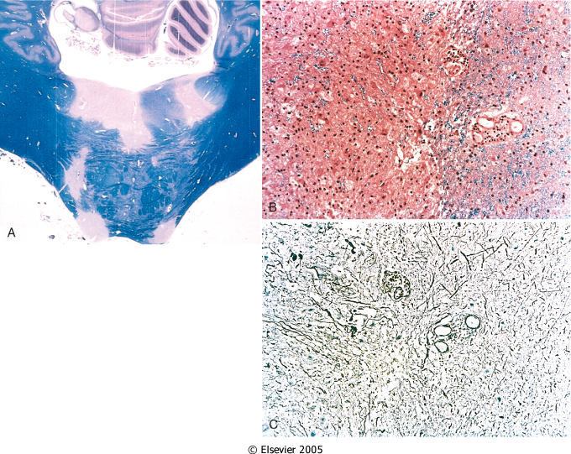
Multiple sclerosis. A, Unstained regions of demyelination (MS plaques) around the fourth ventricle (Luxol fast blue PAS stain for myelin).
B, Myelin-stained section shows the sharp edge of a demyelinated plaque and perivascular lymphocytic cuffs.
C, The same lesion stained for axons shows relative preservation.

Slide 31
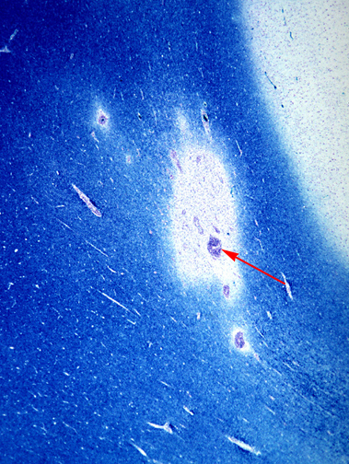
This is a myelin stain (luxol fast blue/PAS) of an early lesion of pale demyelinated area. The lesion is centered around a small vein (arrow) which is surrounded by inflammatory cells .

Slide 32
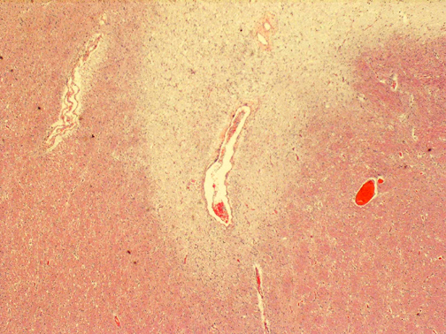
This is an H&E stained sections from a patient with long-standing MS. This lesion is centered on a vein. In this older lesion, however, there is very little inflammation around the vein.
You can see the loss of myelin even without a special stain: it is lighter pink than the normal white matter surrounding it.

Slide 33
Multiple sclerosis

Slide 34
The key microscopic features of multiple sclerosis are:
Perivenous mononuclear inflammation (lymphocytes, plasma cells and macrophages)
Loss of myelin and variable loss of oligodendrocytes.
Relative preservation of axons.
Reactive astrogliosis (sclerosis).
However, MS lesions do vary depending on their age.
Early (acute) lesions are characterized by perivascular and parenchymal infiltration by inflammatory mononuclear cells, and myelin breakdown and phagocytosis by macrophages. Astrogliosis is not yet profound and axons are relatively preserved.
As the lesion progresses, there are fewer inflammatory cells and more astrogliosis. Chronic lesions have few mononuclear cells, almost complete demyelination, and severe astrogliosis. There can be oligodendrocyte loss and some secondary axonal loss in advanced cases.

Slide 36
Case No.4

Slide 37
39 years old man complains that he had noticed a progressive hearing loss over a
2 years period. Except for occasional headache, he has no other complaints . Evaluation discloses severe sensorineural hearing loss of the left side . MRI shows 1.5 cm. mass at the left cerebellopontine angle . What is your provisional diagnosis ?

Slide 38
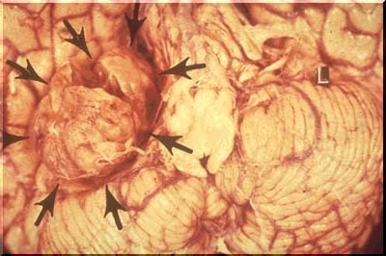
Well circumscribed mass at the cerebello-pontine angle
Notes:
Mass at the cerebello-pontine angle .

Slide 39
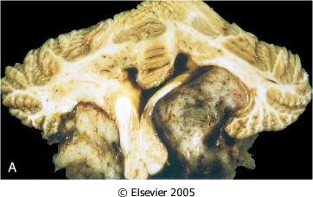
Schwannoma. A, Bilateral eighth nerve schwannomas.
What syndrome is suggested by such finding?
Notes:
Neurofibromatosis type 2

Slide 40
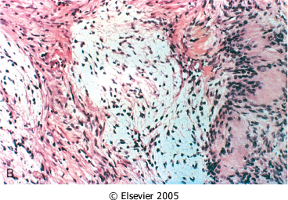
Schwannoma. B, Tumor showing cellular areas, including Verocay bodies (far right), as well as looser, myxoid regions.

Slide 41
A schwannoma. typically has dense areas called Antoni A (black arrow) and looser areas called Antoni B (blue arrows). The cells are elongated (spindle shaped) and the nuclei have a tendency to line up as seen here in the Antoni A area.
A schwannoma is a benign tumor which can be cured by local excision .
Notes:
A schwannoma is a benign tumor which can be cured by local excision .

Slide 42
Schwannoma

Slide 44
Second practical session

Slide 45
Case No. 5

Slide 46
9 months infant was suffering from enlarged head size and admitted to hospital with convulsions, went into coma and died. Autopsy was done and the brain was large with dilated ventricles . What is your provisional diagnosis?

Slide 47
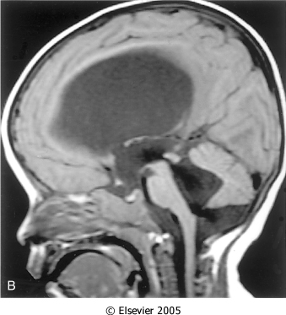
Midsagittal magnetic resonance image of a child with communicating hydrocephalus, involving all ventricles.

Slide 48
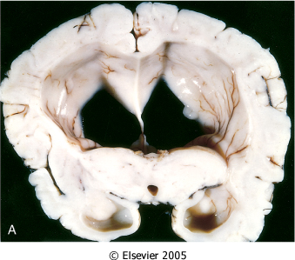
Hydrocephalus. Dilated lateral ventricles seen in a coronal section through the midthalamus.

Slide 49
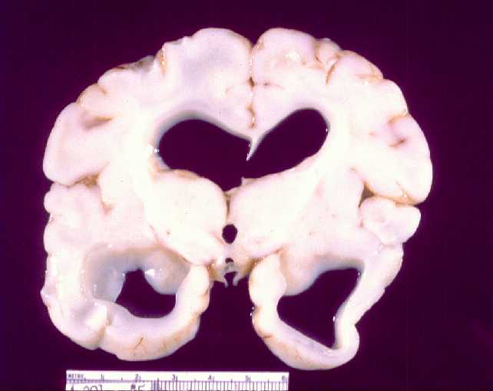
Cross section of brain showing marked dilatation of the ventricles.

Slide 50
Hydrocephalus

Slide 52
Case No. 6

Slide 53
4 years old child who was treated from otitis media and suddenly complained from headache, vomiting, fever and stiff neck. CSF was found to be clouded with abnormal increase of neutrophils, increased protein and absence of sugar. Gram stain of the CSF fluid showed meningiococci . What is your diagnosis ?

Slide 54
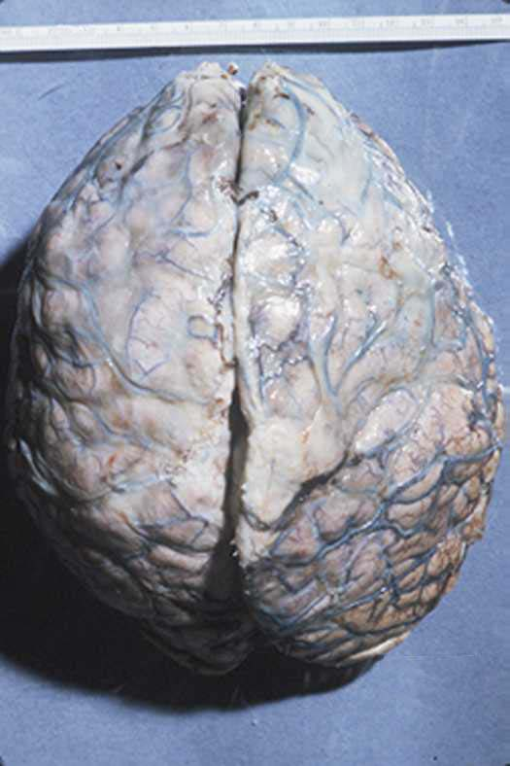
A thick layer of supurative exudate covers the brain hemispheres and meninges

Slide 55
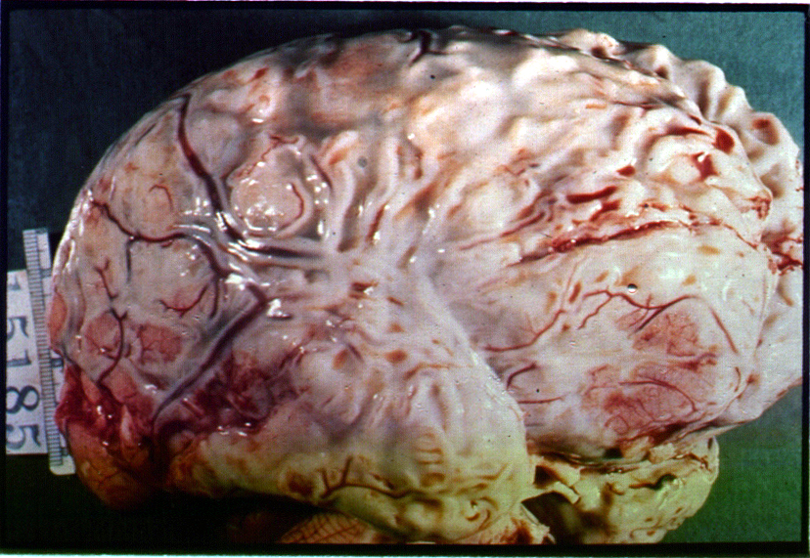
A thick layer of supurative exudate covers the brain hemispheres, with thickens Leptomeninges

Slide 56
Pyogenic ( bacterial ) meningitis

Slide 58
Case No. 7

Slide 59
35 years old lady complains from otitis media . Suddenly she suffers from headache and convulsions. Brain MRI reveals 5 cm. fluid filled cavity in the temporal lobe. Examination of the CSF shows increased pressure with lymphocytes and increased protein but there is no change of sugar content. What is your diagnosis ?

Slide 60
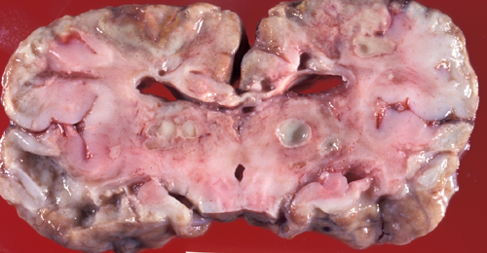
Multiple discrete lesions with central liquefactive necrosis. There is a surrounding fibrous capsule and marked edema

Slide 61
Brain abscess

Slide 63
Case No. 8

Slide 64
A previously healthy 31-year-old woman experiences a severe headache and loses consciousness within an hour. An emergent head CT scan reveals extensive subarachnoid hemorrhage at the base of the brain. She is a febrile. A lumbar puncture yields cerebrospinal fluid with many red blood cells, but no white blood cells. The CSF protein is slightly increased, but the glucose is normal. What is your provisional diagnosis ?

Slide 65
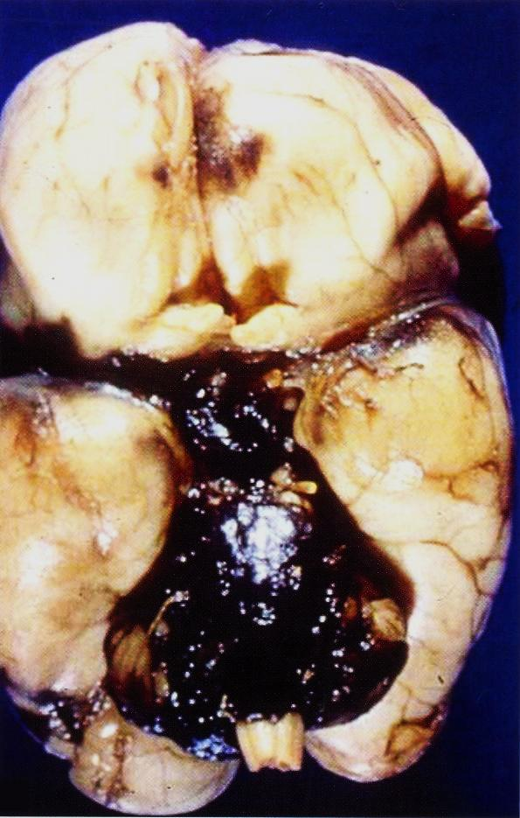
Extensive hemorrhage in the pons with extension to fill the fourth ventiricle

Slide 66
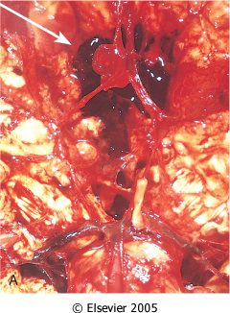
View of the base of the brain, dissected to show the circle of Willis with an aneurysm of the anterior cerebral artery (arrow).

Slide 67
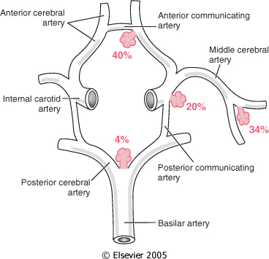
Common sites of saccular (berry) aneurysms in the circle of Willis

Slide 68
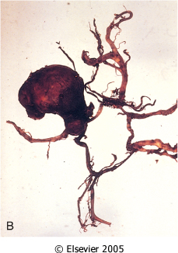
B, Dissected circle of Willis to show large aneurysm.

Slide 69
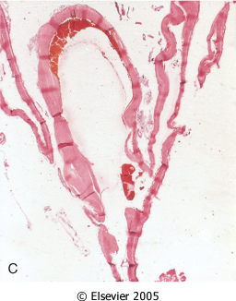
C, Section through a saccular aneurysm showing the hyalinized fibrous vessel wall.

Slide 70
Ruptured berry aneurysm causing subarachnoid hemorrhage

Slide 72
Case No.9

Slide 73
An 85 years old man complains of progressive loss of memory, disorientation and alterations in mood and behavior since 20 years. He was admitted to hospital because he was disabled and immobile and he died in hospital after one week of admission. Autopsy was done and the brain cortex was found to be atrophied. What is your diagnosis ?

Slide 74
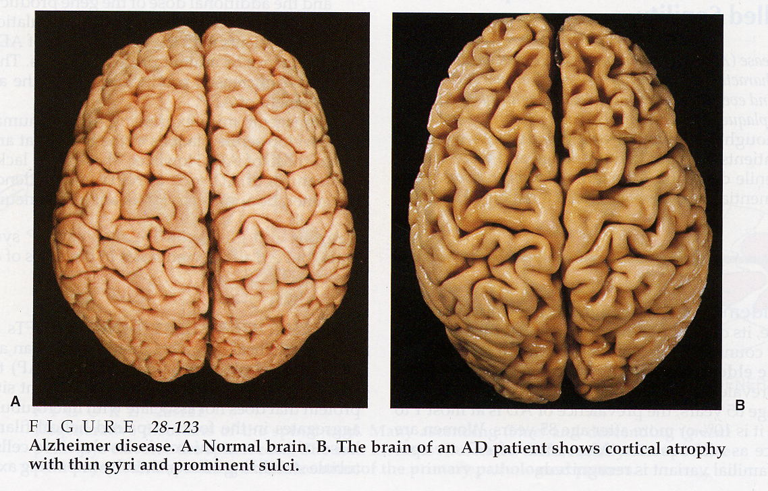

Slide 75
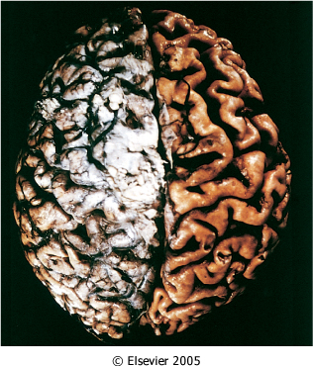
Alzheimer disease with cortical atrophy most evident on the right, where meninges have been removed.
Notes:
Notice the deep and wide sulci and narrow gyri .

Slide 76
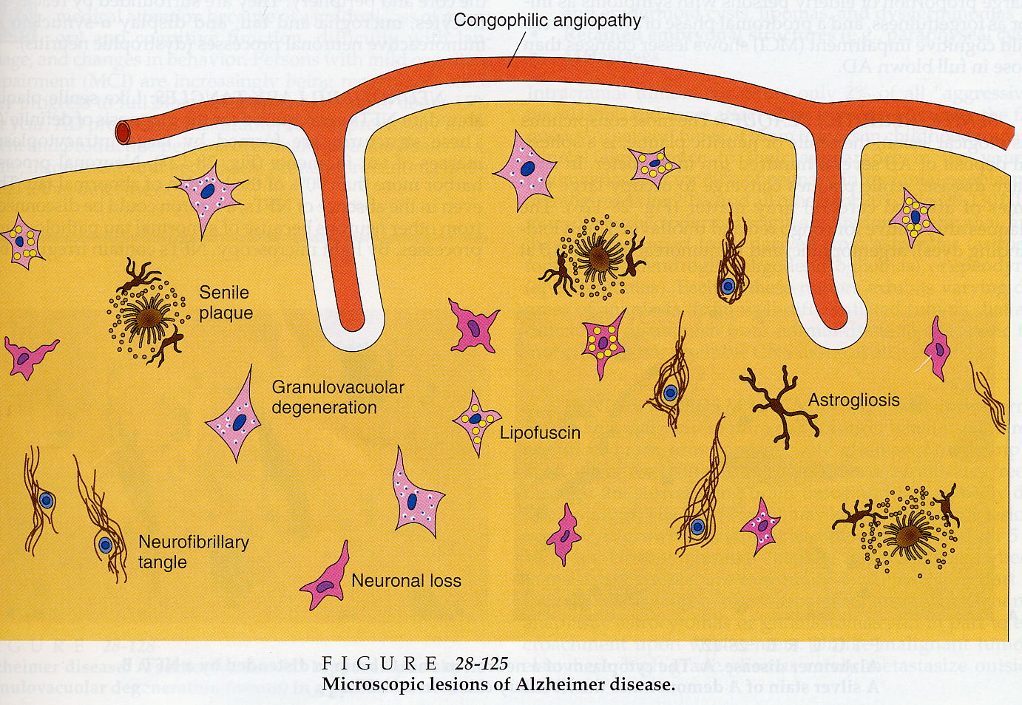

Slide 77
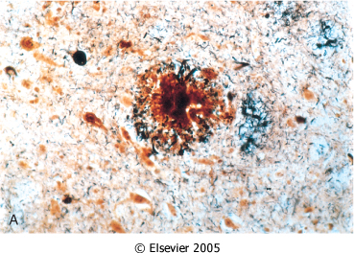
Alzheimer disease. A, Neuritic plaque with a rim of dystrophic neurites surrounding an amyloid core.

Slide 78
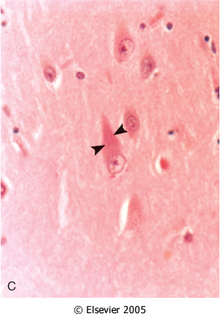
Alzheimer Disease. C, Neurofibrillary tangles (arrowheads) are present within the neurons.

Slide 79
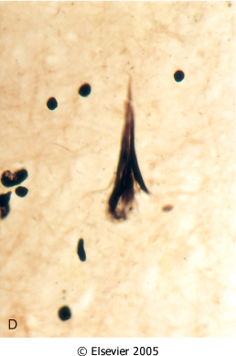
Alzheimer Disease. D, Silver stain showing a neurofibrillary tangle within the neuronal cytoplasm.

Slide 80
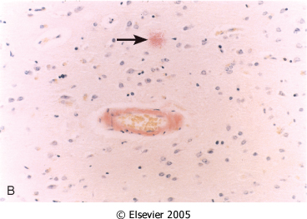
Alzheimer Disease. B, Congo red stain of the cerebral cortex showing amyloid deposition in the blood vessels and the amyloid core of the neuritic plaque (arrow)

Slide 81
Alzheimer disease

Slide 82
Alzheimer Disease
Macroscopic examination of the brain shows a variable degree of cortical atrophy with widening of the cerebral sulci that is most pronounced in the frontal, temporal, and parietal lobes
Microscopic: neuritic (senile) plaques, neurofibrillary tangles, and amyloid angiopathy

