Slide 1
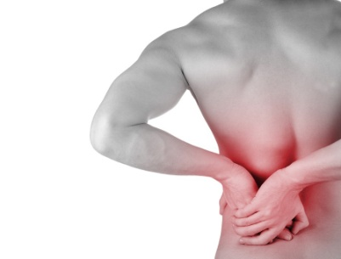
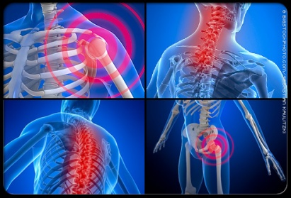
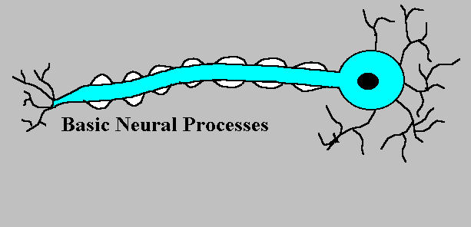
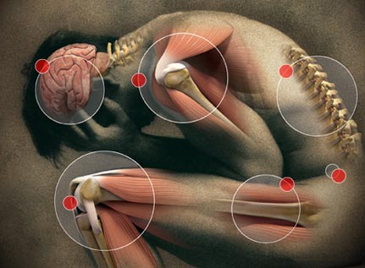

DRUGS IN MANAGEMENT OF
PAIN

Slide 2
DRUGS IN MANAGEMENT OF PAIN
ILOs:
Revise how pain is perceived and modulated, emphasizing
on neurotransmitters, receptors, channels involved
Classify drugs used in management of pain
Expand on pharmacology of opiates, patterns of
classification, mechanism of action, indications, ADR,…etc.
detailing on morphine as an example.
Compare in brief actions and indications of other opiate
agonists and antagonists.

Slide 3
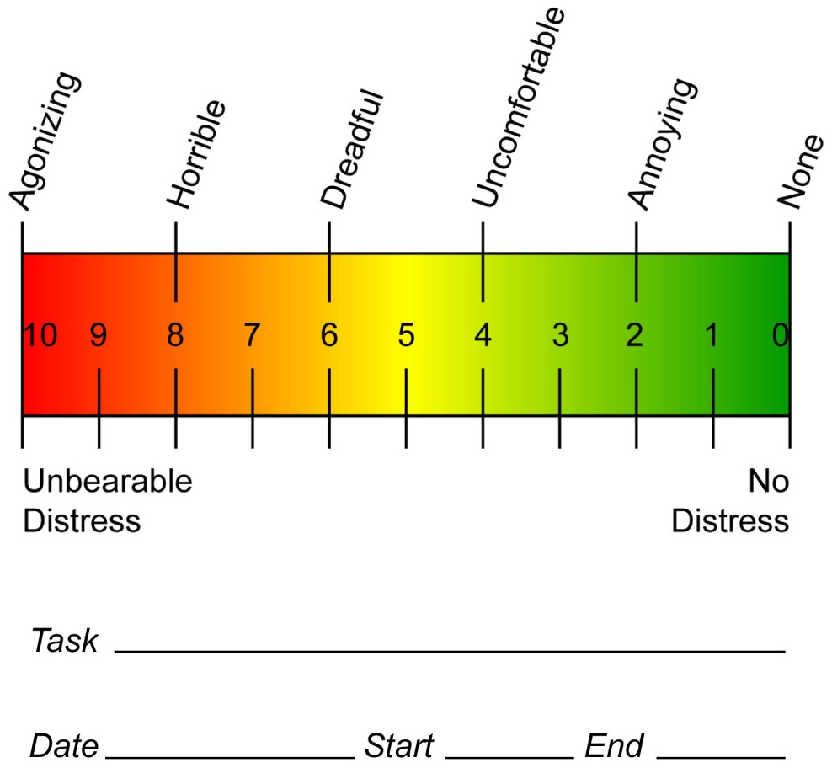
PAIN
Unpleasant sensory & emotional experience associated with actual or potential tissue damage. If uncontrolled  ruin the quality of life. It varies in intensity  annoying to unbearable.
Unbearable
Worst possible
Excruciating
very severe
Miserable severe
Troublesome
moderate
Annoying
mild
It varies in onset & longevity  acute vs chronic
It varies in nature acing, throbbing, burning, stabbing ….etc
It varies according to + damage [apparent injury, ischemia, inflammation, cancer,] or [not apparent as neuralgias].
It varies pathphysiological; noniceptive & neuropathic

Slide 4
PAIN
Noniceptive
Neuropathic
by activation of noniceptors
by damage to or
malfunction of the nervous system
Post Operative
Crush Injuries
Ischemic
Inflammation
Distention
Low back pain
Cancer pain
Diabetic neuropathy
Post herpetic neuralgia
Post amputation

Slide 5
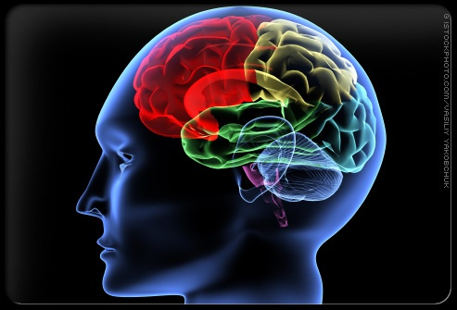
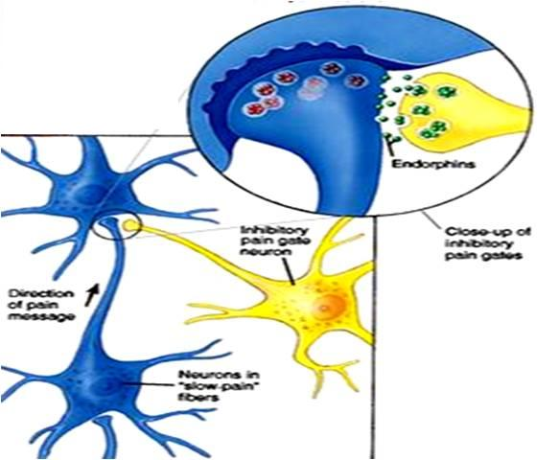
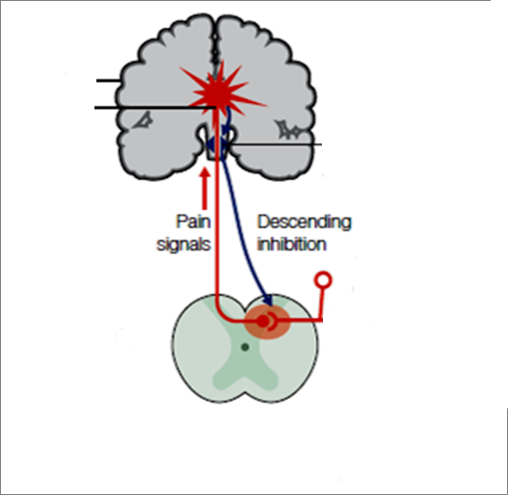
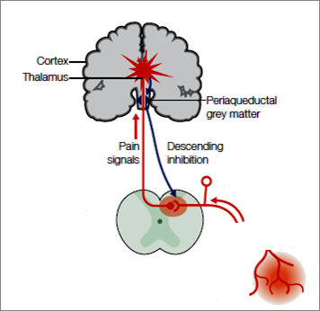
5HT, NE, Dopamine, GABA, Cannabinoids……etc.
Somatosensory Cortex
 Perception of Pain
Cingulate Cortex
 Affective component of Pain
5HT, NE, Dopamine, GABA, Cannabinoids……etc.
Thalamus
Periaqueductal Grey Matter
Inhibitory Pain Gate
Dorsal Root Ganglion
Enkephalines, NE, GABA, Adenosine
Pain signals
PAIN Transmission
& Processing
Substantia Gelatinosa
Spinal
Cord
Noniceptors
ATP, Glutamate, Prostaglandins, Bradykinins, 5HT, Histamine, SP, CGRP, ions, metabolites
Stimulus

Slide 6
Somatosensory Cortex
 Perception of Pain
Opioids, α₂ AD agonists, ADDs Anesthetics,
Cingulate Cortex
 Affective component of Pain
ADDs, Cannabinoid antagonists,
Thalamus
DRUGS USED TO CONTROL PAIN
Periaqueductal Grey Matter
Dorsal Root Ganglion
Local anesthetics, α₂ AD agonists, NMDA R antagonists
Opioids, ADDS,
Anticonvulsants
Pain signals
Local anesthetics
Opioids
Substantia Gelatinosa
Spinal
Cord
Noniceptors
ASA, Acetominophen, NSAIDs, Local Anesthetics, Capsaicin Anticonvulsants, Cannabinoid antagonists…..etc
Stimulus

Slide 7
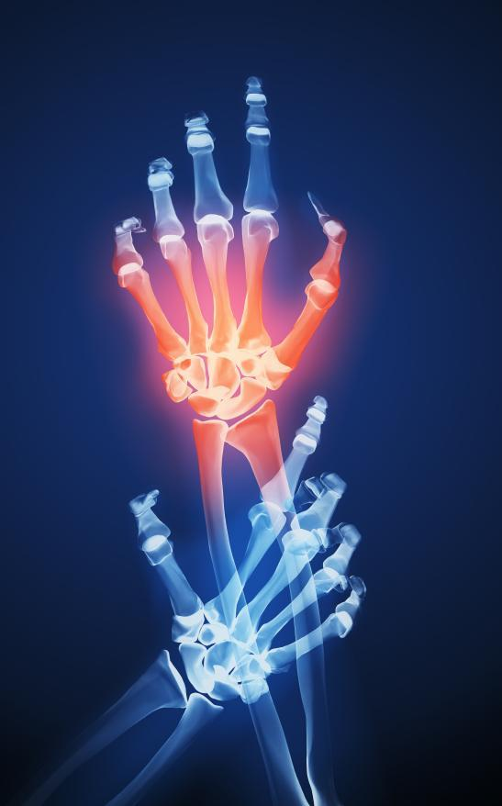
A state in which a painful stimuli is modulated; though perceived but felt no more painful.
TREATMENT OF PAIN
Noniceptive Pain
Neuropathic as Cancer Pain
NSAIDs
 ANALGESICS 
NSAIDs
OPIOIDS
OPIOIDS
Adjunctive
Adjunctive
NSAIDs
OPIOIDS
For Mild To Moderate Dull Aching
For Moderate To Severe
> Visceral

Slide 8
World Health Organization
(WHO) Step Ladder Approach
Severe pain7-10/10
Moderate Pain 4-6/10
Potent opioids (e.g.
morphine) +/-
non-opioids
Weak opioids +/- non-
opioids (e.g. Paracetamol)
Mild Pain 1-3/10
ASA, Paracetamol,
NSAIDS

Slide 9

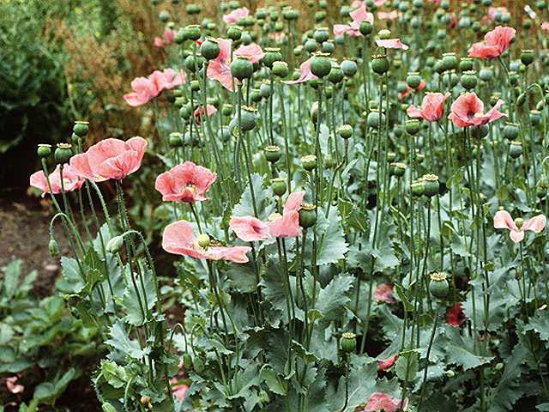
OPIOIDS
ANALGESICS  OPIOIDS
Derived from the dried milky juice  exuded by incised seed capsules of a species of poppy, Papaver somniferum,
It contains a mixture of alkaloids, the principal components being
morphine, codeine & papaverine.
Mimic action of endogenous opioids;
Endorphins, Dynorphins,Enkephalins
Act on endogenous opioid receptors
mu, delta, kappa, sigma

Slide 10
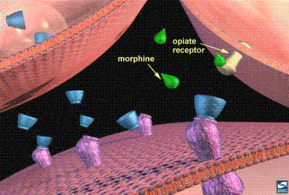
Functions mediated by endogenous OPIOIDS RECEPTORS
μ→ supraspinal analgesia, respiratory depression, euphoria,
physical dependence
δ→spinal analgesia, respiratory depression, GIT motility
Κ→ spinal analgesia, sedation, pupil constriction, dysphoria
All of them typical G-protein coupled receptors.
σ→ dysphoria, hallucination , pupil dilation, anxiety bad
dreams,…
It is not a true opioid receptor, as it binds psychotomimetic drugs.
Exceptionally of opioids only benzomorphans binds to it.

Slide 11
CLASSIFICATION OF OPOID ANALGESICS
According to their source
Natural ( Morphine)
Semisynthetic ( Codeine )
Synthetic ( Mepiridine, Methadone, Fentanyl, Tramadol )
According to agonistic/antagonistic actions at receptors:
Agonists; Morphine, Codeine, Pethidine, Methadone
Fentanyl, Tramadol, Loperamide [no BBB  diarrhea]
Mixed agonists /antagonists; Pentazosine, Buprenorphine
Pure antagonist; Nalaxone, Naltraxone, Nalmefene
According to their specificity of action on receptors:

Slide 12
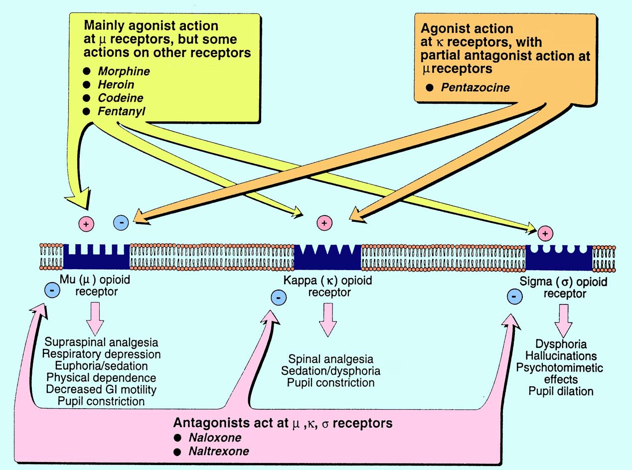

Slide 13
Binding to presynaptic opioid receptors coupled to Gi  AC & cAMP  voltage-gated Ca²⁺ channels  excitatory transmitter.
Binding to postsynaptic opening of K channels neuronal excitability
firing of nociceptive pathways converging at Periaqueductal GM
to allow for inhibitory firing along the descending pathway returning
to dorsal horn pain
Also inhibit pain transmission by acting directly on the dorsal horn, and by  excitation of peripheral nociceptive afferent neurones.
Morphine, Heroin, Pethadine,
Codeine, Fentanyl
CELLULAR MECHANISM OF ACTION OF AGONISTS & ANTAGONISTS

Slide 14
Pharmacodynamic Actions of Morphine
1- Analgesia [in acute & chronic pain]
2- Euphoria → powerful sense of contentment & well being
3- Respiratory depression→↑pCO₂
4- Depression of cough reflexes
5- Nausea & vomiting → ↑CRTZ
6- Pin point pupil:- due to stimulation
of occulomotor center by μ, κ
effects. Diagnostic
7- Effects on GIT:-↑in tone ↓motility
→severe constipation
↑pressure in the biliary tract +
constriction of biliary sphincter →
contraction of gall bladder
8- Releases histamine from mast cells
9- LH, FSH, ACTH , testosterone
Prolactin, GH, ADH → urine
retention

Slide 15
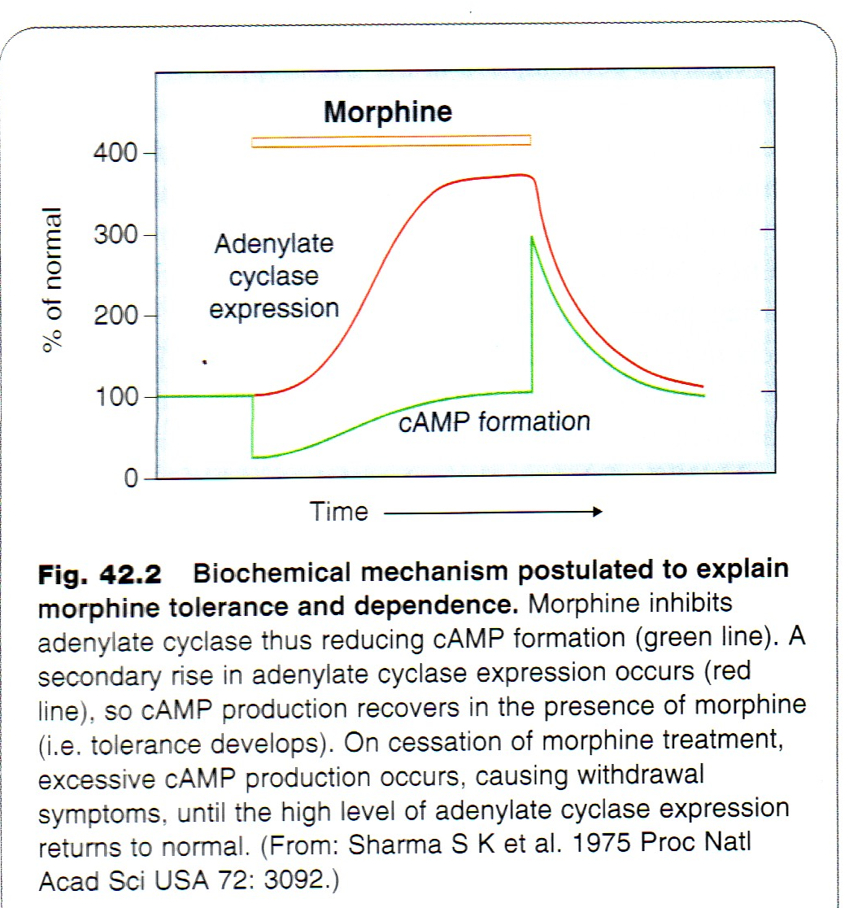
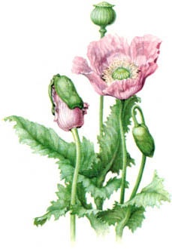
TOLERANCE & DEPENDENCE develop rapidly .
Withdrawal manifestations develops upon stoppage.
Dependence comprises both:
Physical dependence lasting for a few days in form of ↑ body ache, insomnia, diarrhea, goose flesh, lacrimation
Psychological dependence lasting for months / years → craving
Withdrawal→

Slide 16
Pharmacokinetics of Morphine
t ½ is 2-3h
It is slowly & erratically absorbed orally.
Medically given by IM or IV injection.
It should be repeated if sustained effect is needed.
Undergoes enterohepatic recycling,
crosses BBB
crosses placenta.

Slide 17
Clinical Indications of Morphine
CONTROL PAIN; cancer pain, severe burns, trauma
Severe visceral pain (not renal/biliary colics, acute pancreatitis )
DIARRHOEA
COUGH
ACUTE PULMONARY OEDEMA
MYOCARDIAL ISCHEMIA
NON PAINFUL CONDITIONS; HF to relieve distress
PREANAESTHETIC MEDICATION ??
ADR
Sedation
Respiratory depression.
Constipation.
Nausea & vomiting.
Itching → histamine release
Tolerance; not to meiosis, convulsion or constipation
Dependence.
Euphoria.

Slide 18
HEAD INJURY
PREGNANCY
BRONCHIAL ASTHMA or impaired pulmonary function
Liver & Kidney diseases (including renal& biliary colics )
Endocrine diseases ( myxedema & adrenal insufficiency)
Elderly are more sensitive;metabolism, lean body
mass & renal function
Not given infants, neonates or during child birth
conjugating capacity  accumulate   respiratory
With MAOIs
Contrindications of Morphine
Codeine
μ Agonist
Dependence < morphine
Used in mild& moderate pain, cough, diarrhea
HEROIN
μ agonist
Crosses BBB
Converted to morphine
No medical use
Strong addicting drug

Slide 19

Meperidine
Pethidine
Synthetic > effective κ agonism
Actions
analgesic,  constipating ,  depressant on faetal respiration than morphine
Has atropine –like action / Smooth muscle relaxant
No cough suppressant effect
Indications
As in morphine but not in cough & diarrhea
Used in severe visceral pain; renal & biliary colics sm. relaxant)
Used in obstetric analgesia (No  resp.)
Preanaesthetic medication ( better)
ADR
Tremors, Convulsions, Hyperthermia, Hypotension
Burred vision, Dry mouth, Urine retention
Tolerance & Addiction

Slide 20
TRAMADOL
Synthetic, m agonist ,  potent,  NE & 5HT also
Can be given orally;  oral bioavailability
Indications
Mild - moderate acute & chronic visceral pain & during labor
ADR
Seizures (not in epileptics), Nausea , Dry mouth, Dizziness , Sedation
Less adverse effects on respiratory & C.V.S.
Fentanyl
Synthetic, μ agonism, potency > meperdine & morphine
Commonest analgesic supplement during anesthesia, IV or intrathecal.
To induce & maintain anesthesia in poor-risk patients [stabilizing heart.]
In combination with droperidol as NEUROLEPTANALGESIA
In cancer pain & severe postoperative pain; transdermal patch changed every 72 hrs.
ADRs
Mimic opioid agonists / respiratory depression most serious / CV effects are less. Bradycardia may still occur

Slide 21
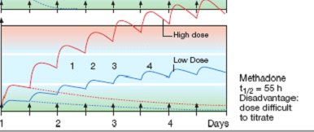
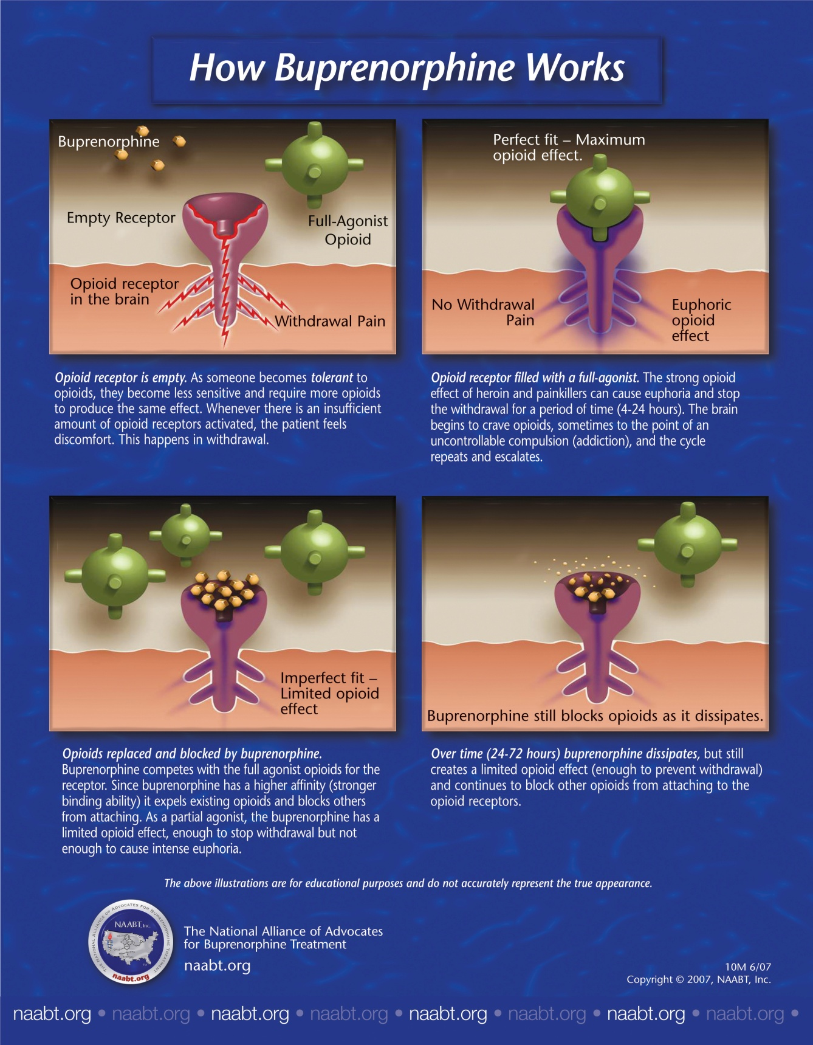
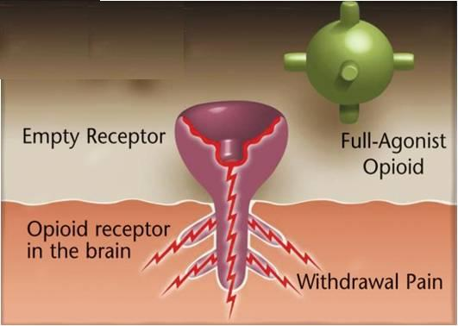
METHADONE
Synthetic, μ- Weaker Agonist, t½ 55 h.
Used to treat opioid withdrawal.
Firm occupancy of opioid receptors by methadone  desire for other opioid intake, because it is producing an  effect that stop withdrawal manifestations. With time addicts improve   craving
An ADDICT
After 72 hours
Methadone
Methadone
In non addicts, it causes tolerance & dependence but not as severe as that of morphine

Slide 22
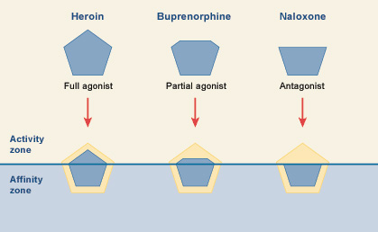
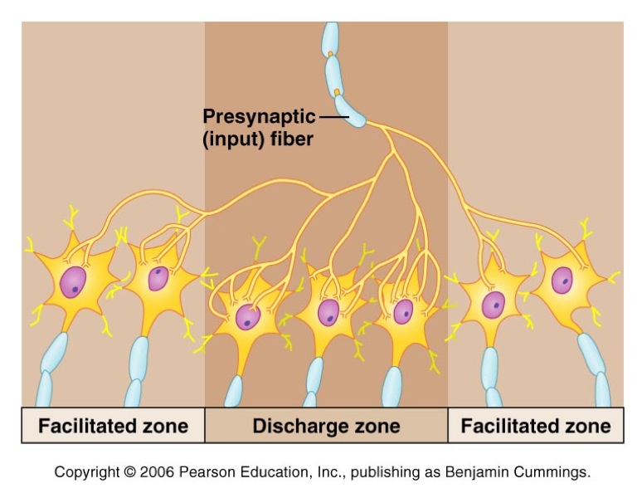
Antagonizing Acute Opioid Toxicity
Morphine
Nalorphine
Naloxone

Slide 23
Antagonizing Acute Opioid Toxicity
Naloxone
Pure opioid antagonist.
Used to treat respiratory depression caused by opioid overdose & to reverse the effect of analgesia on the respiration of the new born baby
Effect lasts only for 2-4 hours.
Precipitates withdrawal syndrome in addicts
Naltrexone
Very similar to naloxone but with longer duration of action [t½=10h]

Slide 24
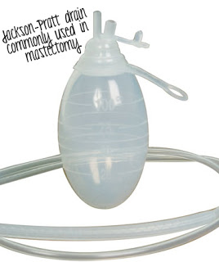
Case 1
A 4 year old has recently returned from having an abscess drained and has a JP drain in place. The nurse is asking for pain medication.
  How would you assess the patient’s pain?
  How would you treat his pain?
  What if it is getting worse?

Slide 25
Case 2
A 10 yo female with a fractured arm is complaining of pruritus with morphine.
  How would you assess her pain?
  What changes would you make to her pain regimen?

Slide 26

GOOD LUCK

