Slide 1
Ageing And Changes In The Brain
Dr Abdulrahman Alhowikan
Collage of medicine
Physiology Dep.

Slide 2
Objectives
1. Definition of Aging
2. Theories and terms Used
3. Body Changes in Aging
4. Brain Changes in Aging
5. Memory Changes in Aging
6. Carotid Hypersensitivity

Slide 3
Define Aging
Most popular definition : decline in intrinsic physiological function, leading to an increase in age-specific mortality rate (i.e., a decrease in survival rate) and a decrease in age-specific reproductive rate
Aging is not a disease; however, the risk of
developing disease is increased, often
dramatically, as a function of age.

Slide 4
Aging is characterized by
Changes in appearance (gradual reduction in height and weight loss due to loss of muscle & bone mass)
A lower metabolic rate
Longer reaction times
Declines in certain memory functions
Declines in sexual activity and in women menopause
A functional decline in audition, olfaction, and vision
Declines in kidney, pulmonary, and immune functions,
declines in exercise performance
(Craik and Salthouse, 1992; Hayflick, 1994, pp. 137-186; Spence, 1995

Slide 5
The Term Of Ageing
UNIVERSAL AGEING: age changes that all
people share
PROBABILISTIC AGEING: age changes that
may happen to some not others(Eg type two diabetes).
CHRONOLOGICAL AGEING: referring to how
old a person is (number of years of life)
SOCIAL AGEING: society's expectations of
how people should act as they grow older
BIOLOGICAL AGEING: an organism's
physical state as it ages

Slide 6
Some Theories of Aging
Genetic Cellular Theories:
the life span of Mammals is under genetic control. So it find that !!
Humans with long lived parents and grandparents live an average of 6 years longer than those whose parents die before the age of 50.
Human body cells grown in tissue cultures are able to divide only about 50 times, after which they age and die.
The reproductive capacity of cells taken from old animals is even more limited; these cells can undergo only about one half as many divisions as those obtained from young animals.

Slide 7
Some Theories of Aging
Oxidative stress:
Accumulation of oxidative damage to DNA,
proteins, and lipids interferes with normal
function and produces a decrease in stress
responses (imbalance between the production of (free radicals) and antioxidant
Mitochondrial dysfunction:
A common deletion in mitochondrial DNA
with age compromises function and alters
cell metabolic processes and adaptability to
environmental change

Slide 8
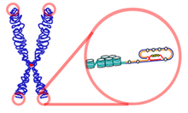
Some Theories of Aging
Hormonal changes:
The decline and loss of circadian rhythm (routine) in secretion of some hormones produces a functional hormone deficiency state. Eg (thyroid gland--control metabolism, Insulin– energy)
Telomere shortening:
Telomeres form the ends of human chromosomes
distinguish chromosome ends from broken DNA
Aging is related to a decline in the ability of cells to replicate
Defective host defenses: -Host defenses that protect against infection include natural barriers (eg, skin, mucous membranes
-The failure of the immune system to respond to infectious agents

Slide 9
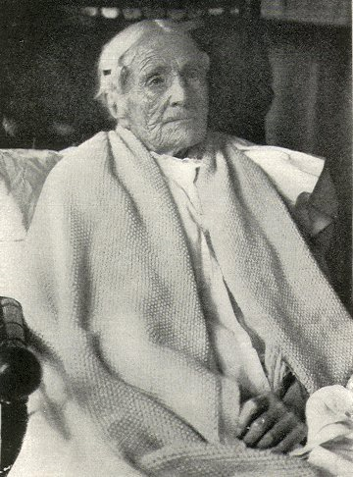
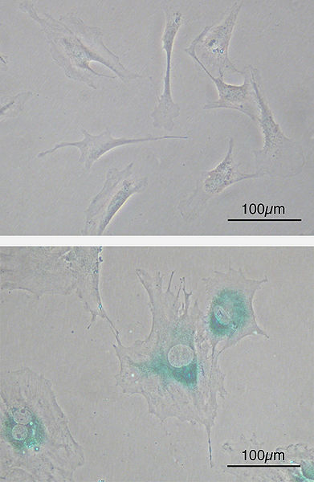
Some Theories of Aging
Accumulation of senescent cells:
Renewing tissues become dysfunctional
through loss of ability to renew
They accumulate in quite large numbers in just one tissue
Normal cells
Senescent cells

Slide 10
Leading Causes of Death Age 65+ “Medical Diagnoses”

Slide 11
Age Related Changes
Aging and nervous system:
Enlargement of the ventricular system of brain (contain spinal fluid) : as people get older, the volume of the ventricles increases. It is thought that this enlargement occurs because cells surrounding the ventricles are lost.
Widening of sulci (the grooves) on the surface of the brain.
Reduced brain weight and brain volume: these changes are probably caused by the loss of neurons.
Reductions in the size of many areas of the cerebral
cortex have been reported.

Slide 12
Age Related Changes
Aging and nervous system cont..:
Neurological disorders: brain disorders such as
Alzheimer's disease, Parkinson's disease and stroke are more common in the elderly.
Cerebral atrophy shows up on CTs and MRI scans
Reduced Sympathetic nervous system activity
Reduced Neurotransmitter levels
Changes in sleep patterns
Abnormalities in EEG tracings
Increased risk of stroke

Slide 13
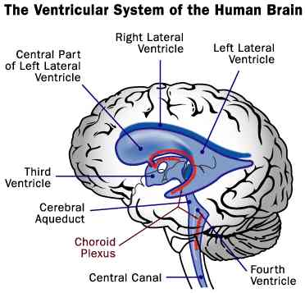
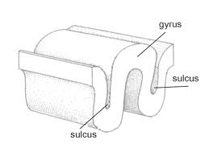
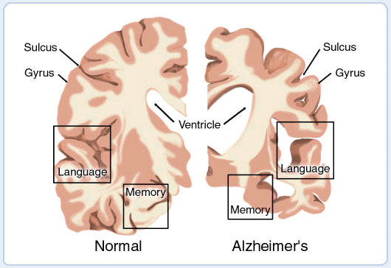
Aging and nervous system:
ventricular system of brain
sulci (the grooves) on the surface of the brain.
Cerebral atrophy

Slide 14
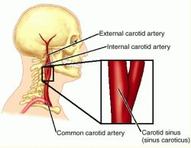
Carotid sinus hypersensitivity
located in the carotid arteries in the neck. The carotid sinus contains a sensory organ, which, when stimulated by pressure within the vessel, causes slowing of the heart rate and dilation of blood vessels in the body
Provoked by wearing
a tight collar, looking
upwards or turning the head
Carotid sinus syndrome occurs
in the elderly and mainly results in bradycardia.
Most common etiologies of atrioventricular block
Do not massage both carotids simultaneously.

Slide 15
Age-related changes
Touch:
Age-related changes in the ability to perceive
tactile stimuli may be due to:
Loss of various receptors (for example, Meissner's and Pacinian corpuscles) in the skin.
Reductions in the number of sensory fibers innervating the skin.

Slide 16
Age-related changes
Vision:
Lens: proteins in the lens change with age and the elasticity of the lens is reduced. Therefore, many elderly individuals have trouble focusing their eyes.
Cornea: the cornea may become less transparent and more flat. This may cause images to appear
distorted or blurred. There may also be a loss of color sensitivity to green, blue and violet shades.
Pupil: changes in the autonomic nervous system alter the ability of older people to dilate the pupil. By age 70, the pupil may not dilate easily in low lighting conditions (Hampton, 1997).

Slide 17
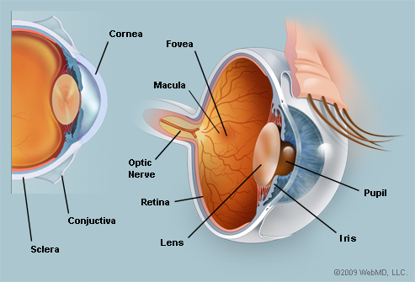
Age-related changes
Vision Cont..
Cataracts: cloudy areas of the lens. Cataracts
decrease the amount of light that passes through the lens and can bend lig abnormally. The National Eye Institute estimates that more than 50% of Americans age 65 years and older have a cataract.
Retina: the peripheral retina is thinner and contains fewer rods in older individuals.

Slide 18
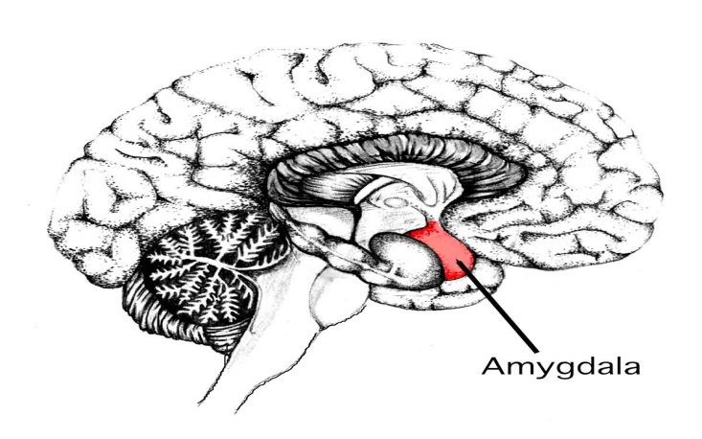
Age-related changes
Olfaction:
Changes in the nasal mucosa, cribriform plate (which separates the nasal cavity from the brain )and air passages may contribute to impaired odor recognition.
The amygdala (is an almond-shape set of neurons located deep in the brain's medial temporal lobe ) and other brain areas involved with smell may be damaged in older individuals.

Slide 19
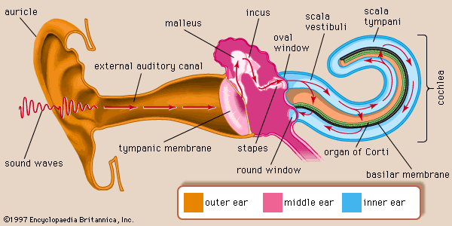
Age-related changes
Hearing Loss:
Ear wax build up.
Stiffening of the tympanic membrane (eardrum).
Atrophy of small ear muscles.
Degeneration of hair cells and support cells in the cochlea.
Stiffening of basilar membrane.
Loss of nerve fibers leading from the cochlea to the brain.
Loss of neurons in auditory areas of the brain.

Slide 20
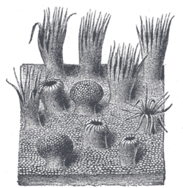
Age-related changes
Disorders of the Sense of Taste:
Medications that the elderly need.
Reductions in the number of taste
buds.
taste buds
Dentures ( artificial teeth) that cover taste buds on the soft palate.

Slide 21
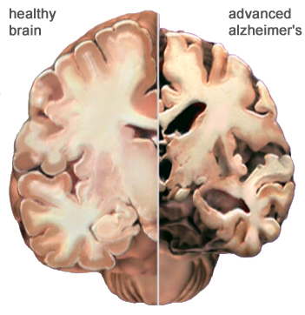
Alzheimer’s Disease
Alzheimer’s disease:
is defined as premature aging of the brain, usually beginning in mid-adult life and progressing rapidly to extreme loss of mental powers similar to that seen in
very, very old age.

Slide 22
Alzheimer’s Disease
Features:
(1) an amnesic ( loss of memory) or type of memory impairment
(2) deterioration of language ( some difficult of
talking )
(3) visuospatial deficits.

Slide 23
Sexual Dysfunction
Erectile dysfunction (ED) is not considered a normal part of the aging process. Nonetheless, it is associated with certain physiologic and psychological changes related to age.
survey of men between the ages of 40 and 70, 52% of responders reported some degree of ED. Complete ED occurred in 10% of respondents, moderate ED occurred in 25%, and minimal ED in 17%

Slide 24
Grow up
https://www.youtube.com/watch?v=ZGgd0DUKok4

Slide 25
Thank you

